Slide 1




A Framework for Automated and Composable
Testing of Component-based Services
Miguel A. Jiménez, Ángela Villota, Norha M. Villegas,
Gabriel Tamura, Laurence Duchien
Icesi University (Colombia) - University of Lille (France)
MESOCA 2014 - Victoria, Canada
Notes:
Good morning everyone, my name is Miguel Jimenez. The work I will present is entitled “A Framework for Automated and Composable Testing of component-based Services” The problem we focus on… →
-1m

Slide 2


Motivation
Service
Service
Service
Service
Composed
Service
Service
Service
Composed
Service
Service
Service
Service
Service
Service provider
Service integrator
Service
Service
Service
Service
1/30
Notes:
[The problem we focus on] takes place in Service-oriented Computing.
In Service-oriented computing vision, software development is based on service provisioning, orchestration and composition. This composition allows us to create flexible, dynamic business processes and applications that trespass the boundaries of organizations, involving third-party computing platforms.
The quality of such systems depends on the quality of all these involved services and their actual composition and orchestration. Moreover, these systems also evolve, either because some of their services change or because other services with similar, but improved, functionalities appear.
This evolution is performed by adding or replacing services, that may have been individually tested, being possible the introduction of failures at the unit, integration, or system level, thus compromising the satisfaction of the requirements.
Now, in a real case scenario, this service provider becomes several providers, and the provided services come with no quality insurance. Then, the service integrator does not have complete control over the system quality.
2m

Slide 3
Motivation
Composed services must provide minimum quality guarantees.
Testers must develop, compose, and execute service tests. This process is error prone due to:
Analysis by hand of services to test
High number of valid service-assembly configurations
Tests are not usually reusable, composable, nor traceable
2/30
Notes:
In this context, testers develop, compose, and execute service tests. This process is error prone, and time and effort consuming for several factors:
first, the tester must analyze by hand the services to test, before specifying the actual tests in the programming languages in which the services were implemented, being these languages possibly different and not tailored for testing;
second, the number of service assembly configurations valid to achieve the system goals can be high and so the respective testing configurations.
And third, ideally, the testing services should be reusable, composable, and traceable by themselves.
+-1m

Slide 4
Outline
Testing Challenges in Software Services
The PaSCAni Framework - Testing Specification - Translation and Execution Models
Composing Tests with PaSCAni
The PaSCAni Architecture
Evaluation
Conclusion and Future Work
3/30
Notes:
Based on this problem that we are facing, the order of this talk is as follows:
First, we identified three main testing challenges to be resolved in the service-oriented computing.
To overcome these challenges, we propose a framework that assists human testers in the specification of tests, using a Domain Specific Language for testing. Then, I am going to explain the basic parts that compose a test and how it becomes an executable component, using for such purpose the strassen algorithm as an example. And then, I am going to present the evaluation of our approach, conclusions and future work.
2m

Slide 5
Testing Challenges in Software Services
Test Specification and Expressiveness
1
Composability
2
Traceability and Logging
3
4/30
Notes:
Let’s start with the identified testing challenges:
test specification and expressiveness,
composability, and
traceability and logging.

Slide 6
Test Specification and Expressiveness
No adequate languages for specifying SCA tests, with appropriate (domain-specific):
Syntax and semantics
Power of expressiveness
Efficiency
Level of abstraction
5/30
Notes:
At the present time, there are not adequate languages for specifying tests, that provide appropriate:
syntax and semantics
power of expressiveness
efficiency, and
level of abstraction.
Languages with these characteristics would allow testers to construct better tests, easier to understand, reuse, compose, trace, and maintain.

Slide 7

Composability
Lack of languages, frameworks, integrated tools to support test composability and reuse, cost-effectively.
6/30
Notes:
Today, there are many many services published on the Internet, and although it is not common, it is possible to find some of them along with their tests. What it’s important in this challenge, is how one can compose those services and their respective tests, in such a way that it maximizes their cost-effectiveness.
There is a lack of languages, frameworks, and tools to support test composability and reuse.

Slide 8
Traceability and Logging
Need for specifying composable tests with automated and standard traceability and logging mechanisms.
Trace information: between sub-tests and service invocations, and tests results.
Logging: record information about the sub-test results.
7/30
Notes:
A third challenge for testing services is the development of controllable logging mechanisms and standardized trace formats.
Service traceability, on the one hand, refers to the capability of tracking the states of services. And consequently, traceability should produce trace information about two aspects: sub-test and service invocations in a test, and partial and accomplished test results.
On the other hand, Logging complements traceability by recording information about the quality of services, which is expected to be registered consistently from service and test execution.

Slide 9
The PaSCAni Framework
8/30
Notes:
To overcome these challenges, we propose PaSCAni →

Slide 10
The PaSCAni Framework
PaSCAni assists human testers in:
Describing the system to be tested
Specifying and executing test modules with the corresponding test cases and strategies
Two parts: DSL and a component & service analyzer
9/30
Notes:
PaSCAni is a framework that assists human testers in:
Describing the system to be tested, in terms of components and services, and
Specifying test modules with the corresponding test cases and strategies for verifying the functional and extra-functional requirements.
In order to accomplish this, PaSCAni comprises two subsystems: a testing specification language, which includes a translation and an execution model. And second, a component and service analyzer that generates a test specification template from a set of components.

Slide 11
DSL for Test Specification
PaSCAni’s main unit for specifying tests: the test module:
Appropriate Syntax and Semantics
for Specifying Service Tests
(challenge 1)
Dependencies
1
System structure
2
Test cases
3
Test strategy
4
10/30
Notes:
The main unit for specifying tests in PaSCAni is the test module. a test module is composed of three main parts: an structure block, a test cases block and an optional block regarding to the test strategy. These three blocks are a key factor for PaSCAni to achieve reusability, composability, and traceability.
These test modules written in our Domain Specific Language are translated into components compliant with the Service Component Architecture, in order to be executable in a common model that supports different kind of bindings such as Web Service, Remote Method Invocation, Corba, and others.

Slide 12
Example: module
package org.driso.matrices.strassen.resources;
java-import org.driso.matrices.common.*;
java-import java.util.Arrays;
module StrassenTest {
composite strassen = loadComposite("Strassen.composite") providing services {
rmi multiplication@"localhost":1099 with interface
org.driso.matrices.strassen.interfaces.MatricesMultiplicationService
} using libraries {
"strassen/mcm-strassen.jar",
"lib/mcm-common.jar"
};
testcase checkCorrectness(int[][] A, int[][] B) using strassen.multiplication {
. . .
}
control {
. . .
}
}
Dependencies .
Test module .
SCA Application
Structure to Test
Test cases .
Test strategy .
11/30
Notes:
This is a basic PaSCAni module that test the correctness of the strassen implementation against the “naive” matrix multiplication algorithm.
Within a module, we must specify:
the structure of the system to be tested, in this case the strassen component with its multiplication service;
the test cases, that work similar to methods in java, with the addition that them must know which service are being tested.
And finally, the test strategy, that is the way the test is going to be executed.
Additionally, PaSCAni allows to import other test modules, in order to use their components and test cases, and java classes, to resolve the dependencies of other modules.

Slide 13
Example: testcase
testcase checkCorrectness(int[][] A, int[][] B) using strassen.multiplication {
int[][] C = strassen.multiplication.multiply(A, B);
int[][] naiveC = MatrixUtils.multiplyUsingNaiveAlgorithm(A, B);
Console.log("Correctness ok(?): " + Arrays.deepEquals(C, naiveC));
test correctness = Arrays.deepEquals(C, naiveC)
labeled "Multiplication's correctness"
message when passed: "The algorithm is well implemented"
failed: "Wrong implementation"
exception: "An exception has been thrown"
inconclusive: "There is no conclusion";
return correctness;
}
12/30
Notes:
Here you can see some logic behind the test case “checkCorrectness”, and messages related to the four possible verdicts a test can get, which are:
passed, that means that everything resulted ok
failed, when the assert returns false
exception, when it could not get any result because an exception was raised, and finally
inconclusive, when there was not an answer from the service.

Slide 14
Example: test strategy
control {
String pathA = "/home/user/app/matrices/images/A1";
String pathB = "/home/user/app/matrices/images/A2";
int[][] A = ImageUtils.getImageData(ImageUtils.readImageFromLocalURL(pathA));
int[][] B = ImageUtils.getImageData(ImageUtils.readImageFromLocalURL(pathB));
MatrixUtils mutils = new MatrixUtils();
long classicStrassenTime = exectime mutils.multiplyUsingStrassen(A, B);
checkCorrectness(A, B);
}
13/30
Notes:
The test strategy here is very simple, it is just a call of the test case, with some additional lines needed to do so.

Slide 15
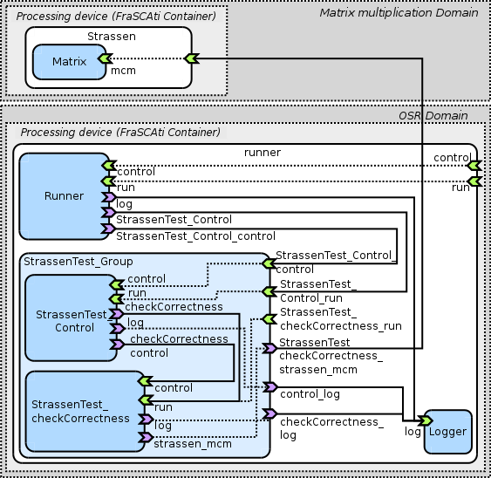
Translation Model
module {
composite name = …
testcase name() … {
…
}
control {
…
}
}
Automatic Orchestration of Services for Tracing and Logging Tests and Results
(challenge 3)
14/30
Notes:
PaSCani translates test module specifications into SCA testing components.
From the three blocks structure of a test module, PaSCAni generates the corresponding SCA configuration as follows:
Each test module become one big composite that contains the following components
Every generated composite is equipped with one runner component, that contains the specified test strategy.
Each of the test cases and control block in the test module are translated into SCA components inside the composite.
The services specified in the system structure block are translated into SCA references that are bound to the testcase and control components. That means, that the test case and control components reference services provided by the system to be tested.

Slide 16
Execution Model
Defines how a test strategy is executed through the behavior of the generated components and services.
Implements the DSL semantics
15/30
Notes:
The execution model relies on the standard SCA interfaces, services, and references defined for realizing the running, composing, logging, and tracing functionalities in each component. The execution model defines the way a test strategy is executed through the behavior of the generated components and services.

Slide 17
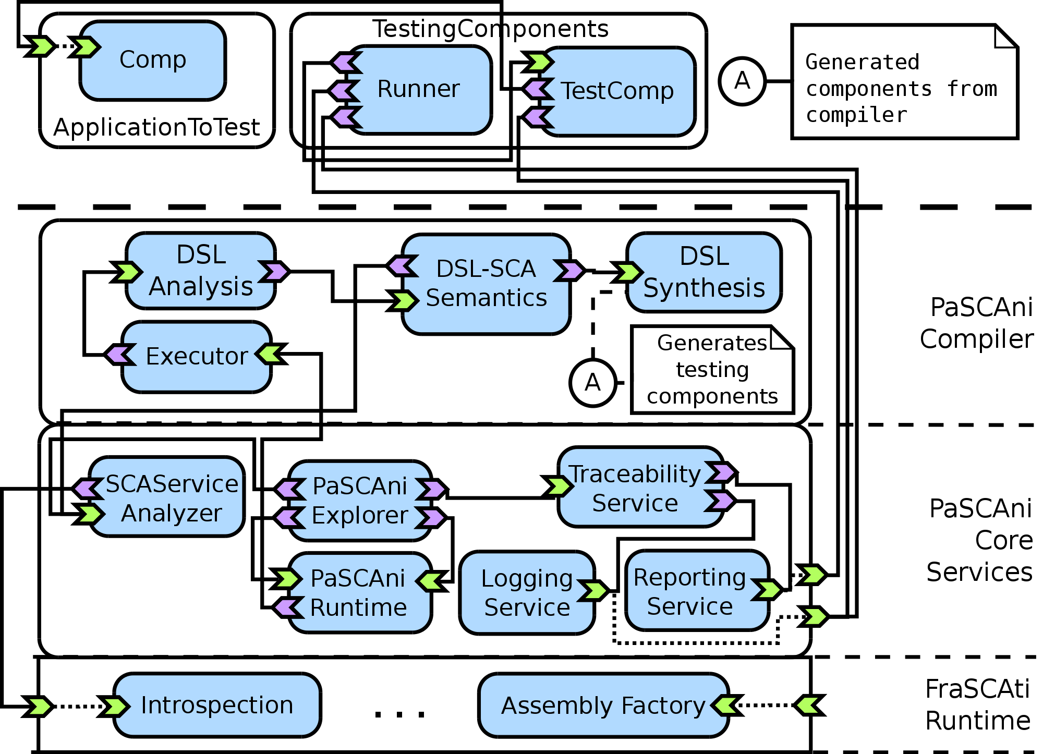
The PASCANI Architecture
16/30
Notes:
This is the PaSCAni architecture represented in an SCA diagram. As you can see at the bottom, our framework relies on the FraSCAti middleware, which is an open source implementation of the Service Component Architecture standard, that allows the dynamic deployment and re-configuration of the pascani test components at runtime.
We divided our implementation in two main layers: the core services, that contains the structure of the main components of the framework that were explained previously, such as .... And the compiler layer, that realizes the translation model.
At the top of the PaSCAni architecture are the application to test and the generated testing components, that consume services from the target application.

Slide 18
Composing Tests with PASCANI
Import definitions from other test modules
Modular scalability
Test composition operators:
Regression
1
Performance
2
Coverage
3
17/30
Notes:
To create composable tests, we propose two ways of composition:
by importing one module into another, in order to use its definition of the system structure block and the definition of the test cases, and
by using operators among test modules. By now, PaSCAni allows to operate modules to create:
- regression tests,
- performance tests, and
- the coverage test

Slide 19

Regression Tests
After being changed, software artifacts that previously passed known tests should still pass them.
Significant at the unit, integration, and system levels.
18/30
Notes:
As you know, when a component is created it should be tested. When some change affects that component, it should be re-tested to verify whether it still do what it is supposed to.

Slide 20
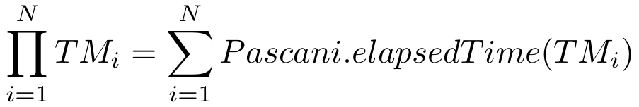
Performance Tests
Its goal is to verify whether the system meets specified performance requirements such as response time and throughput.
Most significant at the system level.
19/30
Notes:
In the case that the system to be tested has to meet performance requirements, such as response time or throughput, PaSCAni makes it easier to measure these times using the performance operator.

Slide 21
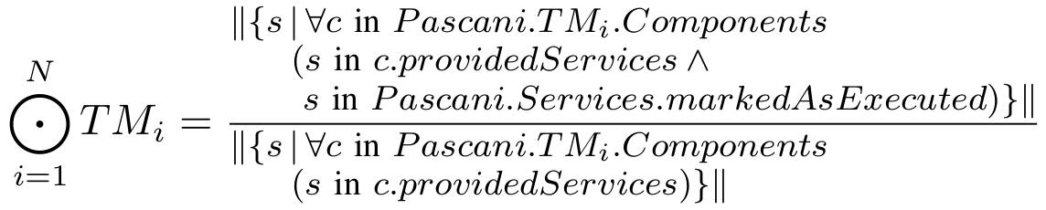
Coverage Test
Evaluation of a software application’s quality depends on:
the results of the executed tests
the quality of these tests themselves
Reusable, Modular-scalable and Composable SCA Tests
(challenge 2)
Coverage test measure the percentage of services that were tested by a set of tests
20/30
Notes:
The quality of a test module can be defined by measuring the percentage of system’s code that is executed when the test modules are applied. And that’s a way to determine the quality of the test cases set.

Slide 22
Evaluation
21/30
Notes:
Now, let’s see some results we got after evaluate PaSCAni in two case of study.

Slide 23
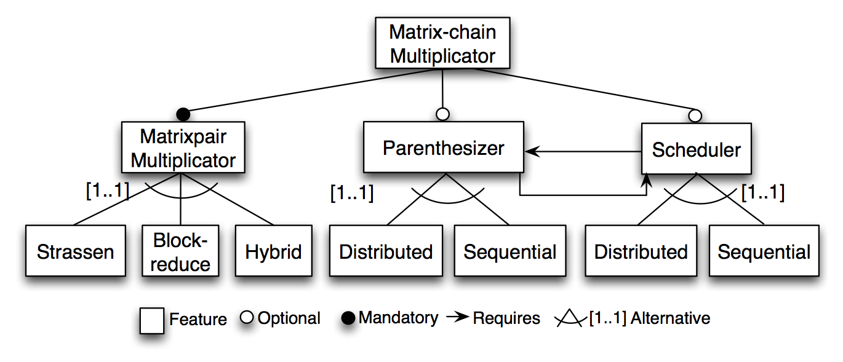
Case Study 1
Matrix-chain multiplication problem (as an SPL)
Strassen
Block-reduce
Hybrid multiplication
N Matrices
22/30
Notes:
The first case of study is a configuration of components that implement different strategies to reduce the execution time when multiplying a matrix-chain. For this case, we implemented four strategies named Strassen, block -reduce, hybrid multiplication and n matrices.
In the second case, we searched two services provided by a third party and implemented tests using PaSCAni.

Slide 24
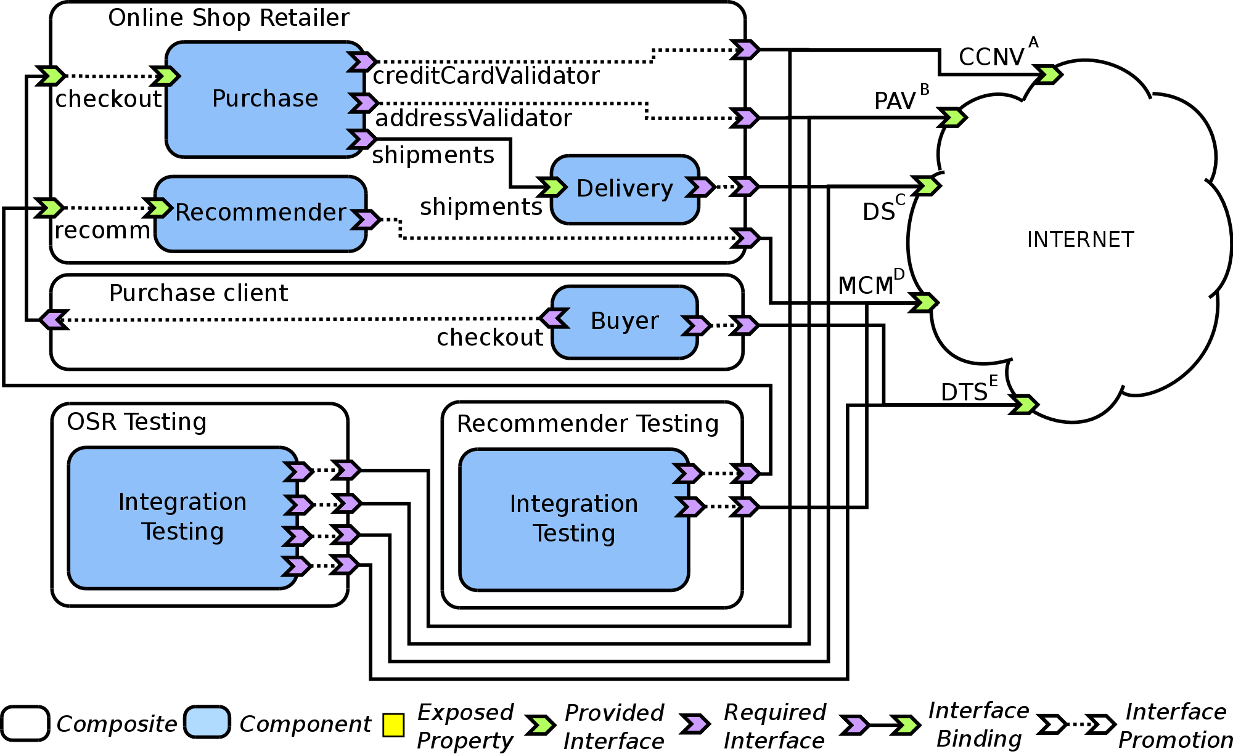
Case Study 2
Online Store Retailer
Credit card verification
Address validation
23/30
Notes:
The first case of study is a configuration of components that implement different strategies to reduce the execution time when multiplying a matrix-chain. For this case, we implemented four strategies named Strassen, block -reduce, hybrid multiplication and n matrices.
In the second case, we searched two services provided by a third party and implemented tests using PaSCAni.

Slide 25
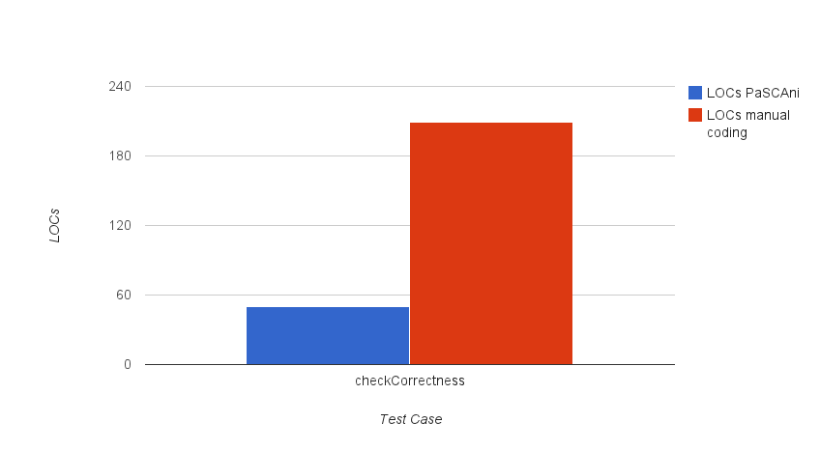
LOCs PaSCAni vs Manual Coding
Relative Effort Gain
Effort reduction = 1 – (PaSCAni LOCs / Generated LOCs)
24/30
Notes:
From our two case of study, we implemented test modules and specifically in this chart we want to highlight the benefits of using PaSCAni when specifying tests. For all the test cases that were implemented, PaSCAni reduced more than 70% of the developer’s effort.
This was measured by counting the lines of code written in PaSCAni against the lines of code that would be necessary to code in Java the same test.
Then, we calculated the relative effort gain.

Slide 26
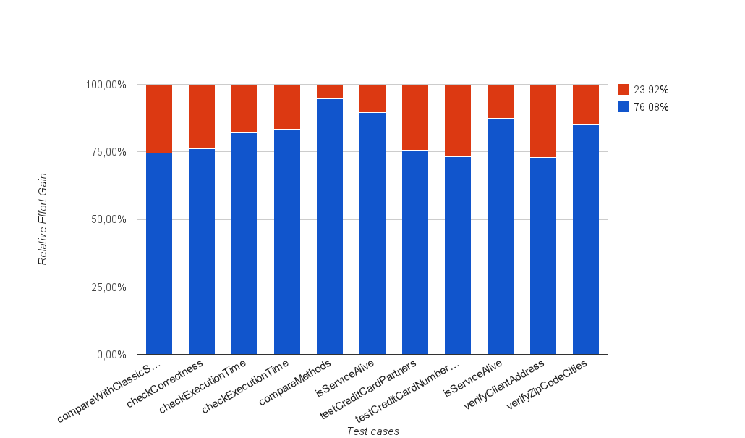
Relative Effort Gain
25/30
Notes:
From our two case of study, we implemented test modules and specifically in this chart we want to highlight the benefits of using PaSCAni when specifying tests. For all the test cases that were implemented, PaSCAni reduced more than 70% of the developer’s effort.
This was measured by counting the lines of code written in PaSCAni against the lines of code that would be necessary to code in Java the same test.
Then, we calculated the relative effort gain.

Slide 27
Conclusions
26/30
Notes:
And finally, some conclusions on PaSCAni

Slide 28
Conclusions
PaSCAni: a framework for specifying and executing automated, composable, and traceable tests for service oriented systems.
Our results show
The applicability of the framework by generating, deploying and executing SCA configurations of composable tests.
The benefits that PaSCAni offer, by saving considerable effort in the testing development process for human testers.
27/30
Notes:
We presented PaSCAni, a framework that assists testing developers in the specification and execution of automated, composable, and traceable tests for service oriented systems. Our results show relative substantial benefits when specifying tests, by saving considerable time and effort.

Slide 29
Conclusions: Testing Challenges
Test specification and Expressiveness
DSL for specifying testing artifacts
Composability
Test module imports and composition operators
Traceability and Logging
Standard trace format and automatic logging
28/30
Notes:
To overcome the test specification and expressiveness challenge, presented at the beginning, we propose a domain specific language with the characteristics I have already mentioned.
Our DSL allows to compose tests by importing definition of other testing modules, and by operating modules to create regression, performance, and coverage tests.
And finally, our translation model ensures the generation of standard trace formats and automatic logging in the generated testing components.

Slide 30
Future Work
Automatic generation of test modules @ runtime
Additional binding support (e.g. EJB)
Integration of the framework to an IDE
29/30
Notes:
In the PaSCAni roadmap, we plan to implement additional features to cover a wider area of the software development process, in the component model of the Service Component Architecture. Such features include:
Automatic generation of test modules to assemble, at runtime, test strategies for a specific target system.
The Service Component Architecture … so we need to support additional bindings beyond RMI and Web Service
the Integration of the framework to an integrated development environment such as Eclipse or Netbeans, to facilitate development, compilation, and test report visualization

Slide 31
Thank You!
Questions?
30/30

Slide 32
Backup slides!

Slide 33
Expressiveness
DSLs must be expressive enough to capture all the necessary concepts in the domain. That is, it must semantically support the full generation of test concepts and required component configurations and strategies, automatically.

Slide 34
Economy
DSLs must provide the user with appropriate syntax to efficiently express sentences of their domain, and to encapsulate and reuse languages modules.

Slide 35
Adequate level of abstraction
DSLs must be effective, that is the notations and abstraction level must be as close to the domain-experts language as possible.
Notes:
For instance, developers are more familiar with programming languages than with formal specification languages. Nonetheless, neither of these two kinds of languages are well suited specifically for testing.

Slide 36

Composability
An adequate testing language is required for expressing not only testing functionalities but also how to compose these functionalities and artifacts, at different levels of application.
Notes:
Service integrators require tools that assist them in the specification and implementation of testing artifacts. Naturally, and adequate testing language with precise semantics is required for expressing not only testing functionalities but also, and more importantly, how to compose these functionalities and artifacts.

Slide 37
An example: Strassen algorithm
The Strassen algorithm is used for matrix multiplication, it is faster than the standard matrix multiplication algorithm and useful in practice for large matrices.
Notes:
Now, let’s look at a simple example to understand what a test module is. In our cases of study we included an implementation of the Strassen algorithm, which is an algorithm used for matrix multiplication, faster than the standard matrix multiplication algorithm published in 1969. We implemented this algorithm and encapsulated it in a SCA component.

Slide 38
Implementation
18/24
The PaSCAni compiler was implemented using:
JLex 1.2.6
CUP 0.10k
Google Closure Template tool
Notes:
To implement our Domain Specific Language, we use the JLex lexical analyzer and the CUP parser generator. The code generator of our compiler relies on the Google Closure template tool to generate the SCA testing components and their java implementations.

