Slide 1
CSS
CSS stands for Cascading Style Sheets

Slide 2
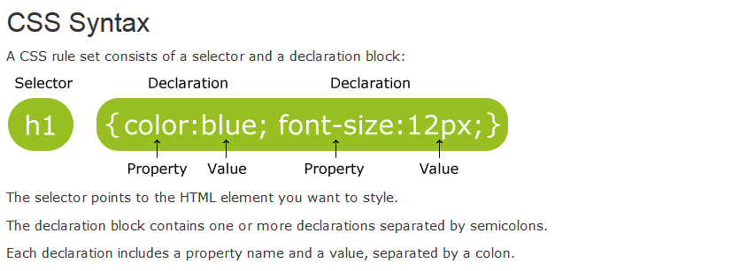

Slide 3
CSS Selectors
CSS Selectors
The id Selector
The class Selector
Grouping Selectors

Slide 4
How To Insert CSS In to HTML
Three Ways to Insert CSS
External style sheet
<head> <link rel="stylesheet" type="text/css" href="mystyle.css"> </head>
Internal style sheet
<head> <style> body { background-color: linen; } h1 { color: maroon; margin-left: 40px; } </style> </head>
Inline style
<h1 style="color:blue;margin-left:30px;">This is a heading.</h1>

Slide 5
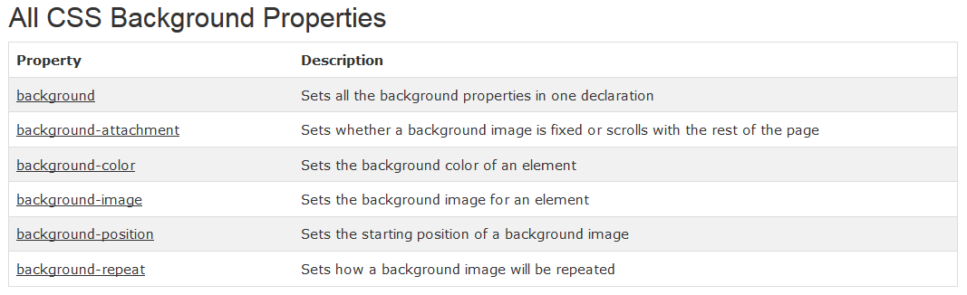

Slide 6
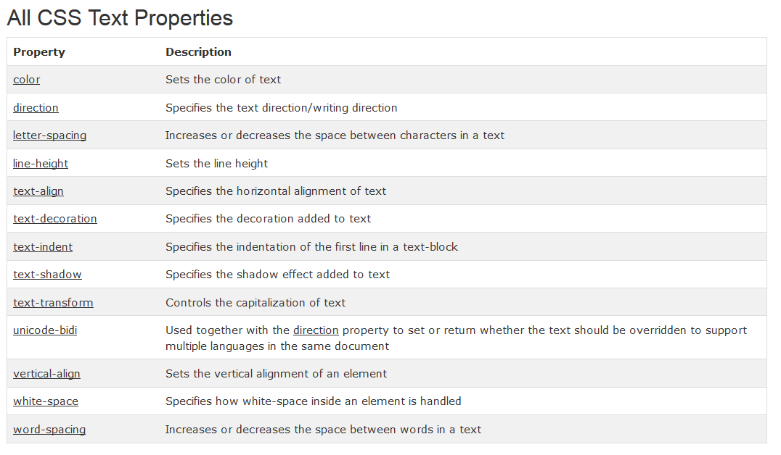

Slide 7
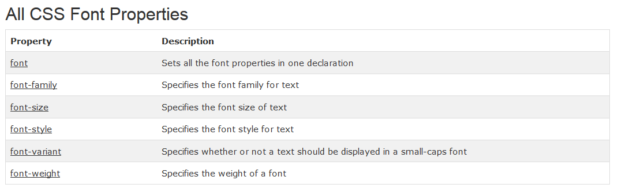
CSS Fonts

Slide 8
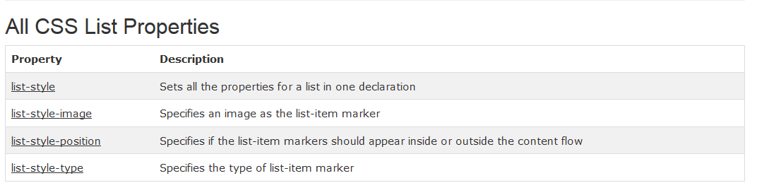
CSS Lists
The CSS list properties allow you to:
Set different list item markers for ordered lists
Set different list item markers for unordered lists
Set an image as the list item marker

Slide 9
CSS Tables
Table Borders
Collapse Borders
table { border-collapse: collapse; } table, th, td { border: 1px solid black; }
Table Width and Height
Horizontal Text Alignment
Vertical Text Alignment
Table Padding
Table Color

Slide 10
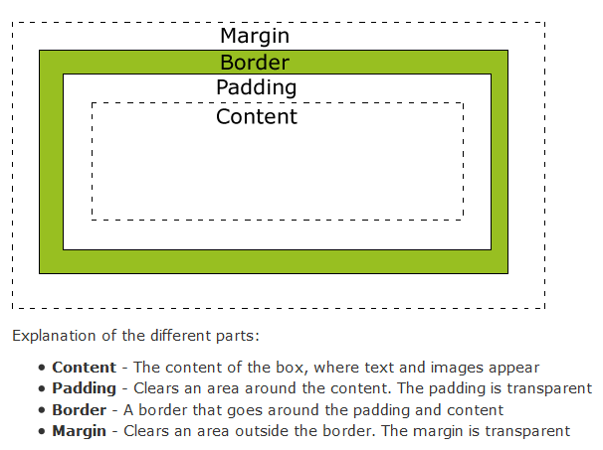
CSS Box Model

Slide 11
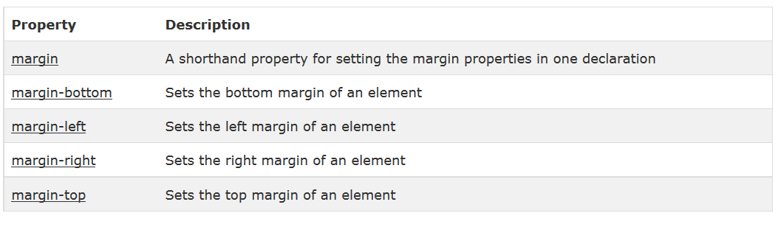
All CSS Margin Properties

Slide 12
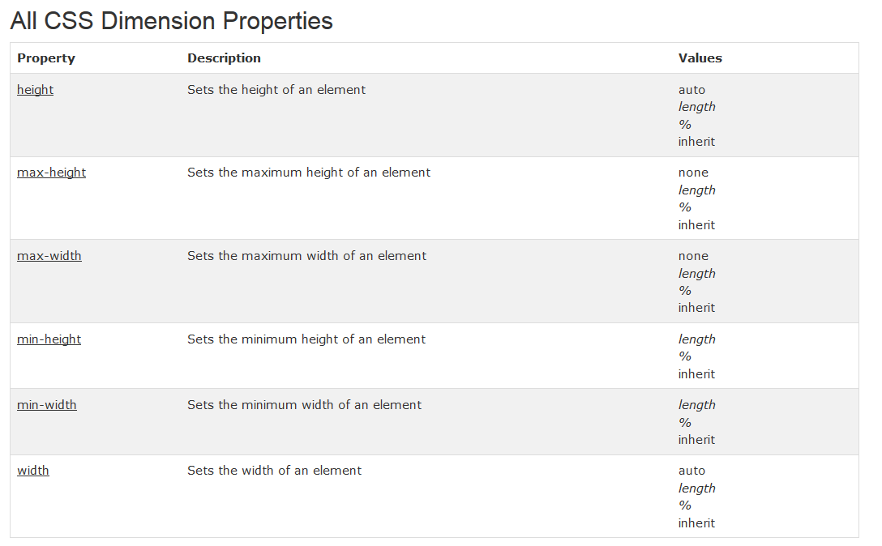
CSS Dimension

Slide 13
CSS Display and Visibility
Hiding an Element - display:none or visibility:hidden
visibility: hidden;
display: none;
display: inline;
display: block;

Slide 14
CSS Positioning
Static Positioning
Fixed Positioning
Relative Positioning
Absolute Positioning

Slide 15
CSS Float
What is CSS Float?
Floating Elements Next to Each Other
Turning off Float - Using Clear

Slide 16
CSS Horizontal Align
Aligning Block Elements
Center Aligning Using the margin Property
Left and Right Aligning Using the position Property
Left and Right Aligning Using the float Property

Slide 17
CSS Combinators
There are four different combinators in CSS3:
descendant selector
The descendant selector matches all elements that are descendants of a specified element.
div p { background-color: yellow; }
child selector
The child selector selects all elements that are the immediate children of a specified element.
div > p { background-color: yellow; }
adjacent sibling selector
The adjacent sibling selector selects all elements that are the adjacent siblings of a specified element.
div + p { background-color: yellow; }
general sibling selector
The general sibling selector selects all elements that are siblings of a specified element.
div ~ p { background-color: yellow; }

Slide 18
CSS Pseudo-classes
A pseudo-class is used to define a special state of an element.
For example, it can be used to:
Style an element when a user mouses over it
Style visited and unvisited links differently
Syntax
The syntax of pseudo-classes:
selector:pseudo-class { property:value; }

Slide 19
Pseudo-classes and CSS Classes
CSS - The :first-child Pseudo-class
In the following example, the selector matches any <p> element that is the first child of any element:
p:first-child { color: blue; }
Match the first <i> element in all <p> elements
p i:first-child { color: blue; }
Match all <i> elements in all first child <p> elements
p:first-child i { color: blue; }

Slide 20
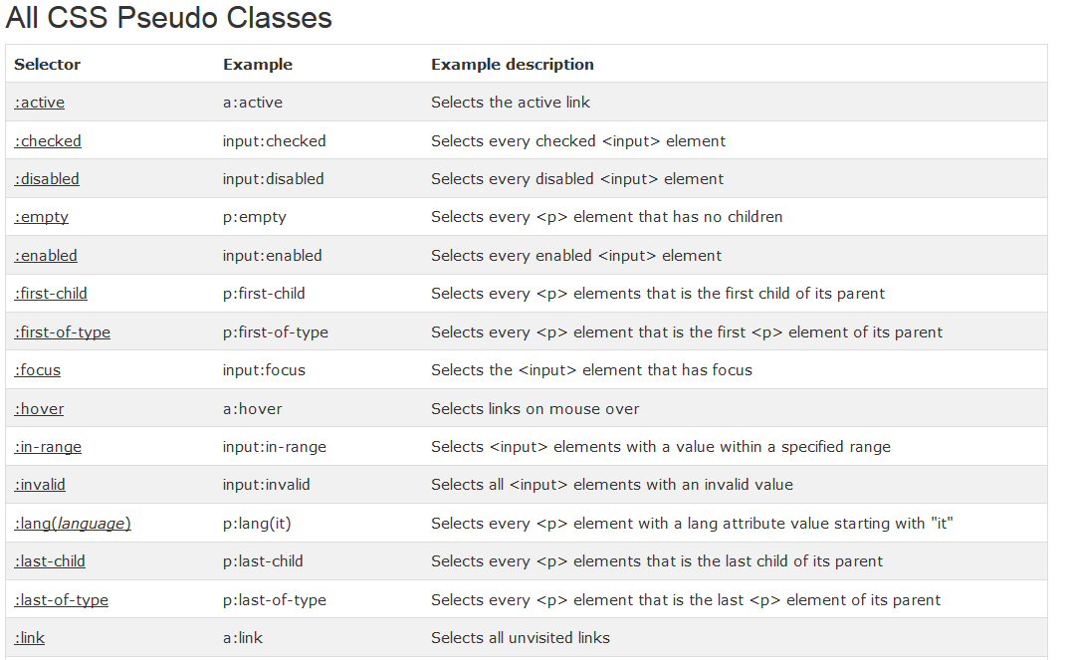

Slide 21
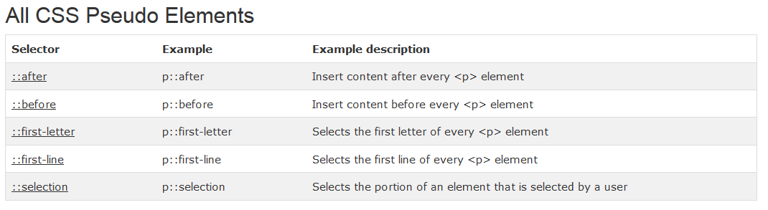

Slide 22
What are Pseudo-Elements?
A CSS pseudo-element is used to style specified parts of an element.
Style the first letter, or line, of an element
Insert content before, or after, the content of an element .
The syntax of pseudo-elements:
selector::pseudo-element { property:value; }
The ::first-line Pseudo-element
The ::first-line pseudo-element is used to add a special style to the first line of a text.
The ::first-line pseudo-element can only be applied to block elements.

Slide 23
CSS Image Opacity / Transparency
The CSS3 property for transparency is opacity.
Example
img { opacity: 0.4; filter: alpha(opacity=40); /* For IE8 and earlier */ }

Slide 24
CSS Image Sprites
An image sprite is a collection of images put into a single image.
A web page with many images can take a long time to load and generates multiple server requests.
Using image sprites will reduce the number of server requests and save bandwidth.
Image Sprites - Hover Effect
The :hover selector is used to select elements when you mouse over them. Tip: The :hover selector can be used on all elements, not only on links.

Slide 25
CSS Media Types
The @media Rule
The @media rule makes it possible to define different style rules for different media types in the same stylesheet.
@media screen { p { font-family: verdana, sans-serif; font-size: 17px; } } @media print { p { font-family: georgia, serif; font-size: 14px; color: blue; } }

Slide 26
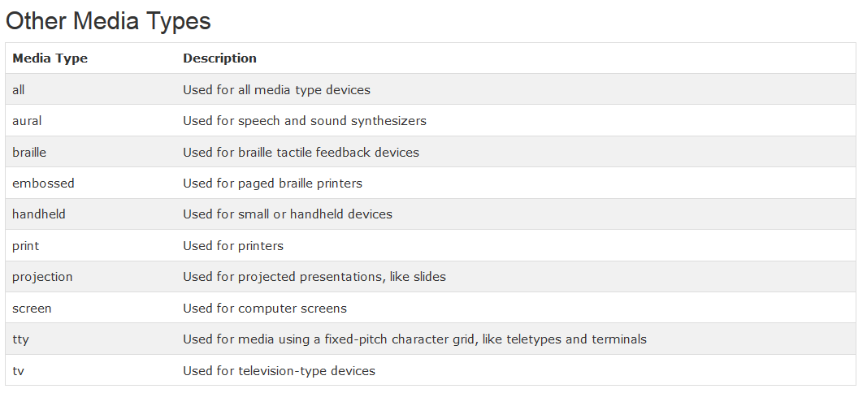

Slide 27
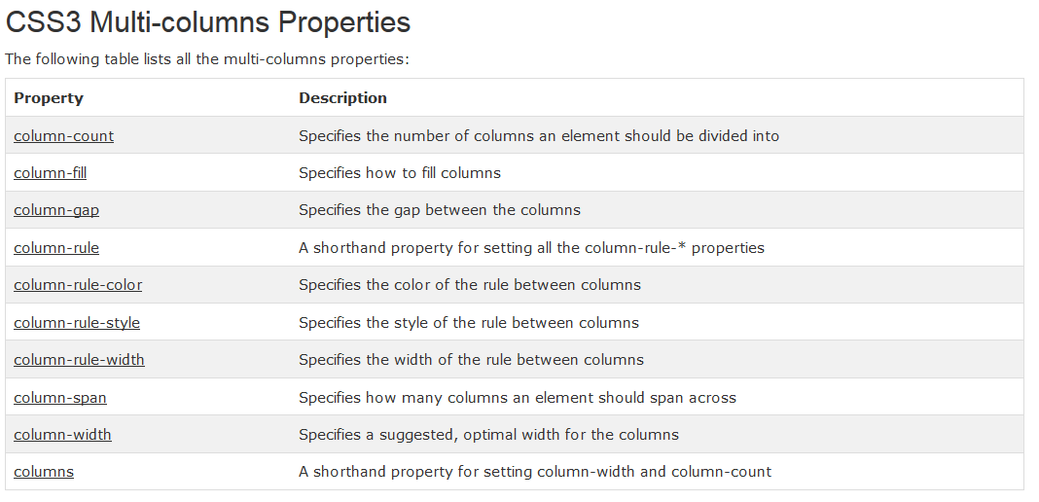
CSS3 Multiple Columns

