Slide 1
Introduction
HTML

Slide 2
What is HTML?
HTML is a markup language for describing web documents (web pages).
HTML stands for Hyper Text Markup Language
A markup language is a set of markup tags
HTML documents are described by HTML tags
Each HTML tag describes different document content

Slide 3
HTML Example
<!DOCTYPE html> <html> <head> <title>Page Title</title> </head> <body> <h1>My First Heading</h1> <p>My first paragraph.</p> </body> </html>
The <!DOCTYPE html> declaration defines this document to be HTML5
The text between <html> and </html> describes an HTML document
The text between <head> and </head> provides information about the document
The text between <title> and </title> provides a title for the document
The text between <body> and </body> describes the visible page content
The text between <h1> and </h1> describes a heading
The text between <p> and </p> describes a paragraph

Slide 4
HTML Elements
HTML Tags Starts With “<” and Ends with “>” . The Text between this two Brackets called As HTML Tags.
We have Two types of Tags in HTML . That is Starting Tag and Closing Tag.
Closing tag will starts with “</” and ends with “>”
Example: <h1>Hello World</h1>

Slide 5
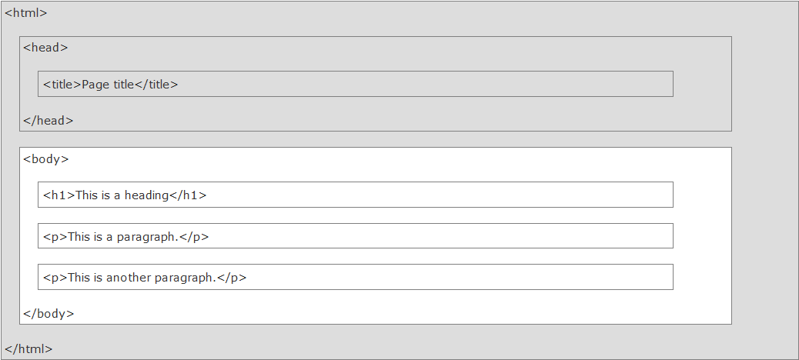
HTML Page Structure

Slide 6
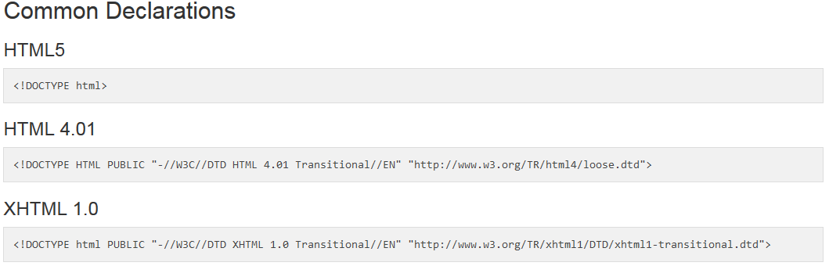
The <!DOCTYPE> Declaration

Slide 7
HTML Basics
HTML Headings .. <h1>,<h2>….<h6>
HTML Paragraphs: <p></p>
HTML Links : <a href=www.google.com></a>
HTML Images <img src=“filename.jpg”/>
HTML Line Break <br>

Slide 8
HTML Attributes
Attributes provide additional information about HTML elements.
HTML elements can have attributes
Attributes are always specified in the start tag
Attributes come in name/value pairs like: name="value"

Slide 9
HTML Attributes
The title Attribute
The href Attribute
Size Attributes
The alt Attribute

Slide 10
The HTML Style Attribute
<h1 style="color:blue">This is a heading</h1> <p style="color:red">This is a paragraph.</p>
HTML Text Size
<h1 style="font-size:300%">This is a heading</h1> <p style="font-size:160%">This is a paragraph.</p>
Use the style attribute for styling HTML elements
Use background-color for background color
Use color for text colors
Use font-family for text fonts
Use font-size for text sizes
Use text-align for text alignment

Slide 11
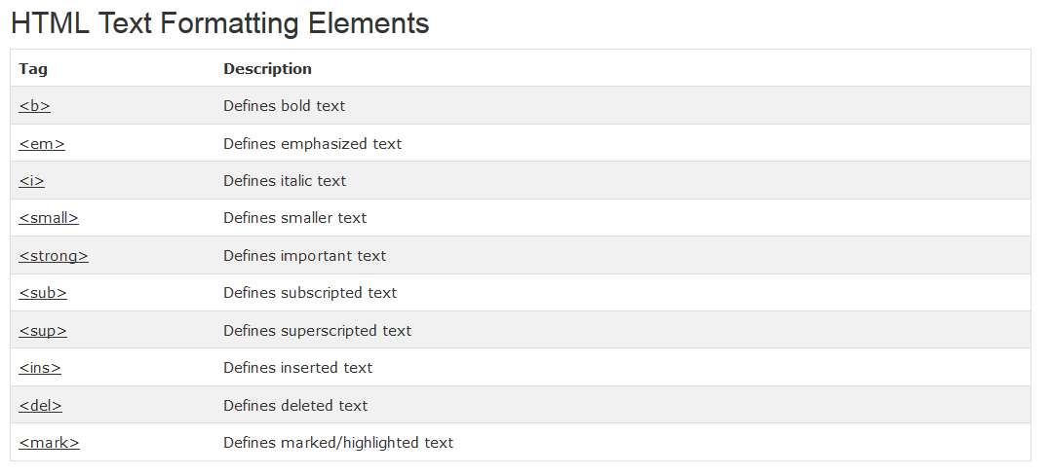
HTML Text Formatting Elements

Slide 12
HTML Comments
Comment tags <!-- and --> are used to insert comments in HTML.
<!-- Write your comments here -->

Slide 13
HTML Styles - CSS
Styling HTML with CSS
CSS stands for Cascading Style Sheets
Styling can be added to HTML elements in 3 ways:
Inline - using a style attribute in HTML elements
Internal - using a <style> element in the HTML <head> section
External - using one or more external CSS files

Slide 14
CSS Syntax
CSS styling has the following syntax:
element { property:value; property:value }
Use the HTML style attribute for inline styling
Use the HTML <style> element to define internal CSS
Use the HTML <link> element to refer to an external CSS file
Use the HTML <head> element to store <style> and <link> elements
Use the CSS color property for text colors
Use the CSS font-family property for text fonts
Use the CSS font-size property for text sizes
Use the CSS border property for visible element borders
Use the CSS padding property for space inside the border
Use the CSS margin property for space outside the border

Slide 15
HTML Links
HTML links are hyperlinks.
You can click on a link and jump to another document.
Note: A link does not have to be text. It can be an image or any other HTML element.
HTML Links - Syntax
In HTML, links are defined with the <a> tag:
<a href="url">link text</a>
<a href="http://www.websitename.com/html/">Visit our HTML tutorial</a>
The href attribute specifies the destination address (http://www.w3schools.com/html/) of the link.
The link text is the visible part (Visit our HTML tutorial).
Clicking on the link text will send you to the specified address.

Slide 16
HTML Links - The target Attribute
The target attribute specifies where to open the linked document.
The target attribute can have one of the following values:
_blank - Opens the linked document in a new window or tab
_self - Opens the linked document in the same window/tab as it was clicked (this is default)
_parent - Opens the linked document in the parent frame
_top - Opens the linked document in the full body of the window
framename - Opens the linked document in a named frame
This example will open the linked document in a new browser window/tab:
Example:
<a href="http://www.w3schools.com/" target="_blank">Visit W3Schools!</a>

Slide 17
HTML Tables
Tables are defined with the <table> tag.
Tables are divided into table rows with the <tr> tag.
Table rows are divided into table data with the <td> tag.
A table row can also be divided into table headings with the <th> tag.
<table border="1" style="width:100%">
Example: <tr> <td>Jill</td> <td>Smith</td> <td>50</td> </tr> <tr> <td>Eve</td> <td>Jackson</td> <td>94</td> </tr> </table>

Slide 18
Use the HTML <table> element to define a table
Use the HTML <tr> element to define a table row
Use the HTML <td> element to define a table data
Use the HTML <th> element to define a table heading
Use the HTML <caption> element to define a table caption
Use the CSS border property to define a border
Use the CSS border-collapse property to collapse cell borders
Use the CSS padding property to add padding to cells
Use the CSS text-align property to align cell text
Use the CSS border-spacing property to set the spacing between cells
Use the colspan attribute to make a cell span many columns
Use the rowspan attribute to make a cell span many rows
Use the id attribute to uniquely define one table

Slide 19
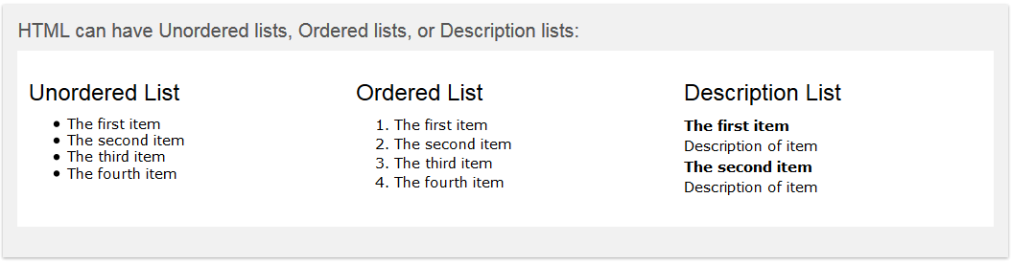
HTML Lists

Slide 20
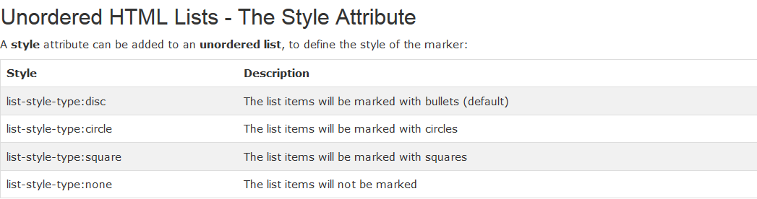

Slide 21
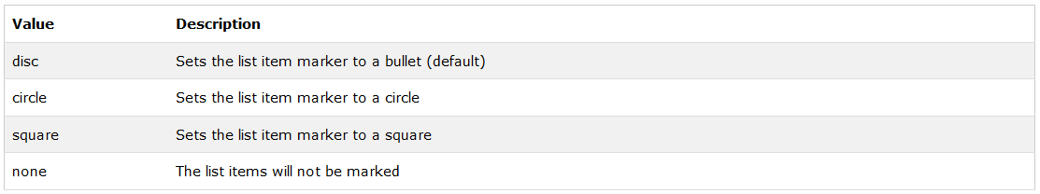
Unordered HTML List
Unordered HTML List - Choose List Item Marker
The CSS list-style-type property is used to define the style of the list item marker:

Slide 22
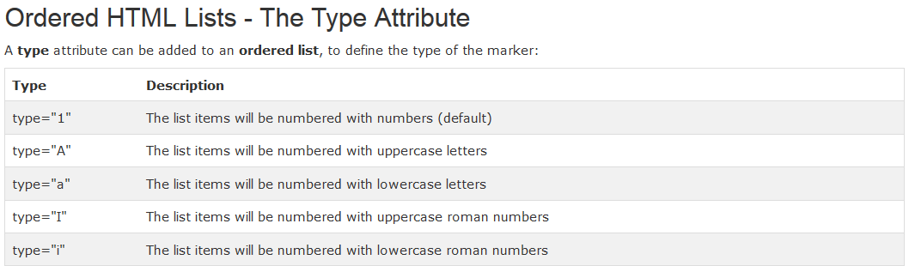

Slide 23
HTML Description Lists & Nested HTML Lists
HTML also supports description lists.
A description list is a list of terms, with a description of each term.
The <dl> tag defines the description list, the <dt> tag defines the term (name), and the <dd> tag describes each term
Nested HTML Lists
List can be nested (lists inside lists):

Slide 24
Horizontal Lists
HTML lists can be styled in many different ways with CSS.
One popular way is to style a list horizontally, to create a menu:
Example : Horizontal menu

Slide 25
HTML Block Elements and Inline Elements
Most HTML elements are defined as block level elements or inline elements.
Block level elements normally start (and end) with a new line, when displayed in a browser.
Examples: <h1>, <p>, <ul>, <table>
An inline element does not start on a new line and only takes up as much width as necessary.
Examples: <b>, <td>, <a>, <img>

Slide 26
The <span> Element
The <span> element is often used as a container for some text.
The <span> element has no required attributes, but both style and class are common.
When used together with CSS, the <span> element can be used to style parts of the text:

Slide 27
The <div> Element
The <div> element is often used as a container for other HTML elements.
The <div> element has no required attributes, but both style and class are common.
When used together with CSS, the <div> element can be used to style blocks of content:

Slide 28
HTML The class Attribute
The HTML class attribute makes it possible to define equal styles for elements with the same class name.
Let us see an Example with three <div> elements that points to the same class name:
Using The class Attribute on Inline Elements
The HTML class attribute can also be used for inline elements:

Slide 29
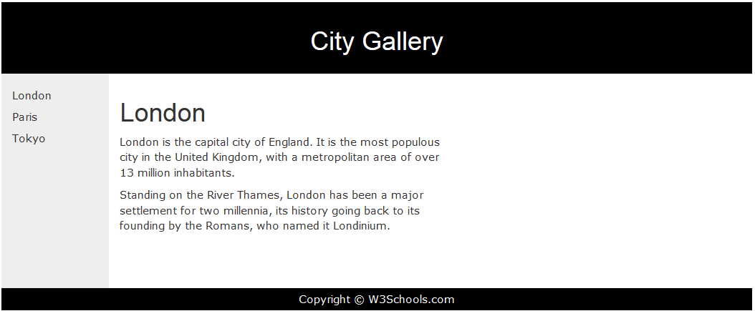
HTML Layouts

Slide 30
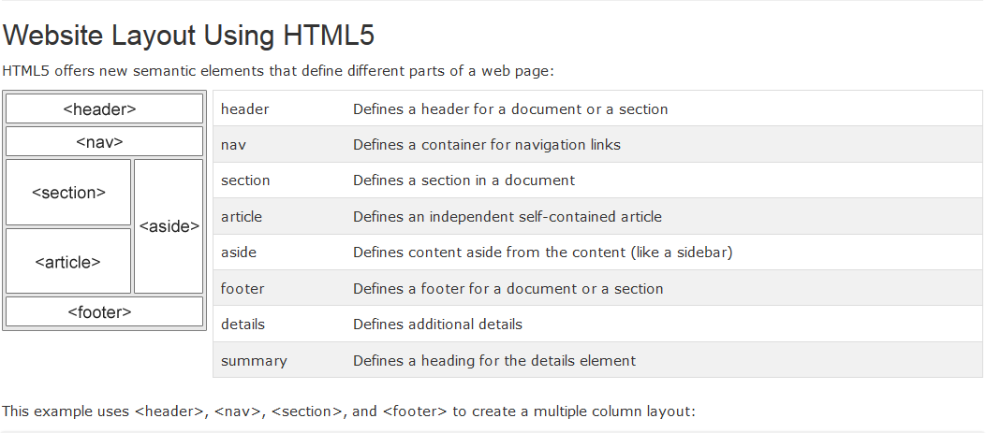
HTML Layouts

Slide 31
HTML Responsive Web Design
Responsive Web Design makes your web page look good on all devices (desktops, tablets, and phones).
Responsive Web Design is about using CSS and HTML to resize, hide, shrink, enlarge, or move the content to make it look good on any screen:

Slide 32
HTML Forms
The <form> Element
HTML forms are used to collect user input.
The <form> element defines an HTML form:
<form> form elements </form>
HTML forms contain form elements.
Form elements are different types of input elements, checkboxes, radio buttons, submit buttons, and more.

Slide 33
The <input> Element
The <input> element is the most important form element.
The <input> element has many variations, depending on the type attribute.
<input type="text"> defines a one-line input field for text input:
<input type="radio"> defines a radio button.
<input type="submit"> defines a button for submitting a form to a form-handler.
The form-handler is typically a server page with a script for processing input data.

Slide 34
Action attribute
The action attribute defines the action to be performed when the form is submitted.
The common way to submit a form to a server, is by using a submit button.
Normally, the form is submitted to a web page on a web server.
<form action="action_page.php">
If the action attribute is omitted, the action is set to the current page.

Slide 35
The Method Attribute
The method attribute specifies the HTTP method (GET or POST) to be used when submitting the forms:
<form action="action_page.php" method="get">
<form action="action_page.php" method="post">

Slide 36
When to Use GET?
You can use GET (the default method):
If the form submission is passive (like a search engine query), and without sensitive information.
When you use GET, the form data will be visible in the page address:
action_page.php?firstname=Mickey&lastname=Mouse
GET is best suited to short amounts of data. Size limitations are set in your browser.

Slide 37
When to Use POST?
You should use POST:
If the form is updating data, or includes sensitive information (password).
POST offers better security because the submitted data is not visible in the page address.

Slide 38
The Name Attribute
To be submitted correctly, each input field must have a name attribute.
This example will only submit the "Last name" input field:
<form action="action_page.php"> First name:<br> <input type="text" value="Mickey"><br> Last name:<br> <input type="text" name="lastname" value="Mouse"><br><br> <input type="submit" value="Submit"> </form>

Slide 39
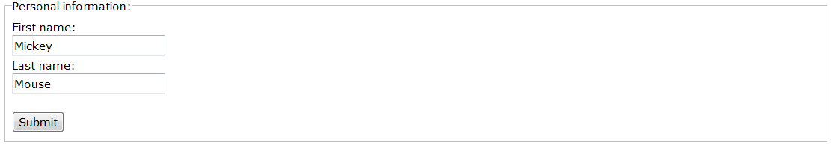
Grouping Form Data with <fieldset>
The <fieldset> element groups related data in a form.
The <legend> element defines a caption for the <fieldset> element.
<form action="action_page.php"> <fieldset> <legend>Personal information:</legend> First name:<br> <input type="text" name="firstname" value="Mickey"><br> Last name:<br> <input type="text" name="lastname" value="Mouse"><br><br> <input type="submit" value="Submit"> </fieldset> </form>
This is how the HTML code above will be displayed in a browser:

Slide 40
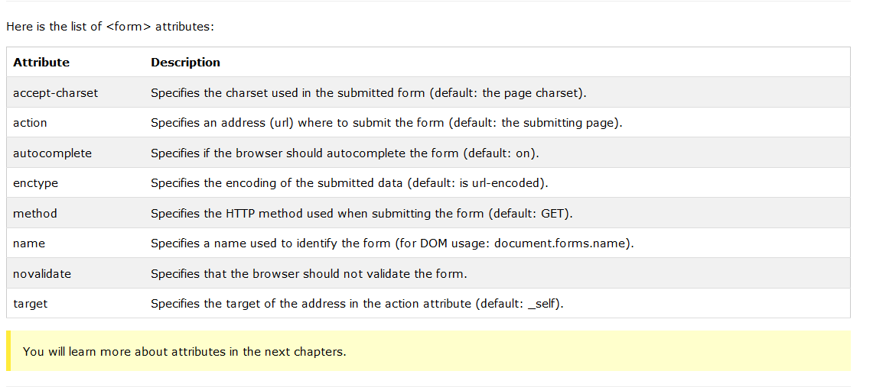

Slide 41
HTML Form Elements
The <select> Element (Drop-Down List)
<select name="cars"> <option value="volvo">Volvo</option> <option value="saab">Saab</option> <option value="fiat">Fiat</option> <option value="audi">Audi</option> </select>
The <textarea> Element
The <textarea> element defines a multi-line input field (a text area):
<textarea name="message" rows="10" cols="30"> The cat was playing in the garden. </textarea>

Slide 42
HTML Input Attributes
The value Attribute
The value attribute specifies the initial value for an input field
The readonly Attribute
The readonly attribute specifies that the input field is read only (cannot be changed)
The disabled Attribute
The disabled attribute specifies that the input field is disabled.
A disabled element is un-usable and un-clickable.
Disabled elements will not be submitted
The size Attribute
The size attribute specifies the size (in characters) for the input field:
The maxlength Attribute
The maxlength attribute specifies the maximum allowed length for the input field:

Slide 43
HTML5 Introduction
New HTML5 Elements
The most interesting new elements are:
New semantic elements like <header>, <footer>, <article>, and <section>.
New form control attributes like number, date, time, calendar, and range.
New graphic elements: <svg> and <canvas>.
New multimedia elements: <audio> and <video>.

Slide 44
What are Semantic Elements?
A semantic element clearly describes its meaning to both the browser and the developer.
Examples of non-semantic elements: <div> and <span> - Tells nothing about its content.
Examples of semantic elements: <form>, <table>, and <img> - Clearly defines its content.

Slide 45
New Semantic Elements in HTML5
<article>
<aside>
<details>
<figcaption>
<figure>
<footer>
<header>
<main>
<mark>
<nav>
<section>
<summary>
<time>

Slide 46
New HTML5 API's (Application Programming Interfaces)
The most interesting new API's are:
HTML Geolocation
HTML Drag and Drop
HTML Local Storage
HTML Application Cache
HTML Web Workers
HTML SSE

Slide 47
HTML5 <section> Element
The <section> element defines a section in a document.
According to W3C's HTML5 documentation: "A section is a thematic grouping of content, typically with a heading."
A Web site's home page could be split into sections for introduction, content, and contact information.
<section> <h1>WWF</h1> <p>The World Wide Fund for Nature (WWF) is....</p> </section>

Slide 48
HTML5 <article> Element
The <article> element specifies independent, self-contained content.
An article should make sense on its own, and it should be possible to read it independently from the rest of the web site.
Examples of where an <article> element can be used:
Forum post
Blog post
Newspaper article
<article> <h1>What Does WWF Do?</h1> <p>WWF's mission is to stop the degradation of our planet's natural environment, and build a future in which humans live in harmony with nature.</p> </article>

Slide 49
HTML5 <header> Element
The <header> element specifies a header for a document or section.
The <header> element should be used as a container for introductory content.
You can have several <header> elements in one document.
The following example defines a header for an article:
<article> <header> <h1>What Does WWF Do?</h1> <p>WWF's mission:</p> </header> <p>WWF's mission is to stop the degradation of our planet's natural environment, and build a future in which humans live in harmony with nature.</p> </article>

Slide 50
Tag | Description
<article> | Defines an article in the document
<aside> | Defines content aside from the page content
<bdi> | Defines a part of text that might be formatted in a different direction from other text
<details> | Defines additional details that the user can view or hide
<dialog> | Defines a dialog box or window
<figcaption> | Defines a caption for a <figure> element
<figure> | Defines self-contained content, like illustrations, diagrams, photos, code listings, etc.
<footer> | Defines a footer for the document or a section
<header> | Defines a header for the document or a section
<main> | Defines the main content of a document
<mark> | Defines marked or highlighted text
<menuitem> | Defines a command/menu item that the user can invoke from a popup menu
<meter> | Defines a scalar measurement within a known range (a gauge)
<nav> | Defines navigation links in the document

Slide 51
HTML Multimedia
The HTML <video> Element
<video width="320" height="240" controls> <source src="movie.mp4" type="video/mp4"> <source src="movie.ogg" type="video/ogg"> Your browser does not support the video tag. </video>
Audio on the Web
Before HTML5, there was no standard for playing audio files on a web page.
Before HTML5, audio files could only be played with a plug-in (like flash).
The HTML5 <audio> element specifies a standard way to embed audio in a web page.
<audio controls> <source src="horse.ogg" type="audio/ogg"> <source src="horse.mp3" type="audio/mpeg"> Your browser does not support the audio element. </audio>

Slide 52
HTML5 Drag and Drop
<script> function allowDrop(ev) { ev.preventDefault(); } function drag(ev) { ev.dataTransfer.setData("text", ev.target.id); } function drop(ev) { ev.preventDefault(); var data = ev.dataTransfer.getData("text"); ev.target.appendChild(document.getElementById(data)); } </script> </head> <body> <div id="div1" ondrop="drop(event)" ondragover="allowDrop(event)"></div> <img id="drag1" src="img_logo.gif" draggable="true" ondragstart="drag(event)" width="336" height="69"> </body>

Slide 53
HTML5 Local Storage
What is HTML Local Storage?
With local storage, web applications can store data locally within the user's browser.
Before HTML5, application data had to be stored in cookies, included in every server request. Local storage is more secure, and large amounts of data can be stored locally, without affecting website performance.
Unlike cookies, the storage limit is far larger (at least 5MB) and information is never transferred to the server.
Local storage is per origin (per domain and protocol). All pages, from one origin, can store and access the same data.

Slide 54
HTML Local Storage Objects
HTML local storage provides two objects for storing data on the client:
window.localStorage - stores data with no expiration date
window.sessionStorage - stores data for one session (data is lost when the browser tab is closed)
Before using local storage, check browser support for localStorage and sessionStorage:
if(typeof(Storage) !== "undefined") { // Code for localStorage/sessionStorage. } else { // Sorry! No Web Storage support.. }

