Slide 1
Mithril.js
Jacinda Shulman

Slide 2
Objectives:
What is Mithril and why do we like it?
Learn two ways to set up your Mithril program
Understand components and how to use them
Learn how routing is done
Learn basic XHR request syntax

Slide 3
General Introduction
Mithril is a JavaScript framework
(like AngularJS, Ember.js, Vue)
Frameworks provide types, functionality
Faster development – don’t have to write web app entirely from scratch
“—if you need a wheel, for instance, it’s a lot more sensible to buy one than it is to reinvent it.” – Skillcrush.com
https://skillcrush.com/2018/07/23/what-is-a-javascript-framework/

Slide 4
What is Mithril?
Mithril is a modern client-side Javascript framework for building Single Page Applications. It's small (< 8kb gzip), fast and provides routing and XHR utilities out of the box.
Designed for SPAs
Routing changes behavior on the same page, rather than loading a new one
Centered around “components” rendered in the view

Slide 5
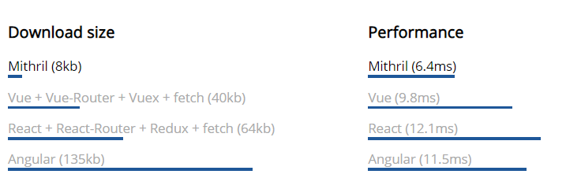
Why use Mithril?
Very small size
Comparable (often better) performance
A lot of functionality in a small box (very few dependencies)
Low complexity
Easier to understand
Smaller learning curve (in my opinion)
https://mithril.js.org/index.html

Slide 6
Mithril vs. React
“Very lightweight, pragmatic, aggressively optimized version of React framework” - Mithril docs https://mithril.js.org/index.html#what-is-mithril
Both:
Use virtual DOM
Organize view with components
Mithril is:
Faster
Lightweight (8kb): “less is more”
Performance strategy: extreme optimization
React
Relies on third parties for routing, XHR, state management
Performance strategy: complex solutions
More comparison information here:
https://www.slant.co/versus/36/10513/~mithril_vs_react

Slide 7
Getting set up
Include script tag in HTML → import from a CDN
Full installation with a bundler
i.e. Webpack
https://mithril.js.org/installation.html
$ npm install mithril@next --save
$ npm install webpack webpack-cli --save-dev

Slide 8
Getting set up (continued)
You can keep all your components in one file
Or… each component gets a file and your bundler (i.e. Webpack) compiles them
Similar to classes in OOP
imports and exports
Some issues with bundlers…

Slide 9
Key features of Mithril
Components
XML HTTP Requests (XHR)
Routing

Slide 10
Components

Slide 11
What is a component?
A component is a JavaScript object with a view function
Activate it using m.mount(root, component)
The m() function creates HTML tags
Change parts of the DOM (like templating)
i.e. …

Slide 12
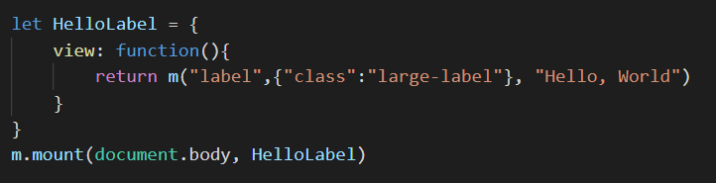
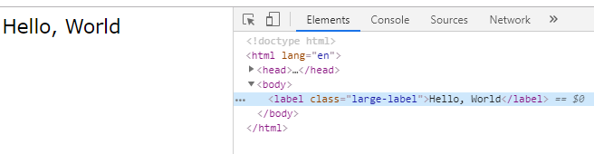

Slide 13
Auto-redraw
Key feature!
This becomes activated when you initiate a component with m.mount or m.route
m.render deactivates this feature
Whenever the data changes, the view function is re-rendered
… we’ll see this in the following demo!
Notes:
PUTTING ALL THE VIEW IN YOUR JAVASCRIPT

Slide 14
Demo: Let’s see a component!

Slide 15
Key features of Mithril
Components
XML HTTP Requests (XHR)
Routing

Slide 16
Routing

Slide 17
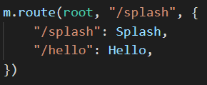
Routing in Mithril
Designed for single-page applications (SPAs)
Routes use “hashbang” !#
i.e. http://localhost:8080/?#!/presenters
Change behavior on the page
Route change → render a new component
Triggers m.mount → auto-redraw is activated
m.route(root, defaultRoute, routes)
https://mithril.js.org/index.html#routing

Slide 18
Demo: Routing

Slide 19
Key features of Mithril
Components
XML HTTP Requests (XHR)
Routing

Slide 20
XHR

Slide 21
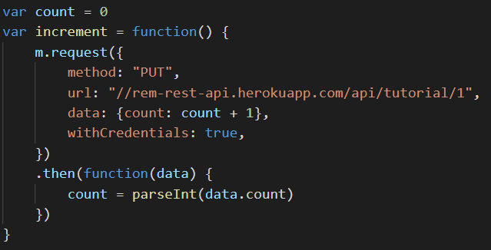
XML HTTP Requests in Mithril
Lightweight wrapper around JavaScript’s XHR
m.request → function (not a component)
Easier to format (in my opinion)
Easy to read!

Slide 22
Demo: XHR

Slide 23
Key features of Mithril
Components
XML HTTP Requests (XHR)
Routing

Slide 24
Multiple choice questions!

Slide 25
Question 1: What is the most basic definition of a Mithril component?
A path or a route in the application
A “page” in a single-page application
An object with a view function
An object with a render function

Slide 26
Question 2: Which command is used to initiate a component that auto-renews when its data changes?
m.mount
m.render
m.renew
m.require

Slide 27
Question 3: Which is NOT part of Mithril’s pragmatic design?
Fast rendering
High dependencies on outside libraries for routing and XHR
Very small download
Practical implementation for SPAs

Slide 28

Any questions?

Slide 29
Thank you!

