Slide 1

ECE 143
Analysis of Uber & Lyft Prices
Group 13
Jiayuan Shen John Xie
Robert Young Jialu Zhao

Slide 2
Overview
Context
Data Overview
Data Visualization
Data Prediction

Slide 3
Context
Rideshare apps have become more and more popular around the world. Uber and lyft are two dominant business rideshare apps in the states. However, prices for those two rideshare apps are not constant like public transport and it depends on a lot of factors such as weather, time, destination and etc.

Slide 4
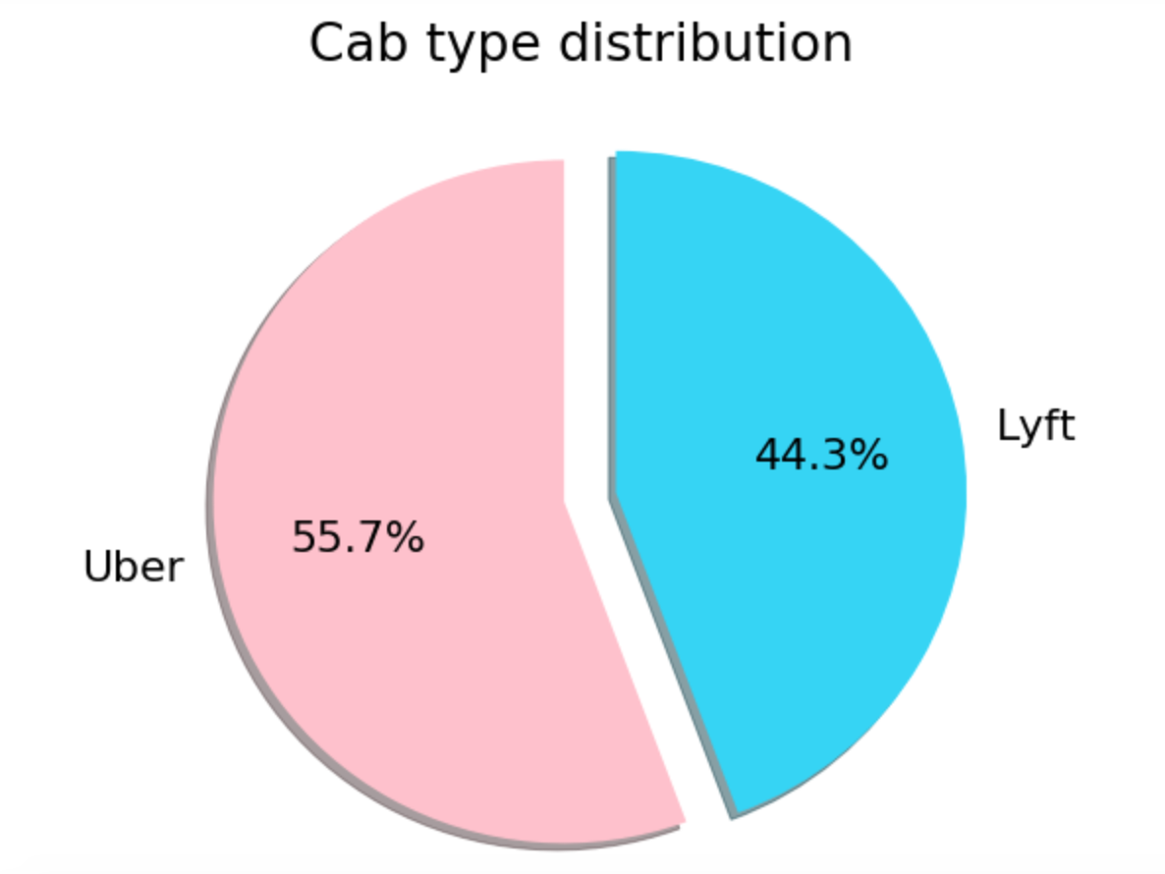
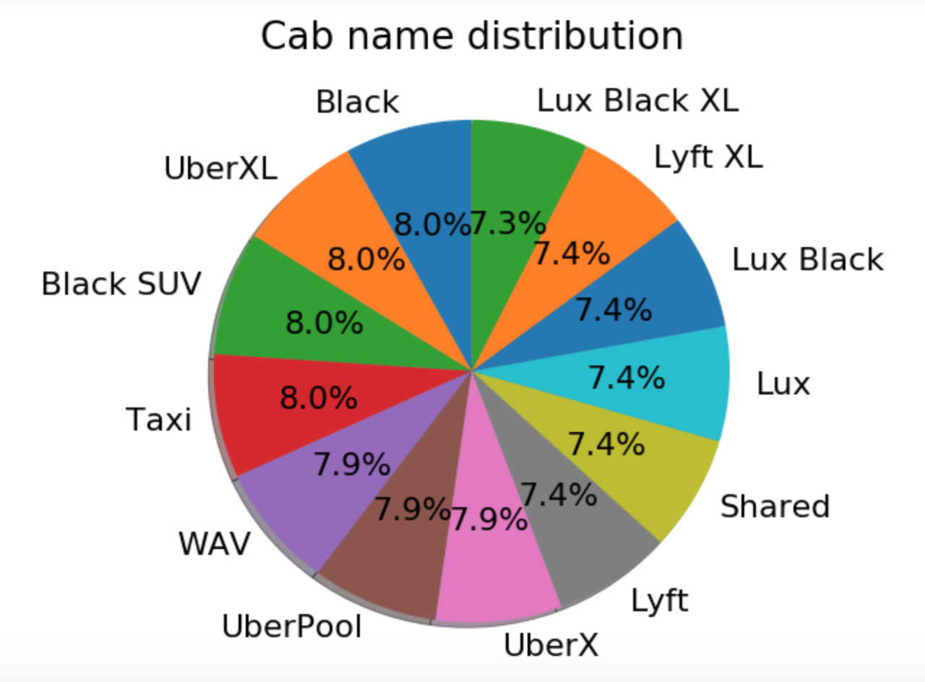
Data Overview
Dataset of cab rides collected for a week in Nov - Dec 2018.
Collected at a regular interval of 5 mins.

Slide 5
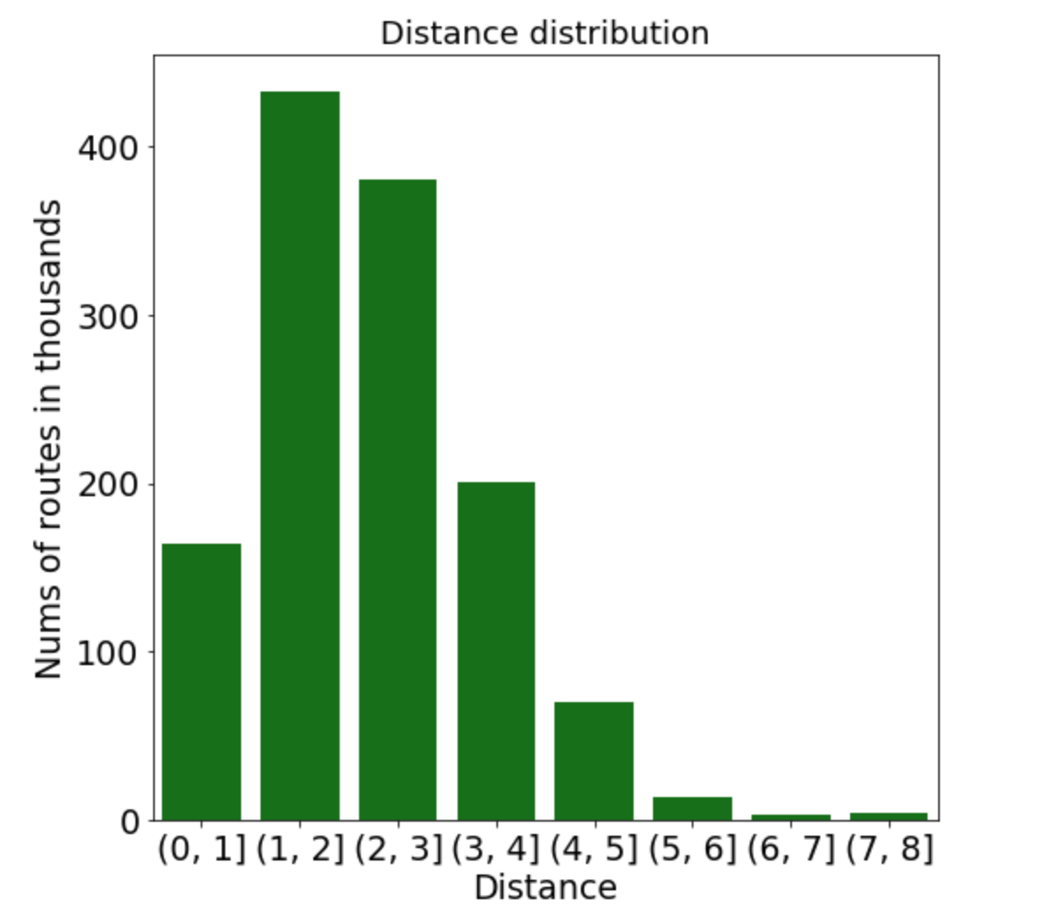
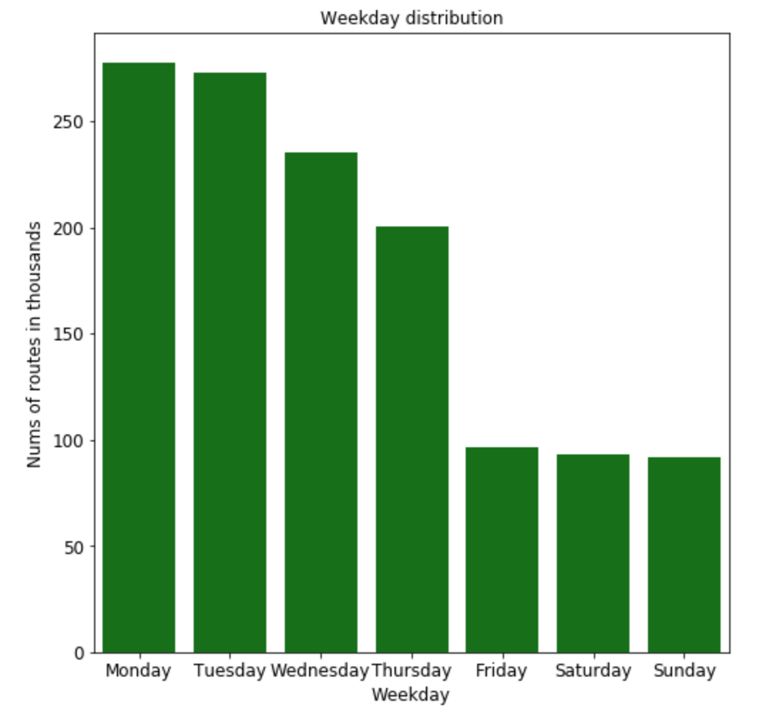
Data Overview
Distance Distribution
Weekday Distribution

Slide 6
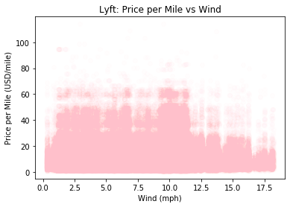
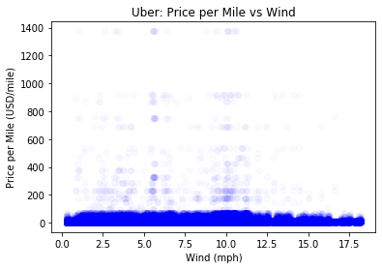
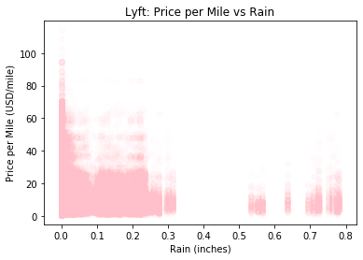
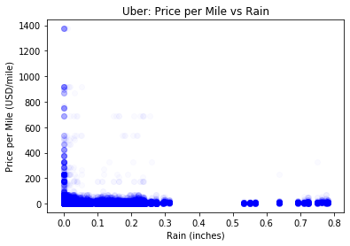
Data Visualization
Uber vs Lyft: Effect of Weather on Price per Mile
Weather does not affect the prices of rides

Slide 7
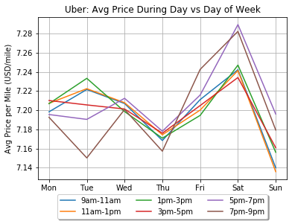
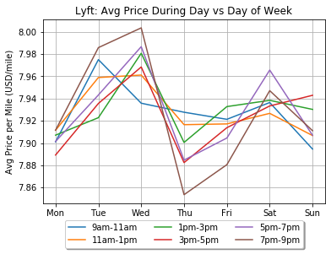
Data Visualization
Uber vs Lyft: Price per Mile vs Day of Week
Uber is generally, slightly less expensive than Lyft
Uber’s prices fluctuate less than Lyft’s
Prices spike from 5pm-9pm

Slide 8
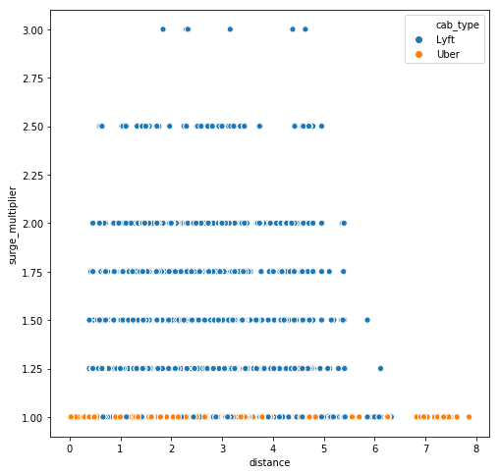
Data Visualization
Uber vs Lyft: Surge Multiplier vs Distance
Uber Surge Multiplier is always 1

Slide 9
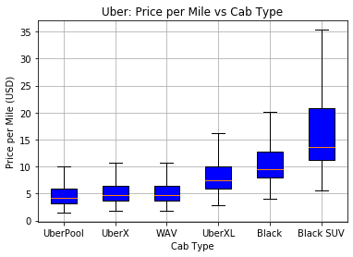
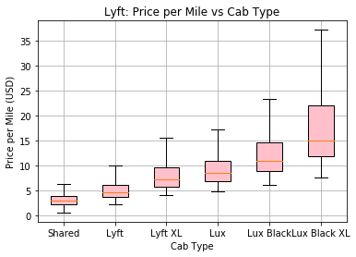
Data Visualization
Uber vs Lyft: Price per Mile vs Cab Type
Uber is generally cheaper than Lyft
Lyft has much more price variation
Better cab type leads higher price

Slide 10
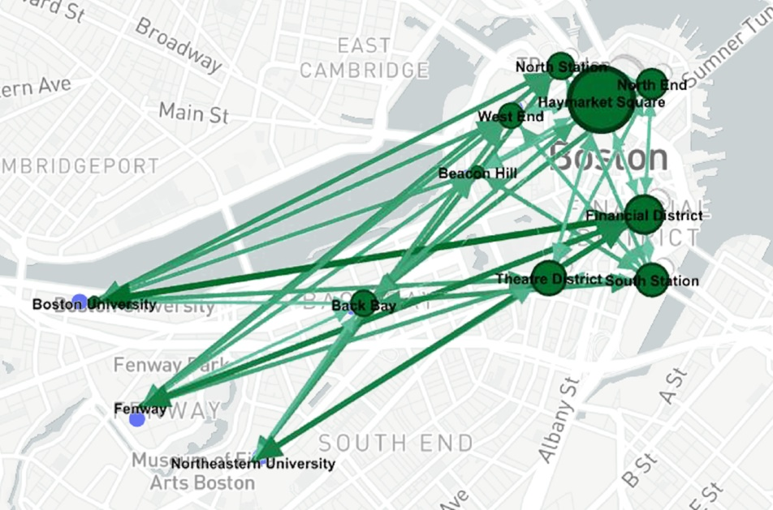
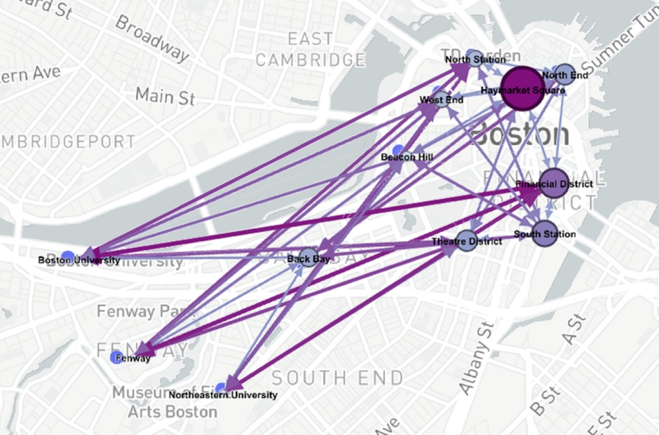
Data Visualization
Suburb area cheaper
Haymarket Square quite large
Generally: Lyft < Uber
Uber
Edge weight = mean price
Node weight = price/distance
Lyft

Slide 11
Data Prediction
Goal
Predict future Uber & Lyft rides price
Training set
Splitting original dataset into 80% training set and 20% validation set.
Test set
Manually collected 3000 entries from Uber & Lyft App.
Model
Random Forest
SVM
Decision Tree

Slide 12
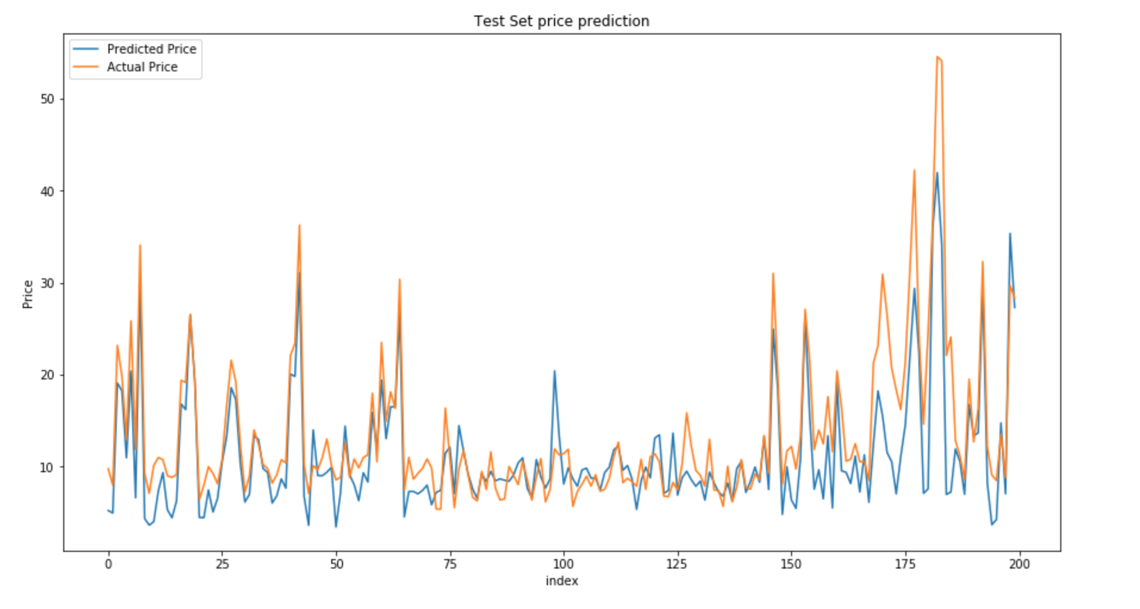
Data Prediction
Accuracy | Training set | Validation set | Test set
Random Forest | 95.95 % | 89.4 % | 81.99 %
SVM | 84.56 % | 59.77 % | 61.56 %
Decision Tree | 98.67 % | 93.01 % | 79.58 %
Random Forest:
Test set price prediction

Slide 13
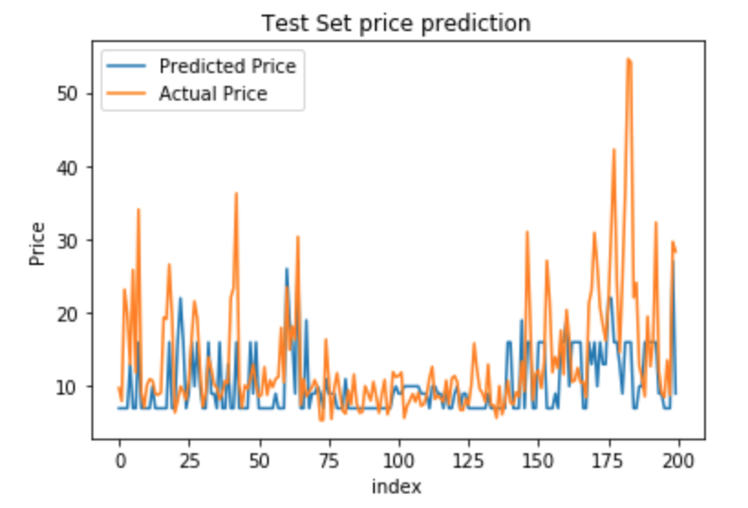
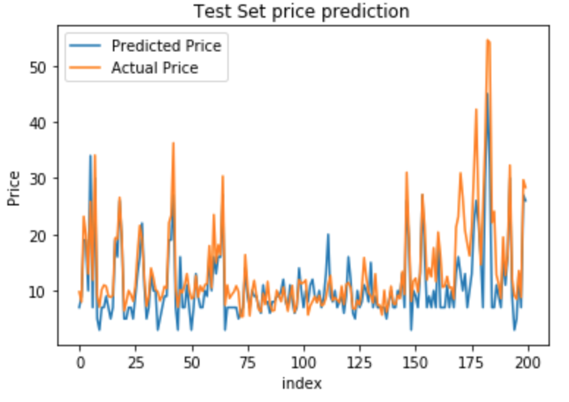
Data Prediction
SVM:
Decision Tree:

