Slide 1
8995 CAPSTONE PROJECT PRESENTATION
Shop Customer Dataset
Jacinda Zou / U3145190
TUTORIAL GROUP – WEEK 13, 2 May 2023/16:30

Slide 2
Table of Contents
Introduction / Problem Statement
Dataset Details
EDA (Exploratory Data Analysis) Outcomes
PDA (Predictive Data Analytics) Outcomes
Implementation and Deployment (TkInter/Flask/Streamlit) Plan and Status Update
References/Bibliography

Slide 3
Introduction / Problem Statement
Problem:
To determine whether a customer is a potential value customer (spending score more than 50) based on the data of the Shop.
The Objective:
To help the shop owner understand their customers and make business decisions.

Slide 4
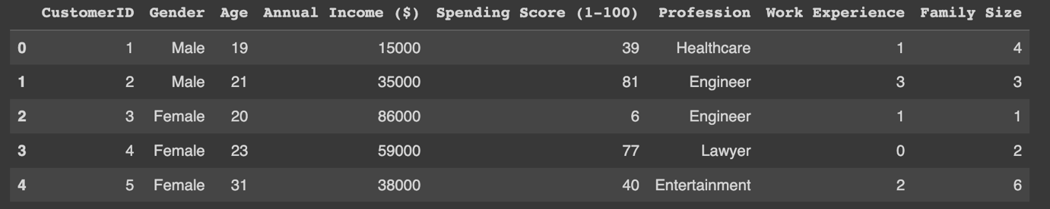
2. Dataset Details
An in-depth investigation of the customers in a shop [1].
It helps the business learn more about its customers.
First 5 rows of Dataset

Slide 5
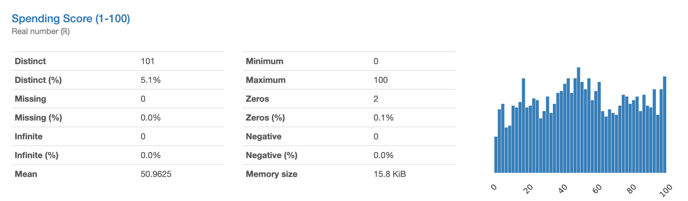
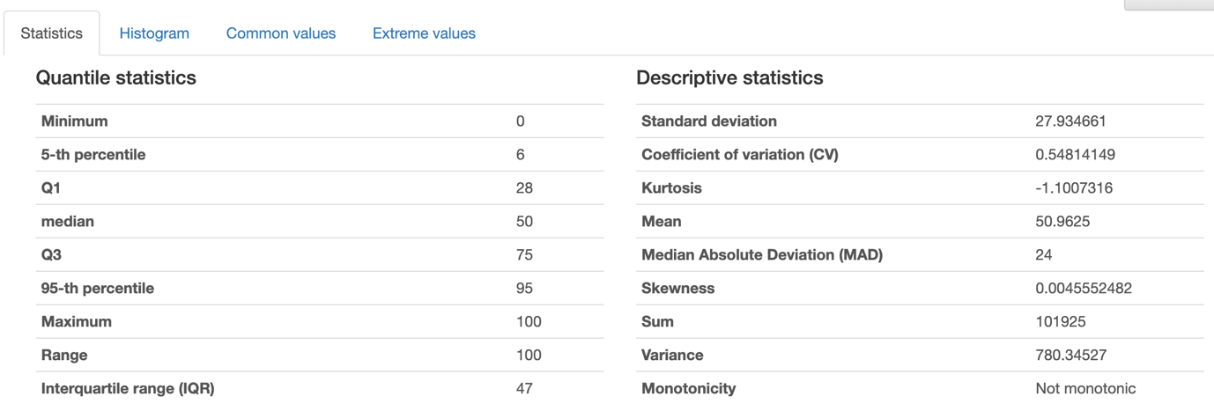
3. EDA (Exploratory Data Analysis) Outcomes
EDA Report – Spending Score

Slide 6
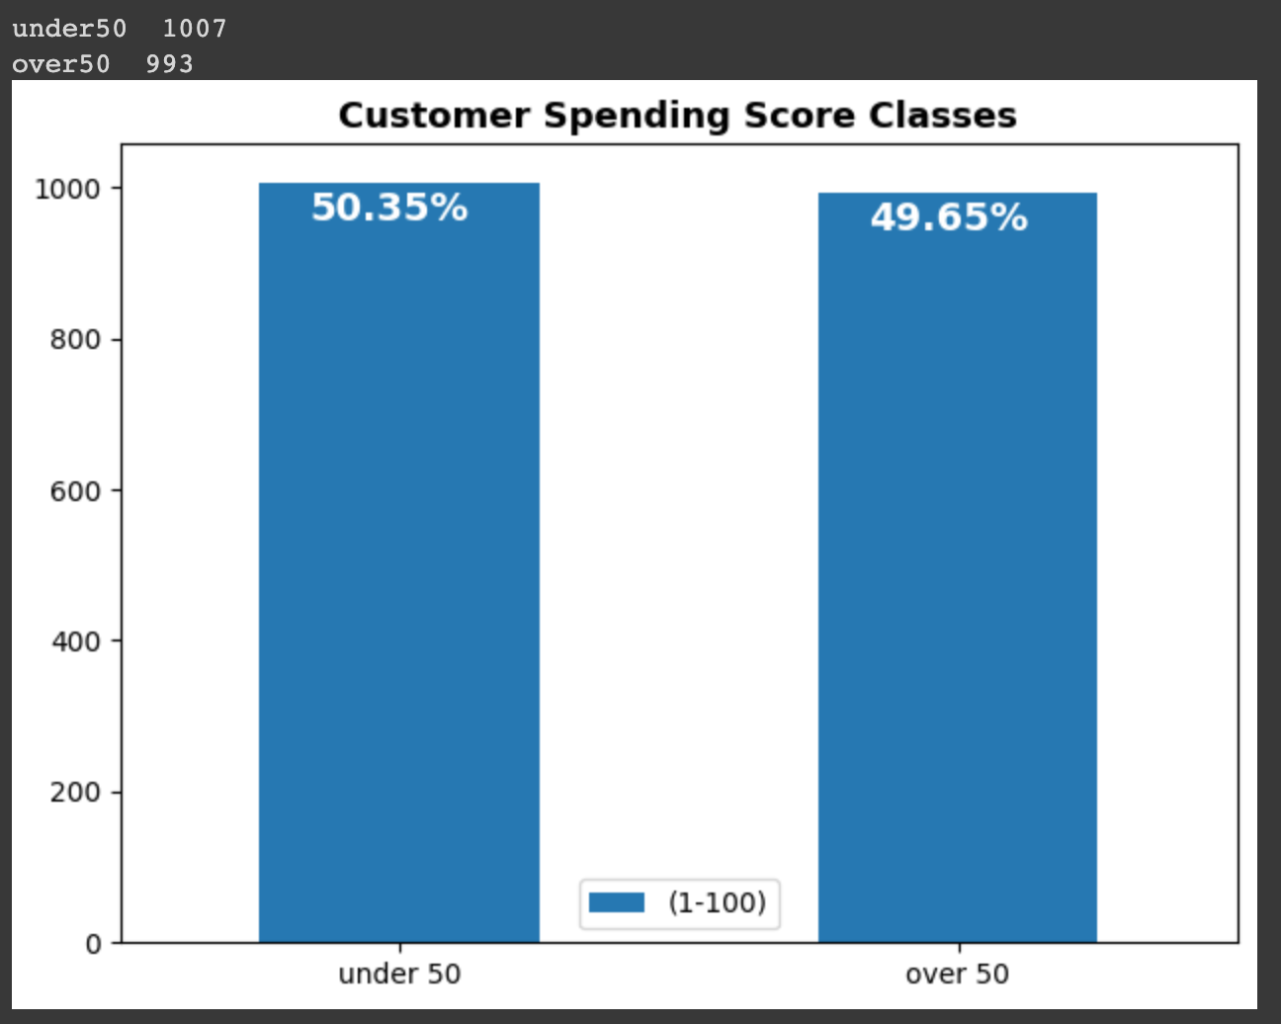
3. EDA (Exploratory Data Analysis) Outcomes
Customer Spending Score Classes

Slide 7
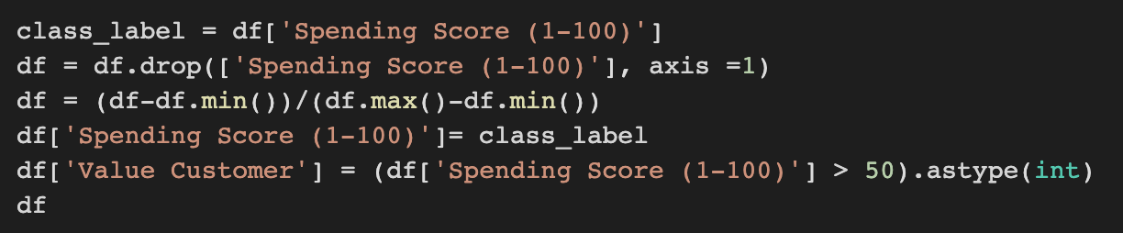
4. PDA (Predictive Data Analysis) Outcomes
Added a new column named ‘value customer’ based on spending score
1 = Spending score > 50
0 = Spending Score <50

Slide 8
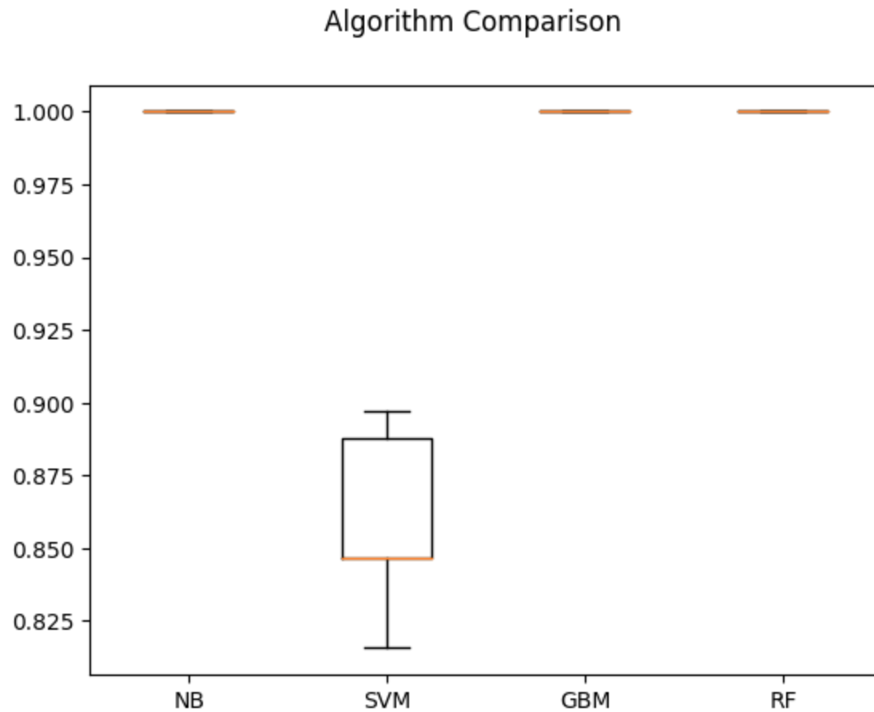
4. PDA (Predictive Data Analysis) Outcomes
Algorithm Comparison
Choose RF (Random Forest Classifier ) for the model performance evaluation

Slide 9
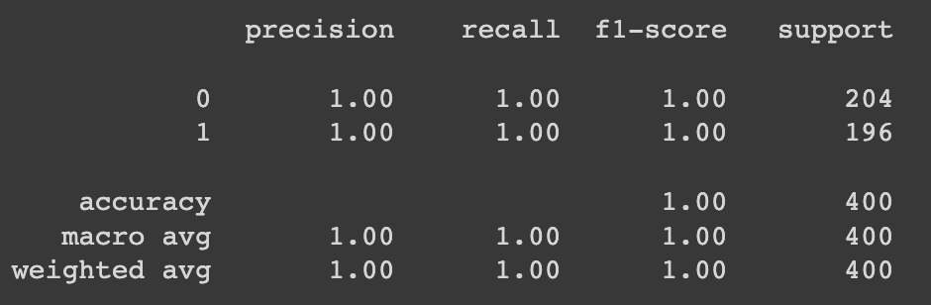
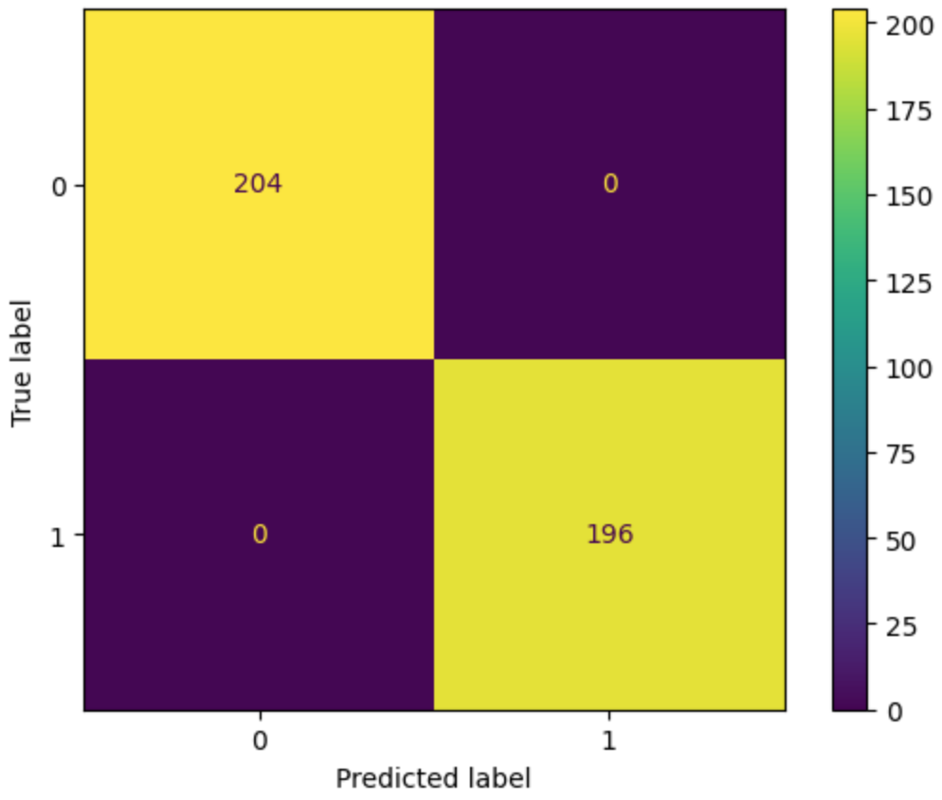
4. PDA (Predictive Data Analysis) Outcomes
Model Performance Evaluation
Classification report
Confusion matrix

Slide 10
5. Implementation and Deployment (TkInter) Plan and Status Update
Implementation: TkInter
Deployment plan: GitHub
Current Status: Write a Gui program by using TkInter

Slide 11
References /Bibilography
Open Database, Shop Customer Data, [Online]. Available: https://www.kaggle.com/datasets/datascientistanna/customers-dataset (accessed: May 2, 2023)

