Slide 1



Jacinto’s Magical Doggy World!
Jacinto Mendoza

Slide 2

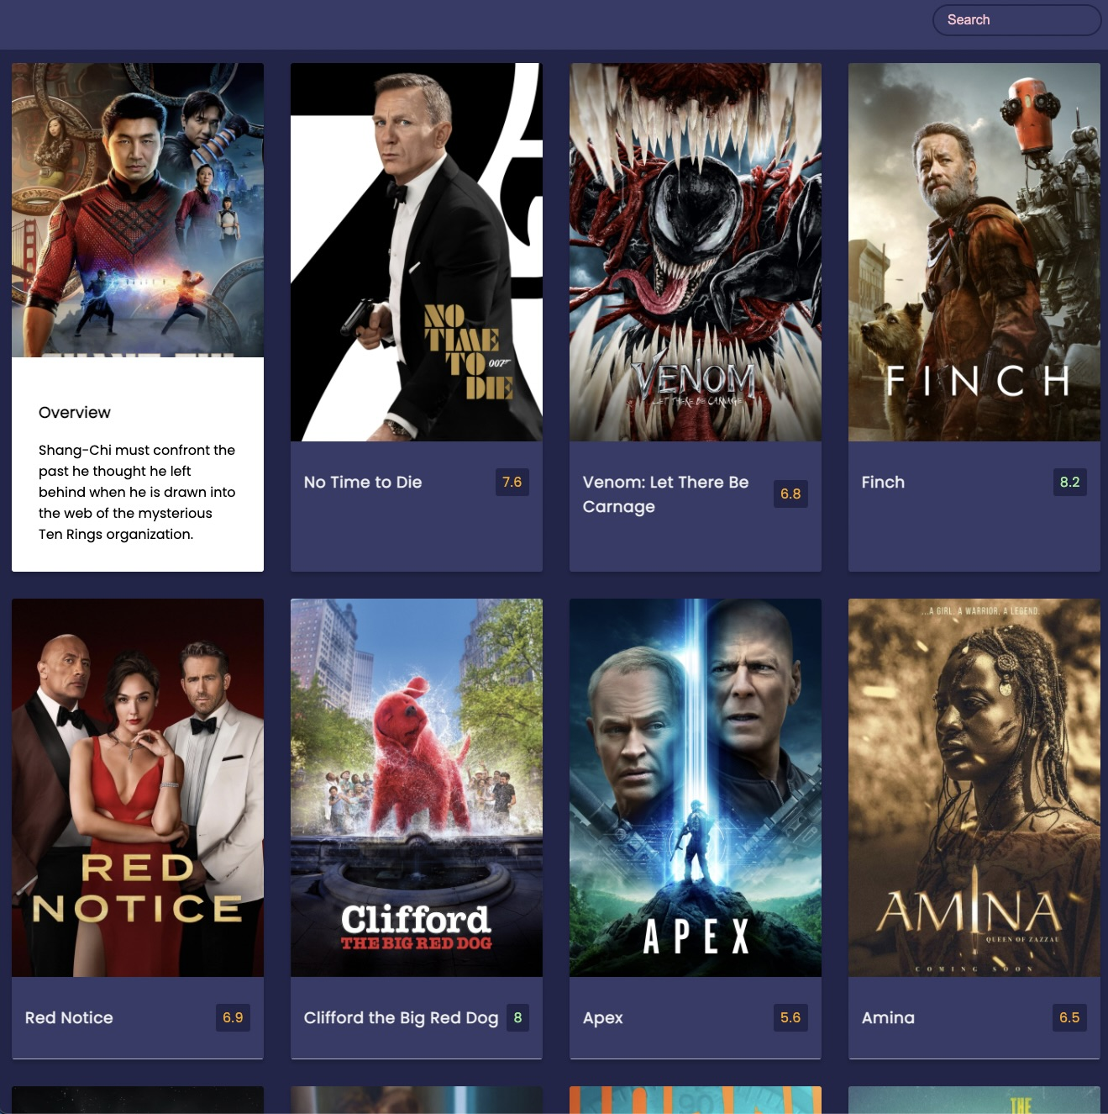
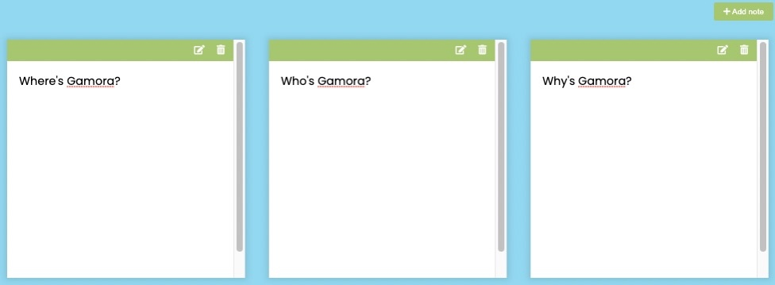
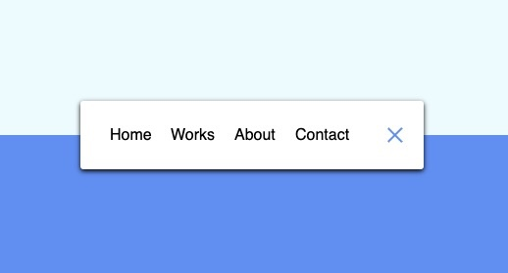
A Combination of Movie UI, Notes and Rotating Navigation

Slide 3

Demo

Slide 4


Why this Combo?
Time constraint
Most of the coding involved learning and converting to an original API
Very interactive webpage
Mostly from the Movie UI
Practice APIs
Practice URLs and CSS
Work with placeholders

Slide 5


Difficulties
API conversion from themoviedb.org to thedogapi.com
Decontructor change
[Element] of [element] errors w/JSON.stringify
Sizing (different picture sizes)
Search bar errors
Search API within thedogapi.com only searches based on ID types rather than names
Would have to rely on creating client-side search rather than Search API
Other solution: creating a key-word search that maps to ID which could pass to Search API
Placeholder issues

Slide 6
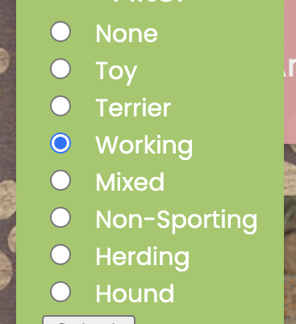
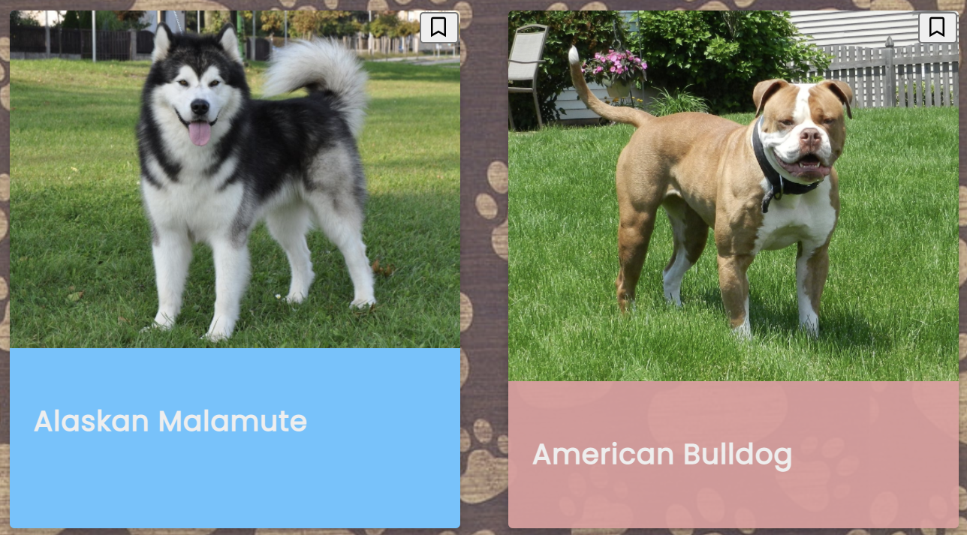
Additional Features
Added a bookmark feature that highlights a dog
Created a filter to group breed groups together

Slide 7

Future Considerations
Implement the search bar to successfully work with thedogAPI.com
Create a recommended list of dogs per client
Connect the application with a database (MongoDB)
Publish the website
Add animation to bookmarking

Slide 8


Thank You!

