Slide 1
Jacin Yan
WORK IN PROGRESS

Slide 2
Design Decision
Minimalism + Basic Features

Slide 3
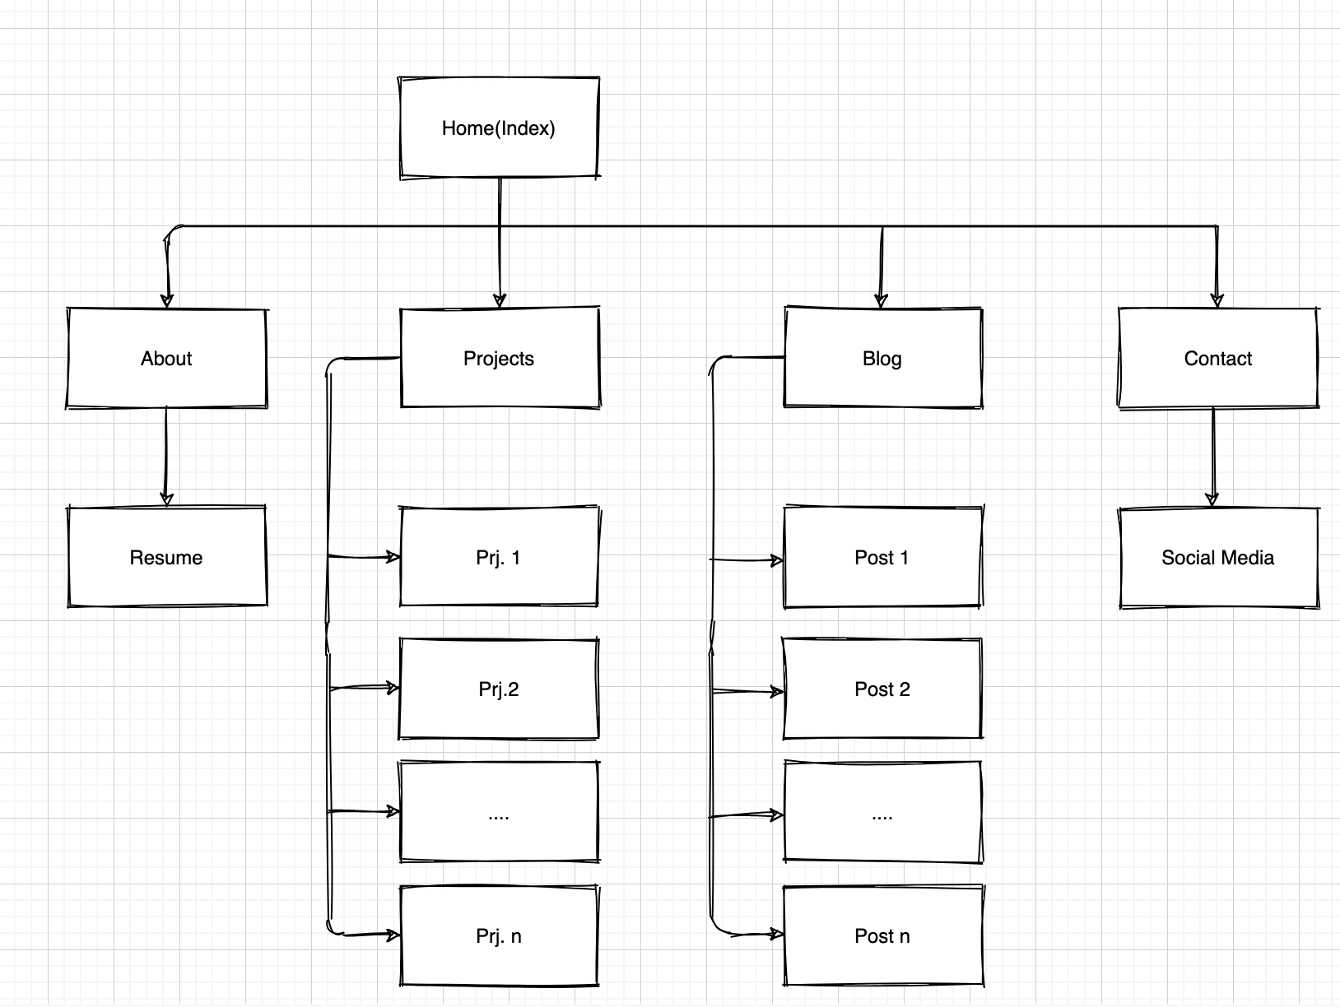
Site Map

Slide 4
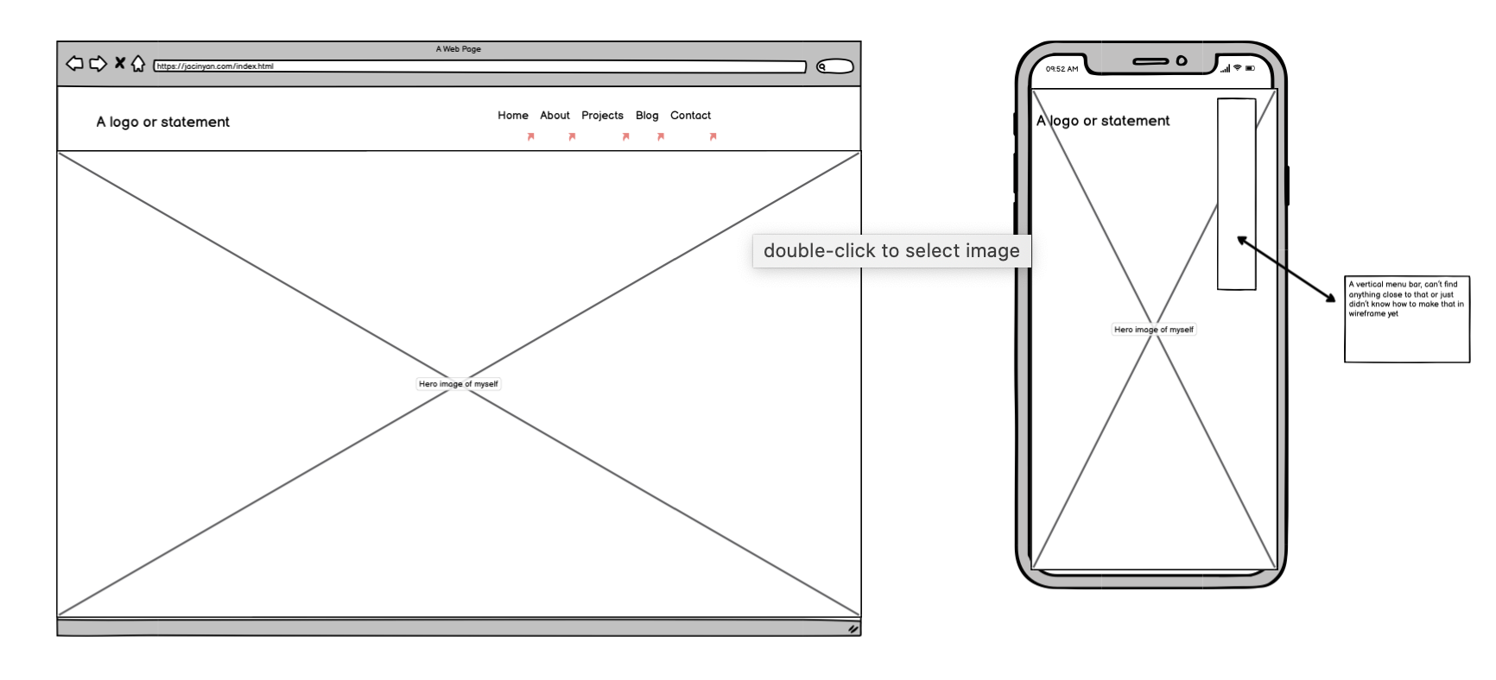
Home

Slide 5
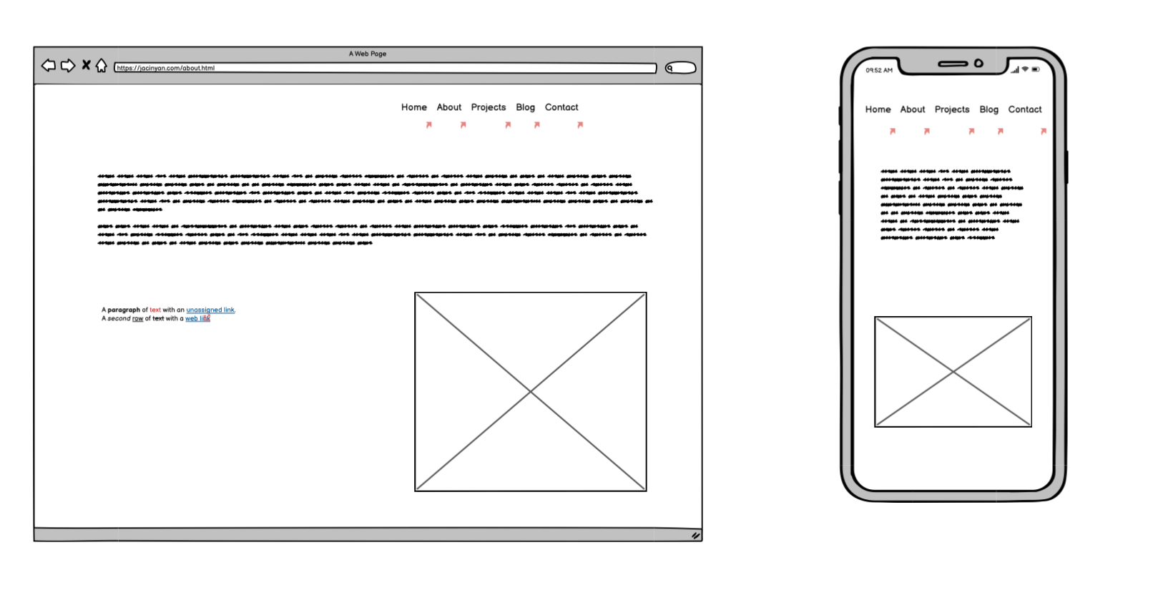
About

Slide 6
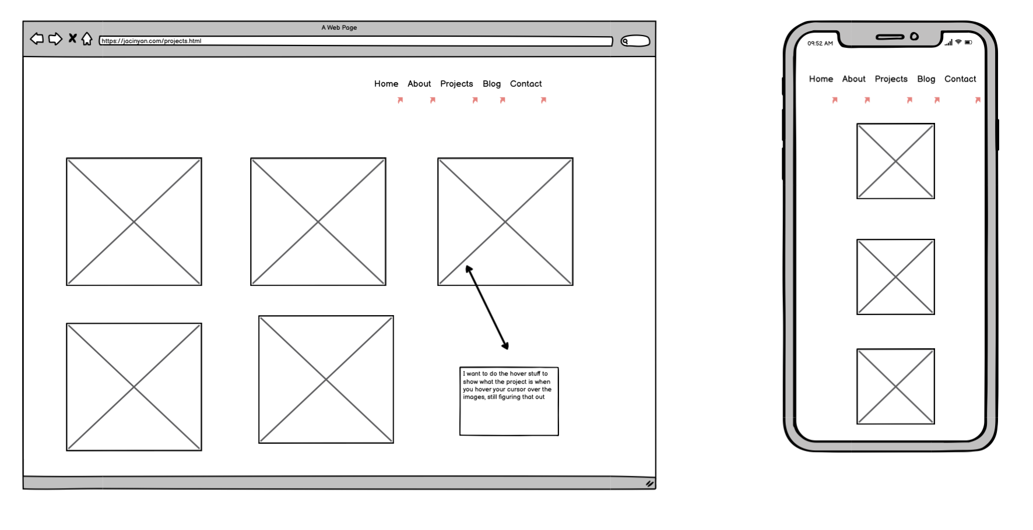
Projects

Slide 7
Components
‘Hero’ image (and it’s really a ‘BIG’ one)
Navigation bar
Call to action buttons
Animations to the thumbnails, e.g. hover effects
Subtle details that add to UI/UX, say the use of shadow

Slide 8
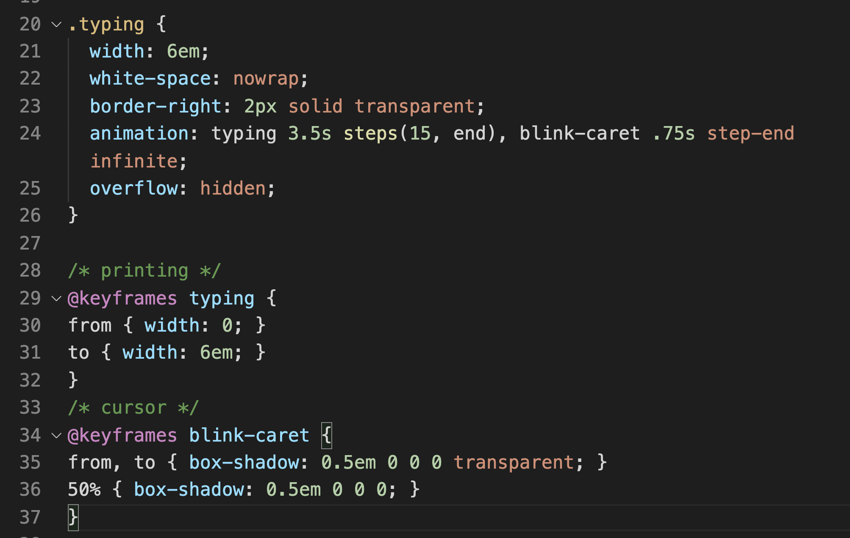
Snippets
Share something new I learned over the past week, such as ‘step’, ‘blink-caret’
Changes to the width of the container

Slide 9

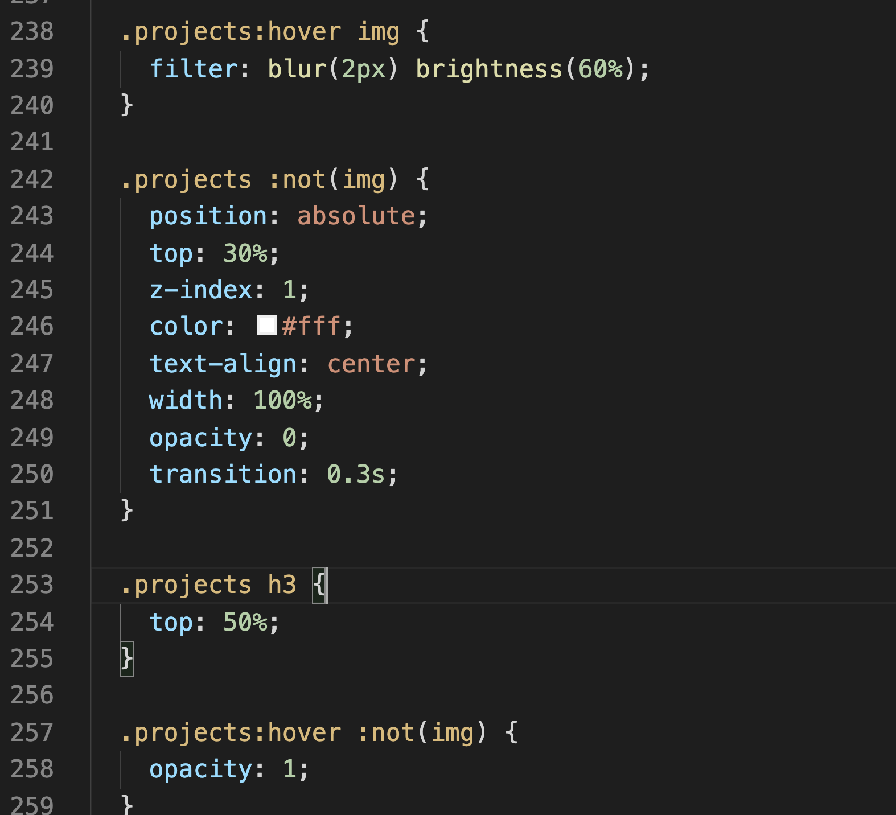
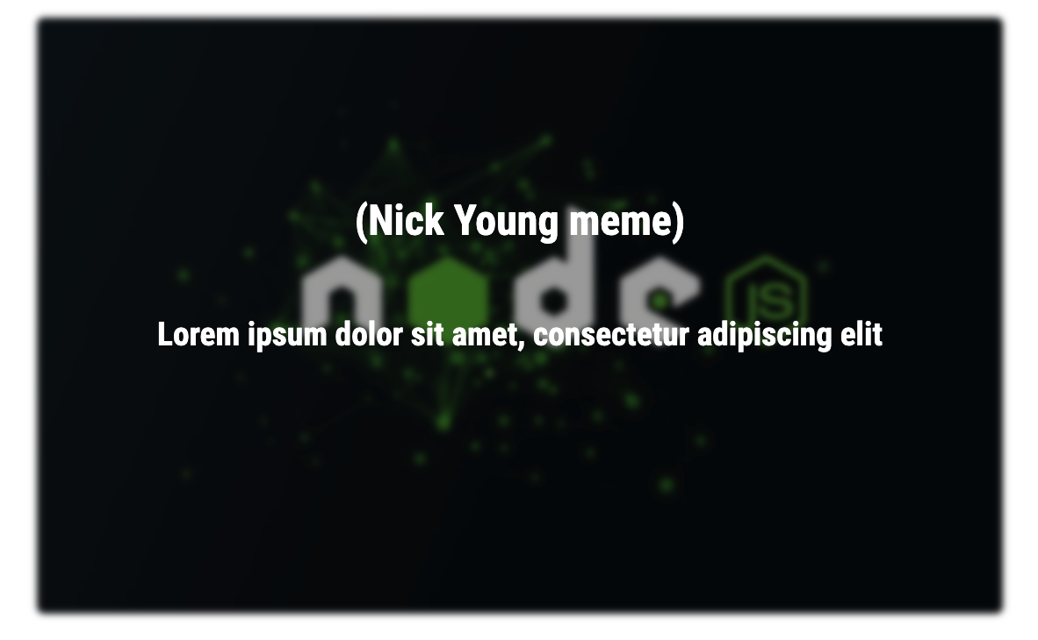
Snippets
Pseudo classes make for better looking websites though slightly harder to get the hang of

Slide 10
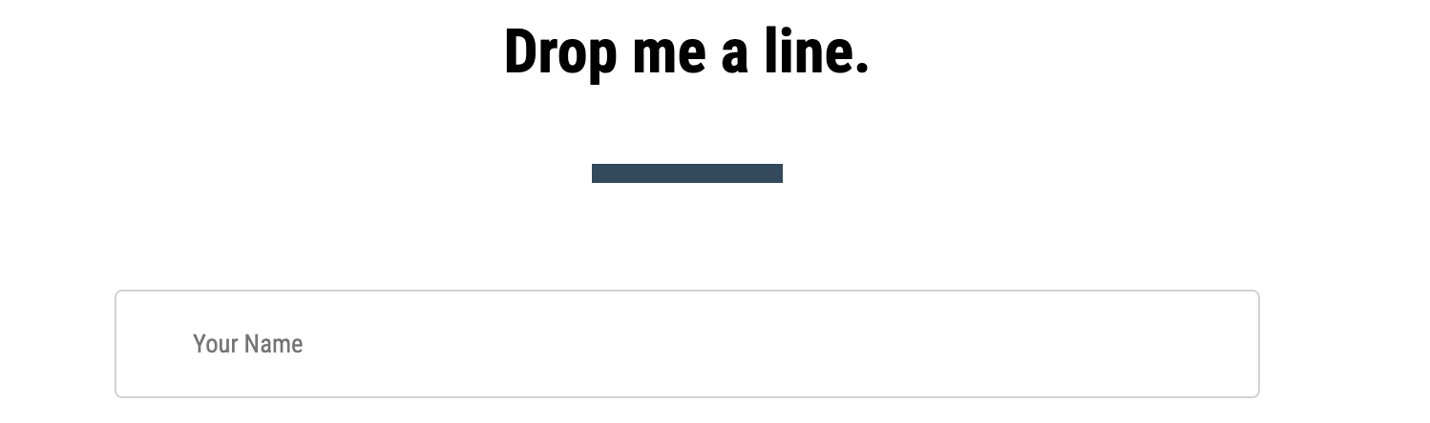
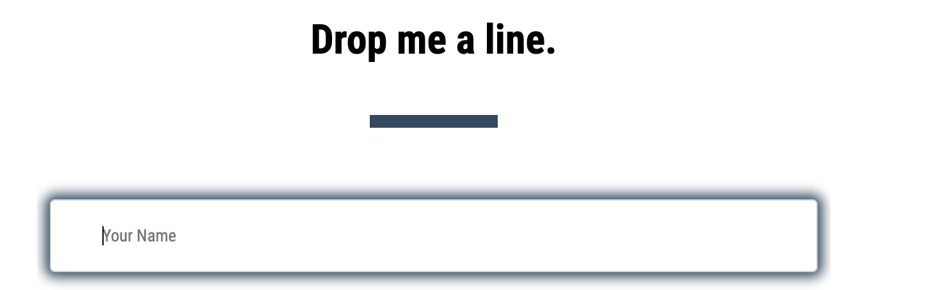
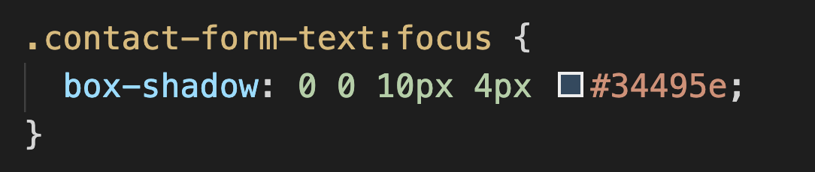
Snippets
Make sure have a full understanding before ‘being an copy cat’

Slide 11
Deployment
https://jacinyan.netlify.app
Check this out!

Slide 12
‘Wrap’
Thank you!

