Slide 1
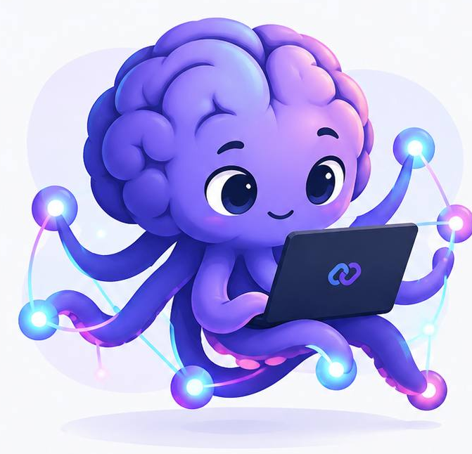
MY PROSPECTIVE MASTER’S RESEARCH
PairUp
An intelligent platform
for collaborative learning
Partner matching and AI study support
01 / 09
Notes:
Good afternoon. Today I would like to present PairUp, the project behind my prospective master’s research. PairUp is an intelligent platform for collaborative learning. It helps learners find a study partner and move into a shared session.
My proposed thesis title is Development of an Intelligent Collaborative Learning Platform with AI-Assisted Study Partner Matching and Automated Processing of Learning Materials. I will introduce the research problem, show how the prototype works, and explain how I plan to evaluate it.

Slide 2
RESEARCH FIELD AND IMPORTANCE
Why I chose collaborative learning
FIELD
WHY IT MATTERS
Educational technology
Make it easier
to start a session
and keep a routine.
Collaborative learning
Recommender systems
MY MOTIVATION
I am learning web development.
Regular study is a problem I recognise.
Effects on engagement and
procrastination will be evaluated.
02 / 09
Notes:
The research field that interests me is educational technology, especially computer-supported collaborative learning and recommender systems. I am learning web development myself, so I understand how difficult it can be to study regularly and find a suitable partner.
I chose this topic because learning involves more than access to information. People also need a practical way to arrange sessions and maintain a routine. PairUp aims to lower that barrier by bringing partner discovery and the study session into one place. Better engagement and less procrastination are possible benefits, but I will investigate them rather than assume that the prototype already produces these effects.

Slide 3
PROBLEM AND KNOWLEDGE GAP
Same topic. Different expectations.
PRACTICAL PROBLEM
PROPOSED KNOWLEDGE GAP
Goals, schedules and
knowledge levels may not fit.
Will richer matching improve
real session outcomes
beyond simple filters?
A trade-off to test
Similar levels or complementary skills?
The literature review will refine
the gap and the comparison baseline.
Background: Steel (2007); Odo, Masthoff and Beacham (2019)
03 / 09
Notes:
The practical problem is that studying the same subject does not automatically make two people compatible. Their goals, schedules or knowledge levels may differ. There is also a design trade-off: should a platform recommend someone with a similar level, or someone whose skills complement the learner’s own skills?
Research already examines how to form learning groups, so I am not claiming that this is a completely new field. My proposed knowledge gap is more specific. In an open platform like PairUp, do richer partner recommendations improve actual session outcomes compared with simple subject and availability filters? A structured literature review will help me refine that question and choose an appropriate baseline.
REFERENCES — NOT SPOKEN
Steel, P. (2007). The nature of procrastination. https://doi.org/10.1037/0033-2909.133.1.65
Odo, C., Masthoff, J., and Beacham, N. (2019). Group Formation for Collaborative Learning: A Systematic Literature Review. https://doi.org/10.1007/978-3-030-23207-8_39

Slide 4
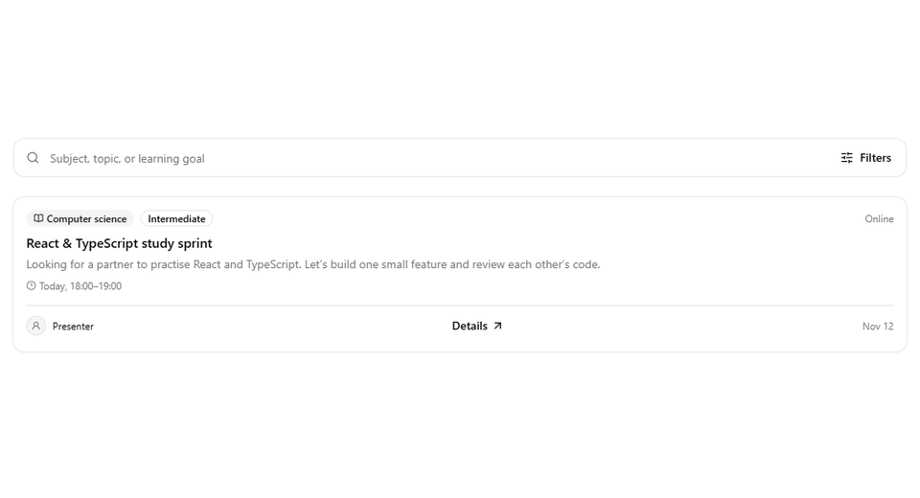
PRODUCT EXPERIENCE
From a listing to a study session
01
A listing
Topic, goal and availability
02
A proposal
An invitation to study
03
Confirmation
The author accepts or declines
Recorded prototype with cursor and focus cues
04 / 09
Notes:
This short animation shows the first part of the user journey. A learner opens a listing and checks the topic, learning goal and preferred time. If the listing is suitable, the learner proposes a session. The author can then accept or decline the invitation.
The cursor and blue outline show the important actions. This is a recording of the working prototype. The idea is to make the next step clear, so that finding a partner leads to a concrete study arrangement.
PLAYBACK CUE — NOT SPOKEN
The GIF plays automatically in Slide Show mode. Let it complete one loop while speaking.

Slide 5
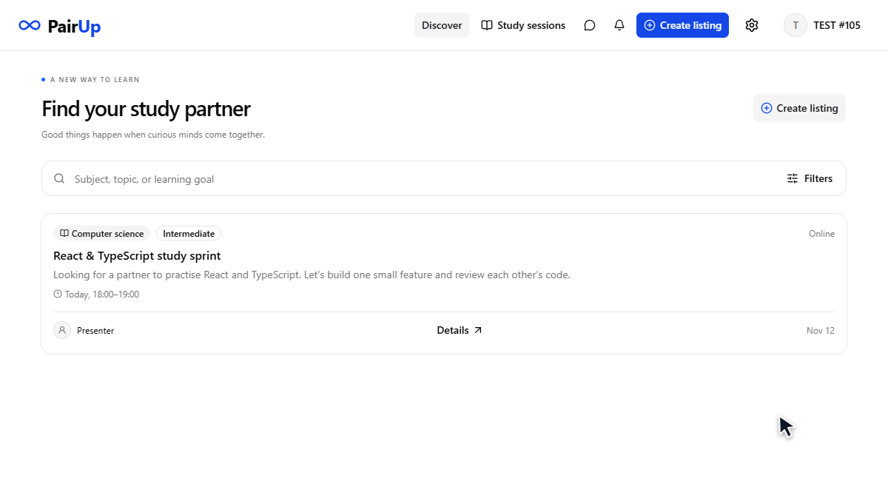
PairUp in action
32-second product walkthrough
Notes:
Let me show you the complete flow in a short video. You will see a listing, a session proposal, confirmation by the author, a real-time conversation, and a request to Neuron, the AI assistant.
The prototype already supports Russian and English interfaces, TEST access, session proposals and persistent chat history. The response from Neuron in this recording comes from a real local model. The study tools shown in the room still include previews. AI partner recommendations and automatic processing of learning materials are planned features, so I am not presenting them as completed functions.
PLAYBACK CUE — NOT SPOKEN
After the first paragraph, play the embedded video and pause speaking for approximately 32 seconds. Continue with the second paragraph when it finishes.

Slide 6
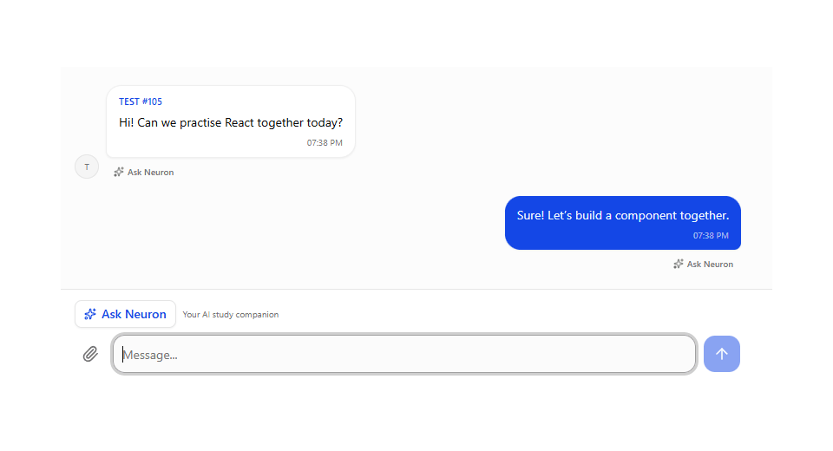
RESEARCH FOCUS AND AIM
Matching learners, supporting the session
PRIMARY FOCUS
AI SUPPORT IN THE SESSION
Study partner
matching
Develop the platform and test
whether recommendations
improve compatibility and
session completion.
Secondary: AI processing
of learning materials
06 / 09
Notes:
The focus of my thesis is the quality of study partner matching. My aim is to develop the platform and evaluate whether a richer matching method improves perceived compatibility and session completion compared with a simple baseline.
AI support inside a session is a secondary direction. In this animation, the presenter selects a message and asks Neuron to translate it. In the current prototype, only the presenter can call the assistant. Later, I plan to explore summaries and practice questions based on learning materials. I will evaluate their accuracy and usefulness while keeping partner matching as the main research contribution.
PLAYBACK CUE — NOT SPOKEN
The GIF shows message selection and translation automatically. No live website or AI connection is needed.

Slide 7
METHODOLOGY AND RESEARCH TOOLS
How I will evaluate PairUp
Design science research
COMPARISON
PILOT AND CONTROLLED COMPARISON
Baseline
Session completion
Compatibility ratings
Subject and availability filters
Candidate method
Goals and knowledge level
Semantic similarity if data allow
Session logs, questionnaires
and participant feedback
React, TypeScript, Next.js / NestJS, Socket.IO / PostgreSQL, Prisma / Ollama, Qwen3 8B
07 / 09
Notes:
I plan to use a design science approach. I will begin with a literature review and interviews with potential users. Then I will develop a baseline based on subject and availability, and compare it with a matching method that also considers learning goals and knowledge level. Semantic similarity is a possible addition if the available data justify it.
A pilot will help test the procedure before a controlled comparison. I will measure session completion and compatibility ratings, using session logs, questionnaires and participant feedback. The software tools include React, TypeScript and Next.js, a NestJS backend with Socket.IO, and PostgreSQL with Prisma. For the assistant, I use Ollama with Qwen3 8B on my own computer.

Slide 8
PROPOSED THESIS STRUCTURE
The thesis behind the product
01
Introduction and research questions
CONTRIBUTION
02
An implemented
platform and an
evaluation of
partner matching.
Literature review and related work
03
Requirements, architecture and matching
04
Prototype implementation
05
Evaluation, discussion and limitations
Conclusion and
future work follow
the main chapters.
08 / 09
Notes:
I plan to organise the thesis into five main chapters. The first chapter introduces the problem, research questions and scope. The second reviews collaborative learning and partner recommendation methods. The third explains the requirements, architecture and proposed matching method.
The fourth chapter describes the implementation of the prototype. The fifth presents the evaluation, discussion and limitations. The conclusion will summarise the contribution and suggest future work. This structure connects the software product to a research question and evidence, rather than describing only its features.

Slide 9
TIMING SUPERVISION AND DEADLINE
A research plan with clear milestones
Month 1
Literature review
and study protocol
ACADEMIC SUPERVISOR
Vladislav Vitalyevich
Gromov
Months 2–3
Platform and matching
method development
Independent prototype development
with academic supervision
Months 4–5
Pilot, evaluation
and analysis
SUBMISSION DEADLINE
Month 6
Writing, revisions
and buffer time
Not yet set
Working target: six months
after research plan approval
09 / 09
Notes:
My academic supervisor is Vladislav Vitalyevich Gromov. I am developing the prototype independently, and I will agree the research protocol and evaluation plan with him.
The submission deadline has not been set yet. For planning, I propose a six-month schedule after approval of the research plan. Month one will cover the literature review and protocol. Months two and three will focus on development. Months four and five will cover the pilot, evaluation and analysis. I will reserve month six for writing, revisions and a buffer for delays.
I have not set a calendar submission date. My working target is to complete the study within this six-month plan, subject to agreement with my supervisor and university. Regular milestones should help me track progress and adjust the scope. Thank you for your attention. I would be happy to answer your questions.

