Slide 1

PairUp
Find a partner.
Start a focused session.
Collaborative learning with Neuron
My prospective master’s research
Notes:
PairUp is a platform for collaborative study. It brings partner discovery and a shared learning session into one interface. I am developing it as the practical artifact for my prospective master's research. The proposed thesis is Development of an Intelligent Collaborative Learning Platform with AI-Assisted Study Partner Matching and Automated Processing of Learning Materials. Today I will show the product through three real recordings rather than a long feature list. The recordings use isolated demonstration data. They show what the prototype can already do. Recommendation algorithms and automatic document processing remain planned research work.

Slide 2
Studying alone is easy
to postpone
A shared subject is only the beginning.
Goals and schedules must fit too.
PairUp connects partner discovery with the study session.
Notes:
The product addresses the difficulty of starting and maintaining a regular study routine. Finding a person who studies the same subject is only the first step: goals, availability and knowledge level can differ. My interest combines educational technology, computer-supported collaborative learning and recommender systems. I am learning software development myself, so this is also a practical problem I recognize. I want to investigate whether partner recommendations improve compatibility and actual session completion. I do not claim the prototype already reduces procrastination. The literature review will refine the gap. Background: Steel (2007), https://doi.org/10.1037/0033-2909.133.1.65. Odo, Masthoff and Beacham (2019), https://doi.org/10.1007/978-3-030-23207-8_39.

Slide 3
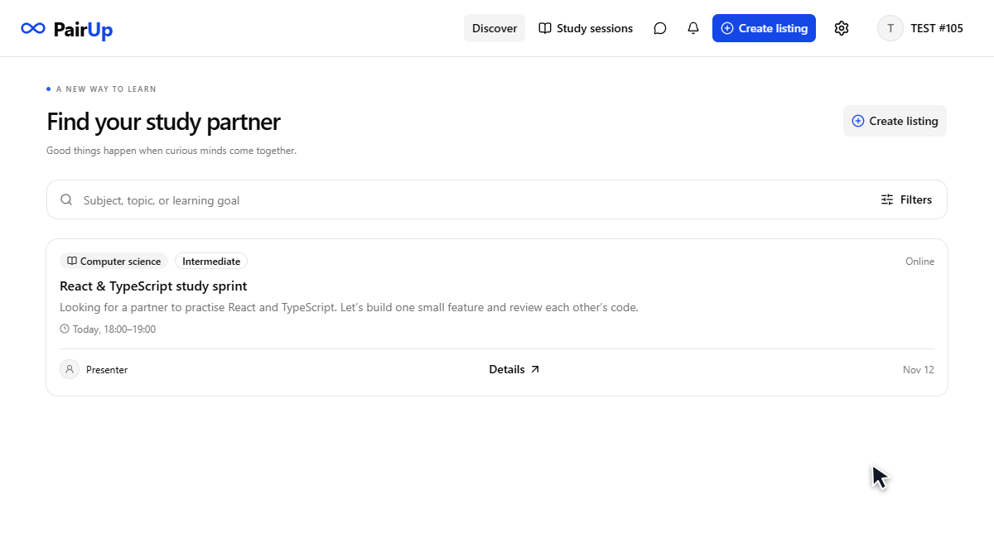
Find your next study partner
Notes:
This recording shows a learner opening a listing, reviewing its learning goal and availability, and proposing a session. The author of the listing will decide whether to accept. The blue outline highlights the relevant interface element, while the cursor shows the action. These actions use the actual application and server, not a simulated design. PairUp already provides Russian and English interfaces, TEST access and protected actions. Standard listings use this approval workflow. The English listing also provides a direct chat entry for the classroom demonstration. Source: actual PairUp prototype, recorded for this presentation.

Slide 4
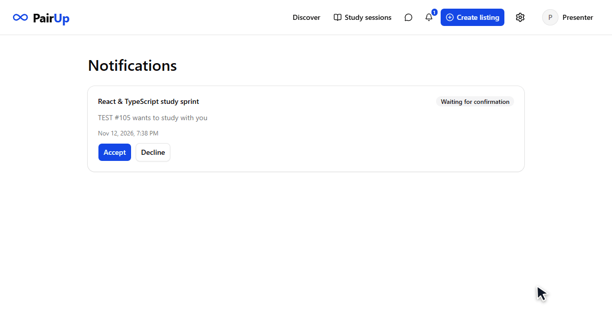
A confirmed session, a shared room
Notes:
The author receives the proposal in notifications. After acceptance, the participants can open a shared room and exchange messages in real time. This connects partner selection with observable study activity, which will matter for evaluation. The tool tabs communicate the intended workspace: notes, tasks, a Pomodoro timer, a whiteboard and files. They currently include previews, so I am not presenting every tool as a complete collaborative feature. The recording uses a temporary room and does not alter existing conversations. Source: actual PairUp prototype, recorded for this presentation.

Slide 5
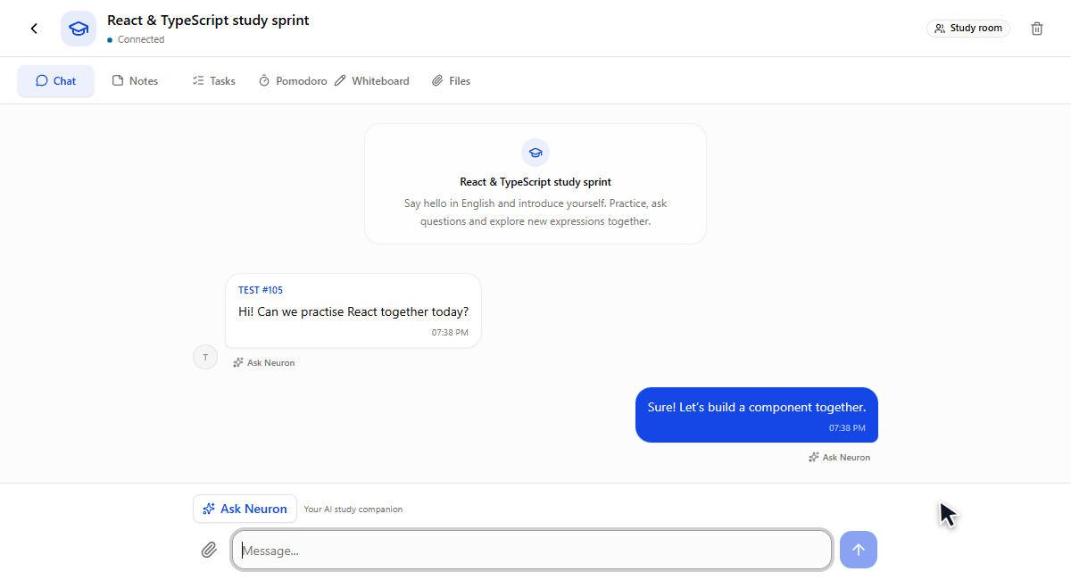
Neuron joins the conversation
Notes:
Neuron works inside the conversation. The presenter selects a message, enters a request and receives the answer in the same chat. Here I ask for a Russian translation of an English message. The response in this recording comes from the real local model, Qwen3 8B running through Ollama on my PC. The worker connects to the NestJS backend using an outgoing connection. Only the presenter can call the assistant in the current prototype. The local implementation also supports an optional configured cloud fallback. Automatic summaries and practice questions from uploaded materials are planned, rather than demonstrated here. Source: actual PairUp prototype and real AI output, recorded for this presentation.

Slide 6
The next step: intelligent matching
Research question
Planned development
Can recommendations improve
partner compatibility and
session completion?
Partner recommendations
Learning material summaries
Practice questions
Evaluation against a baseline based on simple filters
Proposed research schedule: six months
Questions?
Notes:
The main research question is whether richer partner recommendations improve compatibility and session completion compared with simple subject and availability filters. I plan a design science approach with a literature review, user interviews, a baseline, an iterative prototype and a pilot followed by a controlled comparison. I will measure session completion and compatibility ratings, supported by participant feedback. A secondary direction is summaries and practice questions from learning materials, evaluated for accuracy and usefulness. The proposed thesis chapters are introduction, literature review, architecture and matching method, implementation, and evaluation with limitations. I develop the prototype independently. Supervision arrangements and the protocol still require confirmation. The proposed schedule is six months: literature and protocol in month one, development in months two and three, pilot and evaluation in months four and five, and writing plus revisions in month six. The calendar deadline must be agreed with the supervisor and university.

