Slide 1

PairUp
My prospective
master’s research
An intelligent platform for
collaborative learning
AI-assisted partner matching and
automated processing of learning materials
01
Notes:
Good afternoon. Today I would like to present my prospective master’s research, based on a platform called PairUp. My proposed thesis title is Development of an Intelligent Collaborative Learning Platform with AI-Assisted Study Partner Matching and Automated Processing of Learning Materials. It comes from a practical problem: it can be difficult to start studying alone and to find a partner with a compatible goal and schedule. I am developing a prototype and planning an empirical study. This is a research proposal, so I will distinguish implemented features from planned work.

Slide 2
Research field and motivation
Educational technology
Computer-supported collaborative learning
Recommender systems for study partners
Why it matters
Support a regular study routine and make
collaborative learning easier to access.
02
Notes:
My interests combine educational technology, computer-supported collaborative learning and recommender systems. I am learning software development myself and understand the challenge of keeping a regular study routine. I want to make it easier to find a partner and begin a shared session. Better engagement and reduced procrastination are intended benefits to investigate. I have not demonstrated those effects yet. Background: Steel, P. (2007), The nature of procrastination, https://doi.org/10.1037/0033-2909.133.1.65. Odo, C., Masthoff, J., & Beacham, N. (2019), Group Formation for Collaborative Learning: A Systematic Literature Review, https://doi.org/10.1007/978-3-030-23207-8_39.

Slide 3
The problem and the research gap
Practical problem
Proposed research gap
Learners may share a subject
but have different goals,
schedules and knowledge levels.
Do better partner recommendations
lead to more completed sessions
and better perceived compatibility?
The literature review will refine this gap.
Background: Steel (2007); Odo, Masthoff & Beacham (2019)
03
Notes:
Procrastination is commonly studied as a self-regulation problem. Partner selection introduces another difficulty: two learners can study the same subject but have different goals, schedules or knowledge levels. Existing research already examines group formation, so I do not claim that the general topic is new. My proposed gap is narrower: I want to test whether matching improves actual session outcomes in PairUp beyond simple filters. The literature review will refine this gap. Sources: Steel (2007), https://doi.org/10.1037/0033-2909.133.1.65. Odo, Masthoff and Beacham (2019), https://research-portal.uu.nl/en/publications/group-formation-for-collaborative-learning-a-systematic-literatur/.

Slide 4
Research aim
Can partner recommendations improve
the quality of collaborative study?
Aim: develop the platform and evaluate matching
against a baseline based on simple filters.
Primary outcomes: compatibility and session completion
04
Notes:
My aim is to develop and evaluate an intelligent collaborative learning platform. The main research focus is partner matching. My primary question is whether recommendations can improve perceived compatibility and session completion compared with a baseline based on subject and availability. My working hypothesis is that goals and knowledge level provide useful additional signals. I will also explore summaries and practice questions from learning materials, but that will be a secondary direction so the thesis retains a clear primary contribution.

Slide 5
The learner’s journey
01
Create and discover a listing
Topic, learning goal and availability
02
Propose and confirm a session
The author accepts or declines the invitation
03
Study together and keep the results
A shared room connects conversation with learning activity
05
Notes:
The intended workflow begins with a listing that describes a learner’s subject, goal and availability. Another learner opens it and proposes a session. The author receives a notification and decides whether to accept. Acceptance gives the participants access to the room. The room connects conversation with study tools and saved results. This connection matters for evaluation: a relevant recommendation is useful only if participants can successfully arrange and complete study. The English listing has a direct chat shortcut for the presentation.

Slide 6
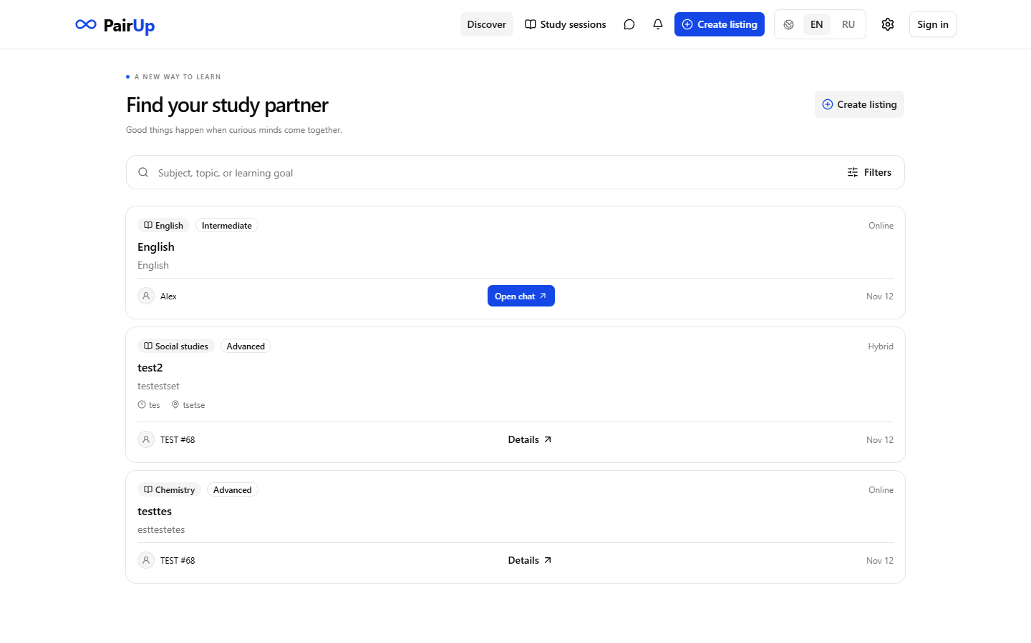
The current prototype
Available now
RU / EN interface
TEST access
Session proposals
Real-time chat
Neuron in chat
Matching and document
processing are planned.
06
Notes:
This screenshot shows the actual local PairUp prototype. It already includes an English and Russian interface, TEST access, listings, session proposals and real-time chat. Neuron can process recent chat context and post a reply in the conversation. The English listing opens the demonstration chat directly. Standard listings use confirmation. Partner matching and automatic processing of documents are planned research features. I will not present them as completed capabilities. Image source: the author’s PairUp local application, captured for this presentation.

Slide 7
Methodology and evaluation
01
Design science and user research
Literature review, learner interviews and iterative prototyping
02
Baseline versus proposed matching
Simple filters compared with a richer compatibility model
03
Pilot and controlled comparison
Session completion, compatibility ratings and feedback
07
Notes:
I plan to follow a design science approach: define the problem, develop an artifact and evaluate it. First, I will review research and interview potential users. I will implement a baseline using subject and availability, then add goals and knowledge level. Semantic representations are an option if the available data justify them. A pilot will test the procedure before a controlled comparison. The main outcomes will be session completion and perceived compatibility. I will also collect satisfaction ratings and short interviews. I will agree sample size, consent and the analysis plan with my supervisor before recruitment.

Slide 8
Research tools and AI support
Web platform
AI assistant
React, TypeScript, Next.js
NestJS and Socket.IO
PostgreSQL and Prisma
Ollama with Qwen3 8B
Local worker on my PC
Optional cloud fallback
Planned material processing: summaries and practice questions
08
Notes:
The frontend uses React, TypeScript and Next.js, with next-intl for localization. NestJS and Socket.IO provide the backend and communication layer, and PostgreSQL with Prisma stores data. Ollama runs Qwen3 8B on my home computer. An outgoing worker connection links it to the backend. A Yandex AI Studio fallback requires configuration and credentials. For future learning-material processing, I plan to evaluate summaries and practice questions for factual accuracy and usefulness. Large-scale capacity remains a separate engineering stage and has not been established by the prototype.

Slide 9
Proposed thesis structure
1
Introduction and research questions
2
Literature review and related work
3
Requirements, architecture and matching method
4
Prototype implementation
5
Evaluation, discussion and limitations
09
Notes:
I expect five main chapters. The first introduces the problem, research questions and scope. The second reviews collaborative learning and recommendation methods. The third explains requirements, architecture and the matching method. The fourth describes prototype implementation. The fifth presents evaluation, discussion and limitations. A conclusion will summarize the contribution and future work. This structure connects software development to a research question and an empirical evaluation rather than describing only a collection of features.

Slide 10
Research schedule and deadline
Month 1
Literature review and study protocol
Months 2–3
Platform, baseline and proposed matching
Months 4–5
Pilot, evaluation and analysis
Month 6
Writing, revision and submission buffer
Target: end of Month 6. Calendar deadline to be confirmed.
10
Notes:
I propose a six-month schedule, subject to agreement with my supervisor and university. Month one covers the literature and protocol. Months two and three cover the platform, baseline and proposed matching. Months four and five cover the pilot, evaluation and analysis. The final month includes writing, revisions and a delay buffer. My proposed target is submission at the end of month six. A calendar deadline has not been confirmed. The immediate milestone is a reliable presentation prototype within one week. I will keep a backup recording for the demonstration.

Slide 11
Supervision and expected contribution
Independent prototype development
Academic supervisor and study protocol
to be confirmed
Expected contribution
A working platform and empirical evidence
about study partner matching
11
Notes:
I am developing the prototype independently. An academic supervisor has not been confirmed in the information available for this proposal. I plan to agree the research questions, evaluation protocol, ethical procedures and deadline with a supervisor. The expected contribution is a working platform and empirical evidence about the proposed matching method. Limitations may include limited initial data, a small participant sample and inaccurate AI output. A negative or modest result would still help identify which signals are useful. No experimental outcomes are available yet.

Slide 12
Live demonstration
1 Sign in as TEST
2 Open English and send a message
3 Ask Neuron to translate the conversation
Thank you. Questions?
12
Notes:
For the demonstration, participants will use the shared website address, choose TEST, open English and send a short English message. I will sign in as Presenter, call Neuron and ask it to translate recent messages into Russian. Everyone should see the response in the chat. I will keep the local model warm and prepare a backup recording before the presentation. A QR code requires the final public URL. A localhost address does not let classmates connect from their own devices. Thank you for your attention. I would welcome questions about the research design or matching criteria.

