Slide 1

EASWARI ENGINEERING COLLEGE
FOOD LAB MANAGEMENT SYSTEM
INFORMATION TECHNOLOGY
PRESENTED BY
UNDER THE GUIDANCE OF
Sarath Raj V
Ms. Grandhi Sai Lakshmi
310624205238
IT D

Slide 2
AGENDA | FOOD PROCESSING LABORATORY MANAGEMENT SYSTEM
Scope of This Review
Requirements (Functional & Non-Functional)
Detailed System Architecture
Use Case & ER Diagrams
Module Description & Tech Stack
UI Design, Frontend & Backend Build
Database & API Design
Feature Status, Screenshots & Challenges
Agenda
Food Processing Laboratory Management System | MERN Stack Project
Notes:
SOURCE: project name and scope come from the README overview.
The agenda mirrors the sample deck flow.

Slide 3
01
REQUIREMENTS
Functional & Non-Functional Requirements
Functional Requirements
Non-Functional Requirements
Batch tracking and traceability
Chemical, microbial & quality testing records
Compliance reporting & audit support
Dashboard for operations & quality overview
Store and retrieve records through the Express API
Usability: browser-based React interface
Modularity: separate client and server
Data storage: records persisted in MongoDB
Maintainability: modular MERN codebase
Portability: runs locally, configured via server/.env
Requirements
Food Processing Laboratory Management System | MERN Stack Project
Notes:
SOURCE: functional requirements 1-4 are the README Features list.
PROJECT-BASED ADDITION: functional item 5 and all non-functional requirements are logical requirements derived from the tech stack and project structure. No performance figures are claimed.

Slide 4
02
ARCHITECTURE
System Architecture (Detailed)
CLIENT TIER
APPLICATION TIER
DATA TIER
React.js frontend
client folder
⇄
Node.js + Express.js
Express API (server folder)
⇄
MongoDB
MongoDB models · foodlab database
The React client communicates with the Express API, which reads and writes data in MongoDB.
Ports & config: API on port 5000 | Client at localhost:5173 | MongoDB at 127.0.0.1:27017/foodlab
Architecture
Food Processing Laboratory Management System | MERN Stack Project
Notes:
SOURCE: React client, Express API, MongoDB, ports 5000 / 5173, MONGO_URI, and the client / server split are all in the README.
PROJECT-BASED ADDITION: the three-tier diagram and the client-to-API-to-database data flow are the logical arrangement of those components.

Slide 5
03
USE CASE
Use Case Diagram
Food Lab Management System
Actors & Use Cases
Track & Trace Batches
Laboratory Staff: track batches and record chemical, microbial & quality tests
Compliance Officer: generate compliance reports and view the dashboard
Actors are illustrative; the README does not define user roles
Record Chemical Tests
Record Microbial Tests
Laboratory
Staff
Record Quality Tests
Generate Compliance Report
View Dashboard
Compliance
Officer
Use Case
Food Processing Laboratory Management System | MERN Stack Project
Notes:
SOURCE: the use cases map directly to the README Features (batch tracking, chemical / microbial / quality testing records, compliance reporting, dashboard).
PROJECT-BASED ADDITION: the two actors and the actor-to-use-case links are illustrative. The README does not define user roles.

Slide 6
04
ER DIAGRAM
ER Diagram / Database Design
Batch
TestRecord
Design Notes
_id (PK)
batchNumber
productName
createdAt
1
has
N
_id (PK)
batchId (FK)
testType
result
testedAt
Batch has many test records (1:N)
Batch has many compliance reports (1:N)
testType: chemical, microbial or quality
Records reference batchId (referenced, not embedded)
Logical model based on the README features
1
has
ComplianceReport
N
_id (PK)
batchId (FK)
summary
generatedAt
ER Diagram
Food Processing Laboratory Management System | MERN Stack Project
Notes:
SOURCE: the README mentions MongoDB models, the foodlab database and the testing / compliance / traceability features.
PROJECT-BASED ADDITION: the three entities, their attributes and the 1:N relationships are a logical model implied by those features. The README does not list the actual collections or fields, so confirm against the models in the server folder.

Slide 7
05
MODULES
Module Description
Module | Description | Key Functions
Batch Management | Batch tracking & traceability | Add, View, Trace
Testing Records | Chemical, microbial & quality tests | Record, View, Update
Compliance Module | Compliance reporting & audit support | Report, Audit Support
Dashboard | Operations & quality overview | Summary, Overview
Express API | Connects the React client to MongoDB | Read / Write Data
Modules
Food Processing Laboratory Management System | MERN Stack Project
Notes:
SOURCE: module names and descriptions come from the README Features list and Project Structure.
PROJECT-BASED ADDITION: the Key Functions column is a logical breakdown of each feature.

Slide 8
06
TECH STACK
Technology Stack
MongoDB
Express.js
React.js
Node.js
NoSQL Database
Backend Framework
Frontend Library
Runtime Environment
Supporting Tools
npm (dependency install & scripts)
server/.env (environment configuration)
Local MongoDB instance (foodlab database)
npm run dev (starts client and server together)
Tech Stack
Food Processing Laboratory Management System | MERN Stack Project
Notes:
SOURCE: MongoDB, Express.js, React.js, Node.js, npm commands, server/.env and local MongoDB are all in the README.
No extra libraries have been added.

Slide 9
07
UI DESIGN
UI Design / Wireframes
Food Lab Management System
Layout Notes
Dashboard
Batch Overview
Test Summary
Compliance Status
Sidebar navigation for the four features
Dashboard as the landing view
Card summaries above a records table
Opens in the browser at localhost:5173
Conceptual wireframe, not a screenshot
Batches
Test Records
Records Table
Compliance
Conceptual layout only. Not a screenshot of the built application.
UI Design
Food Processing Laboratory Management System | MERN Stack Project
Notes:
SOURCE: the four features and the browser address (localhost:5173) come from the README.
PROJECT-BASED ADDITION: the wireframe is a conceptual layout and NOT a screenshot. Replace or supplement it with real screens from the running app.

Slide 10
08
FRONTEND
Frontend Development
React.js frontend in the client folder
Component-based UI for batches, tests, compliance & dashboard
Consumes the Express API for data
Runs in the browser at http://localhost:5173
Dependencies installed with npm install --prefix client
Started with the server using npm run dev
The React frontend lives in the client folder and is served at http://localhost:5173
Frontend
Food Processing Laboratory Management System | MERN Stack Project
Notes:
SOURCE: React frontend in client, port 5173, install and start commands.
PROJECT-BASED ADDITION: the component-based UI mapping to the four features is the logical use of React for this project.

Slide 11
09
BACKEND
Backend Development
Node.js + Express.js API in the server folder
MongoDB models defined for application data
Configuration loaded from server/.env
API server runs on PORT=5000
Dependencies installed with npm install --prefix server
Started together with the client using npm run dev
The backend reads PORT and MONGO_URI from server/.env
Backend
Food Processing Laboratory Management System | MERN Stack Project
Notes:
SOURCE: everything on this slide is stated in the README (server folder, Express API, MongoDB models, server/.env, PORT, commands).
"The backend reads PORT and MONGO_URI" is the natural reading of the README Environment section.

Slide 12
10
DATABASE
Database Integration
Local MongoDB used as the data store
Database name: foodlab
MongoDB models defined in the server folder
Connection set through MONGO_URI in server/.env
Logical collections: batches, test records, compliance reports
Client and API work on top of the same database
MONGO_URI=mongodb://127.0.0.1:27017/foodlab
Database
Food Processing Laboratory Management System | MERN Stack Project
Notes:
SOURCE: local MongoDB, foodlab database, MONGO_URI, MongoDB models.
PROJECT-BASED ADDITION: the logical collection names follow the ER diagram and should be matched to the actual models.

Slide 13
11
API
API Design (Proposed Endpoints)
Method | Endpoint | Description
GET | /api/batches | List all batches
POST | /api/batches | Create a batch record
GET | /api/batches/:id | View and trace a batch
POST | /api/tests | Record a chemical, microbial or quality test
GET | /api/reports | Fetch compliance reports
GET | /api/dashboard | Operations & quality overview
API
Food Processing Laboratory Management System | MERN Stack Project
Notes:
SOURCE: the README only states that the server provides an Express API.
PROJECT-BASED ADDITION: the endpoint list is a proposed REST design derived from the features. The README does not list the actual routes, so replace these with your real routes if they differ.

Slide 14
12
STATUS
Module-wise Implementation Status
Batch Tracking & Traceability
Included in project scope
Testing Records
Included in project scope
Compliance Reporting & Audit
Included in project scope
Operations & Quality Dashboard
Included in project scope
Backend API (server)
Setup documented in README
Frontend (client)
Setup documented in README
Status
Food Processing Laboratory Management System | MERN Stack Project
Notes:
SOURCE: features and the client / server setup are from the README.
No completion percentages are shown, because the README gives no progress figures. Replace the status text with your real progress if you have it.

Slide 15
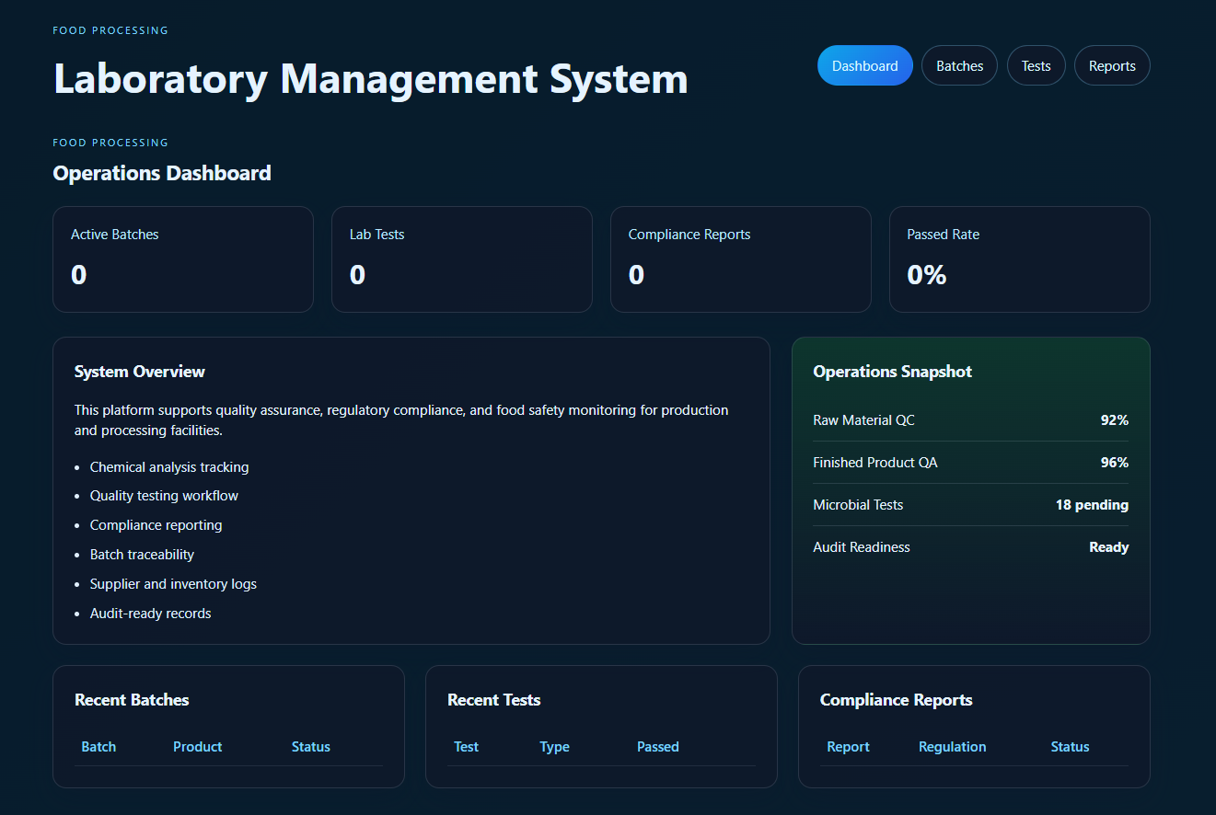
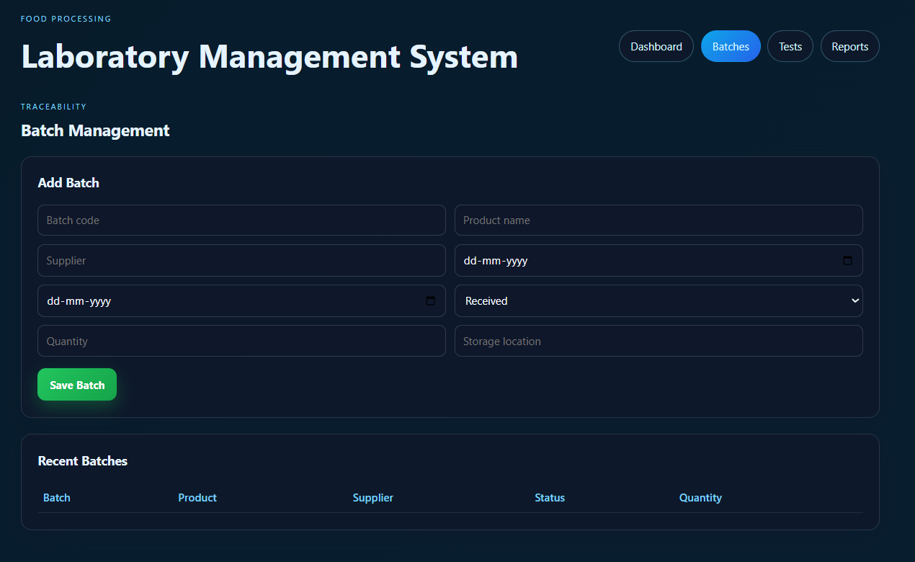
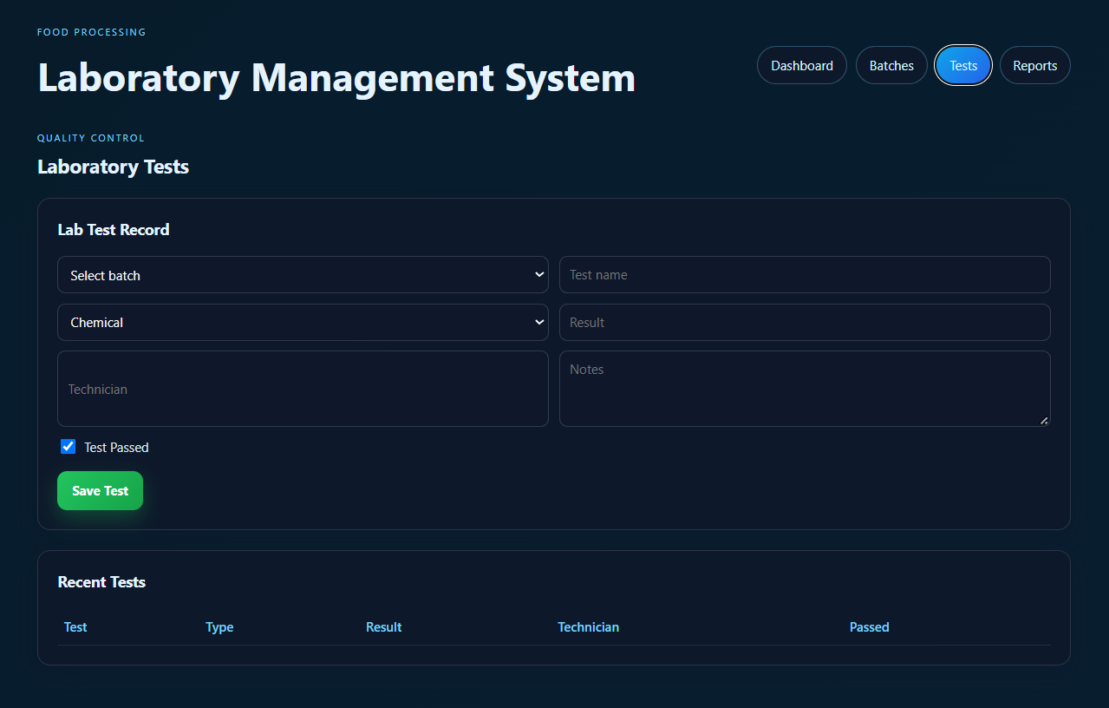
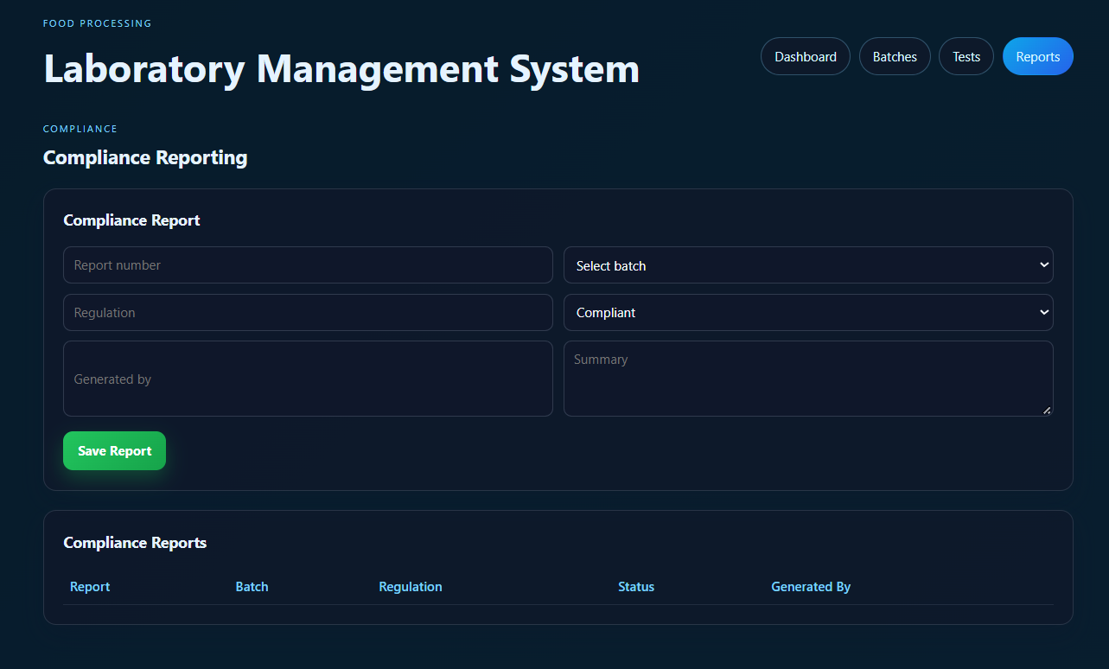
13
SCREENSHOTS
Screenshots
Screenshots
Food Processing Laboratory Management System | MERN Stack Project
Notes:
No screenshots exist in the README or uploaded files, so these frames are intentionally left as placeholders. Screenshots are not fabricated.
Run the app (npm run dev, then http://localhost:5173) and paste real screenshots.

Slide 16
14
CHALLENGES
Setup Challenges & Solutions
Challenge | Solution
MongoDB not running locally | Start MongoDB before launching the apps
Three separate dependency installs | Run npm install for root, server and client
Running client and server together | Use npm run dev to start both apps
Missing environment settings | Define PORT and MONGO_URI in server/.env
Challenges
Food Processing Laboratory Management System | MERN Stack Project
Notes:
SOURCE: each solution is a step from the README Run the app and Environment sections.
PROJECT-BASED ADDITION: framing them as common setup challenges is a logical addition. These are not reported project experiences, so replace them with your own if you have different ones.

Slide 17
15
NEXT STEPS
Future Enhancements & Plan
Add login and role-based access for lab staff and managers
Add alerts for failed or overdue quality tests
Export compliance reports for audits
Extend the dashboard with trend analysis
Conduct integration & user-acceptance testing
Prepare final documentation & demo
Next Steps
Food Processing Laboratory Management System | MERN Stack Project
Notes:
The README lists no future work.
PROJECT-BASED ADDITION: all items are realistic enhancements that follow from the described features (compliance reporting, quality testing, dashboard).

Slide 18
16
REFERENCES
References
# | Reference
1 | Project README — Food Processing Laboratory Management System
2 | MongoDB — Official Documentation
3 | Express.js — Official Documentation
4 | React.js and Node.js — Official Documentation
References
Food Processing Laboratory Management System | MERN Stack Project
Notes:
SOURCE: the README and the four official technology documentations.
No papers or external citations were invented.

