Slide 1
What’s My Bias?
Partisanship Analyzer for Google Chrome

Slide 2
The Goal
To answer key questions about news articles and publications.
How is news coverage slanted by partisanship?
To what extent does a source attempt to be neutral?
How readable or complex is an article?
Potentially many more questions to come!

Slide 3
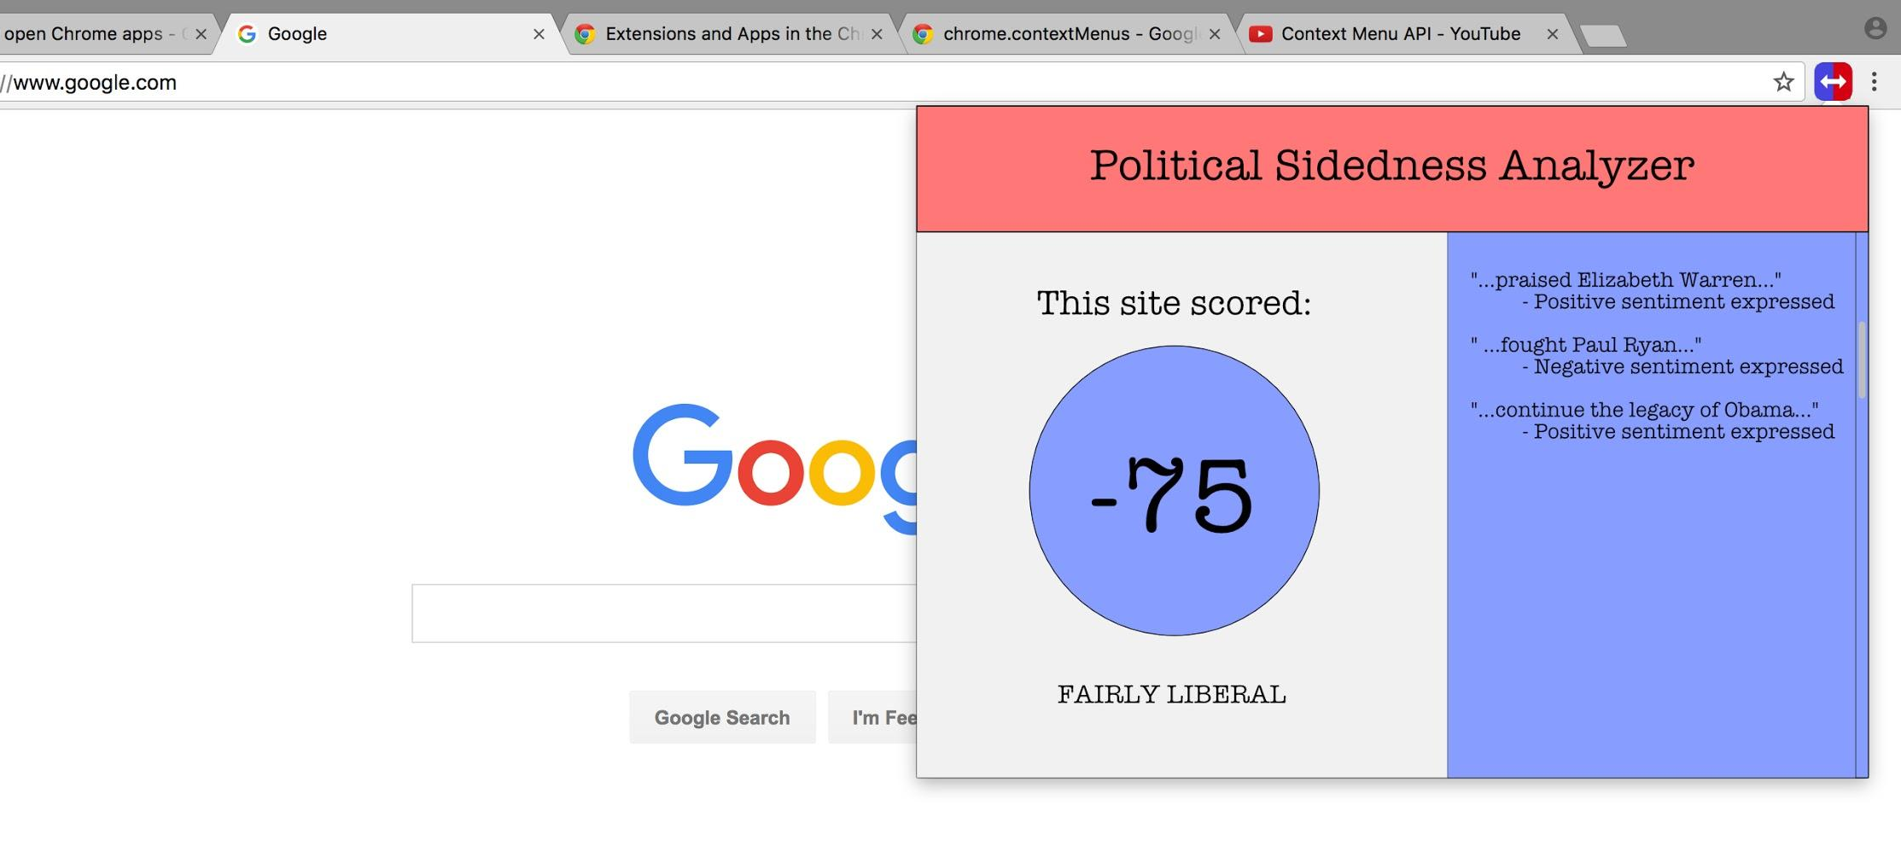
The Vision

Slide 4
Components of the Project
Data Collection (Stage A)
Data Scraping/Word Parsing Functions
Data Analysis (Stage B)
Readability Analysis - Flesch Kincaid Readability Test
Sentiment Analysis - Natural Language Processing Package e.g. Sentiment
Pattern Analysis
Data Presentation (Stage C)
Constructing Chrome Extension/Graphic Designs
Results Presentation/Display Functions

Slide 5
Proposed Sources of Data
Any Politics-Related News Article
Data Sources on Political Leaning Scale
DW-NOMINATE left-right scores for recent members of Congress.
Vote Smart
For other political figures, using a mix of scores by political measurement groups

Slide 6
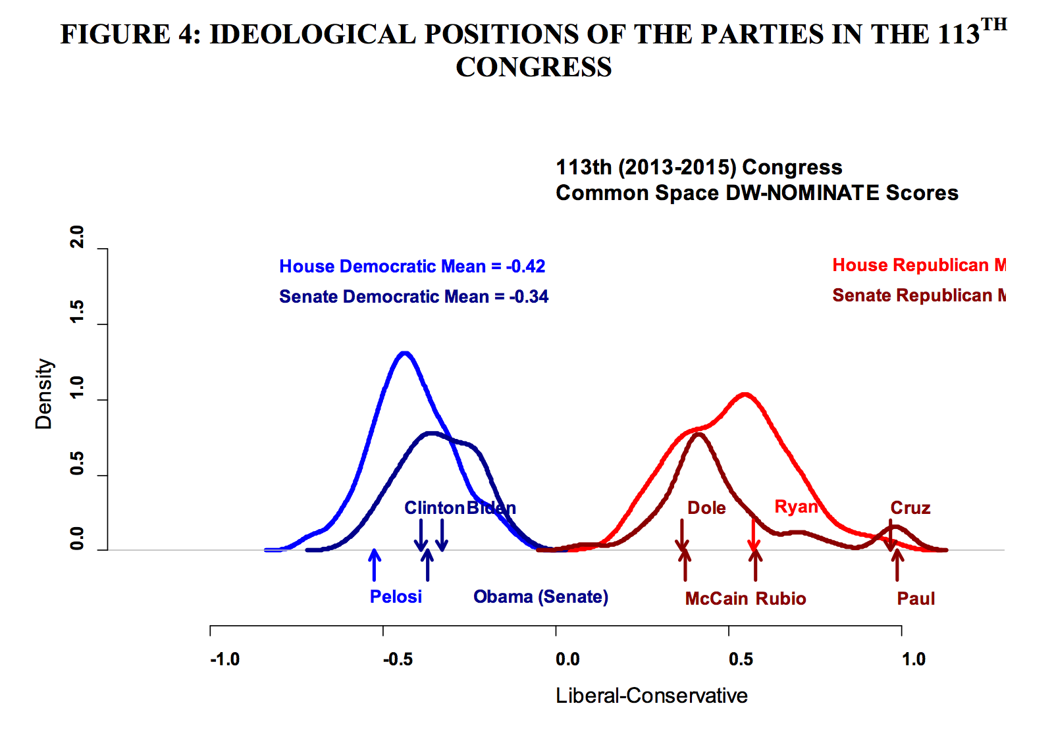
DW-NOMINATE
IDEOLOGICAL POSITIONS OF THE PARTIES IN THE 113TH CONGRESS
(MEASURED BY DW-NOMINATE)

Slide 7
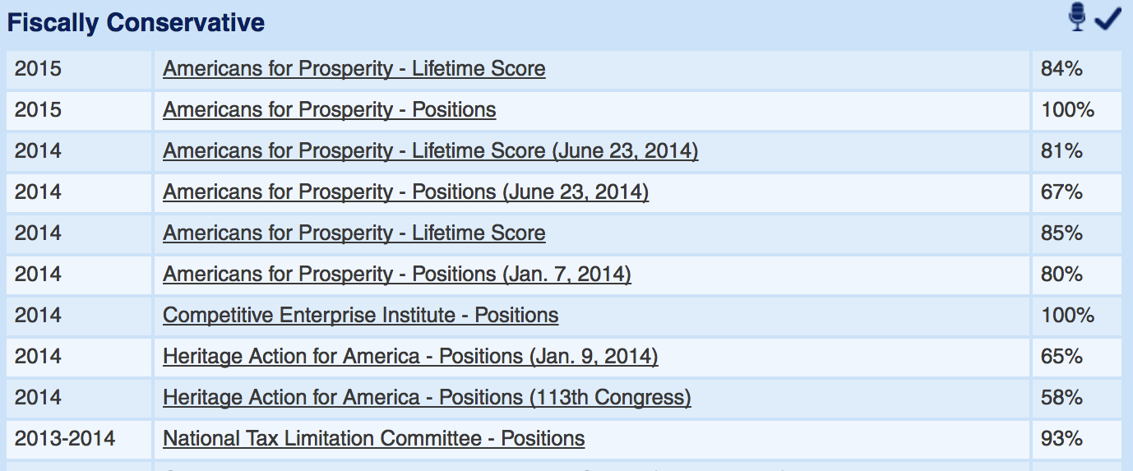
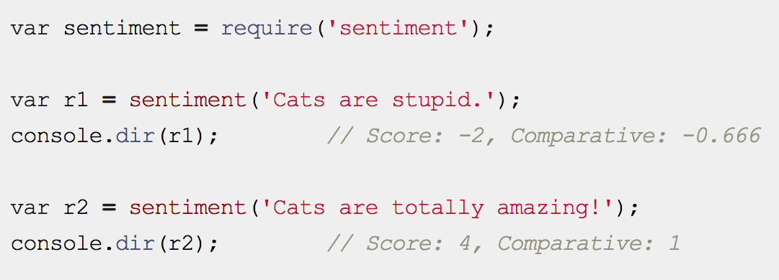
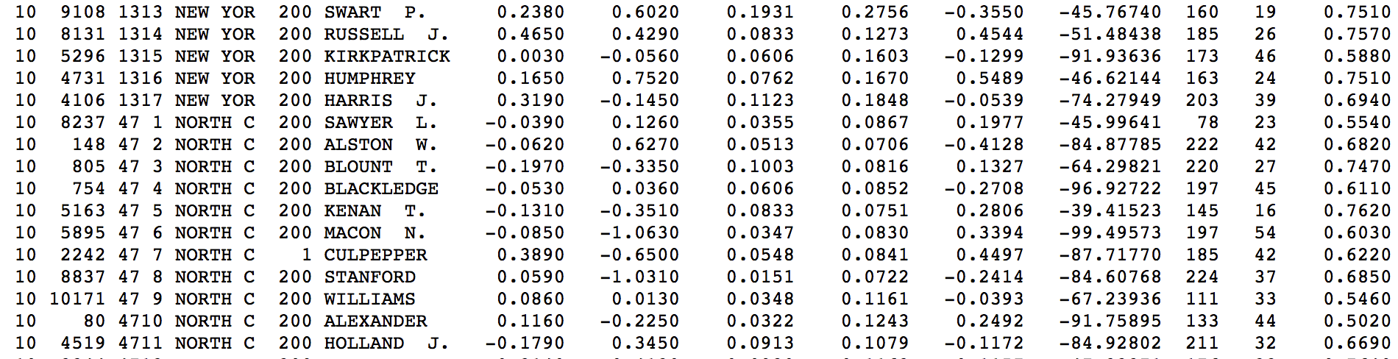
Data and Sample Code

Slide 8
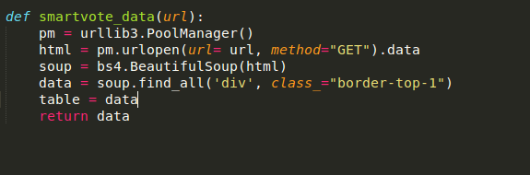
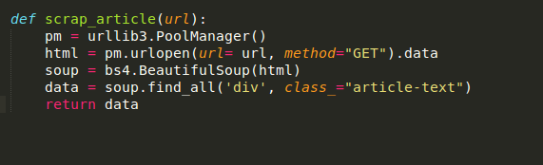
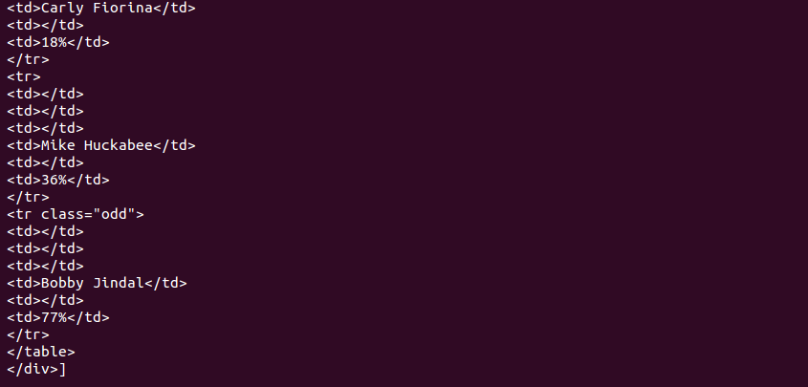
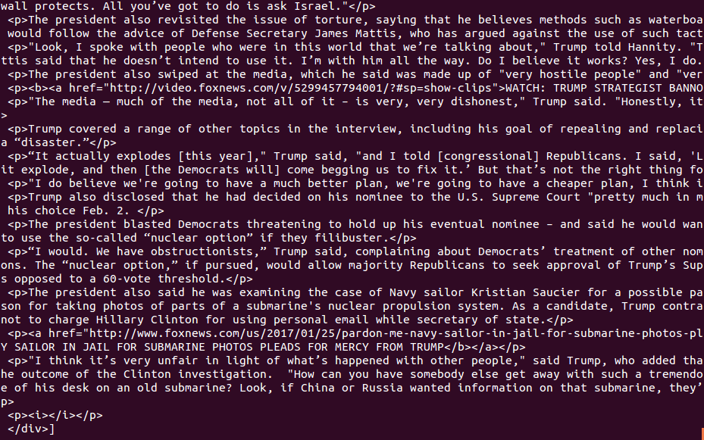
Data and Sample Code

Slide 9
Timeline
Week 5: Build Data Scraping/Parsing Tools (A)
Week 6: Construct Data/Data Analysis Tools (A & B)
Week 7: Data Analysis Tools/Begin Working on Chrome Extension (B & C)
Week 8: Finalize Analysis Tools/Continue Working on Extension (B & C)
Week 9: Product Finished, Testing, and Refining (C)
Week 10: Debugging & Refining

Slide 10
Questions?

