Slide 1
NDIS Cost Growth, Policy Options & Fiscal Risk
How do participant growth, average plan costs, and policy levers affect the long-term fiscal sustainability of the NDIS under alternative scenarios?

Slide 2
Must Show
Long-term projections
Cost drivers & decomposition
Scenario & risk analysis
Policy advice framing
Awareness of data limitations

Slide 3
Data
NDIS quarterly reports (participants, plan costs)
NDIA annual reports
ABS population projections
Commonwealth Budget papers (NDIS expenditure totals)
Optional:
AIHW disability prevalence
Productivity commission NDIS review (for assumptions)

Slide 4
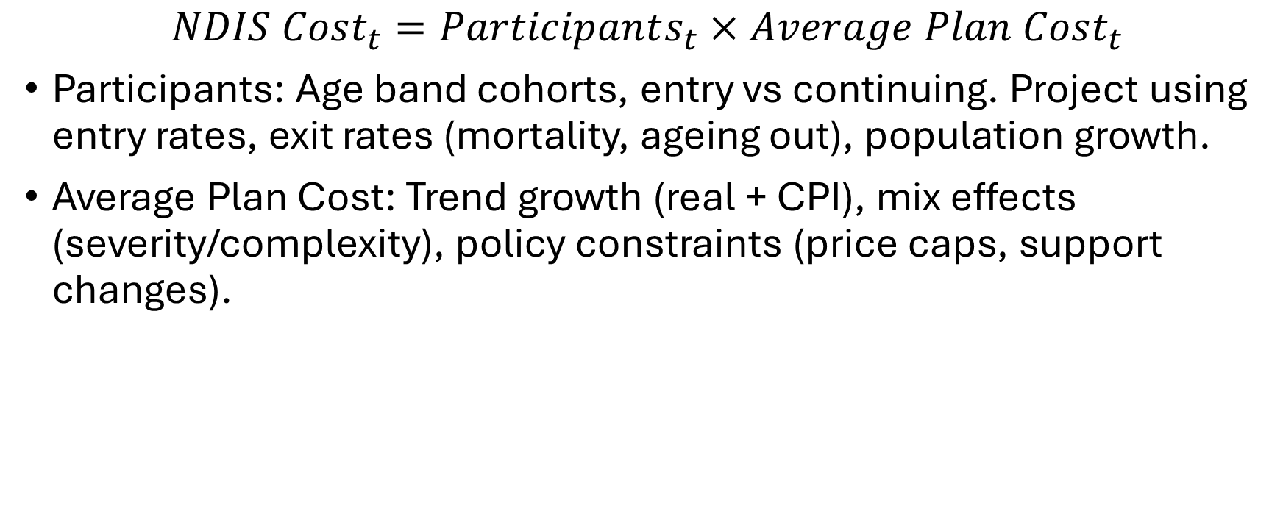
Model Structure
$$NDIS Cost_{t}=Participants_{t}×Average Plan Cost_{t}$$
Participants: Age band cohorts, entry vs continuing. Project using entry rates, exit rates (mortality, ageing out), population growth.
Average Plan Cost: Trend growth (real + CPI), mix effects (severity/complexity), policy constraints (price caps, support changes).

Slide 5
Scenarios
Status Quo: Current growth rates continue. No major policy changes.
Moderate Reform: Slow growth in average plan costs, tighter eligibility or reassessment.
High-Pressure: Higher entry rates, greater service utilization.
Adverse: Economic downturn + higher demand, failure to slow cost growth.

Slide 6
Risk/Uncertainty
Do one of:
Monte-Carlo.
Sensitivity tornado chart
Long-term cost distributions.
Which assumptions drive most risk? Controllable variables?

Slide 7
Framing
Convert findings into things like:
Annual expenditure
Cumulative 10-20 year costs
Cost as % of GDP or spending

