Slide 1
NRL Predictive Classification Model
Uses Bayesian Statistics and Machine Learning to predict NRL match outcomes using historical statistics and odds data

Slide 2
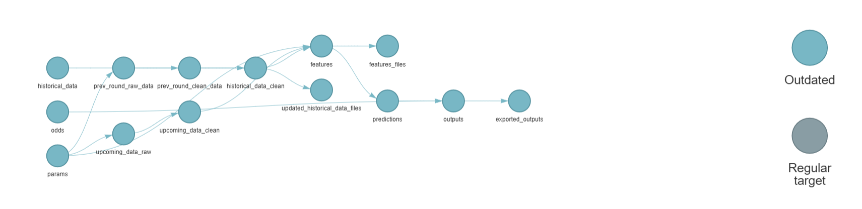
The Pipeline

Slide 3
Next
Add in more features:
If can pull, add in injury feature (along with lineups)
Weather if possible (can make better teams worse)
Uncertainty features (not just rolling means but rolling variance)
Position descriptions (outside backs, spine, forwards, bench)
Differentials
Use Brier with Logloss for tuning
Plot calibration curves to analyse where model is uncalibrated
Calibrate XGBoost probabilities or use hybrid calibrator
Found that Hybrid Calibration (using outcomes + odds), was best
Integrate into current pipeline (fetch current sharpest odds come Tuesday, use for calibration of model outputs)
Or, do not use (as it overpowers my model), and will not be used for betting anyways

Slide 4
High Level Plan
Gather Data:
nrlR package (player level stats, team level stats, ladder position, etc)
Odds data (as many bookies as possible)
Feature Engineering:
Head-2-heads, differentials?
Convert player level data into impacts (bayes)
Build ELO model and combine with ladder for team strengths
Fit underlying Bayes model for points for and against
Calibrate Bayes Model with ML algorithm, tuned for logloss.
Fit logistic regression with bookie odds
Backtest for CLV, ROI, logloss difference
Backtest probability of ruin, Monte Carlo simulations

Slide 5
Analysis and Historical Gathering
Fetch raw data, create csv’s (script)
EDA (script)
Feature engineering (script)
Bayes and ML model training and selection (script)
Create model predictions csv’s (script)
Model analysis via backtesting (script)

Slide 6
Production Pipeline
Append previous round results to raw data csv’s
Fetch upcoming round fixtures/data
Run through modelling pipeline:
Feature engineering
Model predictions
Append new predictions to predictions csv
Append new odds to odds csv
Append new bets to bets csv
Import into Power BI for model analysis

Slide 7
Key Metrics
Logloss (assess model probability calibration to real outcomes) – model training metric.
CLV (assess model probabilities vs closing lines) – edge detection metric.

Slide 8
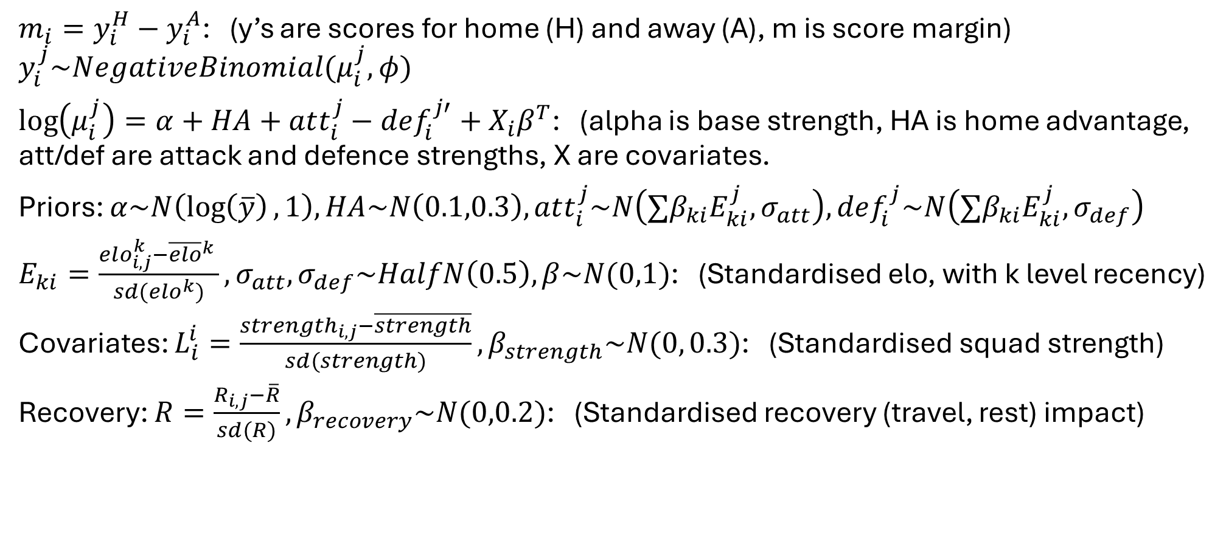
Bayesian Base Model
$m_{i}=y_{i}^{H}−y_{i}^{A}$: (y’s are scores for home (H) and away (A), m is score margin)
$$y_{i}^{j}\sim NegativeBinomial(μ_{i}^{j},φ)$$
$\log\left(μ_{i}^{j}\right)=α+HA+att_{i}^{j}−def_{i}^{j′}+X_{i}β^{T}$: (alpha is base strength, HA is home advantage, att/def are attack and defence strengths, X are covariates.
Priors: $α\sim N\left(\log\left(\overline{y}\right),1\right), HA\sim N\left(0.1,0.3\right), att_{i}^{j}\sim N\left(∑β_{ki}E_{ki}^{j}, σ_{att}\right),def_{i}^{j}\sim N\left(∑β_{ki}E_{ki}^{j}, σ_{def}\right)$
$E_{ki}=\frac{elo_{i,j}^{k}−{\overline{elo}}^{k} }{sd(elo^{k})},σ_{att},σ_{def}\sim HalfN\left(0.5\right),β\sim N(0,1)$: (Standardised elo, with k level recency)
Covariates: $L_{i}^{i}=\frac{strength_{i,j}−\overline{strength}}{sd(strength)}, β_{strength}\sim N(0, 0.3)$: (Standardised squad strength)
Recovery: $R=\frac{R_{i,j}−\overline{R}}{sd(R)}, β_{recovery}\sim N(0,0.2)$: (Standardised recovery (travel, rest) impact)

Slide 9
Deriving Squad Strengths
Attacking Channels:
Running: (run_metres, post_contact_metres,tackle_breaks,line_breaks, offloads)/runs
Play-Making: (try_assists, line_break_assists, kicks_general_play, passes)/possession, kick_metres/kicks_general_play, goal_kick_ratio
Overall: tries/game, errors/possession
Defensive Channels:
Work: tackles/time_weighting, try_saves/game
Discipline: (missed_tackles, penalties_conceded, tackles_ineffective)/tackles

