Slide 1
NRL Predictive Classification Model
Uses Bayesian Statistics and Machine Learning to predict NRL match outcomes using historical statistics and odds data

Slide 2
High Level Plan
Gather Data:
nrlR package (player level stats, team level stats, ladder position, etc)
Odds data (as many bookies as possible)
Feature Engineering:
Head-2-heads, differentials?
Convert player level data into impacts (bayes)
Build ELO model and combine with ladder for team strengths
Fit underlying Bayes model for points for and against
Calibrate Bayes Model with ML algorithm, tuned for logloss.
Fit logistic regression with bookie odds
Backtest for CLV, ROI, logloss difference
Backtest probability of ruin, Monte Carlo simulations

Slide 3
Analysis Pipeline
Fetch raw data, create csv’s (script)
EDA (script)
Feature engineering (script)
Bayes and ML model training and selection (script)
Create model predictions csv’s (script)
Model analysis via backtesting (script)

Slide 4
Production Pipeline
Append previous round results to raw data csv’s
Fetch upcoming round fixtures/data
Run through modelling pipeline:
Feature engineering
Model predictions
Append new predictions to predictions csv’s
Run through model analysis pipeline.

Slide 5
Key Metrics
Logloss (assess model probability calibration to real outcomes)
Brier (assess model probability calibration to real outcomes)
CLV (assess model probabilities vs closing lines)

Slide 6
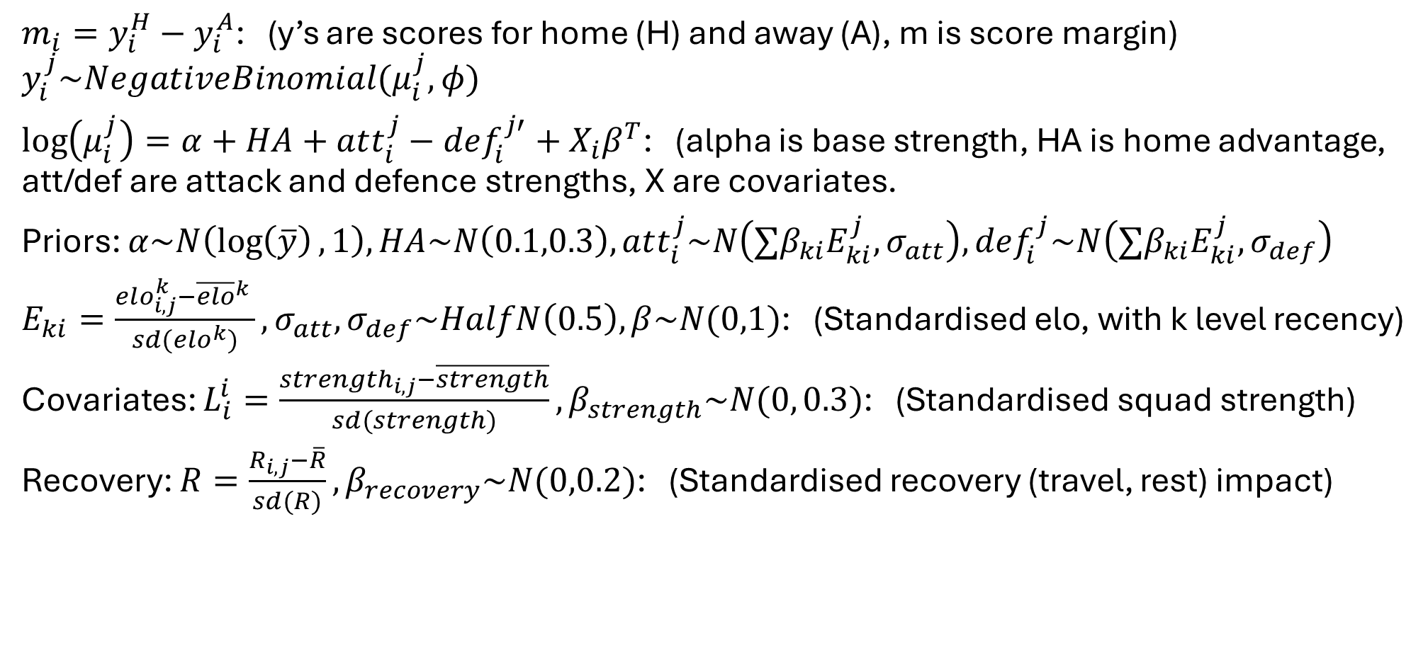
Bayesian Base Model
$m_{i}=y_{i}^{H}−y_{i}^{A}$: (y’s are scores for home (H) and away (A), m is score margin)
$$y_{i}^{j}\sim NegativeBinomial(μ_{i}^{j},φ)$$
$\log\left(μ_{i}^{j}\right)=α+HA+att_{i}^{j}−def_{i}^{j′}+X_{i}β^{T}$: (alpha is base strength, HA is home advantage, att/def are attack and defence strengths, X are covariates.
Priors: $α\sim N\left(\log\left(\overline{y}\right),1\right), HA\sim N\left(0.1,0.3\right), att_{i}^{j}\sim N\left(∑β_{ki}E_{ki}^{j}, σ_{att}\right),def_{i}^{j}\sim N\left(∑β_{ki}E_{ki}^{j}, σ_{def}\right)$
$E_{ki}=\frac{elo_{i,j}^{k}−{\overline{elo}}^{k} }{sd(elo^{k})},σ_{att},σ_{def}\sim HalfN\left(0.5\right),β\sim N(0,1)$: (Standardised elo, with k level recency)
Covariates: $L_{i}^{i}=\frac{strength_{i,j}−\overline{strength}}{sd(strength)}, β_{strength}\sim N(0, 0.3)$: (Standardised squad strength)
Recovery: $R=\frac{R_{i,j}−\overline{R}}{sd(R)}, β_{recovery}\sim N(0,0.2)$: (Standardised recovery (travel, rest) impact)

Slide 7
Deriving Squad Strengths
Attacking Channels:
Running: (run_metres, post_contact_metres,tackle_breaks,line_breaks, offloads)/runs
Play-Making: (try_assists, line_break_assists, kicks_general_play, passes)/possession, kick_metres/kicks_general_play, goal_kick_ratio
Overall: tries/game, errors/possession
Defensive Channels:
Work: tackles/time_weighting, try_saves/game
Discipline: (missed_tackles, penalties_conceded, tackles_ineffective)/tackles

