Slide 1
AUSTRALIA
Jack Gregory
Economist & Data Scientist
Composite Indicator Research Section, WIPO

Slide 2
Instructions

Slide 3
Notes
This document is a sample Quarto pptx.
It includes all the material from the GII briefs unedited:
  The preamble is uncommented and runs prior to the “Instructions” section; while,
  The body is partially commented and appears after the “Example Slides” section below.
The remainder of this section:
  Provides some references; and,
  Describes some useful officer functions in relation to the template.

Slide 4
References
Knitting Quarto (or Rmarkdown) into MS PowerPoint can be quite idiosyncratic.
Be prepared for unexpected behaviours and the need to edit your work post-compiling.
Prior to editing the Qmd file, I would highly recommend consulting the following Quarto references:
  Quarto PowerPoint User Guide
  Quarto PowerPoint Options
Some references on Rmd and pptx are listed below:
  Up and running with officedown
  Officeverse GitBook, in particular: PowerPoint presentation properties; and, Officer for PowerPoint
  Officedown Website

Slide 5
Some useful officer functions
officer::layout_summary
  This function outputs a dataframe of the constituent slides within the pptx template master.
  The master can be accessed by opening the template in MS PowerPoint and selecting View $→$ Slide Master
layout | master
Title Slide | Office Theme
Title and Vertical Text | Office Theme
Vertical Title and Text | Office Theme
Title and Content | Office Theme
Section Header | Office Theme
Two Content | Office Theme
Comparison | Office Theme
Title Only | Office Theme
Blank | Office Theme
Content with Caption | Office Theme
Picture with Caption | Office Theme

Slide 6
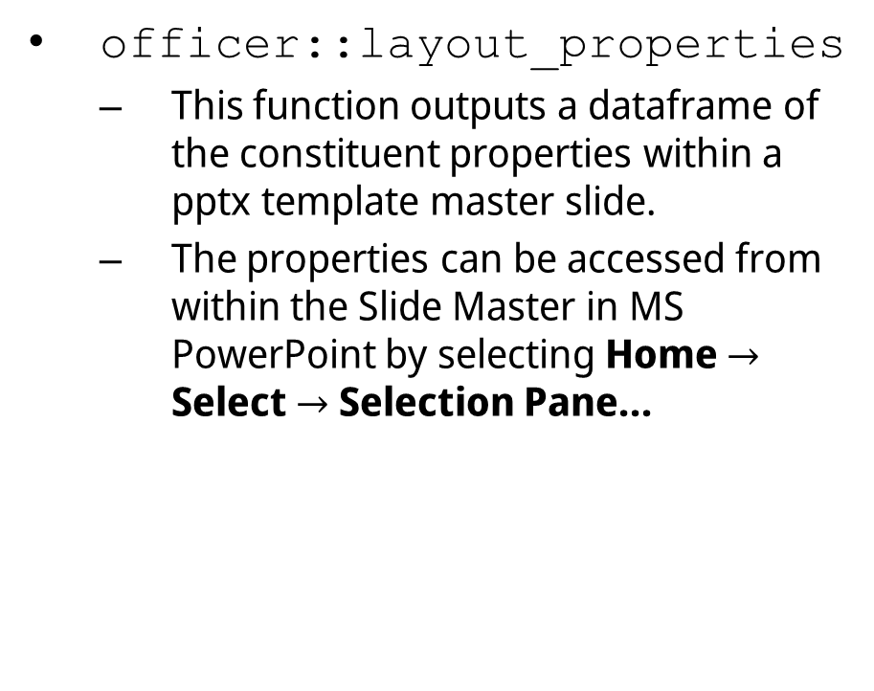
officer::layout_properties
  This function outputs a dataframe of the constituent properties within a pptx template master slide.
  The properties can be accessed from within the Slide Master in MS PowerPoint by selecting Home $→$ Select $→$ Selection Pane…
 | master_name | name | type | id | ph_label
1 | Office Theme | Two Content | body | 4 | Content Placeholder 3
2 | Office Theme | Two Content | body | 3 | Content Placeholder 2
16 | Office Theme | Two Content | ftr | 6 | Footer Placeholder 5
23 | Office Theme | Two Content | sldNum | 7 | Slide Number Placeholder 6
33 | Office Theme | Two Content | title | 2 | Title 1

Slide 7
Example Slides

Slide 8
Title and Content
The “Title Slide” is set using the information in the yaml header.
The preceding was a “Section Header” slide set with a “# …”.
This is a “Title and Content” slide containing a bullet list.
The following is a “Title and Content” slide containing a plot.
NB – Throughout this section, you can confirm the slide layout by selecting Home $→$ Layout in PowerPoint. Moreover, all slide types are included in the speakers notes.
Notes:
This is a “Title and Content” slide with a bullet list.

Slide 9
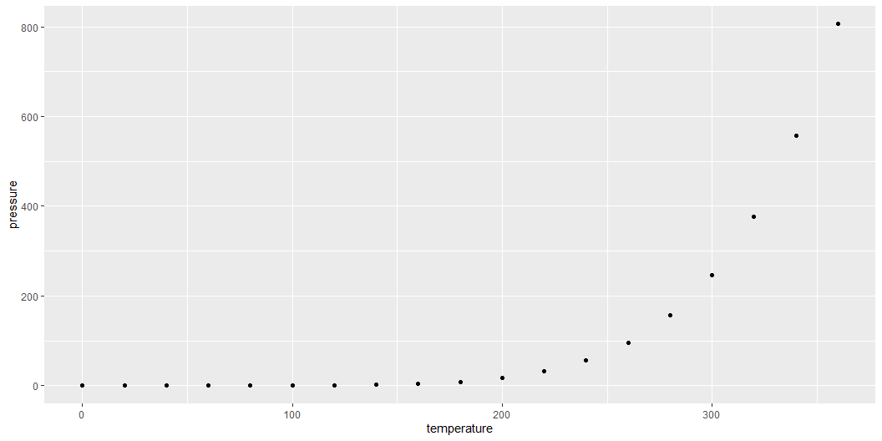
Title and Content
Notes:
This is a “Title and Content” slide with a plot.

Slide 10
Notes:
This is a “Blank” slide.

Slide 11
Two Content
This is a “Two Content” slide.
It requires a pandoc column layout.
The following is a “Comparison” slide.
It requires a pandoc column layout and mixed input in the columns.
Notes:
This is a “Two Content” slide.

Slide 12
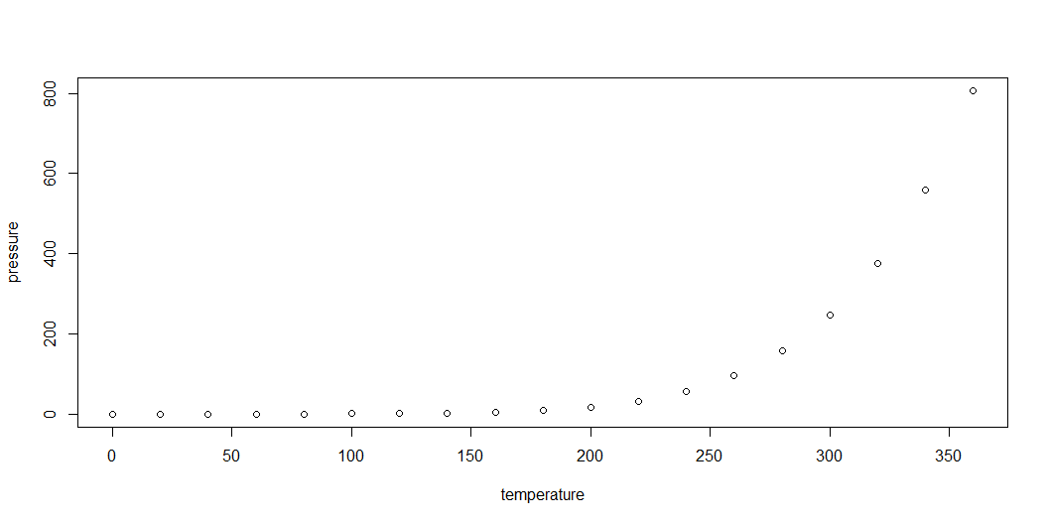
Comparison
plot
ggplot
Notes:
This is a “Comparison” slide.

Slide 13
Content with Caption
Under pressure
This is a “Content with Caption” slide.
Notes:
This is a “Content with Caption” slide.

Slide 14

Background Image
This is not a slide layout.
Rather, it is a “Title and Content” slide with a background.
Notes:
This is a “Title and Content” slide with a background image. It is not a distinct slide layout.

Slide 15
Important Note
Quarto and pandoc only recognize the slide layouts above.
This is clear from how the previous “Background Image” slide renders.
If you desire additional layouts, you can:
  Add them to the pptx template using in the Master View;
  Given them each a unique name; and,
  After rendering, change to new layout manually for each slide within PowerPoint.

Slide 16
GII Brief Code

Slide 17
This section is mostly commented out
To build the presentation:
  Uncomment the desired sections from the economy briefs below; and,
  Edit the uncommented code and content such that it renders properly within a pptx.
An example slide for the bubble plot is provided below.

Slide 18
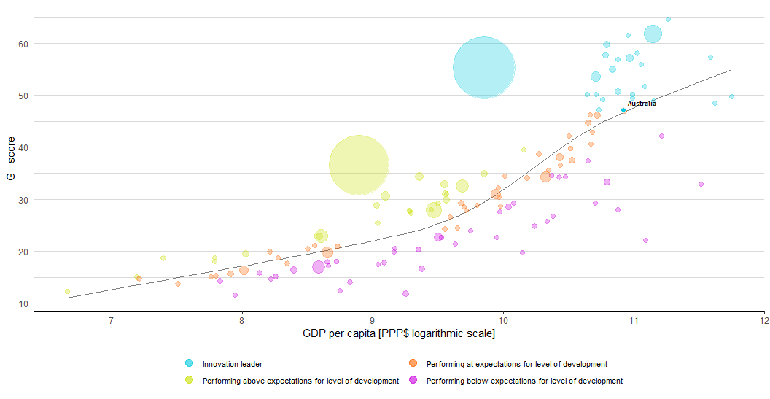
EXPECTED VS. OBSERVED INNOVATION PERFORMANCE
The bubble chart below shows the relationship between income levels (GDP per capita) and innovation performance (GII score). The trend line gives an indication of the expected innovation performance according to income level. Economies appearing above the trend line are performing better than expected and those below are performing below expectations.
Relative to GDP, Australia’s performance is above expectations for its level of development.

