Slide 1

STIMS
Smart Tagged Inventory Management System
Jack Margeson

Slide 2
Outline
01
02
03
04
05
06
Team Introduction
Project Abstract
User Stories & Design Diagrams
Project Constraints
Progress Reports
Demonstration Expectations

Slide 3

Team Introduction
Jack Margeson
Project Advisor
5th year Computer Science
e: margesji@mail.uc.edu
p: 513-615-0468
l: linkedin.com/in/jack-margeson/
w: marg.es/on
Dr. William Hawkins III CEAS Computer Science
e: hawkinwh@ucmail.uc.edu

Slide 4
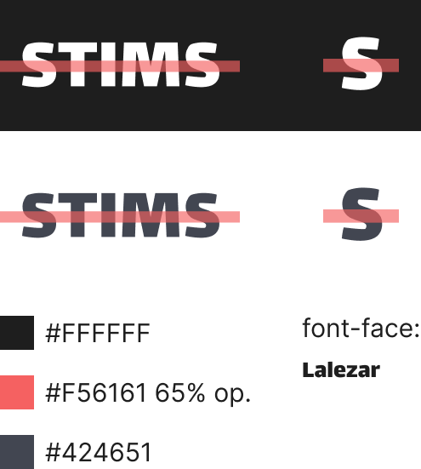
Project Abstract
STIMS, the Smart Tagged Inventory Management System is a database driven storage catalog capable of adding and tracking any combination of real world items. This multi-modal storage paradigm is achieved through the use of many tagging systems, in comparison to other inventory databases using simply one for a specific type of physical media.
The goal of STIMS is to provide database administrators with the tools to easily catalog new items and even create new object types for tracking, while providing a streamlined search and recall dashboard for end-users to facilitate inventory check-in and check-out operations while maintaining database security throughout the whole process.

Slide 5
Purpose and Goals
Usability
Users don’t interact with the database system directly
Database admins can add new items from the GUI app
User onboarding process is quick and automated
Simplicity
Easy to understand GUI web application
Utilizes Docker to facilitate easy set-up by database admins
Works on any device capable of displaying web content
Customizability
Account system allows for options and saved queries
New item types (classes) can be added by administrators
Item filters and sorting allow for dashboard modification

Slide 6
User Stories
General
User #01
As a general user, I want to be able to search and check in/out items from the inventory so that I can easily keep track of my transactions and maintain accurate stock records.
Database Admin. #01
As a database administrator, I want to be able to create new item types in the inventory database so that I can accurately categorize and track a wide range of items.
Database Admin. #02
As a database administrator, I want to be able to assign different tagging systems to item entries so that I can easily retrieve and identify items using various identification methods (such as ISBN, NFC, RFID, etc.).

Slide 7
Project Constraints
Economic
Constraint: physical hardware needed for tagging system, $$$
Proposed solution: options for logging items without extra hardware (generating serial numbers and physically marking for future recall)
Legal
Constraint: taking images for items online results in licensing issues
Proposed solution: have database administrators take pictures of items that they want to add, provide easy way for attaching photos
Security
Constraint: database needs to be properly handled to secure data
Proposed solution: separate user roles for database administrators and end-users to prevent accidental/malicious actions on data

Slide 8
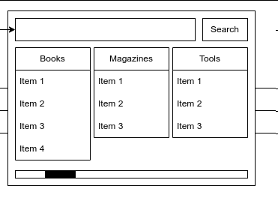
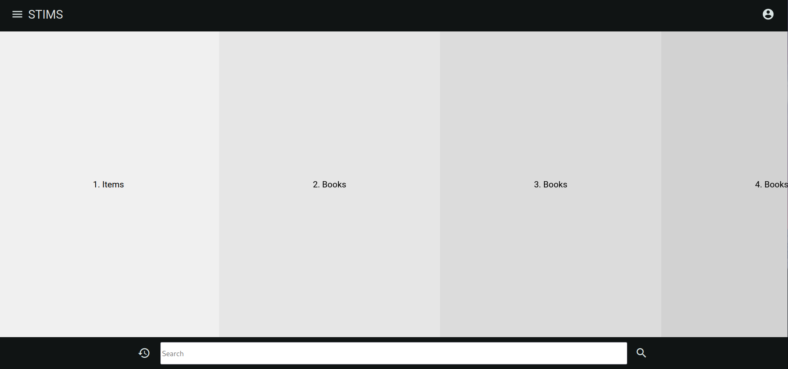
Progress Report
Currently, a rough UI design has been created for the “dashboard”, where users will be able to see and search for items in the database. This dashboard has been drafted in Angular, a TypeScript web framework.
As for the backend, I have also completed a Docker container that will create an instance of MariaDB (flavor of MySQL) that runs on a persistent data volume for storage.
The next big step in the project is to create some sort of middleware with Express to allow our frontend to make API calls to the MariaDB backend for processing and querying data.

Slide 9
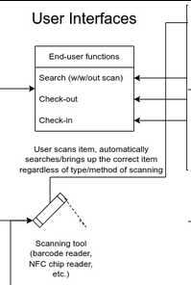
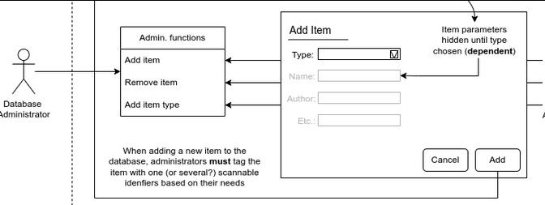
Expected Progress by December, 2024
By the end of the Fall 2024 semester, I plan to be done with the rough UI as well as have a database system in place with the ability to accept queries from the frontend.
Most of the work regarding implementing different scanning technology will be left for the Spring 2025 semester, as well as any improvements to the frontend design.

Slide 10
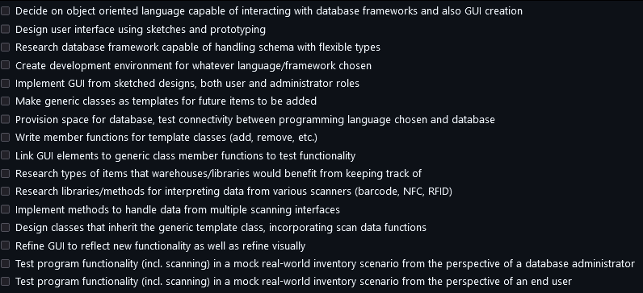
Division of Work
STIMS is a solo endeavor, and therefore, all work for the project will be completed by myself, Jack Margeson. I will be responsible for the entirety of the work outlined in this presentation.
A list of planned project goals/work units (pictured here) is available on the project’s GitHub repository.

Slide 11
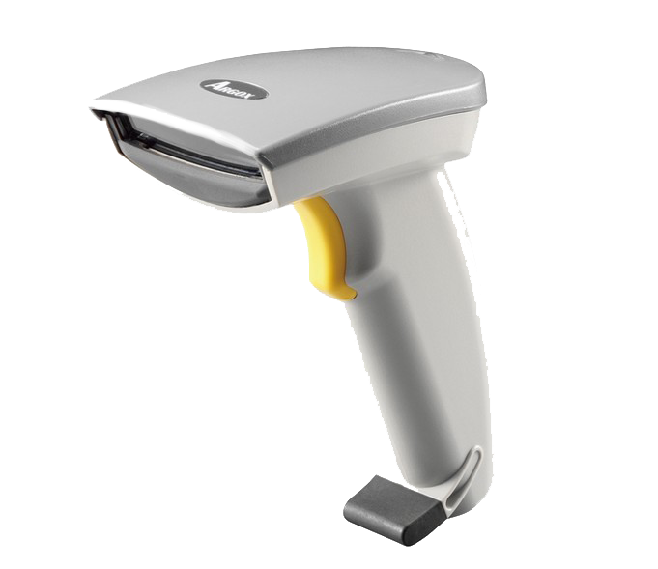
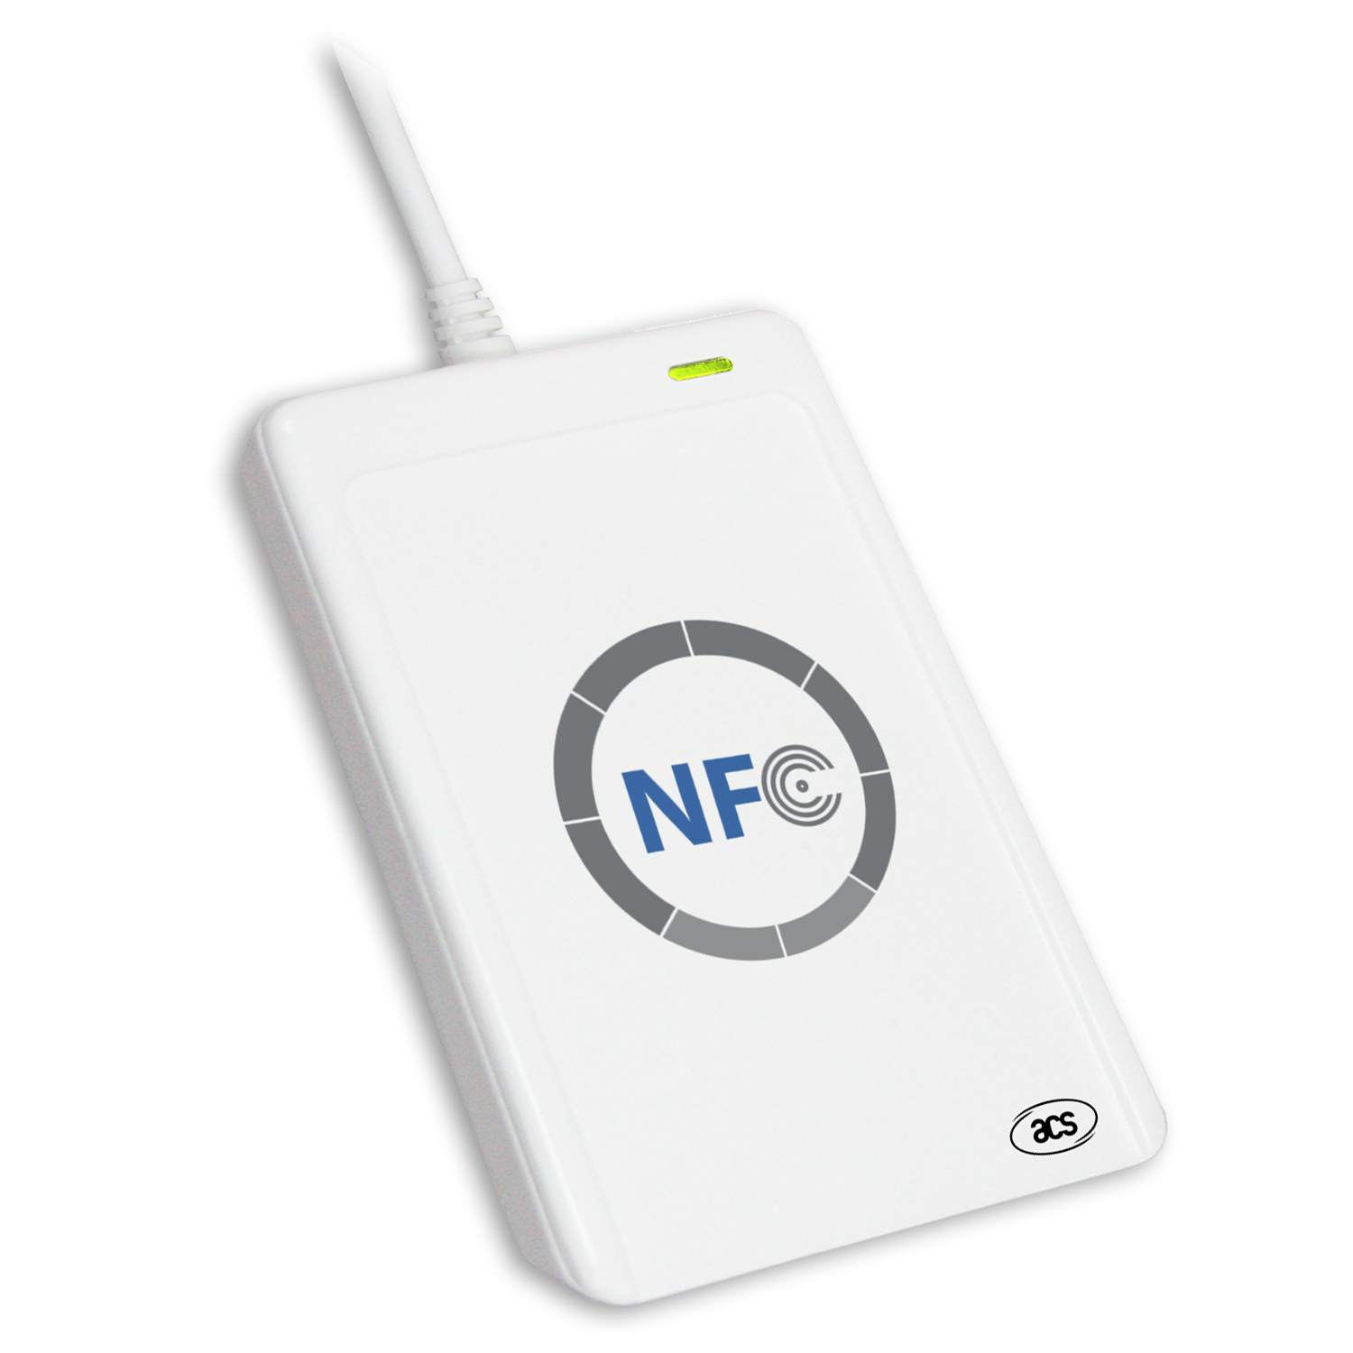
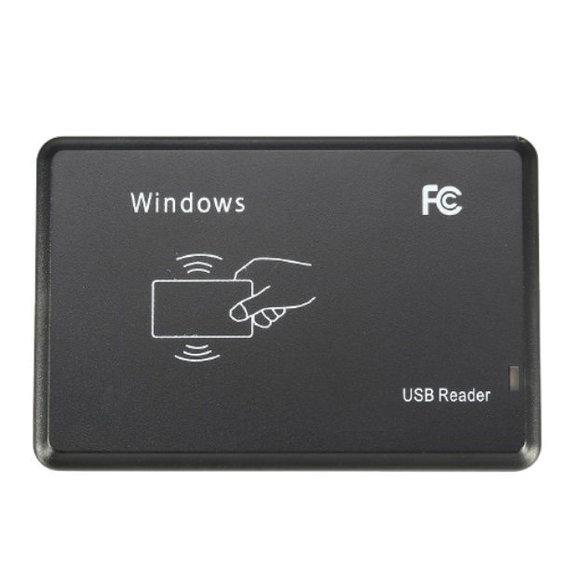
Demonstration Expectations
For the demonstration showcase at the end of the project, I’d like to bring a few different items tagged with different media (ISBN barcode, NFC tag, RFID, etc) and show off how the system can easily catalogue and handle these items.
I’d also like to show how account management works and what the GUI looks like for a generic end-user vs a database administrator.
I think a fun idea would be to have a label-maker with a barcode generator to give fairgoers a nametag that could be scanned into the system for demonstration purposes.

