Slide 1
Neural Network Questions
Provider: 王瑞評 (Jack)

Slide 2
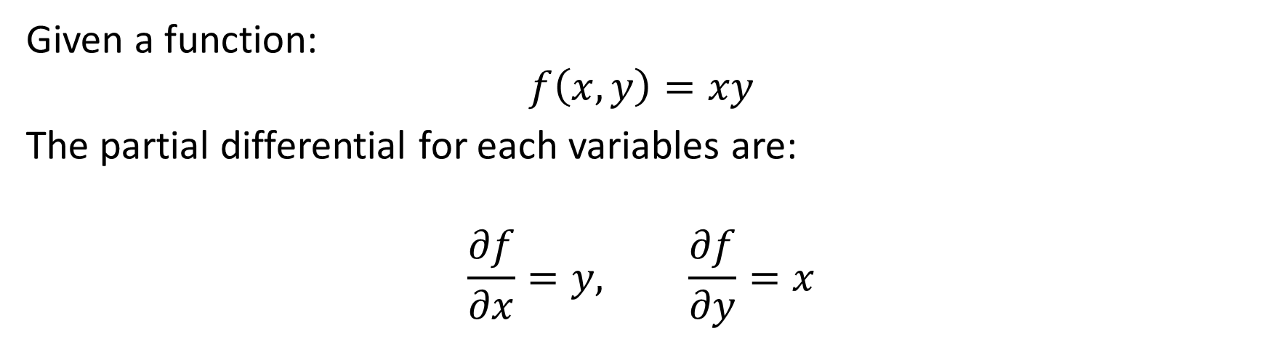
Introduction 1
Given a function:
$$f\left(x,y\right)=xy$$
The partial differential for each variables are:
$$\frac{∂f}{∂x}=y, \frac{∂f}{∂y}=x$$

Slide 3

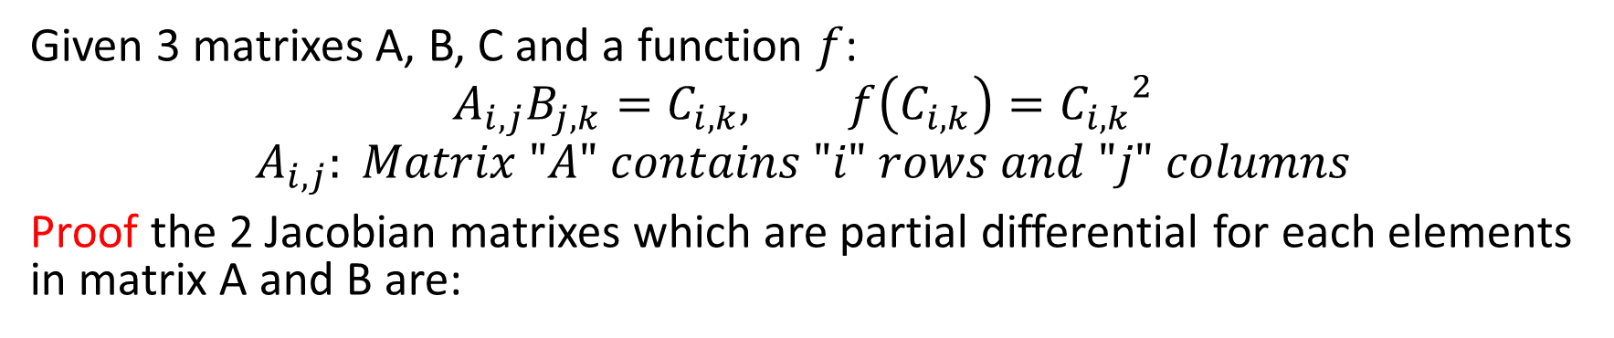
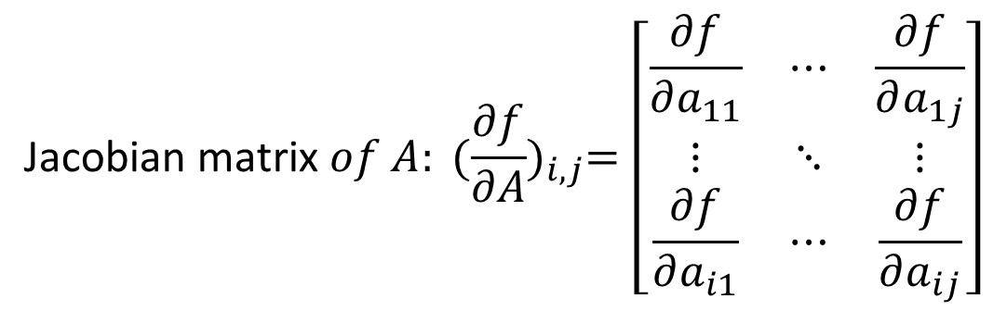
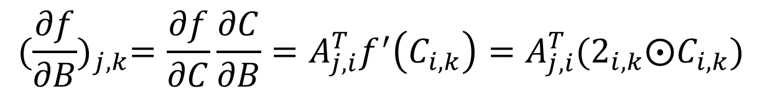
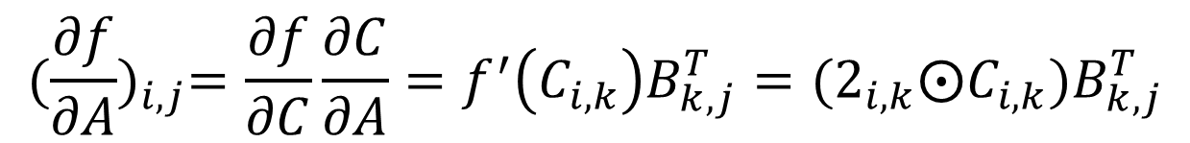
Question 1: $\text{Jacobian} \text{matrix}$
Given 3 matrixes A, B, C and a function $f$:
$$A_{i,j}B_{j,k}=C_{i,k}, f\left(C_{i,k}\right)={C_{i,k}}^{2}$$
$$A_{i,j}: Matrix "A" contains "i" rows and "j" columns$$
Proof the 2 Jacobian matrixes which are partial differential for each elements in matrix A and B are:
$$\text{Jacobian} \text{matrix} of A: {(\frac{∂f}{∂A})}_{i,j}=\left[\begin{matrix}\frac{∂f}{∂a_{11}} & ⋯ & \frac{∂f}{∂a_{1j}} \\ ⋮ & ⋱ & ⋮ \\ \frac{∂f}{∂a_{i1}} & ⋯ & \frac{∂f}{∂a_{ij}}\end{matrix}\right]$$
$${(\frac{∂f}{∂A})}_{i,j}=\frac{∂f}{∂C}\frac{∂C}{∂A}=f^{′}\left(C_{i,k}\right)B_{k,j}^{T}=(2_{i,k}⨀C_{i,k})B_{k,j}^{T}$$
$${(\frac{∂f}{∂B})}_{j,k}=\frac{∂f}{∂C}\frac{∂C}{∂B}=A_{j,i}^{T}f^{′}\left(C_{i,k}\right)=A_{j,i}^{T}(2_{i,k}⨀C_{i,k})$$
* $⨀$ is element wise product for matrix

Slide 4
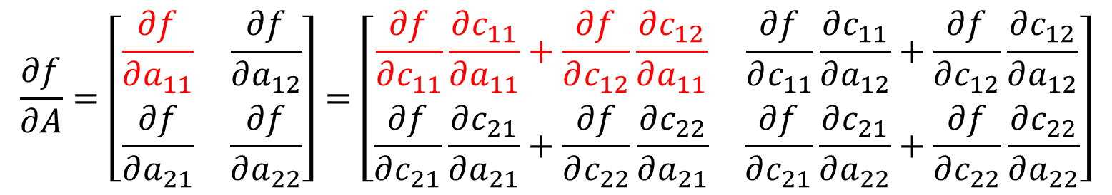
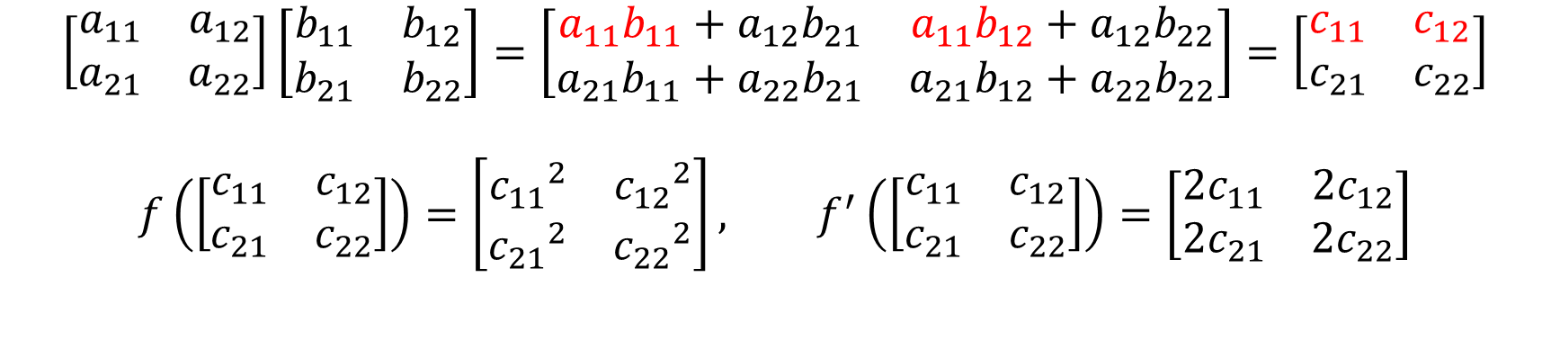
Answer 1
$$\left[\begin{matrix}a_{11} & a_{12} \\ a_{21} & a_{22}\end{matrix}\right]\left[\begin{matrix}b_{11} & b_{12} \\ b_{21} & b_{22}\end{matrix}\right]=\left[\begin{matrix}a_{11}b_{11}+a_{12}b_{21} & a_{11}b_{12}+a_{12}b_{22} \\ a_{21}b_{11}+a_{22}b_{21} & a_{21}b_{12}+a_{22}b_{22}\end{matrix}\right]=\left[\begin{matrix}c_{11} & c_{12} \\ c_{21} & c_{22}\end{matrix}\right]$$
$$f\left(\left[\begin{matrix}c_{11} & c_{12} \\ c_{21} & c_{22}\end{matrix}\right]\right)=\left[\begin{matrix}{c_{11}}^{2} & {c_{12}}^{2} \\ {c_{21}}^{2} & {c_{22}}^{2}\end{matrix}\right], f^{′}\left(\left[\begin{matrix}c_{11} & c_{12} \\ c_{21} & c_{22}\end{matrix}\right]\right)=\left[\begin{matrix}2c_{11} & 2c_{12} \\ 2c_{21} & 2c_{22}\end{matrix}\right]$$
$$\frac{∂f}{∂A}=\left[\begin{matrix}\frac{∂f}{∂a_{11}} & \frac{∂f}{∂a_{12}} \\ \frac{∂f}{∂a_{21}} & \frac{∂f}{∂a_{22}}\end{matrix}\right]=\left[\begin{matrix}\frac{∂f}{∂c_{11}}\frac{∂c_{11}}{∂a_{11}}+\frac{∂f}{∂c_{12}}\frac{∂c_{12}}{∂a_{11}} & \frac{∂f}{∂c_{11}}\frac{∂c_{11}}{∂a_{12}}+\frac{∂f}{∂c_{12}}\frac{∂c_{12}}{∂a_{12}} \\ \frac{∂f}{∂c_{21}}\frac{∂c_{21}}{∂a_{21}}+\frac{∂f}{∂c_{22}}\frac{∂c_{22}}{∂a_{21}} & \frac{∂f}{∂c_{21}}\frac{∂c_{21}}{∂a_{22}}+\frac{∂f}{∂c_{22}}\frac{∂c_{22}}{∂a_{22}}\end{matrix}\right]$$
$$=\left[\begin{matrix}\left(2c_{11}\right)b_{11}+(2c_{12})b_{12} & \left(2c_{11}\right)b_{21}+(2c_{12})b_{22} \\ \left(2c_{21}\right)b_{11}+(2c_{22})b_{12} & \left(2c_{21}\right)b_{21}+(2c_{22})b_{22}\end{matrix}\right]=(2_{i,k}⨀C_{i,k})B_{k,j}^{T}$$

Slide 5

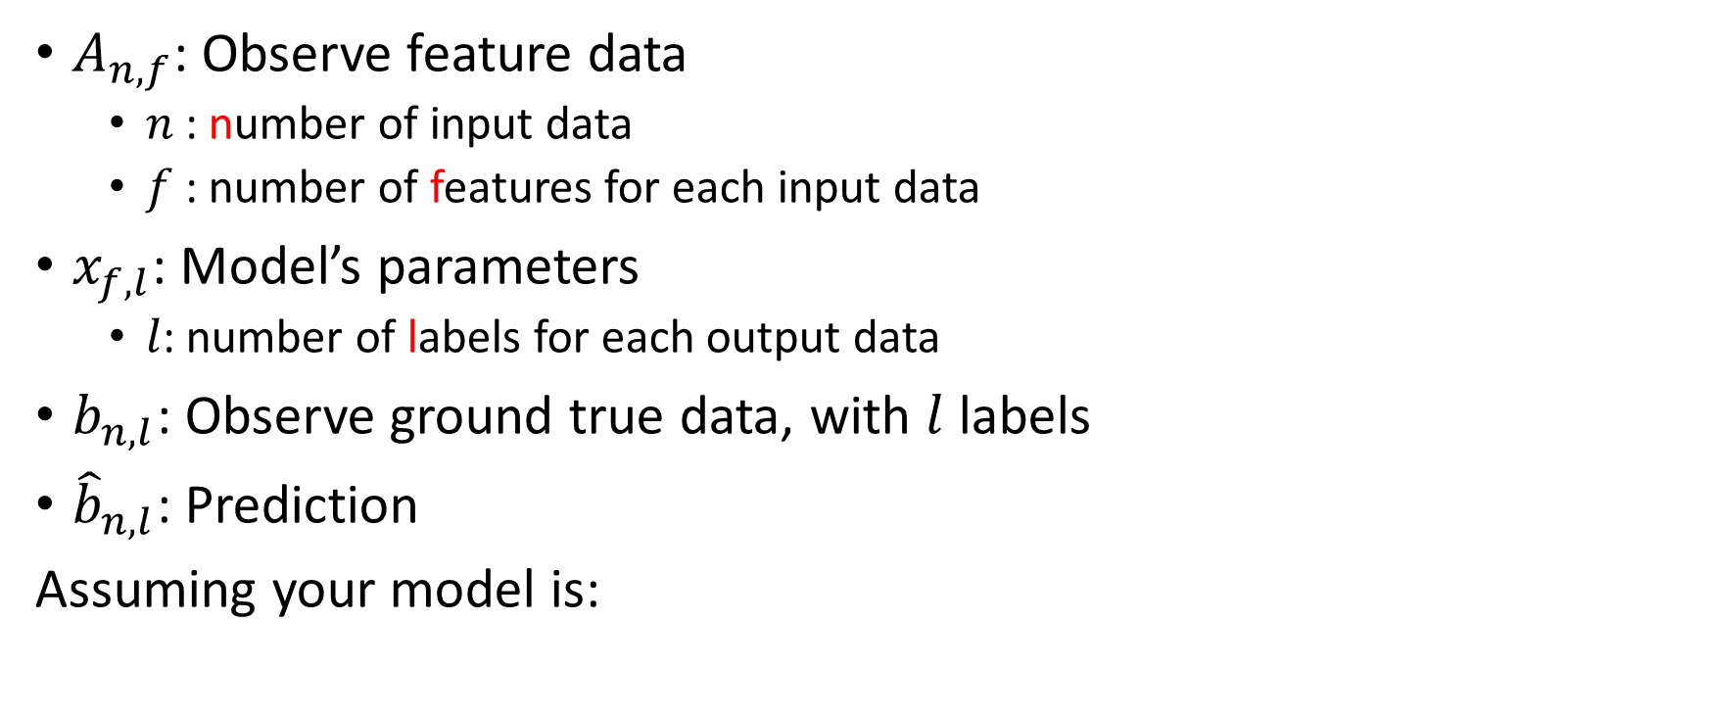

Introduction 2
$A_{n,f}$: Observe feature data
$n$: number of input data
$f$: number of features for each input data
$x_{f,l}$: Model’s parameters
$l$: number of labels for each output data
$b_{n,l}$: Observe ground true data, with $l$ labels
${\hat{b}}_{n,l}$: Prediction
Assuming your model is:
$$Ax=\hat{b}, min. \left\|Ax−b\right\|$$
You can calculate best model’s parameter $x^{∗}$ by:
$$x^{∗}={(A^{T}A)}^{−1}A^{T}b, \left\|Ax^{∗}−b\right\| is minimum$$

Slide 6
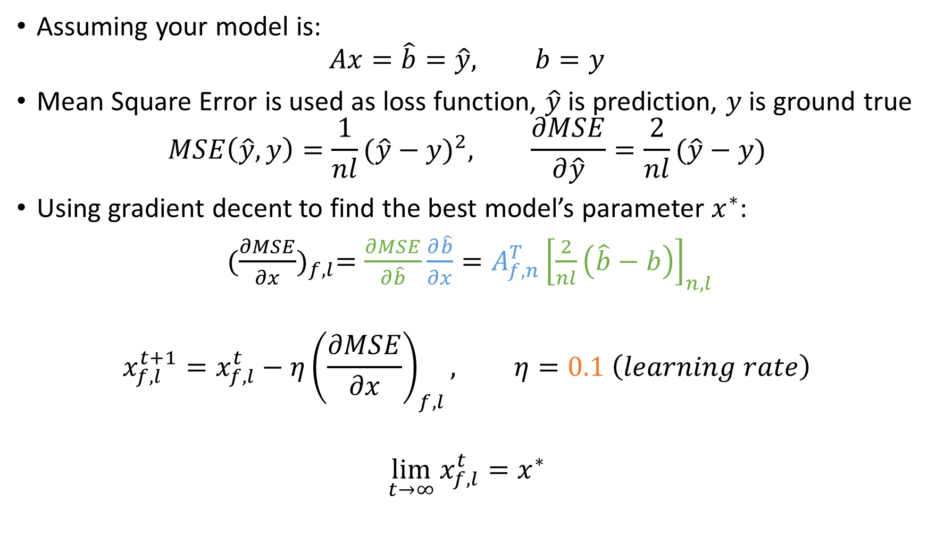
Question 2: Solve Least Square by Gradient Decent
Assuming your model is:
$$Ax=\hat{b}=\hat{y}, b=y$$
Mean Square Error is used as loss function, $\hat{y}$ is prediction, $y$ is ground true
$$MSE\left(\hat{y}, y\right)={\frac{1}{nl}(\hat{y}−y)}^{2}, \frac{∂MSE}{∂\hat{y}}=\frac{2}{nl}(\hat{y}−y)$$
Using gradient decent to find the best model’s parameter $x^{∗}$:
${(\frac{∂MSE}{∂x})}_{f,l}=\frac{∂MSE}{∂\hat{b}}\frac{∂\hat{b}}{∂x}=A_{f,n}^{T}{\left[\frac{2}{nl}\left(\hat{b}−b\right)\right]}_{n, l}$
$$x_{f,l}^{t+1}=x_{f,l}^{t}−η{\left(\frac{∂MSE}{∂x}\right)}_{f,l}, η=0.1 \left(learning rate\right)$$
$$\lim_{t→∞}{x_{f,l}^{t}}=x^{∗}$$

Slide 7
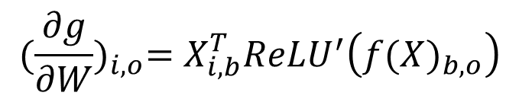
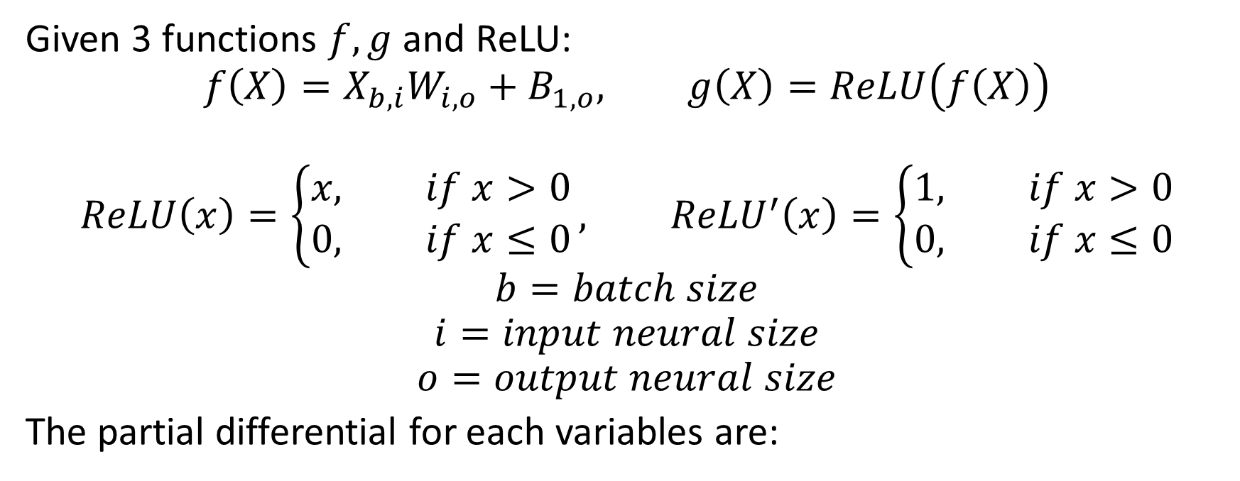

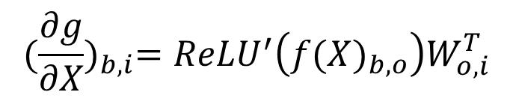
Introduction 3
Given 3 functions $f,g$ and ReLU:
$$f\left(X\right)=X_{b,i}W_{i,o}+B_{1,o}, g\left(X\right)=ReLU\left(f\left(X\right)\right)$$
$$ReLU\left(x\right)=\left\{\begin{aligned}x, if x>0 \\ 0, if x≤0\end{aligned}\right., {ReLU}^{′}\left(x\right)=\left\{\begin{aligned}1, if x>0 \\ 0, if x≤0\end{aligned}\right.$$
$$b=batch size$$
$$i=input neural size$$
$$o=output neural size$$
The partial differential for each variables are:
$${(\frac{∂g}{∂X})}_{b,i}={ReLU}^{′}\left({f(X)}_{b,o}\right)W_{o,i}^{T}$$
$${(\frac{∂g}{∂B})}_{1,o}=1_{1,b}{ReLU}^{′}\left({f(X)}_{b,o}\right)$$
$$=\sum_{b}{{ReLU}^{′}\left({f\left(X\right)}_{b,o}\right)}$$
$${(\frac{∂g}{∂W})}_{i,o}=X_{i,b}^{T}{ReLU}^{′}\left({f(X)}_{b,o}\right)$$

Slide 8
Question 3: Classification in IRIS dataset by MSE Loss
You have to do one-hot encoding the labels in IRIS
Normally, MSE is used in regression problem but not classification
Create following neural network with MSE Error
MSE Error
W, b
No Activation
W, b
ReLU

Slide 9
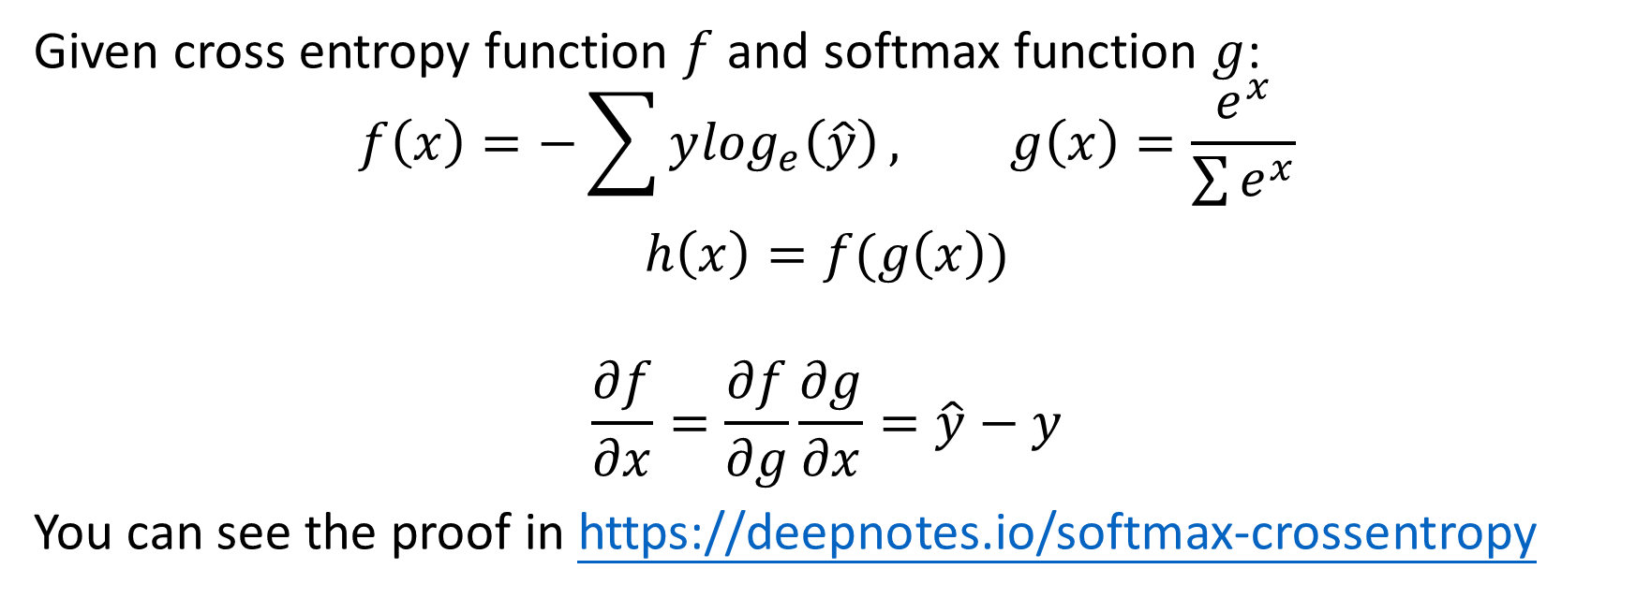
Introduction 4
Given cross entropy function $f$ and softmax function $g$:
$$f\left(x\right)=−\sum{y\log_{e}\left(\hat{y}\right)}, g\left(x\right)=\frac{e^{x}}{\sum{e^{x}}}$$
$$h\left(x\right)=f(g\left(x\right))$$
$$\frac{∂f}{∂x}=\frac{∂f}{∂g}\frac{∂g}{∂x}=\hat{y}−y$$
You can see the proof in https://deepnotes.io/softmax-crossentropy

Slide 10
Question 4: Classification in IRIS dataset by Cross Entropy Loss
You have to do one-hot encoding the labels in IRIS
Normally, cross entropy + softmax is used in classification, MSE is used in regression
Create following neural network with softmax and cross entropy to get better result
Cross Entropy
W, b
Softmax
W, b
ReLU

