Slide 1
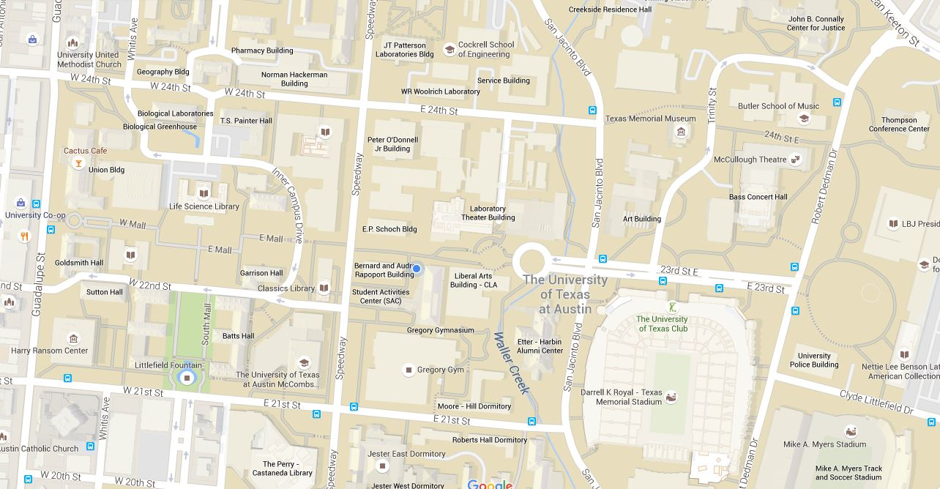

walk here faster
start
end

Slide 2
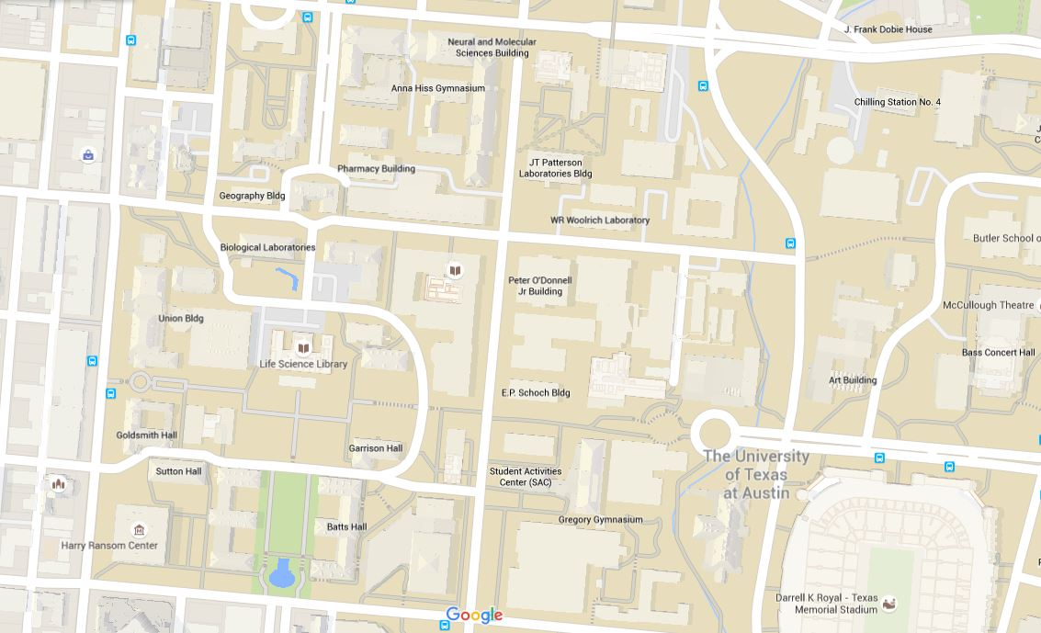
walk here faster
start
end

Slide 3
