Slide 1
Door Sensors That Help You (Smart Doors)
Shivam Sharma (15ucs130)
¹Department of Electronics and Communication Engineering The LNM Institute of Information Technology, Jaipur
May 2018
(c) jack_1729
Licensed under the MIT License
Title of the Project

Slide 2





Outline
1
Introduction
Current State of the Art
2
Literature Survey
Existing recent solutions
3
Proposed Work
Proposed solution to the problem
4 Results
Simulations and Results
5
Discussions and Future Work Discussions on the results Future Work
Title of the Project

Slide 3
What is the problem that you are tacking
What is the last time you opened your door for someone(friend) , when you were actually sleeping , or were busy ?
Yes I know it's painful .
That’s why I made this project.
Title of the Project

Slide 4
State of the Art
Automatically sending Emails to friends when you are not in the condition of opening the door.
I am focusing on sending info to friends when I can’t tell them thus automating the task of telling when will I be free.
Title of the Project

Slide 5
Existing recent solutions
Most of the authors haven’t considered this problem yet.
They have usually used face recognition to open doors for family member.
Which according to me is a weaker use of the power of Face Recognition.
Title of the Project

Slide 6

Proposed solution to the problem
My project solves the problem by sending emails , to the person or a friend standing on the door . It also tell the next time I will be active to talk to him/her.
Figure: When someone rings a bell
Title of the Project

Slide 7

Proposed solution to the problem
Person rings the bell
He/She is my friend
He/She is Unknown
5
Title of the Project

Slide 8
Proposed solution to the problem
If he/she is known
Program checks my calendar for schedule.
If I am busy or sleeping.
Does face recognition on the person
5
Send email to the person with my details
Title of the Project

Slide 9
Proposed solution to the problem
He/She is Unknown
Takes a pic of the Unknown person.
Stores the pic in the Target Bucket in Amazon S3
5
Title of the Project

Slide 10
Proposed solution to the problem
The Button.py is always active and keeps a track of the pressing of the bell. When someone presses the bell it calls TheDoor.py gets executed.
As the bell gets pressed the button.py calls the TheDoor.py and but the bell is still not disabled.
After the completion of the code processing in TheDoor.py the call gets transferred again to Button.py , which disables the button for some time.
Now if someone rings a bell for that time it won’t work. After some time the button again is enabled to take the input.
5
Title of the Project

Slide 11
Proposed solution to the problem
5. Checks day schedule –
Program checks my google calendar using google calendar API.
Checks the event on the current time. And if I am busy or sleeping.
6. Takes a pic –
Takes the picture using OpenCV library using to the webcam connected to the door. Using secure SSL certificate.
7. Does Face Recognition –
This done using Amazon face Rekognition API , which requires use of several libraries like boto3 and auth.
8. Putting in the S3 Database –
The picture gets stored by the name Unknown.jpg in the Target bucket of my S3 account.
5
Title of the Project

Slide 12
Proposed solution to the problem
9. Running Face Recognition Algorithm –
Does face recognition from the source bucket of my S3 account . In the source bucket the pictures of all the known persons are stored.
Finds the largest image in the Unknown.jpg and does face recognition.
10. Checking Email –
If the face of the person is recognized , then the program checks the name of the person and email written in the database.
11. Sending Email –
If the name of the person along with email is found in the database , then it sends email using the smtp library.
The Code is here - https://github.com/jack17529/Smart-Doors
5
Title of the Project

Slide 13
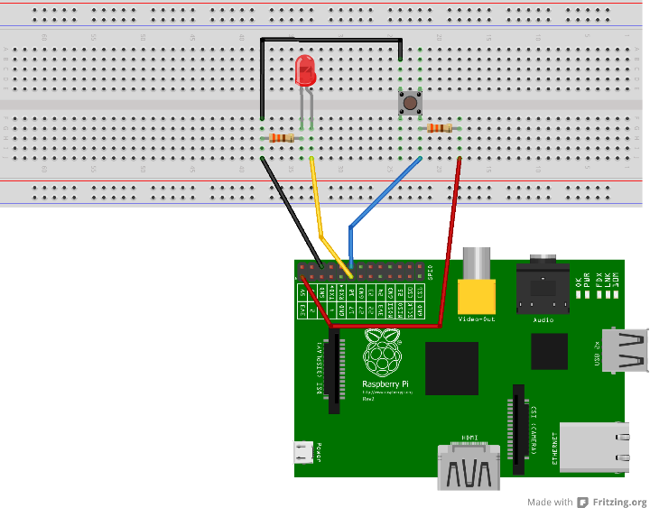
Proposed solution to the problem
5
Figure 2 – Circuit of the Bell with the use of LED
Title of the Project

Slide 14
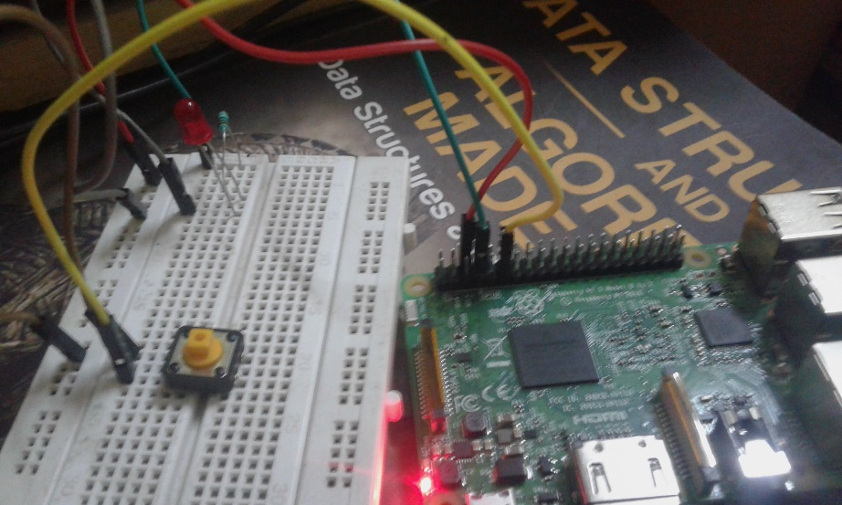
Proposed solution to the problem
5
Figure 3. Picture of the Bell simulation Circuit.
Title of the Project

Slide 15
Simulations and Results
Environment –
1. The ip webcam or a phone with ip webcam app installed .
2 . Raspberry Pi 3
3 . Gmail account.
4. Amazon account.
5. Wifi connection.
Title of the Project

Slide 16
Simulations and Results
Hardware –
1. Ip webcam or a phone with Ip-webcam app installed.
2. Raspberry Pi 3
Software –
Python 2.7 must be installed in the pc to run the program.
Libraries that need to be installed –
Numpy
Boto3
Opencv
Google-api-python-client
Title of the Project

Slide 17
Simulations and Results
The work is original as the idea no one has ever done this before.
So I have no competitors yet.
Title of the Project

Slide 18
Discussions on the results
I have made a software that sends emails to a known person when you are busy or sleeping or have any urgent work. Giving them the next time you can meet.
Discuss the problem faced and challenges –
Problem of SSL certification error –
It was a networking encoding error , took 3 days to solve .
2. Google api event list problem –
The function get() and list() in the library seems to be deprecated , need to do a do over. Took 3 days to solve.
Title of the Project

Slide 19
Discussions on the results
Good Results –
1. The software accomplishes its goal to send emails.
Also reducing the tension in stressful situations.
2. It disables the bell so as to let the person in the room do his important work.
3. Even the Unknown persons image will be stored on the S3 Bucket so one can know who actually came.
Bad Results –
Title of the Project

Slide 20
Future work and time-line
Future Work –
The future work would be to see weather the person inside the room is alright , because it may be a scenario that the person is in trouble and need help.
The button.py seems to be active always, so it would be a better solution to put it on Heroku , so that it can be aware always.
Emailing the face of an unknown person to oneself.
Difficulties –
I have faced a lot of difficulties during the project and even did lot of sacrifices
Title of the Project

Slide 21
Future work and time-line
Difficulties –
I have faced a lot of difficulties during the project and even did lot of sacrifices to get an A++ grade.
Because I didn’t have any Display , I faced a lot of problems with making the connection to my laptop possible using SSH . But in the end I was able to do it using TightVNC .
Even after enabling SSH the Raspberry required password which was changed by the last user , thus can’t able to get cli using putty.
Raspberry pi graphical settings for time update does not work. Need to connect it to other Asian servers.
Title of the Project

Slide 22
Future work and time-line
4. Problems when logging to Amazon Web Services , due to security it does not allow to login a code , thus one login through CLI , but the Raspberian OS didn’t supported the aws-cli of the latest version, thus have to checkout like 4 versions to see which one works.
Title of the Project

Slide 23
References
1. PythonRekognitionDemo by drpventura
https://github.com/drpventura/PythonRekognitionDemo/tree/fda89bcc14c1607f0967c313e573f9f56fdace45
2. python-aws-s3 by keithweaver
https://github.com/keithweaver/python-aws-s3
3. Aws docs by Amazon
https://docs.aws.amazon.com/rekognition/latest/dg
4. Amazon Cli User guide by Amazon
https://docs.aws.amazon.com/cli/latest/userguide
Title of the Project

Slide 24
References
5. How to use Rpi.GPIO ?
https://www.youtube.com/watch?v=LEi_dT9KDJI
6. I have referred like 60 websites , so I don’t have the name of all of them.
Title of the Project

