Slide 1
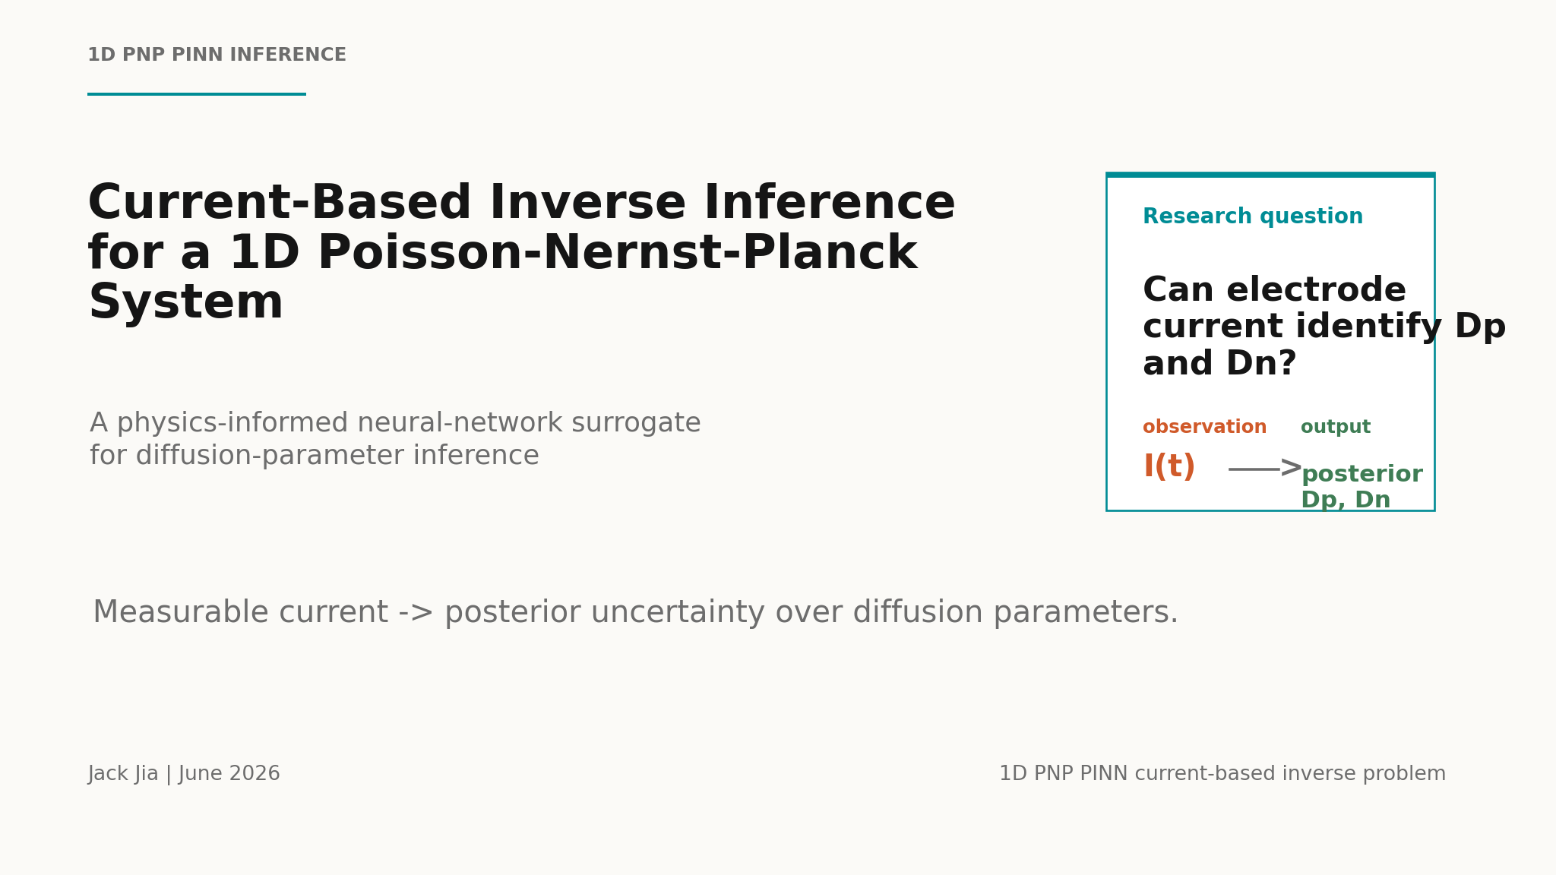

Slide 2
OPENING
02
The central question is whether current identifies diffusion parameters.
The project connects a measurable signal to a Bayesian posterior over Dp and Dn.
PNP model
>
PINN surrogate
>
Current
likelihood
>
Posterior
Dp, Dn
measurable current -> forward PNP physics -> PINN surrogate -> posterior uncertainty
Talk thesis

Slide 3
MOTIVATION
03
The inverse problem must start from what the experiment measures.
The PINN may predict fields, but the likelihood should be built from current.
Hidden state
Measured signal
cp(x,t), cn(x,t), phi(x,t)
electrode current I(t)
useful for validation
used for inference
Unknowns: Dp and Dn.
Data: noisy current observations.
Observation model

Slide 4
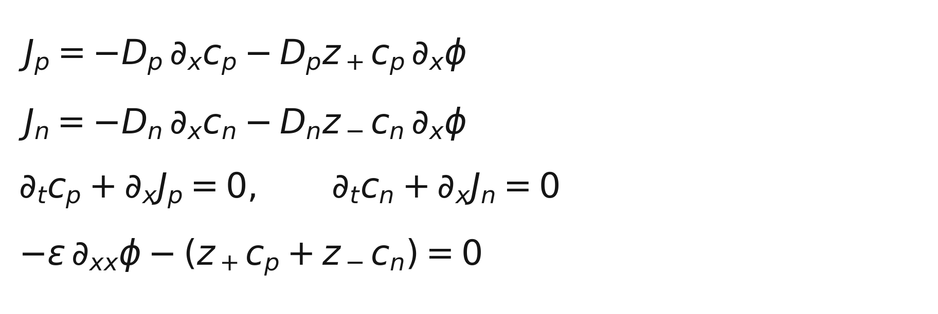
FORWARD MODEL
04
The controlled benchmark is a blocking-electrode PNP system.
Parameter box
x in [0,1], t in [0,0.2]
Dp, Dn in [0.5,2.0]
true case: Dp = Dn = 1.25
phi(0) = -0.5, phi(1) = 0.5
Blocking boundary: ions do not cross the electrode, but charging current can still be measured.
Physical setup and assumptions

Slide 5
PINN SURROGATE
05
The PINN learns the forward map, not the inverse answer.
This distinction is the core role of the neural network.
input
PINN
output
>
8-layer tanh MLP
width 256
JAX / Equinox
>
(x, t, Dp, Dn)
(cp, cn, phi)
One trained model can be evaluated at many candidate parameter pairs.
The inverse problem compares current predicted from this state map.
What the neural network represents

Slide 6
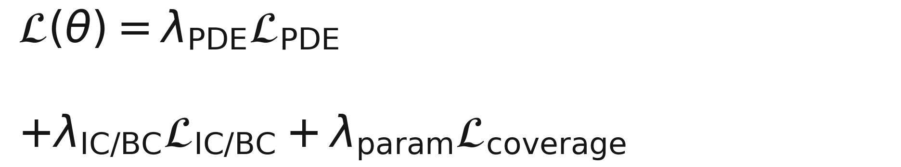
TRAINING
06
Training makes the network satisfy the PNP equations over parameter space.
The reference solver is used later for validation and synthetic observations, not as pointwise training labels.
PDE residuals
Initial and boundary
conditions
Parameter-domain
sampling
Current completed run: 500000 Adam steps.
Training objective

Slide 7
AMORTIZATION
07
The computational benefit is reuse across many likelihood evaluations.
Benchmark-only inference
PINN-based inference
candidate parameters
-> numerical PDE solve
-> current prediction
>
candidate parameters
-> trained PINN evaluation
-> current prediction
many times
Training is expensive once; inference becomes useful when the forward surrogate is reused many times.
Why a PINN is useful here

Slide 8
SYNTHETIC EXPERIMENT
08
The current data are generated independently of the PINN.
This keeps the inverse test honest: the surrogate is tested against a separate numerical model.
true case
reference solver
observation noise
79
current
intervals
Dp = 1.25
Dn = 1.25
>
finite difference
BDF integration
>
2% Gaussian
>
Reference solver to synthetic current observations

Slide 9
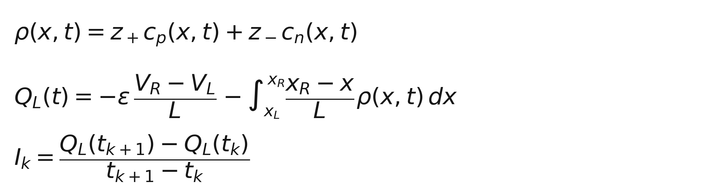
CURRENT OBSERVABLE
09
Q(t) is a simulator construction; the observation is current I(t).
experiment
external circuit
measures I(t)
The Q(t) route avoids unstable boundary derivatives when computing the current from a learned field.
Current measurement and simulation-side construction

Slide 10
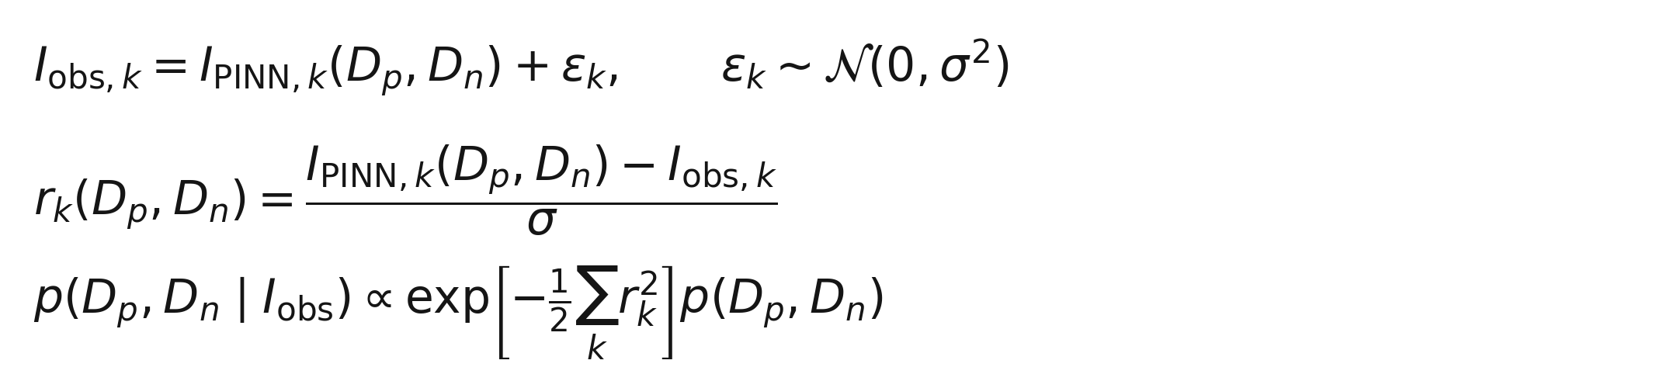
BAYESIAN INVERSE PROBLEM
10
The posterior compares observed current with PINN-predicted current.
The current diagnostic uses a transparent 41 by 41 grid posterior.
Uniform prior over the grid; posterior mass is normalized after evaluating all candidates.
Likelihood and posterior

Slide 11
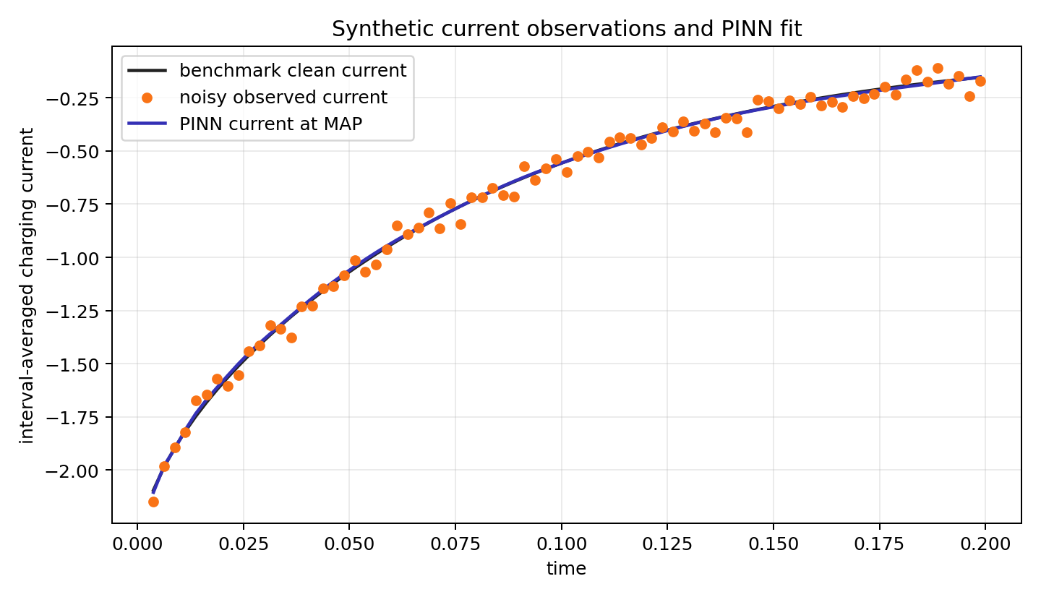
CURRENT FIT
11
At the MAP point, the PINN matches the observed current at the noise level.
MAP
Dp = 1.25
Dn = 1.2125
Data
79 current intervals
2% relative noise
Fit on the likelihood signal

Slide 12
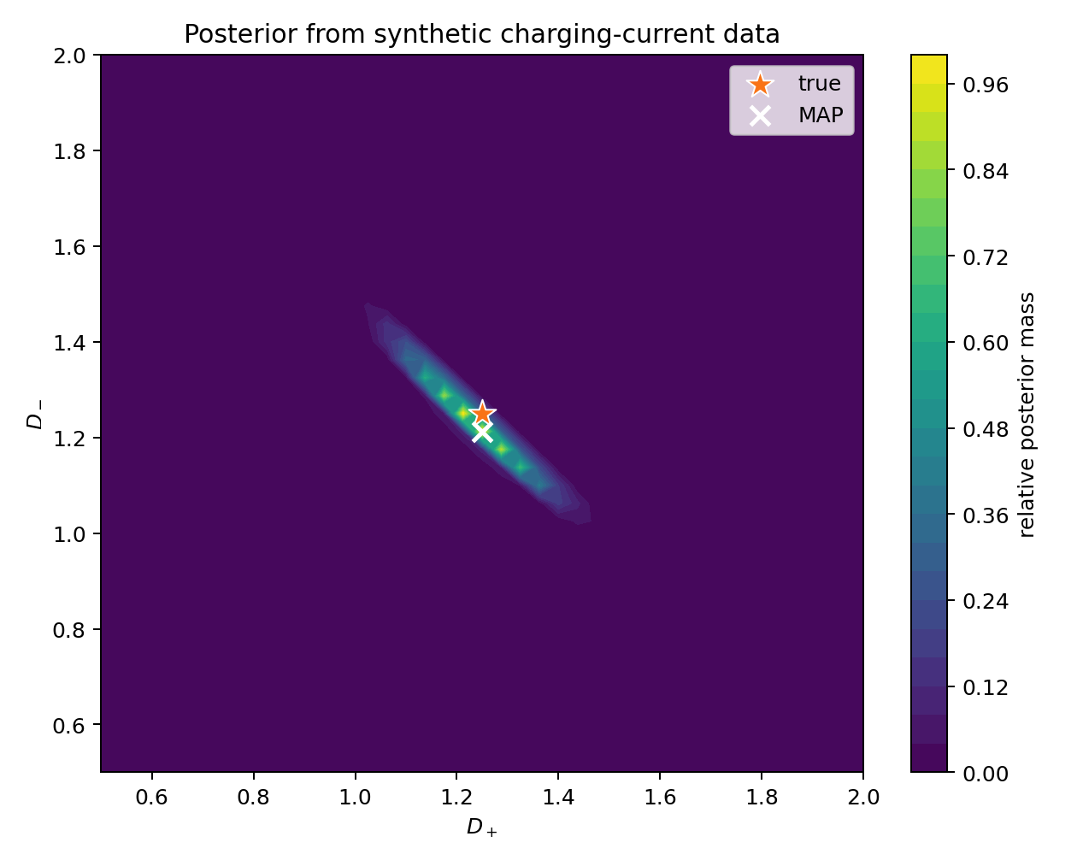
POSTERIOR
12
The posterior covers the true parameters and shows coupled uncertainty.
true
Dp = 1.25, Dn = 1.25
posterior mean
Dp = 1.2353
Dn = 1.2368
95% marginal intervals
Dp: [1.0625, 1.4000]
Dn: [1.0625, 1.4375]
The true values are inside the reported intervals.
Posterior over diffusion parameters

Slide 13
TAKEAWAY
13
This is a controlled proof of concept for current-based PINN inverse inference.
The observation is experimentally meaningful current, not hidden fields.
The PINN acts as a reusable forward model, not as the data generator.
The output is a posterior over Dp and Dn, so uncertainty is explicit.
Next
Test more true parameter pairs, vary noise and time sampling, then replace the grid posterior by MCMC when the parameter space grows.
Conclusion

Slide 14
Q&A
Any questions?
Current-based inverse inference for a 1D PNP system using a reusable PINN forward surrogate
Jack Jia | June 2026

