Slide 1
SSC 2026
A Parameterized PINN Solution to the
Poisson Nernst Planck Model
PROJECT IN ONE LINE
current observations
>
A parametric physics-informed neural network as an amortized forward surrogate
posterior over
Dp and Dn
Jack Jia
June 2026
Society of Statistics Canada

Slide 2
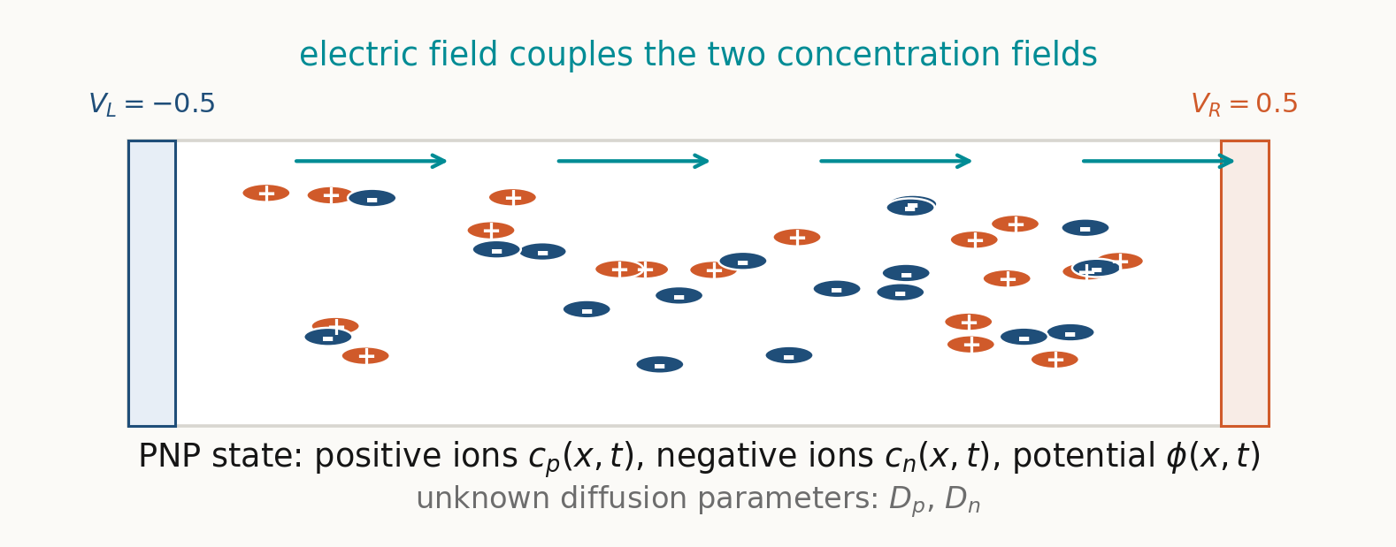
MOTIVATION
02
PNP is a coupled model of charged particles and an electric field.
The inference target is physical: the diffusion rates of the positive and negative species.
PNP context: dynamic ion transport coupled to electrostatics.

Slide 3
MOTIVATION
03
The bottleneck is repeated forward solves over parameter space.
A Bayesian inverse problem may need many candidate evaluations, not just one accurate simulation.
BENCHMARK SOLVER
PARAMETRIC PINN
candidate Dp, Dn
-> numerical PDE solve
-> predicted current
candidate Dp, Dn
-> trained neural surrogate
-> predicted current
>
many times
The PINN is expensive to train once; it becomes useful when the forward map is reused.
Many-query motivation: parametric PDEs and uncertainty quantification.

Slide 4
PINN
04
A PINN trains the solution function by penalizing physics violations.
The network is not given a full table of solution labels; the governing equations enter the loss.
NETWORK
INPUT
u_theta(x,t)
approximate solution
RESIDUAL
(x, t)
>
>
PDE = 0
PINN framework: Raissi, Perdikaris, and Karniadakis (2019); Karniadakis et al. (2021).

Slide 5
PARAMETRIC SURROGATE
05
Adding Dp and Dn to the input turns one network into a family of solvers.
This is the step that makes the trained PINN useful for inverse inference.
PARAMETRIC PINN USED HERE
ORDINARY PINN
>
(x, t, Dp, Dn) -> (c_p, c_n, phi)
(x, t) -> one PDE solution
parameter inputs
Dp, Dn in [0.5, 2.0]
Candidate parameters become ordinary neural-network inputs.
The inverse problem can evaluate many candidates without retraining.
Parameterized PDE motivation: Cho et al. (2024); Le Boudec et al. (2025).

Slide 6
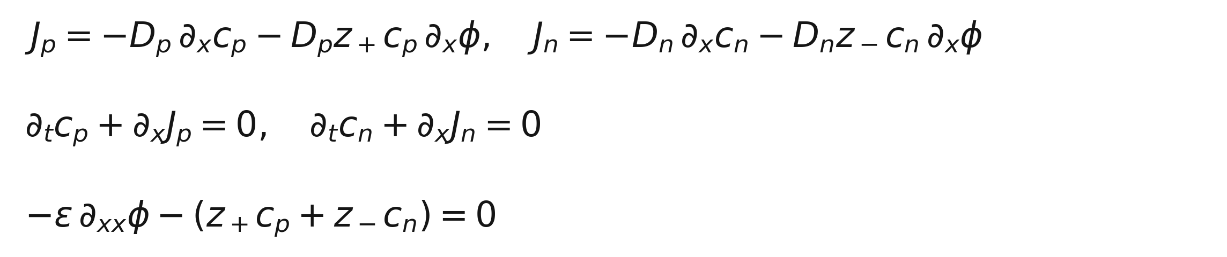
FORWARD MODEL
06
The benchmark is controlled: 1D, nondimensional, and blocking-electrode.
ACTIVE SETUP
x in [0, 1], t in [0, 0.2]
Dp, Dn in [0.5, 2.0]
phi(0,t) = -0.5, phi(1,t) = 0.5
Jp = Jn = 0 at both walls
The equations couple diffusion, electric drift, conservation of each species, and Poisson electrostatics.
Blocking electrodes: ions do not cross the boundary, but charging current can still be measured.
Dynamic PNP systems are strongly coupled and nonlinear; see Huang et al. (2024).

Slide 7
TRAINING
07
Training builds the surrogate; the reference solver is not used as a label set.
The reference model is held for validation and synthetic current generation.
PHYSICS
CONSTRAINTS
COVERAGE
PDE residuals
initial and boundary conditions
sampling over Dp, Dn
500k
training steps
Main run: 8-layer tanh MLP, width 256, JAX / Equinox, hard initial condition and voltage boundary.

Slide 8
INVERSE SETUP
08
The inverse problem is posed around current, not hidden concentration fields.
The PINN predicts fields internally, but the likelihood compares a measurable signal.
TRUTH
REFERENCE
OBSERVE
posterior
p(Dp,Dn | I)
Dp = 1.25
Dn = 1.25
>
finite difference
BDF integration
>
current I(t)
+ Gaussian noise
>
79 current intervals, 2% relative Gaussian noise, uniform prior on the parameter box.
Synthetic data come from the independent benchmark model; inference uses the trained PINN surrogate.

Slide 9
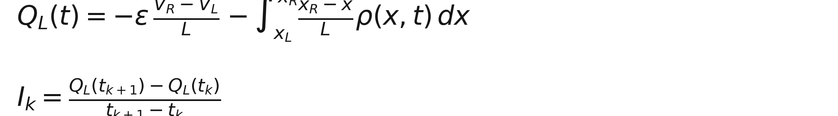
CURRENT OBSERVABLE
09
The measured quantity is I(t); Q(t) is a stable simulator-side construction.
In the blocking-electrode setup, current is charging current through the external circuit.
EXPERIMENTAL VIEW
external circuit measures current I(t)
Using Q(t) avoids differentiating the learned potential exactly at the wall.
This is a modeling choice for the synthetic benchmark, not an assumption that Q(t) is directly measured.
Current construction follows the Gauss-law electrode charge identity used in the code.

Slide 10
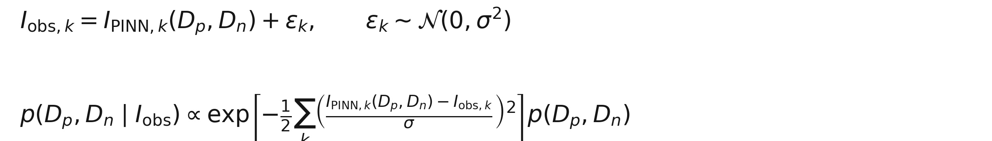
BAYESIAN INFERENCE
10
Gaussian current errors turn residuals into a posterior over diffusion parameters.
The current diagnostic uses a transparent grid posterior before moving to heavier samplers.
41 x 41
uniform
2%
parameter grid
prior over box
relative current noise
Bayesian inverse problem framing: posterior uncertainty is the inferential object.

Slide 11
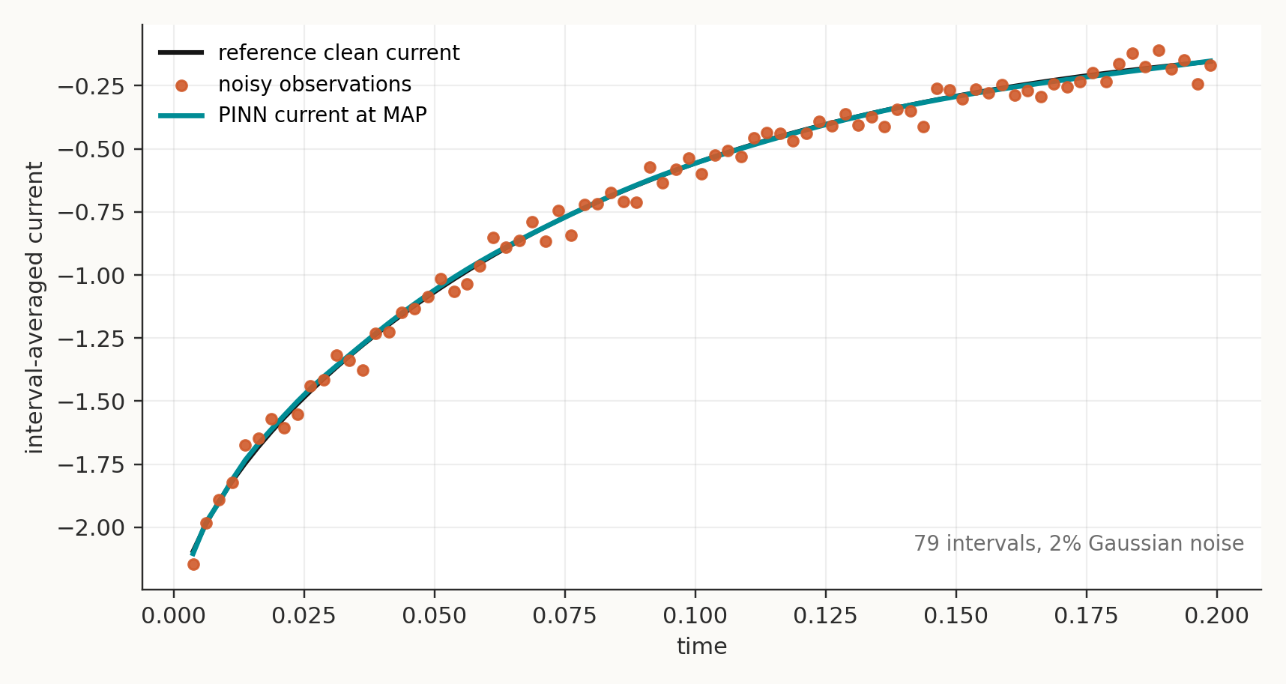
RESULT
11
At the MAP point, the PINN-predicted current follows the noisy observations.
1.25
MAP Dp
1.2125
MAP Dn
79
current intervals
Observation signal: interval-averaged charging current from the left electrode.

Slide 12
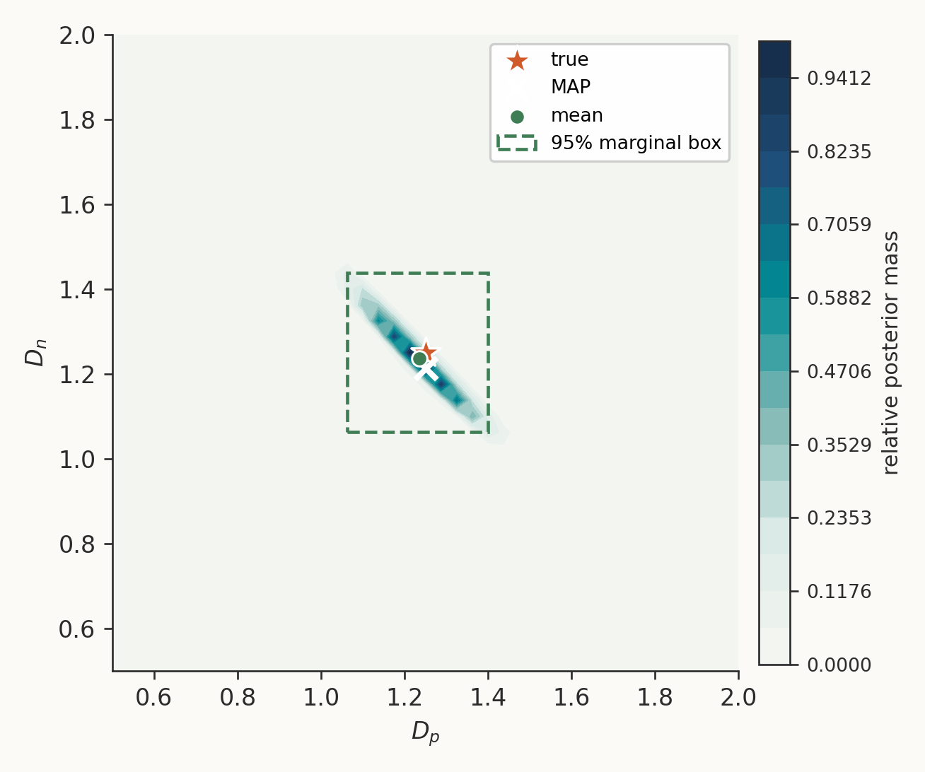
POSTERIOR
12
The posterior covers the truth and reveals coupled uncertainty between Dp and Dn.
SUMMARY
true: Dp = 1.25, Dn = 1.25
posterior mean: Dp = 1.2353, Dn = 1.2368
95% marginal intervals
Dp: [1.0625, 1.4000]
Dn: [1.0625, 1.4375]
Truth lies inside both intervals.
Posterior grid normalized to total mass 1.0.

Slide 13
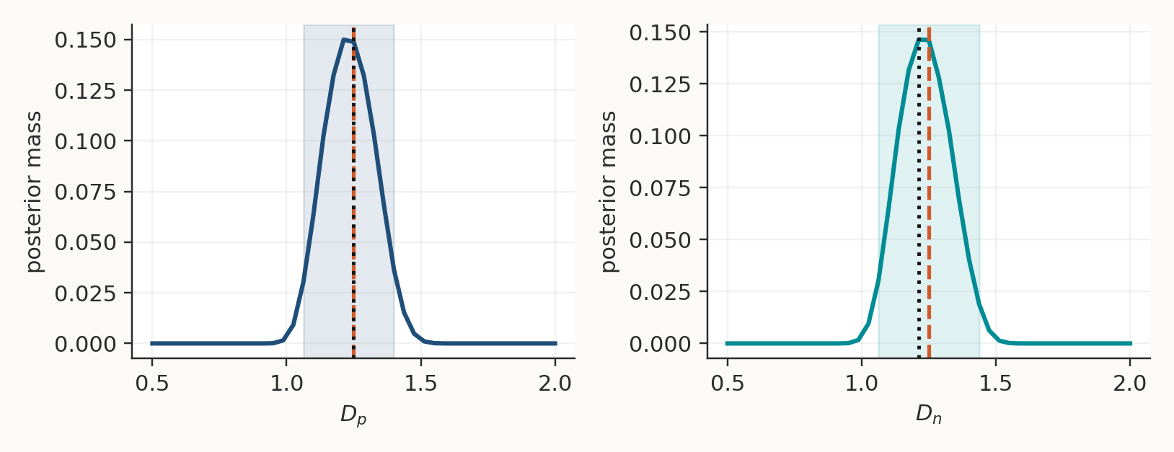
INTERPRETATION
13
The posterior shape is part of the scientific result.
The problem is indirect, coupled, and sensitive to both observation noise and surrogate error.
The data are current only; c_p, c_n, and phi are not directly observed.
Dp and Dn affect the signal through a coupled nonlinear PDE.
The forward map is approximate, so validation against the benchmark remains necessary.
A narrow-looking curve fit is not enough; the posterior shows what the current data actually identify.
This is why the result is treated as a controlled proof of concept, not a final physical claim.

Slide 14
TAKEAWAYS
14
A current-based PINN inverse pipeline is working in a controlled benchmark.
WHAT WORKS
WHAT THE PINN DOES
WHAT COMES NEXT
Current-only synthetic data recover a posterior region that contains the true Dp and Dn.
It amortizes the forward PNP map across parameter space; it is not the inverse estimator by itself.
Stress-test more true parameters, noise levels, sampling schedules, and then replace the grid by MCMC.
Main message: train the forward surrogate once, then use measurable current to quantify uncertainty in diffusion parameters.
Controlled benchmark today; broader physical realism and sampler scalability are the next steps.

Slide 15
Q&A
Any questions?
Current-based Bayesian inference for a 1D PNP system using a parametric PINN surrogate
Jack Jia | SSC 2026 | June 2026

