Slide 1

Java Tutorials
Liam Hollins
Ian McGregor
Jack Holland
Alan yu
Lina Larson

Slide 2
Tools Used
PostgreSQL – Database Management 5 stars Iterative, Waterfall, agile

Slide 3
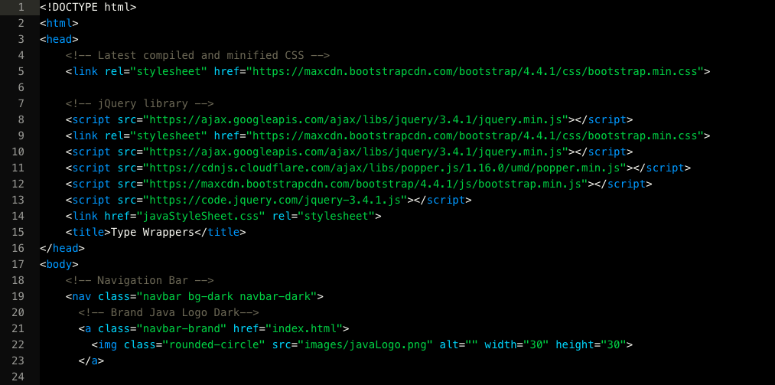
Tools Used
HTML/CSS - Web Design 5 stars Iterative, Waterfall, agile

Slide 4
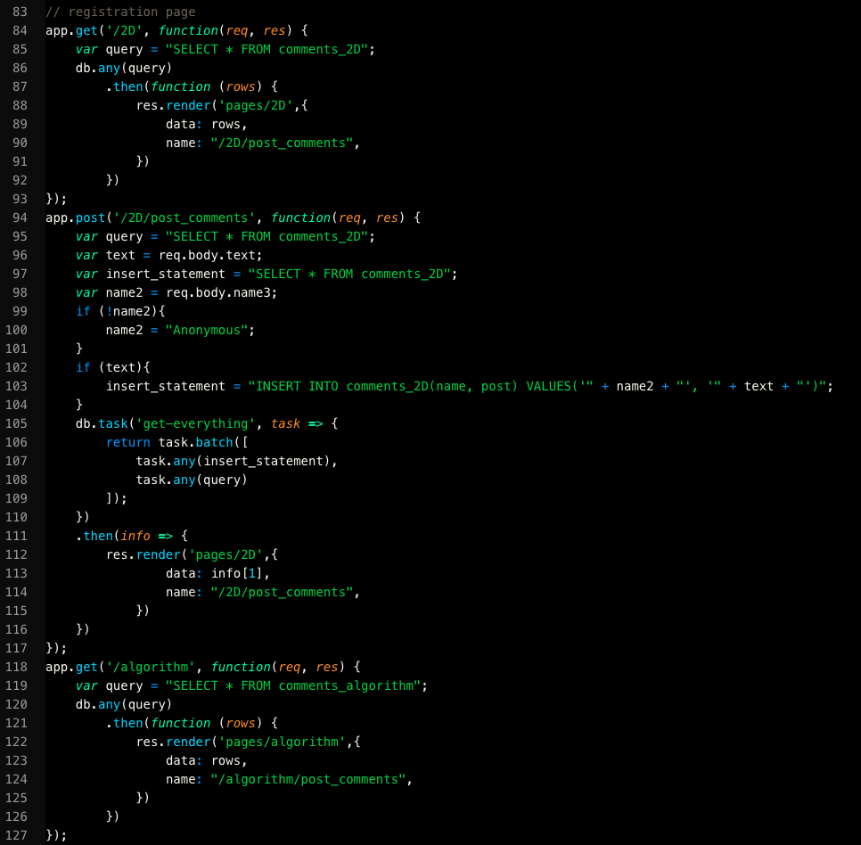
Tools Used
EJS 5 stars Iterative, Waterfall, agile

Slide 5
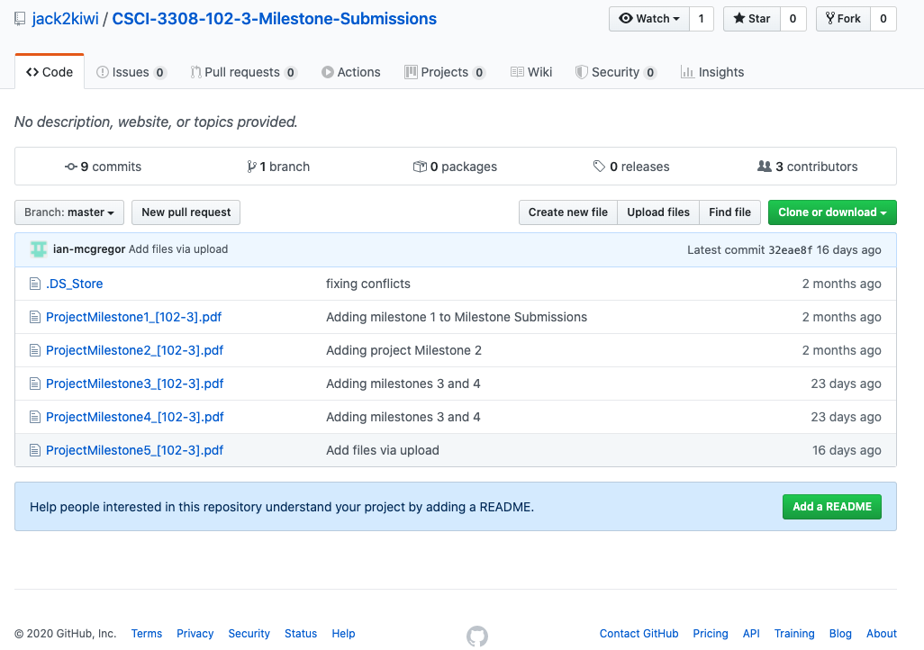
Tools Used
GitHub/Google Drvie – VCS Repository 5 stars Iterative, Waterfall, agile

Slide 6
Challenges Faced

Slide 7
how we overcame These challenges

