Slide 1

41_Presentation
FCI
Assiut University
Eng . Amjad Dife

Slide 2
Team member
Name | ID
Muhammad Hussein Fayek Hassan | 162020506
Muhammad Hussein Muhammad Hussein | 162020507
Yacoub Zaghloul Samaan Rizk | 162020738

Slide 3
Task description
we work on AI Coach App
Application that Provide users real-time guidance , tips and advice during exercise to improve the quality of exercise at home and reduce the risk of injury .

Slide 4
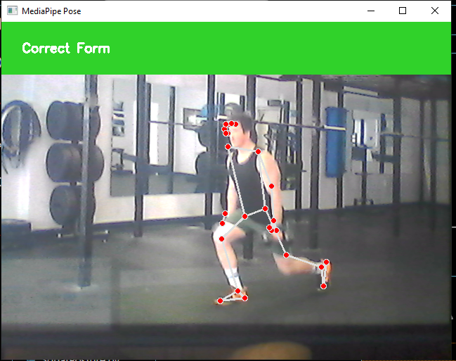
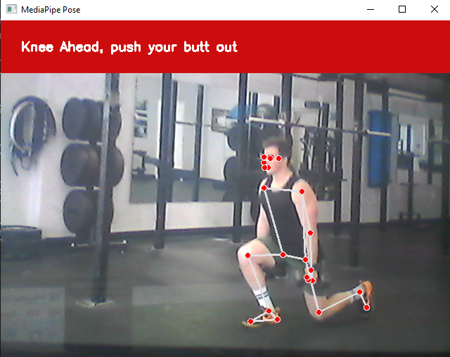
Demo

Slide 5
Contribution
Imports libraries such as OpenCV, Mediapipe, TensorFlow, and pandas.
Utilizes the “ReverseLung” module , presumably containing functions related to Reverse Lung analysis.
Uses the “Mediapipe” library for real-time pose detection from video input.
Collects pose parameters such as neck, knee, hip, and ankle positions.
Stores these parameters in a dictionary and converts them into a Pandas DataFrame.
Loads a pre-trained TensorFlow model(“working_model_1”) for posture classification.
Utilizes the model to predict the type of posture based on the extracted pose parameters.
Draws labels indicating the recognized posture on the video frames using OpenCV.
We modified the model to give the user the correct way(Feedback) to perform the exercise.

Slide 6
Data
We brought a dataset that was made for Reverse Lung from “Kaggle”.
Dataset consists of 2 folders for the exercise.
Each folder contains 30-50 video.

Slide 7
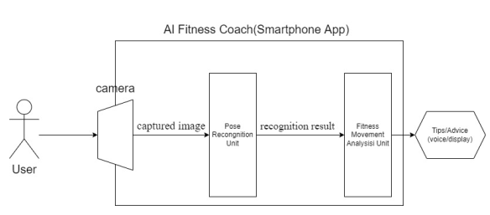
Project architecture
Flowchart how the model work

Slide 8
Methods
The Model created with Tensorflow Keras.
Using Mediapipe for pose landmark detection.
The number of classes for the Model is 2.
The optimizer is “Adam”.
The Loss function is “binary_crossentropy”

Slide 9
Result
Model Accuracy =
Number of correct predictions​ / Total number of predictions * 100%
Accuracy = 79 / 80 *100% = 98.75%
The percentage of loss 0.65%

