Slide 1
Commodities, Stocks, & Crypto
Analysis with Openbb
Jack Schultheis, Michael Peters, and Stanley Azie

Slide 2
Analysis
Time Frames:
Precovid: January 1, 2015 to December 31, 2019
Covid: January 1, 2020 to December 31, 2022
Post Covid: January 1 2022, September 30, 2023
Metrics:
Daily Return
Cumulative Return
Volatility
High/lows

Slide 3
Asset Classes
Commodities
WTI
Brent
Natural Gas
Gold
Soybean
Crypto
Bitcoin(BTC)
Dogecoin(DOGE)
Ethereum(ETH)
Litecoin(LTC)
Stocks
JP Morgan (JPM)
Apple (AAPL)
Coca-Cola (KO)
Disney (DIS)
Accenture (ACN)

Slide 4
Pre-Covid Analysis
January 1, 2015 to December 31, 2019

Slide 5
Commodities: Pre-Covid Analysis
January 1, 2015 to December 31, 2019
Cumulative Return
Gold: +28%
Brent: +21%
WTI: +17%
Soybean: +10%
Natural Gas: -27%
Volatility
Natural Gas - highest volatility (0.46)
WTI - high volatility (0.38)
Brent - high volatility (0.36)
Gold - low volatility (0.13)
Soybean - moderate volatility (0.19)
High/low
WTI
Highest Price: $76.41 on Oct 3, 2018
Lowest Price: $26.21 on Feb 11, 2016
Brent
Highest Price: $86.29 on Oct 3, 2018
Lowest Price: $27.88 on Jan 20, 2016
Natural Gas
Highest Price: $4.84 on Nov 14, 2018
Lowest Price: $1.64 on Mar 3, 2016
Gold
Highest Price: $1550.3 on Sep 4, 2019
Lowest Price: $1050.8 on Dec 17, 2015
Soybean
Highest Price: $37.72 on Dec 7, 2016
Lowest Price: $26.05 on Sep 18, 2015
Notes:
WTI - High volatility (0.38) suggests significant price swings in WTI crude oil returns, making it a more risk-prone asset.
Brent - high volatility (0.36), indicating notable fluctuations in returns, albeit slightly lower than WTI.
Natural Gas - highest volatility (0.46), signifying substantial price variability and a riskier investment.
Gold - low volatility (0.13), indicating more stable returns and positioning it as a relatively safer investment.
Soybean - moderate volatility (0.19) in soybean returns suggests a balanced risk profile compared to other commodities.

Slide 6
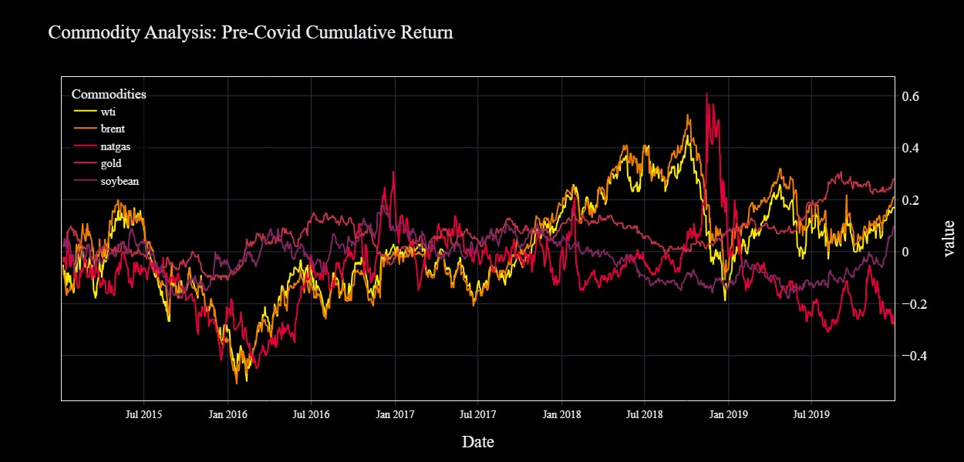
Commodities: Pre-Covid Analysis
Notes:
The initial drop in oil prices from mid-2014 to early 2015 was primarily driven by supply factors, including booming U.S. oil production, receding geopolitical concerns, and shifting OPEC policies. However, deteriorating demand prospects played a role as well, particularly from mid-2015 to early 2016. This partly explains why the oil price plunge failed to provide a subsequent boost to global activity.
Natural gas November 2018: This spike however seems to be also fueled by concerns about winter supplies in the US as well and the possibility of natural gas shortage in British Columbia, following a pipeline explosion and what looks like the start of a harsh winter.

Slide 7
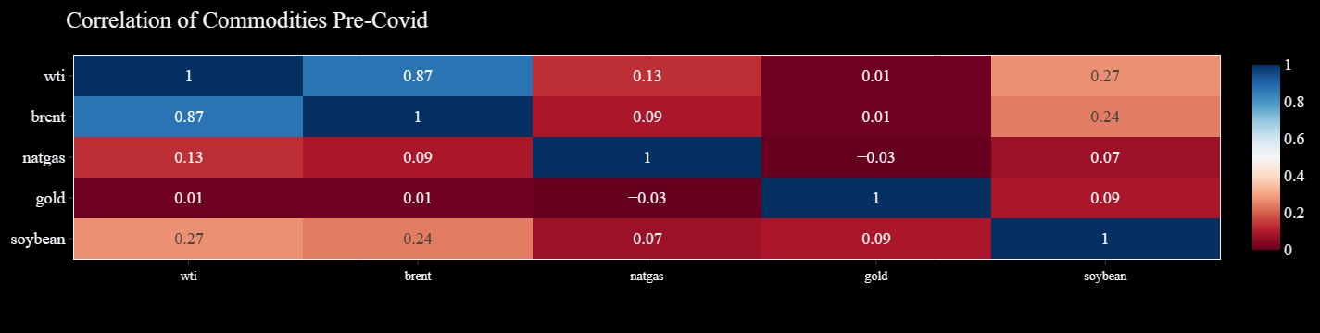
Commodities: Pre-Covid Analysis

Slide 8
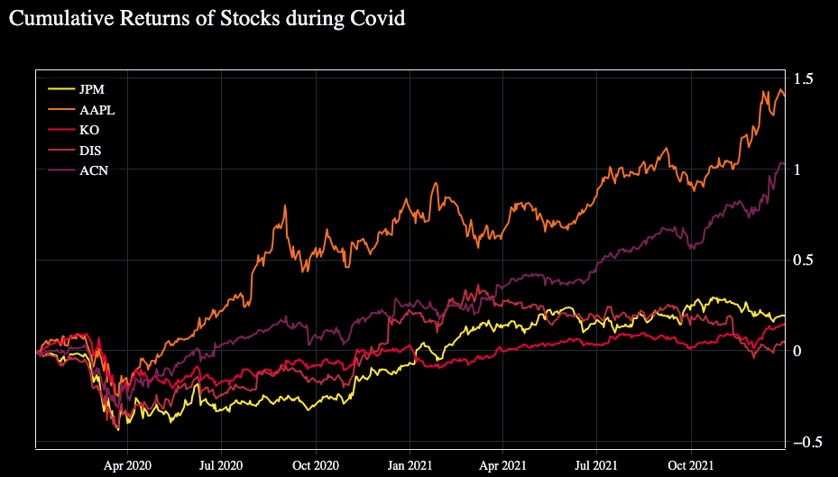
Stocks: Pre-Covid Analysis
High/Lows
JPM High of $123.52 on Dec 31 2019 --- JPM Low of $42.51 on Jan 30 2015
AAPL High of $71.52 on Dec 31 2019 --- AAPL Low of $20.8 on May 12 2016
KO High of $48.85 on Dec 27 2019 --- KO Low of $28.96 on Aug 25 2015
DIS High of $150.25 on Nov 26 2019 --- DIS Low of $83.55 on Feb 10 2016
ACN High of $200.36 on Dec 27 2019 --- ACN Low of $72.38 on Jan 30 2015
Cumulative Return
JPM +152.9%
AAPL +192.3%
KO +54.6%
DIS +65.5%
ACN +159.8%
Volatility
JPM - moderate volatility (0.21)
AAPL - moderate volatility (0.25)
KO - low volatility (0.14)
DIS - moderate volatility (0.20)
ACN - moderate volatility (0.19)
Notes:
The Fed raised rates four times in 2018, including a December 2018 hike that took its key rate to 2.5 percent.
It was a different story in 2019, when after a change of heart the Fed lowered rates three times. Falling interest rates sent investors on a quest for yield, forcing more money into stocks expected to appreciate, pay dividends or both.
As the year came to a close, the House passed the United States-Mexico-Canada Agreement, which is Trump's replacement for NAFTA, and the Senate is expected to pass it soon.
Stocks dive
https://www.pbs.org/newshour/economy/making-sense/6-factors-that-fueled-the-stock-market-dive-in-2018#:~:text=But%20this%20year%20a%20number,reaction%20from%20the%20stock%20market.

Slide 9
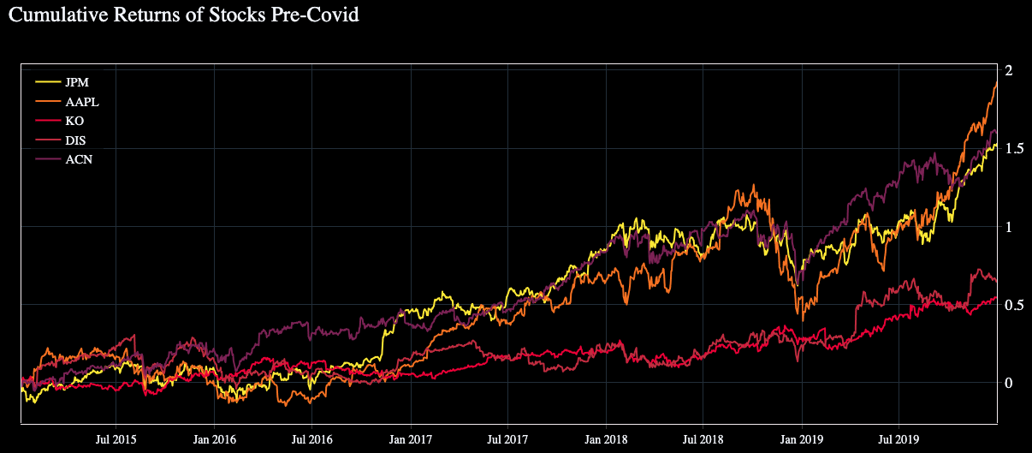
Stocks: Pre-Covid Analysis
Notes:
The Fed raised rates four times in 2018, including a December 2018 hike that took its key rate to 2.5 percent.
It was a different story in 2019, when after a change of heart the Fed lowered rates three times. Falling interest rates sent investors on a quest for yield, forcing more money into stocks expected to appreciate, pay dividends or both.
As the year came to a close, the House passed the United States-Mexico-Canada Agreement, which is Trump's replacement for NAFTA, and the Senate is expected to pass it soon.
Stocks dive
https://www.pbs.org/newshour/economy/making-sense/6-factors-that-fueled-the-stock-market-dive-in-2018#:~:text=But%20this%20year%20a%20number,reaction%20from%20the%20stock%20market.

Slide 10
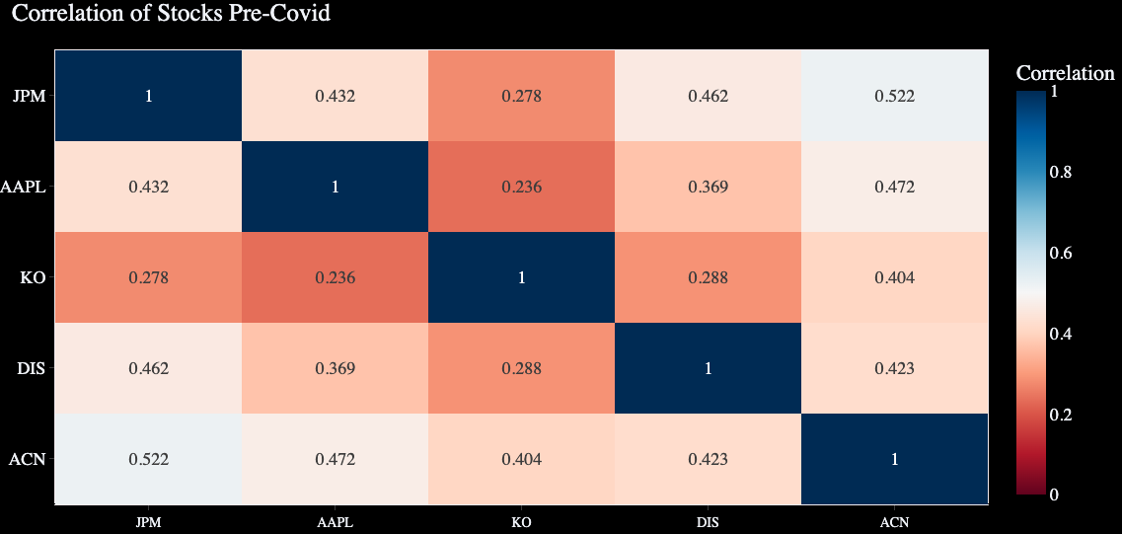
Stocks: Pre-Covid Analysis
Notes:
The Fed raised rates four times in 2018, including a December 2018 hike that took its key rate to 2.5 percent.
It was a different story in 2019, when after a change of heart the Fed lowered rates three times. Falling interest rates sent investors on a quest for yield, forcing more money into stocks expected to appreciate, pay dividends or both.
As the year came to a close, the House passed the United States-Mexico-Canada Agreement, which is Trump's replacement for NAFTA, and the Senate is expected to pass it soon.
Stocks dive
https://www.pbs.org/newshour/economy/making-sense/6-factors-that-fueled-the-stock-market-dive-in-2018#:~:text=But%20this%20year%20a%20number,reaction%20from%20the%20stock%20market.

Slide 11
Crypto: Pre-Covid Analysis
Cumulative Return
Bitcoin : +.7%
Dogecoin : +43.3%
Ethereum : -59.6%
Litecoin : -35.6%
Volatility
Bitcoin : 0.67
Dogecoin : 1.02
Ethereum : .80
Litecoin : .94
Pre-Covid Highs/Lows
Bitcoin High of $19,497.4 on 12/16/2017 | Bitcoin Low of $3,236.76 on 12/15/2018
___________________________________________________________________________________________
Dogecoin High of $0.017088 on 1/7/2018 | Dogecoin Low of $0.001038 on 11/12/2017
___________________________________________________________________________________________
Ethereum High of $1,396.42 on 1/13/2018 | Ethereum Low of $84.31 on 12/14/2018
___________________________________________________________________________________________
Litecoin High of $358.34 on 12/18/2017 | Litecoin Low of $23.46 on 12/14/2018
___________________________________________________________________________________________
Notes:
Donald Trump July 19 tweets he’s not a fan of cryptocurrencies, saying they are based on thin air, and highly volatile, and can facilitate unlawful behavior.
Total Market cap at the end of 2019 was over 190 billion, from 130 at the end of 2018.
Banance launched in june 2017 and in just 6 months was the largest crypto exchange in the world.

Slide 12
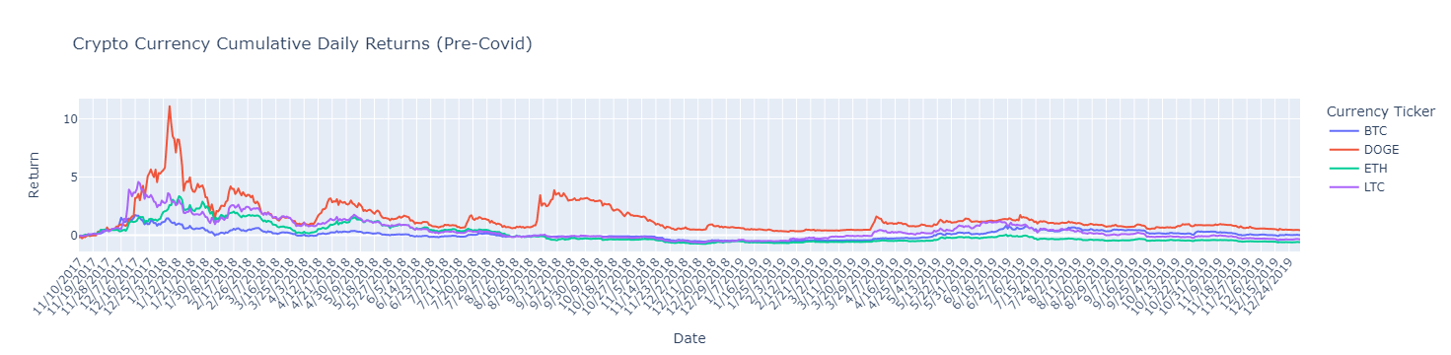
Crypto: Pre-Covid Analysis

Slide 13
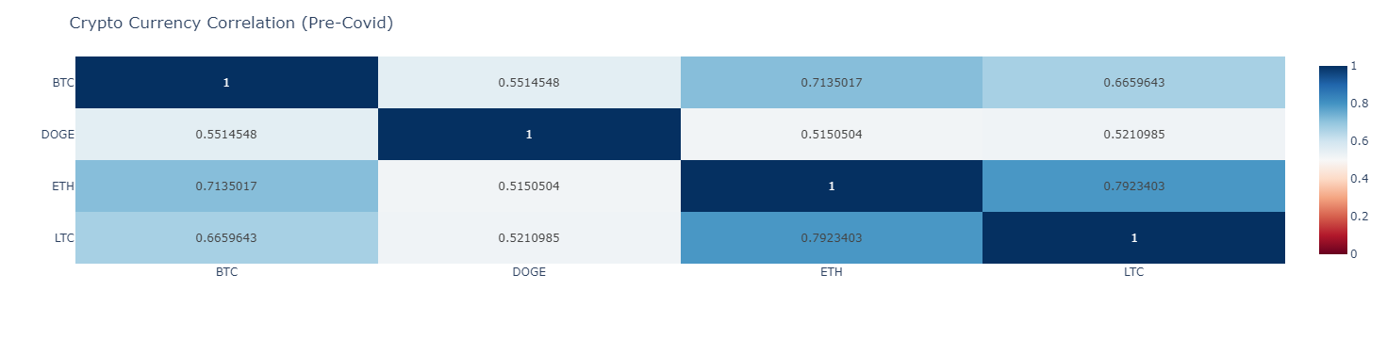
Crypto: Pre-Covid Analysis

Slide 14
Covid Analysis
January 1, 2020 to December 31, 2021

Slide 15
Commodities: Covid Analysis
Cumulative Return
Gold: +19%
Brent: +20%
WTI: +26%
Soybean: +60%
Natural Gas: +68%
Volatility
Natural Gas - high volatility (0.63)
WTI - highest volatility (2.45)
Brent - high volatility (0.57)
Gold - moderate volatility (0.19)
Soybean - moderate volatility (0.29)
High/low
WTI
Highest Price: $84.65 on Oct 26, 2021
Lowest Price: -$37.63 on Apr 20, 2020
Brent
Highest Price: $86.4 on Oct 26, 2021
Lowest Price: $19.33 on Apr 21, 2020
Natural Gas
Highest Price: $6.31 on Oct 5, 2021
Lowest Price: $1.48 on Jun 25, 2020
Gold
Highest Price: $2051.5 on Aug 6, 2020
Lowest Price: $1477.3 on Mar 18, 2020
Soybean
Highest Price: $72.08 on Jun 8, 2021
Lowest Price: $24.99 on Mar 16, 2020

Slide 16
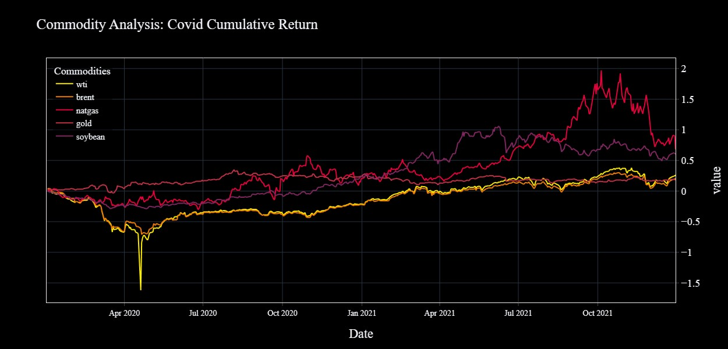
Commodities: Covid Analysis

Slide 17
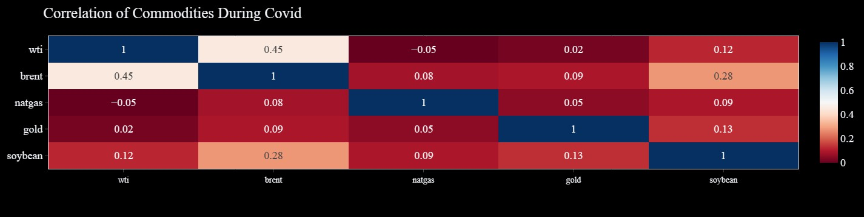
Commodities: Covid Analysis

Slide 18
Stocks: Covid Analysis
High/Lows
JPM High of $161.7 on Oct 22 2021 --- JPM Low of $70.48 on Mar 23 2020
AAPL High of $178.29 on Dec 27 2021 --- AAPL Low of $54.78 on Mar 23 2020
KO High of $55.75 on Dec 31 2021 --- KO Low of $33.44 on Mar 23 2020
DIS High of $201.25 on Mar 08 2021 --- DIS Low of $85.48 on Mar 23 2020
ACN High of $403.42 on Dec 29 2021 --- ACN Low of $136.18 on Mar 23 2020
Cumulative Return
JPM +19.2%
AAPL +140.0%
KO +24.9%
DIS +4.5%
ACN +103%
Volatility
JPM - high volatility (0.41)
AAPL - high volatility (0.37)
KO - moderate volatility (0.27)
DIS - high volatility (0.39)
ACN - high volatility (0.33)
Notes:
Stocks started the period diving because of COVID uncertainty and lockdowns.
After the CARES ACT passed and the fed signaled lower rates the markets rallied.

Slide 19
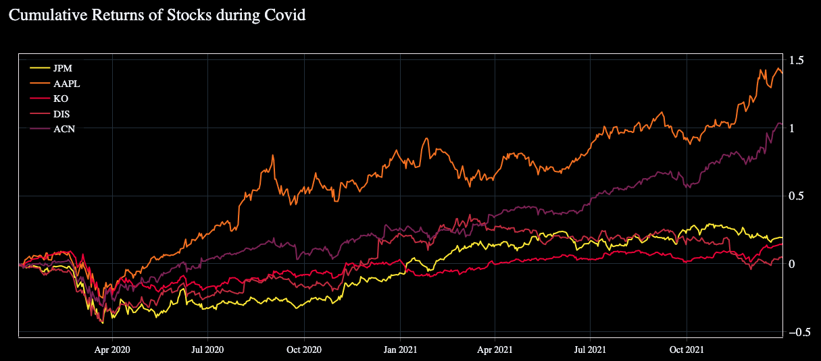
Stocks: Covid Analysis
Notes:
The Fed raised rates four times in 2018, including a December 2018 hike that took its key rate to 2.5 percent.
It was a different story in 2019, when after a change of heart the Fed lowered rates three times. Falling interest rates sent investors on a quest for yield, forcing more money into stocks expected to appreciate, pay dividends or both.
As the year came to a close, the House passed the United States-Mexico-Canada Agreement, which is Trump's replacement for NAFTA, and the Senate is expected to pass it soon.
Stocks dive
https://www.pbs.org/newshour/economy/making-sense/6-factors-that-fueled-the-stock-market-dive-in-2018#:~:text=But%20this%20year%20a%20number,reaction%20from%20the%20stock%20market.

Slide 20
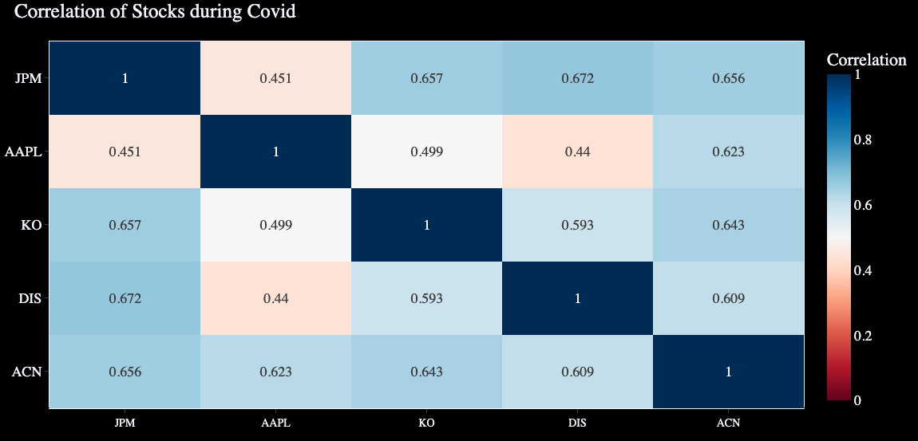
Stocks: Covid Analysis
Notes:
The Fed raised rates four times in 2018, including a December 2018 hike that took its key rate to 2.5 percent.
It was a different story in 2019, when after a change of heart the Fed lowered rates three times. Falling interest rates sent investors on a quest for yield, forcing more money into stocks expected to appreciate, pay dividends or both.
As the year came to a close, the House passed the United States-Mexico-Canada Agreement, which is Trump's replacement for NAFTA, and the Senate is expected to pass it soon.
Stocks dive
https://www.pbs.org/newshour/economy/making-sense/6-factors-that-fueled-the-stock-market-dive-in-2018#:~:text=But%20this%20year%20a%20number,reaction%20from%20the%20stock%20market.

Slide 21
Crypto: Covid Analysis
Cumulative Return
Bitcoin : +543%
Dogecoin : +8,286%
Ethereum : +2715%
Litecoin : +248%
Volatility
Bitcoin : 0.63
Dogecoin : 2.54
Ethereum : 0.83
Litecoin : 0.89
Covid Highs/Lows
Bitcoin High of $67,566.83 on 11/8/2021 | Bitcoin Low of $4,970.79 on 3/12/2020
_________________________________________________________________________________________
Dogecoin High of $0.684777 on 5/7/2021 | Dogecoin Low of $0.001537 on 3/12/2020
_________________________________________________________________________________________
Ethereum High of $4,812.09 on 11/8/2021 | Ethereum Low of $1,10.61 on 3/16/2020
_________________________________________________________________________________________
Litecoin High of $386.45 on 5/9/2021 | Litecoin Low of $30.93 on 3/12/2020
_________________________________________________________________________________________
Notes:
Nearly everytime Elon tweeted about doge the price jumped.
Elon Musk appears on snl may 2021 drops 40%.
December 21 Doge can used to buy tesla merchandise, price jumps 33%.
Bitcoin third halving happened May 2020 bitcoin rewards for solving a block, generally took a while for the price to surge greatly.

Slide 22
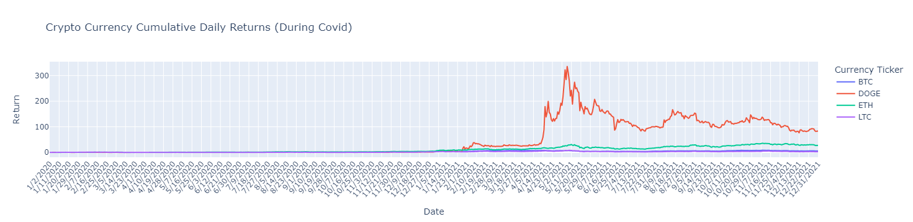
Crypto: Covid Analysis
Notes:
The beginning of 2019 total market capitalisation of crypto currency was $130 billion, by the end of that year it was nearly $200 billion.

Slide 23
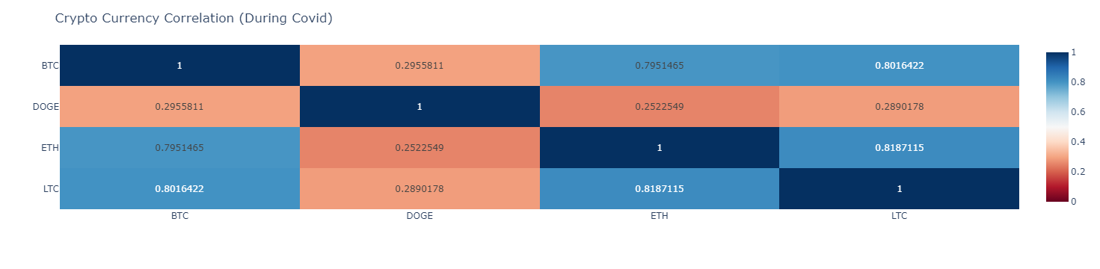
Crypto: Covid Analysis

Slide 24
Post-Covid Analysis
January 1, 2022 to September 30, 2023

Slide 25
Commodities: Post-Covid Analysis
Cumulative Return
Gold: +3%
Brent: +21%
WTI: +19%
Soybean: +2%
Natural Gas: -23%
Volatility
Natural Gas - highest volatility (0.91)
WTI - high volatility (0.42)
Brent - high volatility (0.40)
Gold - low volatility (0.14)
Soybean - high volatility (0.36)
High/low
WTI
Highest Price: $123.7 on Mar 8, 2022
Lowest Price: $66.74 on Mar 17, 2023
Brent
Highest Price: $127.98 on Mar 8, 2022
Lowest Price: $71.84 on Jun 12, 2023
Natural Gas
Highest Price: $9.68 on Aug 22, 2022
Lowest Price: $1.99 on Mar 29, 2023
Gold
Highest Price: $2048.0 on May 4, 2023
Lowest Price: $1623.3 on Sep 26, 2022
Soybean
Highest Price: $90.6 on Apr 28, 2022
Lowest Price: $46.2 on May 30, 2023

Slide 26
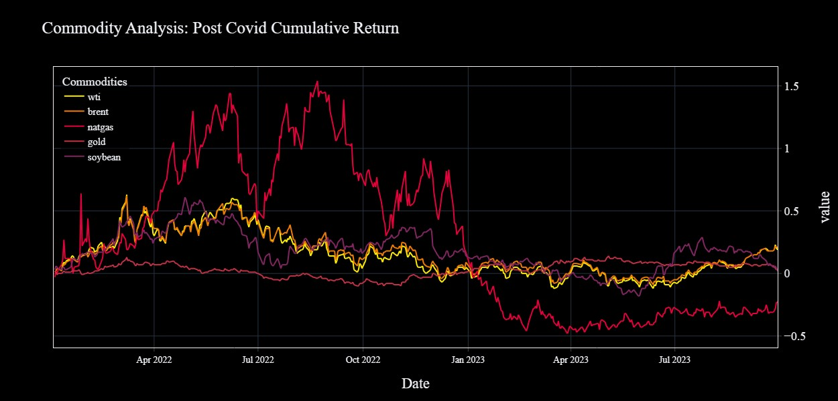
Commodities: Post-Covid Analysis

Slide 27
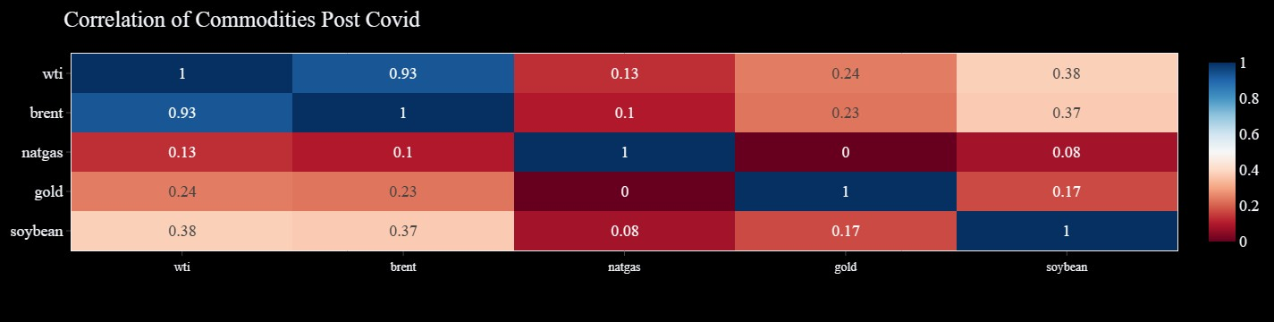
Commodities: Post-Covid Analysis

Slide 28
Stocks: Post-Covid Analysis
High/Lows
JPM High of $159.51 on Jan 12 2022 --- JPM Low of $99.01 on Oct 11 2022
AAPL High of $195.93 on Jul 31 2023 --- AAPL Low of $124.33 on Jan 05 2023
KO High of $62.82 on Apr 21 2022 --- KO Low of $52.36 on Oct 10 2022
DIS High of $157.38 on Jan 11 2022 --- DIS Low of $79.64 on Sep 27 2023
ACN High of $395.45 on Jan 03 2022 --- ACN Low of $243.31 on Mar 15 2023
Cumulative Return
JPM -5.4%
AAPL -5.0%
KO -0.6%
DIS -48.3%
ACN -22.7%
Volatility
JPM - moderate volatility (0.27)
AAPL - high volatility (0.31)
KO - low volatility (0.17)
DIS - high volatility (0.33)
ACN - moderate volatility (0.29)
Notes:
Interest rate hikes last year and this year have kept prices down.

Slide 29
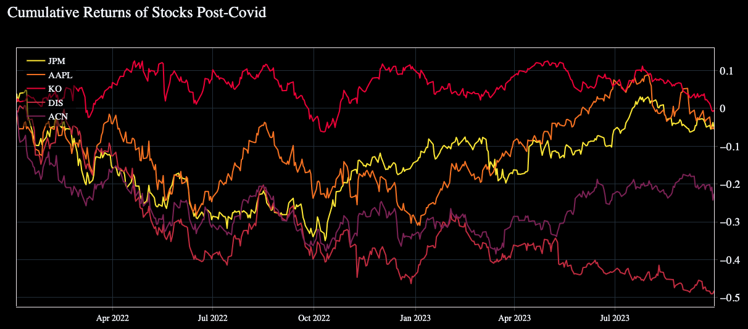
Stocks: Post-Covid Analysis
Notes:
The Fed raised rates four times in 2018, including a December 2018 hike that took its key rate to 2.5 percent.
It was a different story in 2019, when after a change of heart the Fed lowered rates three times. Falling interest rates sent investors on a quest for yield, forcing more money into stocks expected to appreciate, pay dividends or both.
As the year came to a close, the House passed the United States-Mexico-Canada Agreement, which is Trump's replacement for NAFTA, and the Senate is expected to pass it soon.
Stocks dive
https://www.pbs.org/newshour/economy/making-sense/6-factors-that-fueled-the-stock-market-dive-in-2018#:~:text=But%20this%20year%20a%20number,reaction%20from%20the%20stock%20market.

Slide 30
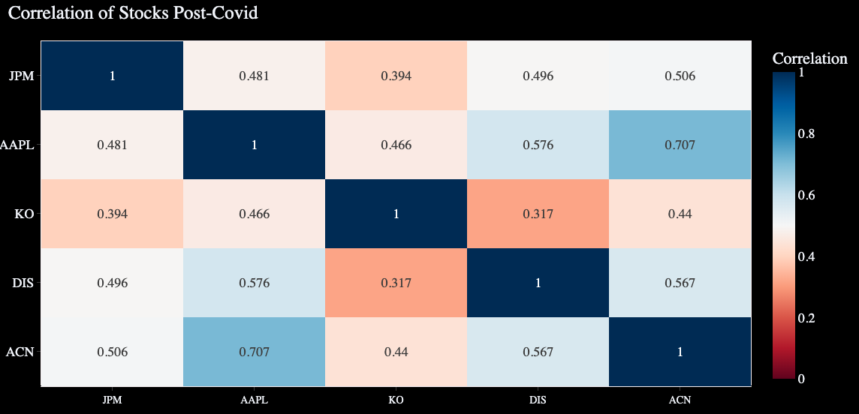
Stocks: Post-Covid Analysis
Notes:
The Fed raised rates four times in 2018, including a December 2018 hike that took its key rate to 2.5 percent.
It was a different story in 2019, when after a change of heart the Fed lowered rates three times. Falling interest rates sent investors on a quest for yield, forcing more money into stocks expected to appreciate, pay dividends or both.
As the year came to a close, the House passed the United States-Mexico-Canada Agreement, which is Trump's replacement for NAFTA, and the Senate is expected to pass it soon.
Stocks dive
https://www.pbs.org/newshour/economy/making-sense/6-factors-that-fueled-the-stock-market-dive-in-2018#:~:text=But%20this%20year%20a%20number,reaction%20from%20the%20stock%20market.

Slide 31
Crypto: Post-Covid Analysis
Cumulative Return
Bitcoin : -43.4%
Dogecoin : -64%
Ethereum : -55.6%
Litecoin : -56.1%
Volatility
Bitcoin : 0.46
Dogecoin : 0.75
Ethereum : 0.59
Litecoin : 0.66
Post-Covid Highs/Lows
Bitcoin High of $47,686.81 on 1/1/2022 | Bitcoin Low of $15,787.28 on 11/21/2022
________________________________________________________________________________
Dogecoin High of $0.185103 on 1/15/2022 | Dogecoin Low of $0.053012 on 6/18/2022
________________________________________________________________________________
Ethereum High of $3,829.56 on 1/2/2022 | Ethereum Low of $993.64 on 6/18/2022
________________________________________________________________________________
Litecoin High of $151.67 on 1/17/2022 | Litecoin Low of $43.3 on 6/13/2022
________________________________________________________________________________
Notes:
May 2023 Elon Musk tweeted that SpaceX merchandise can be bought using Dogecoin, jumped 10%.
FTX collapse november

Slide 32
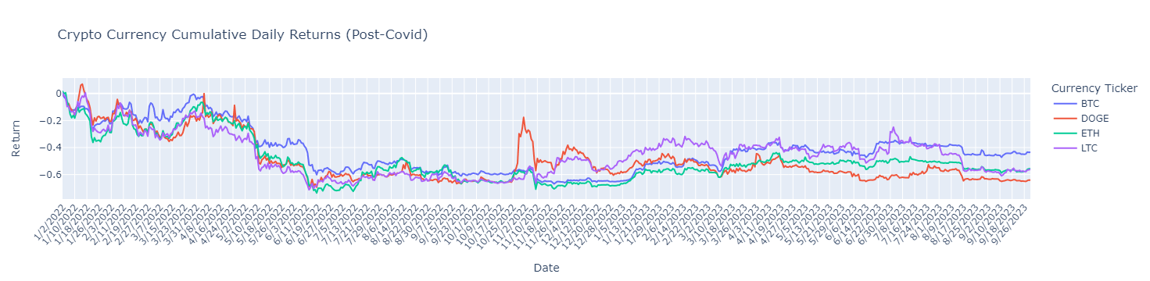
Crypto: Post-Covid Analysis

Slide 33
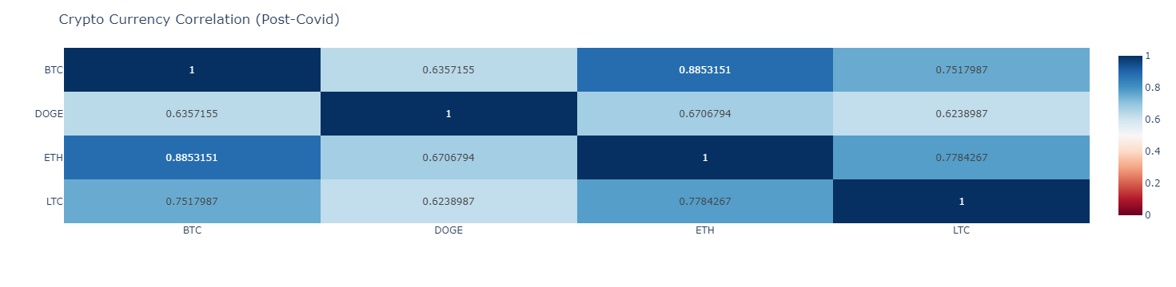
Crypto: Post-Covid Analysis

