Slide 1
Moving to Git
Dean Glazeski

Slide 2
Agenda
General Overview
Basic Operations
Changing History
Submodules
Customizing Git
Development Workflows
Distributed Workflows
Demo

Slide 3
Goals and Objectives
Be able to equate mercurial and TFVC operations to git
Understand the difference between mercurial, git, and TFVC
Work effectively with a git repository
Command line
GUI tools (VS and TortoiseGit)
Be ready for our future transition to git

Slide 4
Why are we Moving?
Clone/Pull/Push times are very inconsistent between sites (ie. very slow)
Regular corruption of repositories due to partial pushes
Large number of repositories making grafting/updating/setup more difficult
Attempt to get better integration with Visual Studio and TFS

Slide 5
Top Level Overview

Slide 6
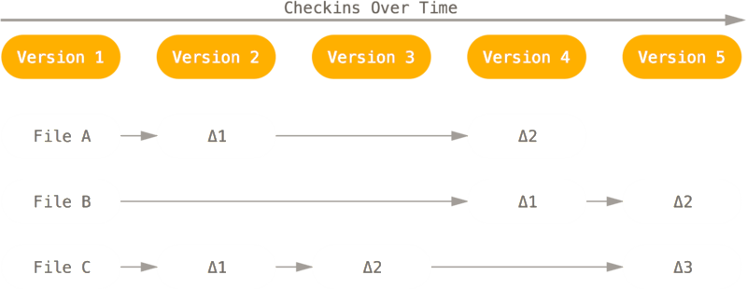
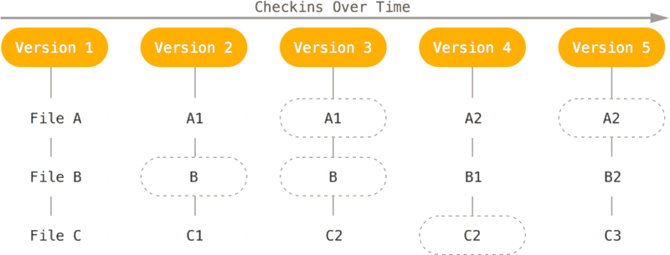
Snapshots, not Differences
Files and Differences (Hg, TFVC)
Stream of Snapshots (Git)
https://git-scm.com/book/en/v2/Getting-Started-Git-Basics

Slide 7
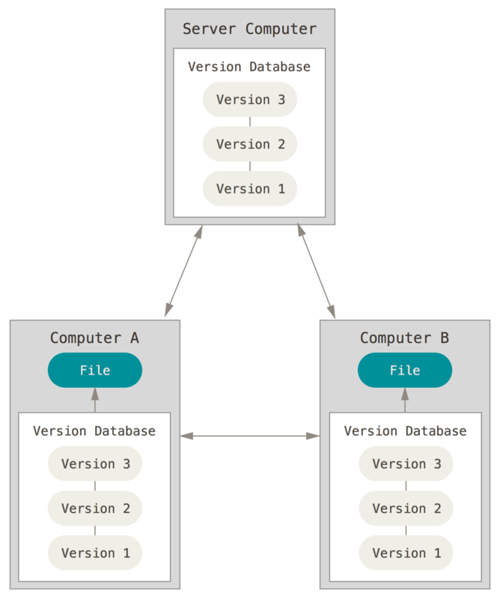
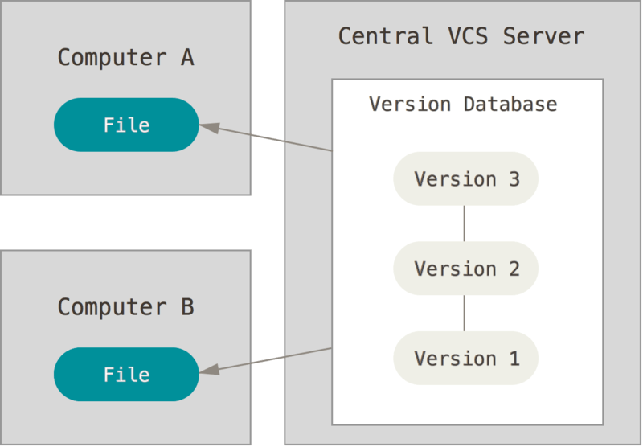
Distributed
Mercurial and git both have the full repository history locally
.hg and .git folders hold this information
Most operations are executed locally
This makes them faster
Enables working without network access to server
Many possible workflows become possible
https://git-scm.com/book/en/v2/Getting-Started-About-Version-Control

Slide 8
Branch Comparison
Git
Mercurial
TFVC
Core component of Git
Very lightweight
Effectively pointers to revision
Requires a name
Anonymous branches are common
Official branch requires commit
Official branches can never disappear, only close
Have to use bookmarks for lightweight pointers to anonymous branches
Like SVN, separate folders needed as complete copy of main
Requires separate folders on development machine for each branch
Local branches are not possible

Slide 9
Branch Comparison
Git
Mercurial
TFVC
HEAD
F30AB (default)
master
($/TFVC/src/master)
topic
C2B9E
C2B9E (topic)
topic
($/TFVC/branches/topic)
master
F30AB

Slide 10
Storage Level Comparison
Remote Repo
Local Repo
Index
Working Directory
Stash
Git
Remote Repo
Local Repo
Working Directory
Shelf
Mercurial
Remote Repo
Working Directory
Shelveset
TFVC

Slide 11
Basic Operations

Slide 12
Cloning a Repository
Copies existing repository for local development and checks out master
$ git clone <url> [<local_directory>]
$ hg clone <url> [<local_directory>]
$ tf workfold /map <server_path> <local_directory>
$ tf get /all /recursive
Remote Repo
Local Repo
Index
Working Directory
Stash
Git
Remote Repo
Local Repo
Working Directory
Shelf
Mercurial
Remote Repo
Working Directory
Shelveset
TFVC

Slide 13
Checking Out a Version
Sets HEAD pointer and updates the working directory
Checks out a specific state from the repository
$ git checkout <branch|commit>
$ hg checkout <branch|commit>
$ tf get /version:1234
Remote Repo
Local Repo
Index
Working Directory
Stash
Git
Remote Repo
Local Repo
Working Directory
Shelf
Mercurial
Remote Repo
Working Directory
Shelveset
TFVC

Slide 14
Checking Out a Version
Checkout and create a branch
$ git checkout -b <branch> [<base_branch=current>]
Checkout a specific file to reset (this deletes all local modifications)
$ git checkout -- <file_name>
Remote Repo
Local Repo
Index
Working Directory
Stash
Git
Remote Repo
Local Repo
Working Directory
Shelf
Mercurial
Remote Repo
Working Directory
Shelveset
TFVC

Slide 15
Fetching Updates
Copies new commits from the remote repo to the local repo
Notice how working directory is not affected
$ git fetch
$ hg fetch
Remote Repo
Local Repo
Index
Working Directory
Stash
Git
Remote Repo
Local Repo
Working Directory
Shelf
Mercurial
Remote Repo
Working Directory
Shelveset
TFVC

Slide 16
Pulling New Commits
Copies new commits from the remote repo to the local repo
Combined fetch with merge or rebase on active branch
$ git pull [--rebase]
$ hg pull --update
$ tf get /all /recursive
Remote Repo
Local Repo
Index
Working Directory
Stash
Git
Remote Repo
Local Repo
Working Directory
Shelf
Mercurial
Remote Repo
Working Directory
Shelveset
TFVC

Slide 17
Add/Remove Changes To/From Index (Staging)
Stages files in index for next commit
$ git add <file_name>
$ git add <directory>
Stage individual lines
$ git add --patch <file_name>
Unstage changes
$ git reset <file_name>
Remote Repo
Local Repo
Index
Working Directory
Stash
Git
Remote Repo
Local Repo
Working Directory
Shelf
Mercurial
Remote Repo
Working Directory
Shelveset
TFVC

Slide 18
Reviewing Staged Changes Before Commit
Review all changes staged (and unstaged) before committing
$ git status
$ git diff --staged
Remote Repo
Local Repo
Index
Working Directory
Stash
Git
Remote Repo
Local Repo
Working Directory
Shelf
Mercurial
Remote Repo
Working Directory
Shelveset
TFVC

Slide 19
Commit
Creates a new commit and opens editor for message
$ git commit
$ hg commit
$ tf checkin
Remote Repo
Local Repo
Index
Working Directory
Stash
Git
Remote Repo
Local Repo
Working Directory
Shelf
Mercurial
Remote Repo
Working Directory
Shelveset
TFVC

Slide 20
Undoing a Commit
Creates a new commit that reverses an existing one
$ git revert <commit>
$ hg backout <rev>
$ tf rollback /changeset:C123
Remote Repo
Local Repo
Index
Working Directory
Stash
Git
Remote Repo
Local Repo
Working Directory
Shelf
Mercurial
Remote Repo
Working Directory
Shelveset
TFVC

Slide 21
Stashing
Save all pending and staged commits on a stack
$ git stash save [<name>]
$ hg shelve [-n <name>]
$ tf shelve /recursive <name>
Apply patch to working directory
$ git stash apply [<name>]
$ hg unshelve [<name>]
$ tf unshelve <name>
Remote Repo
Local Repo
Index
Working Directory
Stash
Git
Remote Repo
Local Repo
Working Directory
Shelf
Mercurial
Remote Repo
Working Directory
Shelveset
TFVC

Slide 22
Cherry-Picking Commits
Copies an individual commit to current branch
$ git cherry-pick <commit>
$ hg graft <rev>
C5’
Remote Repo
Local Repo
Index
Working Directory
Stash
master
C7
C5
topic
Git
C6
C4
C3
Remote Repo
Local Repo
Working Directory
Shelf
Mercurial
C2
C1
Remote Repo
Working Directory
Shelveset
TFVC
C0

Slide 23
Merging
Merges one (or more) branches into current branch
$ git merge <branch>
$ hg merge <branch>
$ tf merge <branch> <dest>
C8
Remote Repo
Local Repo
Index
Working Directory
Stash
master
C7
C5
topic
Git
C6
C4
C3
Remote Repo
Local Repo
Working Directory
Shelf
Mercurial
C2
C1
Remote Repo
Working Directory
Shelveset
TFVC
C0

Slide 24
Pushing Changes to Remote
Copies new commits from current branch to remote repo for target branch
Notice how working directory is not affected
$ git push [<remote_name>] [<branch_name>]
$ hg push
$ tf checkin
Remote Repo
Local Repo
Index
Working Directory
Stash
Git
Remote Repo
Local Repo
Working Directory
Shelf
Mercurial
Remote Repo
Working Directory
Shelveset
TFVC

Slide 25
Deleting Branches
Deletes the branch reference
$ git branch -d <branch>
$ git push origin :<branch> # closes remote branch
$ hg commit --close-branch
$ hg push
Remote Repo
Local Repo
Index
Working Directory
Stash
Git
Remote Repo
Local Repo
Working Directory
Shelf
Mercurial
Remote Repo
Working Directory
Shelveset
TFVC

Slide 26
Tagging
Creates a label to a specific commit and is published like a branch
$ git tag <tag_name>
$ git push origin <tag_name>
$ hg tag <tag_name>
$ hg push
$ tf label <name>
Remote Repo
Local Repo
Index
Working Directory
Stash
Git
Remote Repo
Local Repo
Working Directory
Shelf
Mercurial
Remote Repo
Working Directory
Shelveset
TFVC

Slide 27
Ignoring Files
Similar to .hgignore, there is a .gitignore
Ignore file can be placed in every directory
Similar ignore syntax as mercurial
*.obj
[Rr]elease
Enables keeping empty directories without extra files (although this is kind of discouraged)
# Ignore everything in directory
*
# Except the ignore file
!.gitignore

Slide 28
Changing History

Slide 29
Be Careful!
All operations discussed in this section should be handled with care
These change old commits and should only be done on local items
If a commit has already been published DO NOT modify it!
These SHOULD be used to clean up the history BEFORE pushing
Feel free to experiment as long as changes aren’t published

Slide 30
Amending
Enables updating last commit with additional content
Can be used to fix the commit message
Very useful if commit was applied and issues are discovered
$ git commit --amend
master
C5
master
C5’
C5
C4
C4
C3
C3
C2
C2
C1
C1
C0
C0

Slide 31
Removing a Previous Commit
Forces a branch reference back in order to remove the commit
Useful for when a commit is done accidentally, but before pushing
$ git reset <commit>
$ git reset HEAD~1
master
C5
C5
C4
master
C4
C3
C3
C2
C2
C1
C1
C0
C0

Slide 32
Rebasing
Replays changesets in current branch onto another branch
$ git rebase <branch>
C5’
topic
C4’
master
C7
C5
topic
master
C7
C5
C6
C4
C6
C4
C3
C3
C2
C2
C1
C1
C0
C0
Notes:
C4’ and C5’ are both effectively new commits, separate from C4 and C5. C4 and C5 will eventually be removed via garbage collection now that they are not referenced by anything.

Slide 33
Interactive Rebase
Opens a text editor to select which commits to apply, compress changesets, and even reorder commits
$ git rebase -i <branch>
C5’
topic
master
C7
C5
topic
master
C7
C5
C6
C4
C6
C4
C3
C3
C2
C2
C1
C1
C0
C0
Notes:
In this example, we are skipping C4 and only applying C5. We could have also squashed both C4 and C5 into a single commit (C5’).

Slide 34
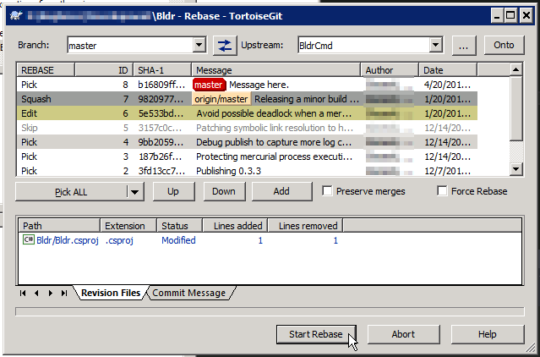
Interactive Rebase
Can move around commits by reordering lines
Apply different commands
pick – use the commit as is
reword – use commit, but modify message
edit – use commit, but stop for amending
squash – use commit, but meld into previous commit and merge messages
fixup – like “squash”, but discard this commit’s message
exec – run command (rest of line) using shell
drop – remove commit

Slide 35
Again, Be Careful!
Just want to make sure that care and attention is taken when using these operations
DO NOT use these on published changes
Don’t be afraid of these tools as they are very powerful to have in one’s git toolbelt

Slide 36
Submodules

Slide 37
What are They?
Embedded clones of other repositories placed at certain folders in the hierarchy
Points to a specific point in that repo (commit ID)
Can be setup to track a specific branch from that repo as well

Slide 38
Adding Submodules
Command to add a new submodule
$ git submodule add <remote> <local_directory>
Adds or updates a new file (.gitmodules) that contains the above information
Repository will be cloned and checked out into the local directory
Follow this up with a commit to finalize the submodule addition

Slide 39
Cloning a Repository that has Submodules
If you use a traditional clone, there is some work to do
$ git clone <repo_url>
$ git submodule init
Sets things up in git to support the submodules
$ git submodule update
Actually grabs the remote submodule and checks out the appropriate version
You can add an option to the clone to handle the init and update steps
$ git clone --recursive <repo_url>

Slide 40
Updating a Submodule
If updating content in a submodule
$ cd submodule_folder
$ git pull --rebase
$ git checkout <branch>
…add/modify files as needed…
$ git push origin <branch>
$ cd ..
$ git add submodule_folder
$ git commit
$ git push origin <branch>

Slide 41
Updating a Submodule
Easy update to latest version of submodule (for tracked branch)
$ git submodule update --remote <submodule>
More fine-grained approach
$ cd submodule
$ git checkout <branch>
$ git pull --rebase
$ cd ..
In both cases, follow this up with
$ git add submodule
$ git commit

Slide 42
Customizing Git

Slide 43
.gitconfig
Mutlilevel configuration support (similar to mercurial)
$HOME/.gitconfig is read first (user config)
REPO_PATH/.git/config is read second (repo config)
Most options apply to simplifying command line usage
Define colors
Custom command aliases
Default command behavior
Sample configuration file attached to this slide
Be aware, VS will apply some custom repo configurations if you clone through that tooling

Slide 44
[user]
Controls both the name and email associated with commits
name = Glazeski, Dean E
email = dean.e.glazeski@intel.com
These settings are important to set before commits are done
$ git config --global user.name “Glazeski, Dean E”
$ git config --global user.email “dean.e.glazeski@intel.com”

Slide 45
[alias]
co = checkout
cp = cherry-pick
ci = commit
amend = commit --amend
dc = diff --cached
ds = diff --staged
glog = log --graph --pretty=format:'%Cred%h%Creset -%C(yellow)%d%Creset %s %Cgreen(%cr) %C(bold blue)<%an>%Creset‘
ls = log --pretty=format:'%C(yellow)%h%Cred%d %Creset%s%C(bold blue) [%cn]' --decorate
switch = "!f() { git checkout $1; git submodule update; }; f"

Slide 46
Git Local Workflows

Slide 47
Git Local Workflows
Topic Workflow
Master Branch Workflow
Alternative Master Branch Workflow

Slide 48
Topic Workflow
$ git checkout master
$ git pull origin master
$ git checkout -b topic
…do work, commit, rebase etc…
$ git checkout master
$ git pull origin master
$ git checkout topic
$ git rebase master
$ git checkout master
$ git merge topic
$ git push origin master
$ git branch -D topic
master
C3
origin/master
C2
C1
C0

Slide 49
Topic Workflow
$ git checkout master
$ git pull origin master
$ git checkout -b topic
…do work, commit, rebase etc…
$ git checkout master
$ git pull origin master
$ git checkout topic
$ git rebase master
$ git checkout master
$ git merge topic
$ git push origin master
$ git branch -D topic
topic
master
C3
origin/master
C2
C1
C0

Slide 50
Topic Workflow
$ git checkout master
$ git pull origin master
$ git checkout -b topic
…do work, commit, rebase etc…
$ git checkout master
$ git pull origin master
$ git checkout topic
$ git rebase master
$ git checkout master
$ git merge topic
$ git push origin master
$ git branch -D topic
topic
C5
C4
master
C3
origin/master
C2
C1
C0

Slide 51
Topic Workflow
$ git checkout master
$ git pull origin master
$ git checkout -b topic
…do work, commit, rebase etc…
$ git checkout master
$ git pull origin master
$ git checkout topic
$ git rebase master
$ git checkout master
$ git merge topic
$ git push origin master
$ git branch -D topic
topic
C5
C4
master
C3
origin/master
C2
C1
C0

Slide 52
Topic Workflow
$ git checkout master
$ git pull origin master
$ git checkout -b topic
…do work, commit, rebase etc…
$ git checkout master
$ git pull origin master
$ git checkout topic
$ git rebase master
$ git checkout master
$ git merge topic
$ git push origin master
$ git branch -D topic
master
C7
origin/master
topic
C5
C6
C4
C3
C2
C1
C0

Slide 53
Topic Workflow
$ git checkout master
$ git pull origin master
$ git checkout -b topic
…do work, commit, rebase etc…
$ git checkout master
$ git pull origin master
$ git checkout topic
$ git rebase master
$ git checkout master
$ git merge topic
$ git push origin master
$ git branch -D topic
master
C7
origin/master
topic
C5
C6
C4
C3
C2
C1
C0

Slide 54
Topic Workflow
$ git checkout master
$ git pull origin master
$ git checkout -b topic
…do work, commit, rebase etc…
$ git checkout master
$ git pull origin master
$ git checkout topic
$ git rebase master
$ git checkout master
$ git merge topic
$ git push origin master
$ git branch -D topic
master
C7
origin/master
topic
C5
C6
C4
C3
C2
C1
C0

Slide 55
Topic Workflow
$ git checkout master
$ git pull origin master
$ git checkout -b topic
…do work, commit, rebase etc…
$ git checkout master
$ git pull origin master
$ git checkout topic
$ git rebase master
$ git checkout master
$ git merge topic
$ git push origin master
$ git branch -D topic
topic
C5’
C4’
master
C7
origin/master
C5
C6
C4
C3
C2
C1
C0

Slide 56
Topic Workflow
$ git checkout master
$ git pull origin master
$ git checkout -b topic
…do work, commit, rebase etc…
$ git checkout master
$ git pull origin master
$ git checkout topic
$ git rebase master
$ git checkout master
$ git merge topic
$ git push origin master
$ git branch -D topic
topic
C5’
C4’
master
C7
origin/master
C5
C6
C4
C3
C2
C1
C0

Slide 57
Topic Workflow
$ git checkout master
$ git pull origin master
$ git checkout -b topic
…do work, commit, rebase etc…
$ git checkout master
$ git pull origin master
$ git checkout topic
$ git rebase master
$ git checkout master
$ git merge topic
$ git push origin master
$ git branch -D topic
master
topic
C5’
C4’
C7
origin/master
C5
C6
C4
C3
C2
C1
C0

Slide 58
Topic Workflow
$ git checkout master
$ git pull origin master
$ git checkout -b topic
…do work, commit, rebase etc…
$ git checkout master
$ git pull origin master
$ git checkout topic
$ git rebase master
$ git checkout master
$ git merge topic
$ git push origin master
$ git branch -d topic
master
topic
C5’
origin/master
C4’
C7
C5
C6
C4
C3
C2
C1
C0

Slide 59
Topic Workflow
$ git checkout master
$ git pull origin master
$ git checkout -b topic
…do work, commit, rebase etc…
$ git checkout master
$ git pull origin master
$ git checkout topic
$ git rebase master
$ git checkout master
$ git merge topic
$ git push origin master
$ git branch -d topic*
master
C5’
origin/master
C4’
C7
C5
C6
C4
C3
C2
C1
C0
* Not required. Developer can choose to keep or remove local branches

Slide 60
Master Branch Flow
$ git checkout master
…do work, commit, rebase, etc…
$ git fetch origin master
$ git rebase origin/master
$ git push origin master
master
C3
origin/master
C2
C1
C0

Slide 61
Master Branch Flow
$ git checkout master
…do work, commit, rebase, etc…
$ git fetch origin master
$ git rebase origin/master
$ git push origin master
master
C5
C4
C3
origin/master
C2
C1
C0

Slide 62
Master Branch Flow
$ git checkout master
…do work, commit, rebase, etc…
$ git fetch origin master
$ git rebase origin/master
$ git push origin master
master
C5
C7
origin/master
C4
C6
C3
C2
C1
C0

Slide 63
Master Branch Flow
$ git checkout master
…do work, commit, rebase, etc…
$ git fetch origin master
$ git rebase origin/master
$ git push origin master
master
C5’
C4’
C5
C7
origin/master
C4
C6
C3
C2
C1
C0

Slide 64
Master Branch Flow
$ git checkout master
…do work, commit, rebase, etc…
$ git fetch origin master
$ git rebase origin/master
$ git push origin master
master
C5’
origin/master
C4’
C5
C7
C4
C6
C3
C2
C1
C0

Slide 65
Master Branch Flow (alt)
$ git checkout master
…do work, commit, rebase, etc…
$ git pull --rebase origin master
$ git push origin master
master
C3
origin/master
C2
C1
C0

Slide 66
Master Branch Flow (alt)
$ git checkout master
…do work, commit, rebase, etc…
$ git pull --rebase origin master
$ git push origin master
master
C5
C4
C3
origin/master
C2
C1
C0

Slide 67
Master Branch Flow (alt)
$ git checkout master
…do work, commit, rebase, etc…
$ git pull --rebase origin master
$ git push origin master
master
C5’
C4’
C5
C7
origin/master
C4
C6
C3
C2
C1
C0

Slide 68
Master Branch Flow (alt)
$ git checkout master
…do work, commit, rebase, etc…
$ git pull --rebase origin master
$ git push origin master
master
C5’
origin/master
C4’
C5
C7
C4
C6
C3
C2
C1
C0

Slide 69
Example HDMTOS Scenarios

Slide 70
Critical Ticket
Ticket impacting production targeting 3.4.2 identified
Target versions include 3.4.3 and 3.5.0
Working directory is messy, but committing isn’t an option
What’s more, current branch is master
How to proceed…

Slide 71
Working on the Ticket
$ git stash save “CoolFeatureWIP”
$ git clean -X
$ git checkout 3.4.2
$ git pull --rebase
...build and reproduce issue...
...fix the issue...
$ git add path/to/buggy/file.cpp
$ git commit -m “Fixed the critical interrupt”
$ git pull --rebase
$ git push origin 3.4.2
$ git checkout 3.4.3
$ git pull --rebase
$ git cherry-pick 3.4.2
...validate the fix...
$ git push origin 3.4.3
$ git checkout master
$ git cherry-pick 3.4.3
...validate the fix...
$ git push origin master
$ git stash pop
...now back to the start...

Slide 72
Additional Information

Slide 73
Git Resources
Git
https://git-scm.com/
Free Book! https://git-scm.com/book/en/v2
TortoiseGit
https://tortoisegit.org/
Git installers and other nice things
\\datagroveaz\sttd\HDMT\TOS\Development\Users\deglazes\Applications\Git
Helpful guide to compare mercurial operations to git
https://www.mercurial-scm.org/wiki/GitConcepts
Interactive Tutorial
http://learngitbranching.js.org/
Git HG Rosetta Stone
https://github.com/sympy/sympy/wiki/Git-hg-rosetta-stone

Slide 74
Need Help?
Just type `git`
Lists out all the commands with a description of what they do
`git help <command>` or `git <command> --help`
Opens a web browser with detailed help information about the command
`git <command> -h`
Shows quick help like command line options and brief description

Slide 76
Additional Topics
Interactive Session
Hunk commits (adv.)
Demo merge conflict
Demo interactive rebase
Demo multiple remotes
Demo rebase autosquash (adv.)?

Slide 77
Distributed Workflows

Slide 78
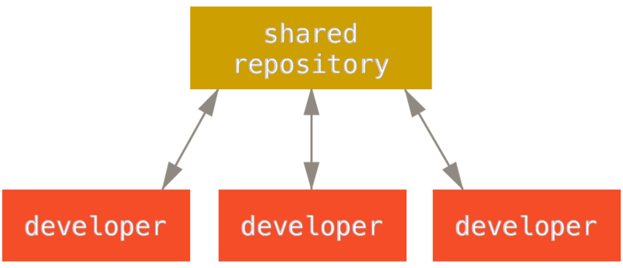
Centralized Workflow
One repo, everyone can push
Very similar to normal TFVC and SVN flows
https://git-scm.com/book/en/v2/Distributed-Git-Distributed-Workflows

Slide 79
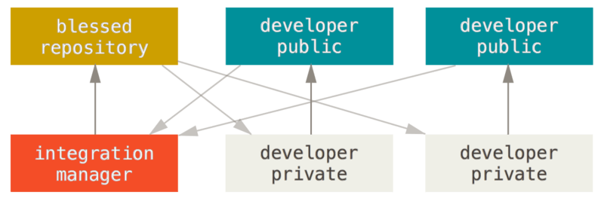
Integration-Manager Workflow
Developers work and push to their own repositories based on the “blessed” repo
Integration manager pulls developers’ code and merges into blessed repo
GitHub and GitLab flows are examples of this
https://git-scm.com/book/en/v2/Distributed-Git-Distributed-Workflows

Slide 80
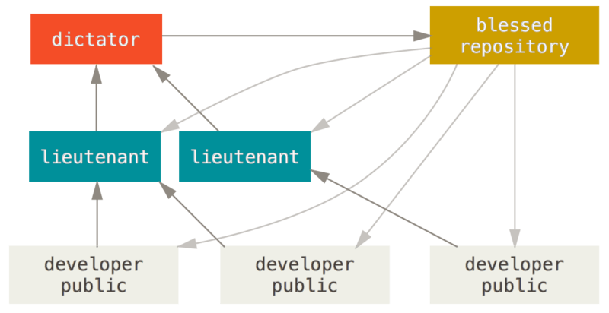
Dictator and Lieutenants Workflow
Developers work on topic branches and rebase on master
Lieutenants pull developer code and merge to their master
Dictator pulls from lieutenant and pushes to the main repo
Everyone pulls from blessed to get latest
Linux kernel development follows this model
https://git-scm.com/book/en/v2/Distributed-Git-Distributed-Workflows

Slide 81
GUI Demo

Slide 82
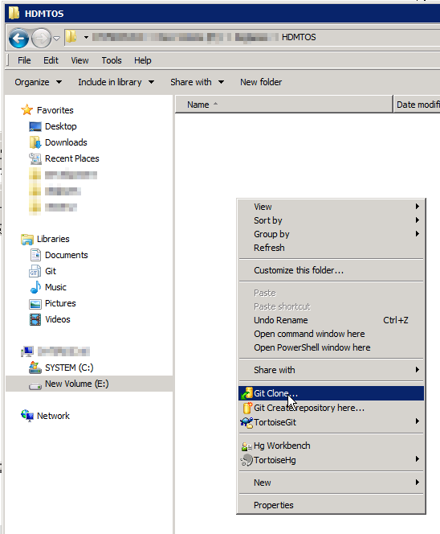
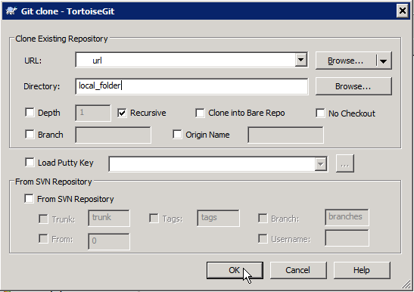
Cloning
Recursively Clone Submodules

Slide 83
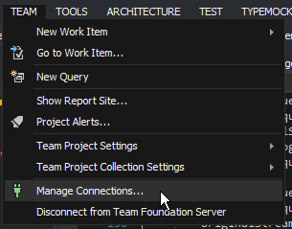

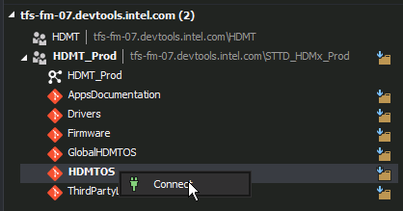
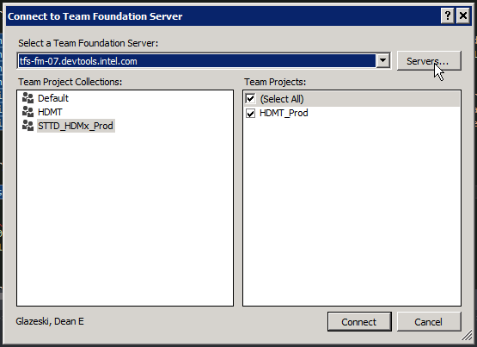
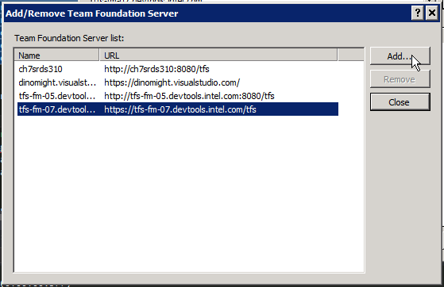
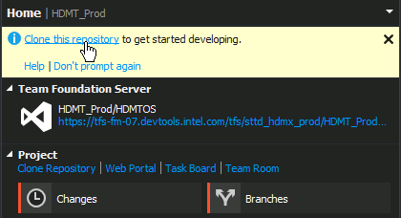
Cloning

Slide 84
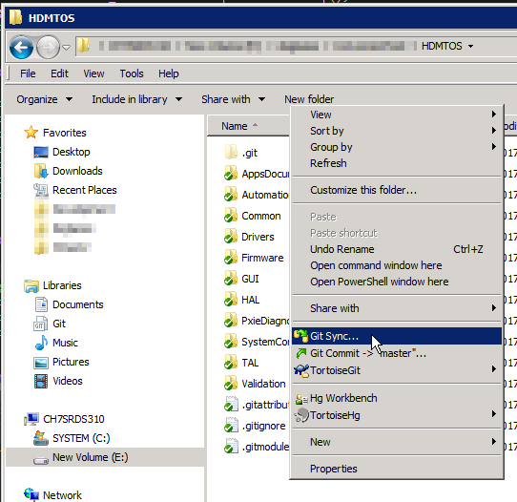
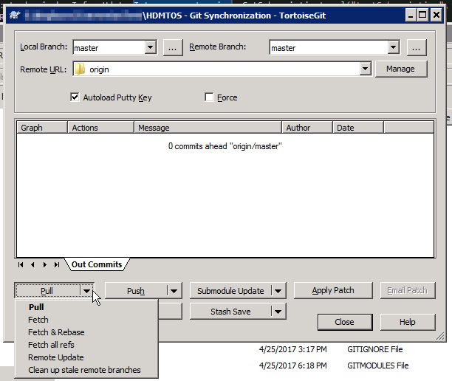
Pulling and Fetching

Slide 85
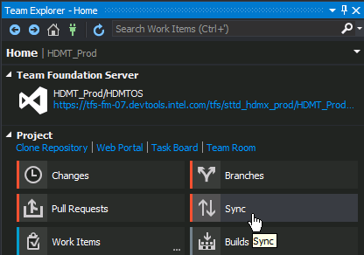
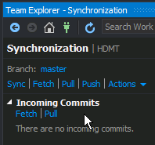
Pulling and Fetching

Slide 86
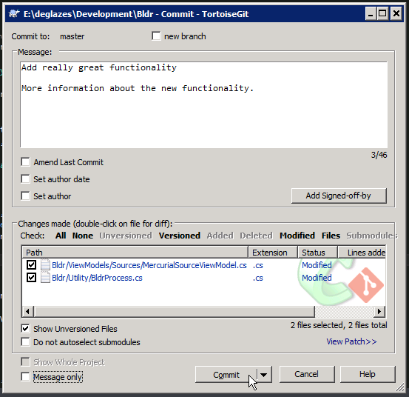
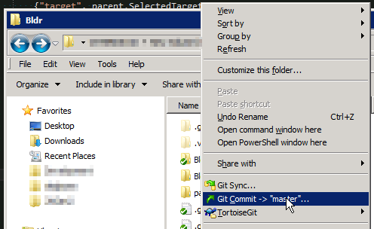
Staging and Committing
Notes:
You’ll notice how there isn’t really a way to stage from TortoiseGit. It effectively works similar to a normal TortoiseHg and how it handles normal committing.

Slide 87
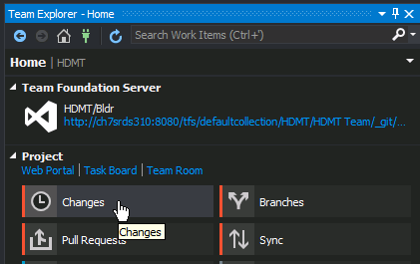
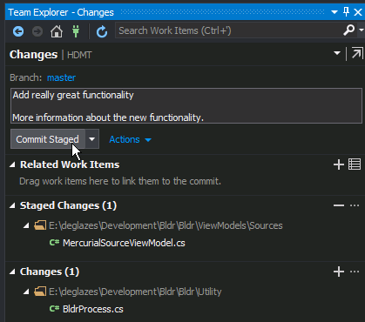
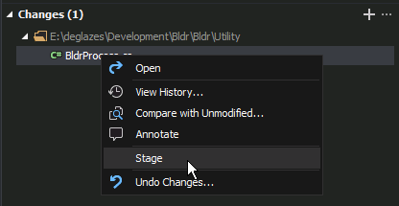
Staging and Committing

Slide 88
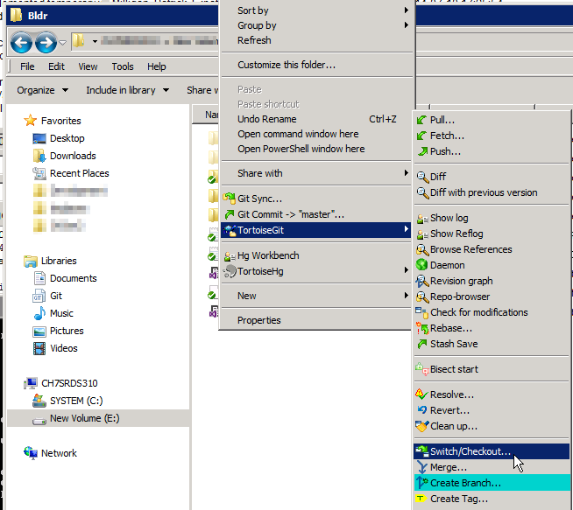
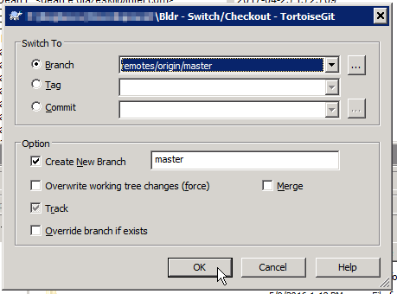
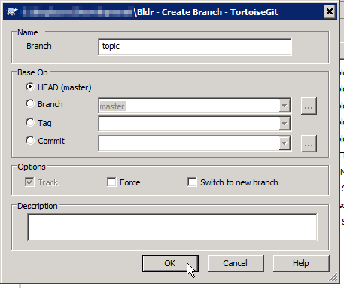
Branching

Slide 89
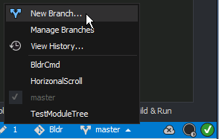
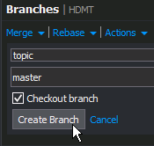
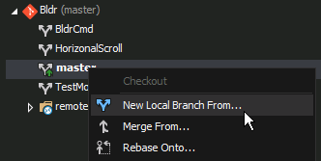
Branching

Slide 90
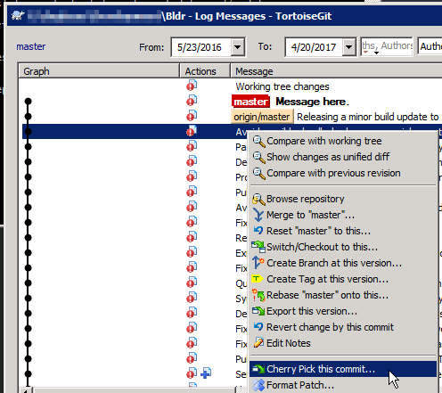
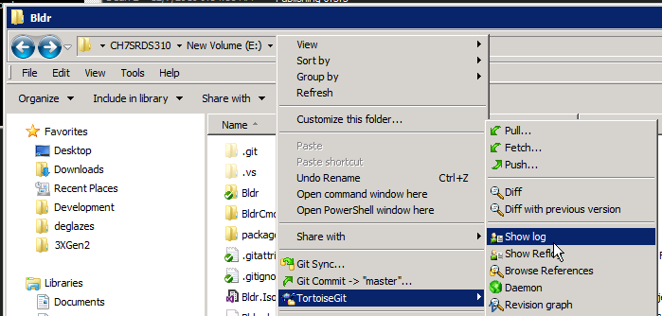
Cherry-Pick

Slide 91
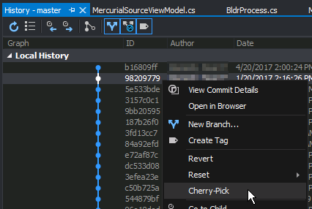
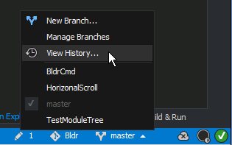
Cherry-Pick

Slide 92
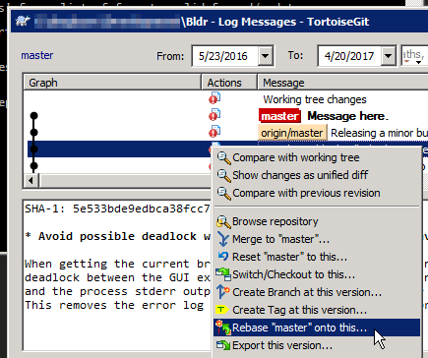
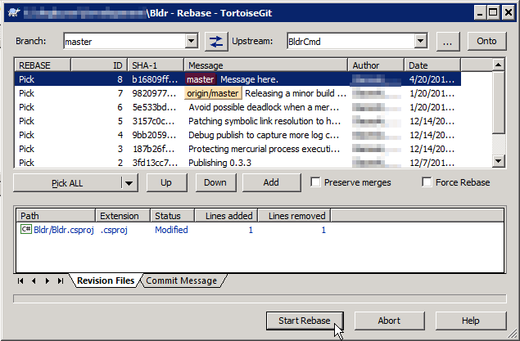
Rebase

Slide 93
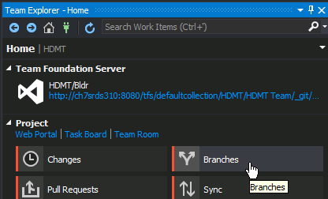
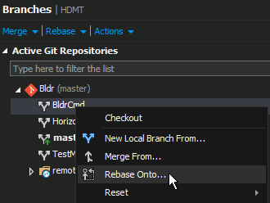
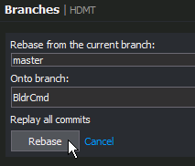
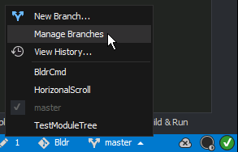
Rebase

Slide 94
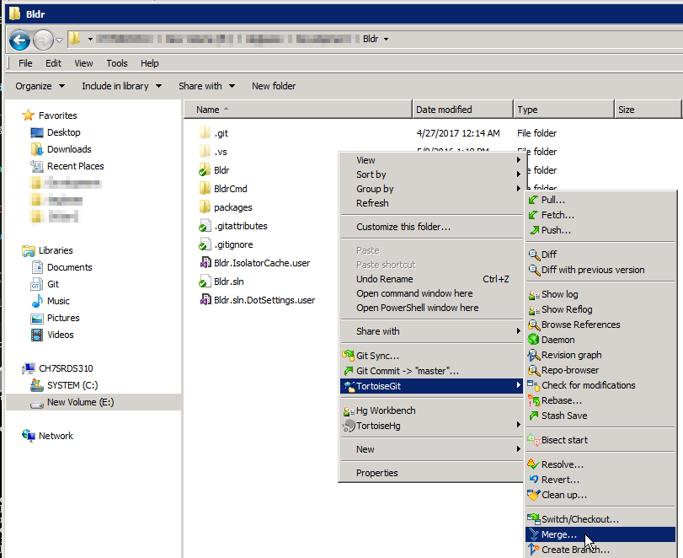
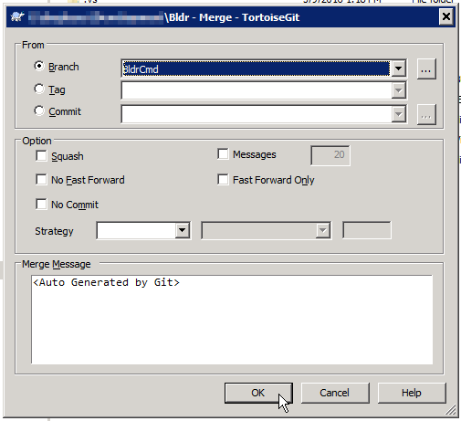
Merging

Slide 95
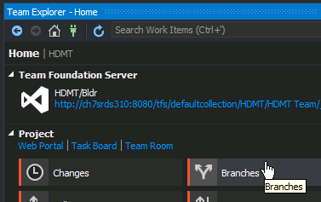
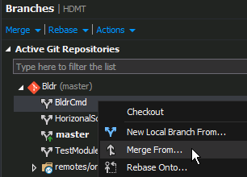
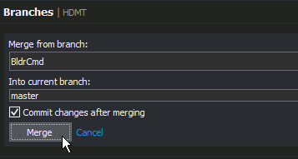
Merging

Slide 96
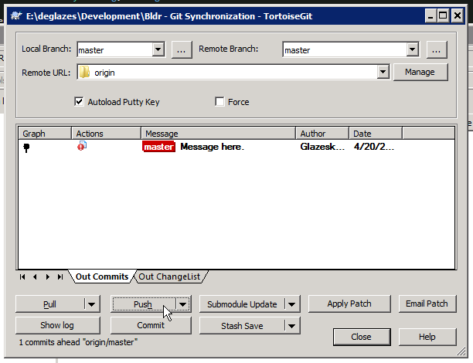
Pushing

Slide 97
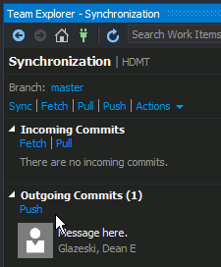
Pushing

Slide 98
mkdir test
git init .

