Slide 1
Requirements Engineering
Requirement: A function, constraint or other property that the system must provide to fill the needs of the system’s intended user(s)
Engineering: implies that systematic and repeatable techniques should be used
Requirement Engineering means that requirements for a product are defined, managed and tested systematically.

Slide 2
Requirements Engineering
Requirement: A function, constraint or other property that the system must provide to fill the needs of the system’s intended user(s)
Engineering: implies that systematic and repeatable techniques should be used
Requirement Engineering means that requirements for a product are defined, managed and tested systematically.

Slide 3
Requirements Engineering
Feasibility Study
Requirements Elicitation
Requirements Analysis
Requirements Documentation
Requirements Review/ verification

Slide 4
Requirements Engineering
Requirements describe the “what” is the system, not the “how” is the system.
Requirements Engineering produces a one large document, written in a natural language, contains a description of what the system will do.

Slide 5
Characteristics of Requirements
Are the requirements correct?
Are the requirements consistent?
Are the requirements unambiguous?
Are the requirements complete?
Are the requirements feasible?
Is every requirement is relevant?
Are the requirements testable?
Are the requirements traceable?

Slide 6
Why is Getting Good Requirements Hard?
Stakeholders don’t know what they really want.
Stakeholders express requirements in their own terms.
Different stakeholders may have conflicting requirements.
Organisational and political factors may influence the system requirements.
The requirements change during the RE process. New stakeholders may emerge and the business environment change.

Slide 7
Type of Requirements
Known requirements
Unknown requirements
Undreamt requirements

Slide 8
Type of Requirements
Functional requirements
Nonfunctional requirements

Slide 9
Functional requirements and Nonfunctional requirements
Functional requirements :These are statements of services the system should provide, how the system should react to particular inputs, and how the system should behave in particular situations.
In some cases, the functional requirements may also explicitly state what the system should not do.
Non-functional requirements These are constraints on the services or functions offered by the system. They include timing constraints, constraints on the development process, and constraints imposed by standards.
Non-functional requirements often apply to the system as a whole, rather than individual system features or services.

Slide 10
Functional Requirements
Example: Library Management System
Issue of books
A student of any course should able to get books
Books from general section will be issued
A limitation is imposed on no of books
Semester books and general books
The software will take system date as book issued data
Bar code reader to detect the book details.
Return of books
Any person can return the book the issued books.
The student information is displayed using bar code detector.
The system displays the student details, issued date, return due date.
The system operator verifies due date, fine will imposed if due date is over.
The information will be saved
Enquiry/Query processing
The system should be able to provide information like
Availability of books
Availability of a particular author
Number copies available of desired book.

Slide 11
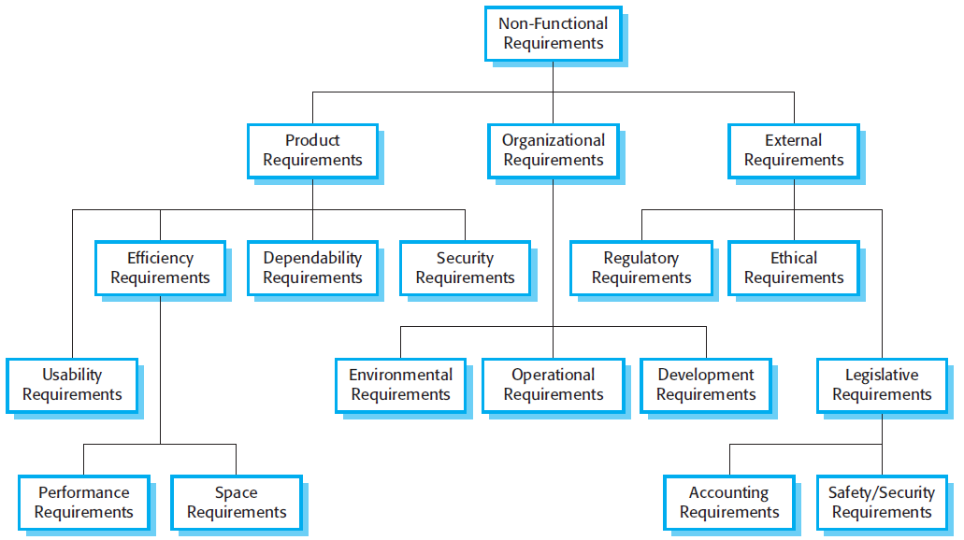
Nonfunctional Requirements

Slide 12
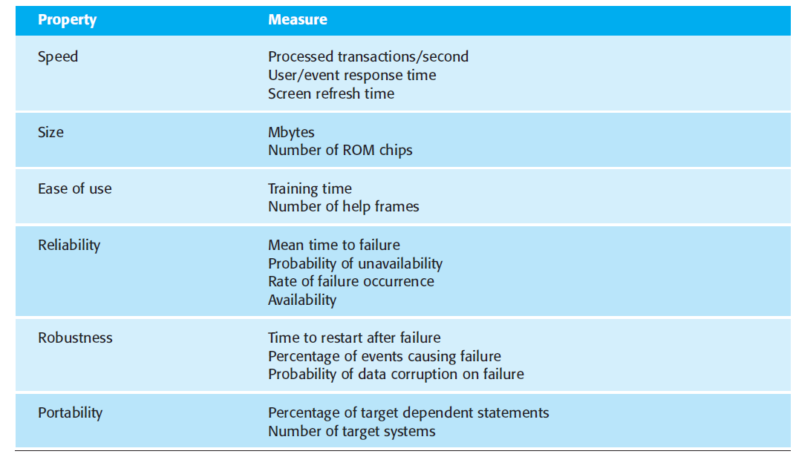
Measuring the Nonfunctional requirements

Slide 13
Requirements Engineering
Problem Statement
Feasibility Study
Requirements
Engineering
Elicitation
Analysis
Documentation
SRS
Review

Slide 14
Requirements Engineering
Feasible Study: Assessing whether system is useful to business.
Requirements Elicitation: Also known as gathering of requirements. Requirements are identified with the help of the customer and existing system processes, if available.
Requirements Analysis: The requirements are analyzed in order to identify inconsistencies, defects, omissions, conflicts, etc.
Requirements Documentation: The documentation is very important as it will be foundation for the software design of the software. The document known as Software Requirement Specification (SRS).
Requirement Review: The review process is carried out to improve the quality of SRS.

Slide 15
The SRS should be consistent; correct and complete with respect to customer needs; understandable to the users, customers, designers, developers and Testers.
The SRS document may act as contract between the developer and customer.

Slide 16
Feasibility Study
For all new systems, the requirement engineering process should start with a feasibility study.
The input to the feasibility study is set of preliminary business requirements.
The result of feasibility study should be a report that recommends whether it is worth carrying on with RE and System development process or not.
A feasible study is a short, focused on
Does the system contribute to the overall objectives of the organization?
Can the system be implemented using current technology and with in cost and schedule constraints?
Can the system be integrated with other systems which are already in place?

Slide 17
Requirements Elicitation
requirements elicitation is the practice of collecting the requirements of a system from users, customers and other stakeholders.
The practice is also sometimes referred to as "requirement gathering“
Requirements are gathered by asking questions, writing answers, asking other questions, etc.
Developers and users have different mind set, expertise and vocabularies.
requirements elicitation requires the collaboration of several participants who have different background.

Slide 18
Interviewing
Formal or informal interviews with stakeholders are part of most RE processes.
An Interview is generally conducted by an experienced analyst, who has some generic knowledge about the application domain as well.
Types of interview
Closed interviews based on pre-determined list of questions
Open interviews where various issues are explored with stakeholders.
Effective interviewing
Be open-minded, avoid pre-conceived ideas about the requirements and are willing to listen to stakeholders.
Prompt the interviewee to get discussions going using a springboard question, a requirements proposal, or by working together on a prototype system.

Slide 19
Interviews in practice
Normally a mix of closed and open-ended interviewing.
Interviews are good for getting an overall understanding of what stakeholders do and how they might interact with the system.
Interviews are not good for understanding domain requirements
Requirements engineers cannot understand specific domain terminology;
Some domain knowledge is so familiar that people find it hard to articulate or think that it isn’t worth articulating.

Slide 20
Requirements Elicitation
Questionnaire: Questionnaires are one of the methods of gathering requirements in less cost []. Questionnaires reach a large number of people, not only in less time but also in a lesser cost. The general factors which affect the usage of the questionnaire are
The available resources to gather the requirements mainly depends on the available resource
Type of Requirements that has to be gathering depends on the level of the respondent’s knowledge and background.
Anonymity provided to the respondent

Slide 21
Questionnaires
Validity
- sample size, audience
Reliability
Questions
- open ended
- fill in the blank
- multiple choice
- rating scales

Slide 22
Brainstorming
To invent new way of doing things or when much is unknown
When there are few or too many ideas
Early on in a project particularly when:
Terrain is uncertain
There is little expertise for the type of applications
Innovation is important (e.g., novel system)
Two main activities:
The Storm: Generating as many ideas as possible (quantity, not quality) – wild is good!
The Calm: Filtering out of ideas (combine, clarify, prioritize, improve…) to keep the best one(s) – may require some voting strategy
Roles: scribe, moderator (may also provoke), participants

Slide 23
Brainstorming – Objectives
Hear ideas from everyone, especially unconventional ideas
Keep the tone informal and non-judgemental
Keep the number of participants “reasonable“ – if too many, consider a “playoff “-type filtering and invite back the most creative to multiple sessions
Encourage creativity
Choose good, provocative project name.
Choose good, provocative problem statement
Get a room without distractions, but with good acoustics, whiteboards, coloured pens, provide coffee/donuts/pizza/beer
Provide appropriate props/mock-ups

Slide 24
Brainstorming – Participants
Virtually any stakeholder, e.g.
Developers
Domain experts
End-users
Clients
...
“Ideas-people” – a company may have a special team of people
Chair or participate in brainstorming sessions
Not necessarily further involved with the project

Slide 25
Brainstorming – The Storm
Goal is to generate as many ideas as possible
Quantity, not quality, is the goal at this stage
Look to combine or vary ideas already suggested
No criticism or debate is permitted – do not want to inhibit participants
Participants understand nothing they say will be held against them later on
Scribe writes down all ideas where everyone can see
e.g., whiteboard, paper taped to wall
Ideas do not leave the room
Wild is good
Feel free to be gloriously wrong
Participants should NOT censor themselves or take too long to consider whether an idea is practical or not – let yourself go!

Slide 26
Brainstorming – The Calm
Go over the list of ideas and explain them more clearly
Categorize into "maybe" and "no" by pre-agreed consensus method
Informal consensus
50% + 1 vote vs. “clear majority”
Does anyone have veto power?
Be careful about time and people
Meetings (especially if creative or technical in nature) tend to lose focus after 90 to 120 minutes – take breaks or reconvene later
Be careful not to offend participants
Review, consolidate, combine, clarify, improve
Rank the list by priority somehow
Choose the winning idea(s)

Slide 27
Requirements Elicitation
Facilitated Application Specification Approach(FAST):
The objective is to close the gap between what the developers intend and what users expect.
It is a team-oriented approach for gathering requirements.
Meetings are conducted at a neutral site attended by both developers and users.
The group establishes rules for preparation and participation.
An agenda is suggested that with enough formality to cover all important points but informal enough to encourage the free flow of ideas.
A facilitator controls the meeting.
A definition mechanism is used.

Slide 28
FAST
After initial meeting, user and developer should write a one or two product request form. Before the next meeting it is distributed to all other attendees. Each attendee is asked to make the following lists:
List of objects
List of services
List of constraints
performance criteria

Slide 29
Comparison of Data-Gathering Techniques¹
Technique | Good for | Kind of data | Plus | Minus
Questionnaires | Answering specific questions | Quantitative and qualitative data | Can reach many people with low resource | The design is crucial. Response rate may be low. Responses may not be what you want
Interviews | Exploring issues | Some quantitative but mostly qualitative data | Interviewer can guide interviewee. Encourages contact between developers and users | Time consuming. Artificial environment may intimidate interviewee
Focus groups and workshops | Collecting multiple viewpoints | Some quantitative but mostly qualitative data | Highlights areas of consensus and conflict. Encourages contact between developers and users | Possibility of dominant characters
[1] Preece, Rogers, and Sharp “Interaction Design: Beyond human-computer interaction”, p214

Slide 30
Requirement Elicitation: Quality Function Development
Incorporate with the voice customer
The voice is translated into technical requirements and these requirements are documented.
Normal Requirements
Expected Requirements
Exciting Requirements
A value indicating a degree of importance of each requirements (1 to 5).

Slide 31
Use Case Approach
The approach uses a combination of text and pictures in order to improve the understanding the requirements.
Use case, Use case scenario and Use case diagrams.

Slide 32
Use Case Diagrams
Use case diagrams are used to visualize, specify, construct, and document the (intended) behavior of the system, during requirements capture and analysis.
Provide a way for developers, domain experts and end-users to Communicate.
Serve as basis for testing.
Use case diagrams contain use cases, actors, and their relationships.

Slide 33
Use Case
name
Use cases specify desired behavior.
A use case is a description of a set of sequences of actions, including variants, a system performs to yield an observable result of value to an actor.
Each sequence represent an interaction of actors with the system.

Slide 34
Specifying the Behavior of a Use Case
Describing the flow of events within the use case.
Can be done in natural language, formal language or pseudo-code.
Includes: how and when the use case starts and ends; when the use case interacts with actors and what objects are exchanged; the basic flow and alternative flows of the behavior.

Slide 35
Actors
name
An actor represents a set of roles that users of use case play when interacting with these use cases.
Actors can be human or automated systems.
Actors are entities which require help from the system to perform their task or are needed to execute the system’s functions.
Actors are not part of the system.

Slide 36
Use Cases and Actors
From the perspective of a given actor, a use case does something that is of value to the actor, such as calculate a result or change the state of an object.
The Actors define the environments in which the system lives

Slide 37
Example of Use Case Diagram
registration
updating
grades
student
faculty
output
generating

Slide 38
Relationships between Use Cases
1. Generalization - use cases that are specialized versions of other use cases.
2. Include - use cases that are included as parts of other use cases. Enable to factor common behavior.
3. Extend - use cases that extend the behavior of other core use cases. Enable to factor variants.

Slide 39
1. Generalization
The child use case inherits the
behavior and meaning of the
parent use case.
The child may add to or
override the behavior of its parent.
parent
child

Slide 40
More about Generalization
registration
non-graduate
registration
graduate
registration

Slide 41
2. Include
The base use case explicitly incorporates the behavior of another use case at a location specified in the base.
The included use case never stands alone. It only occurs as a part of some larger base that includes it.
base
<<include>>
included

Slide 42
More about Include
Enables to avoid describing the same flow of events several times by putting the common behavior in a use case of its own.
updating
grades
<<include>>
verifying
student id
output
generating
<<include>>

Slide 43
3. Extend
The base use case implicitly incorporates the behavior of another use case at certain points called extension points.
The base use case may stand alone, but under certain conditions its behavior may be extended by the behavior of another use case.
base
<<extend>>
extending

Slide 44
More about Extend
Enables to model optional behavior or branching under conditions.
<<extend>>
Exam-grade appeal
Exam copy request

Slide 45
Relationships between Actors
Generalization.
student
graduate
student
non-graduate
student

Slide 46
Relationships between Use Cases and Actors
Actors may be connected to use cases by associations, indicating that the actor and the use case communicate with one another using messages.
updating
grades
faculty

Slide 47
Example
place
conference call
place
phone call
<<extend>>
cellular
network
receive
additional call
receive
phone call
<<extend>>
use
scheduler
user
Cellular Telephone

Slide 48
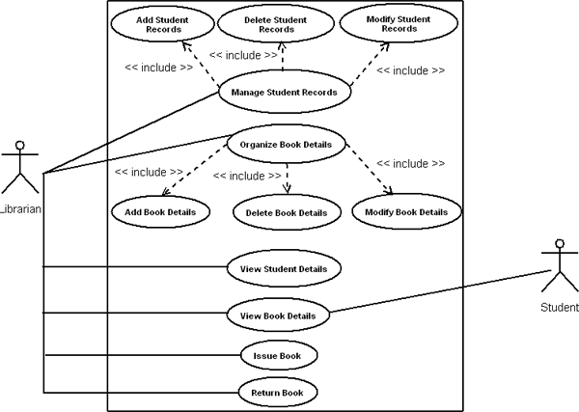
Example
<<exclude>>
Fine

Slide 49
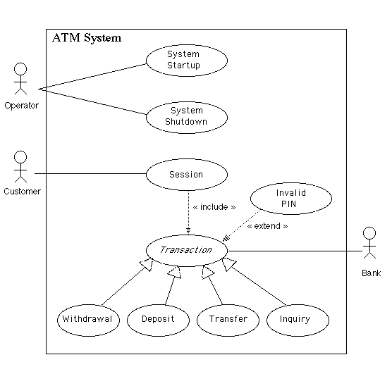
Example

Slide 50
Use Case Template
There are many different templates for use cases but they often consist of a subset of the following items:
Identifier: unique label for use case used to reference it elsewhere
Name: succinctly state user task independently of the structure or implementation
Suggested form “verb object” (e.g., Order a product)
Authors: people who discovered use case
Goal: short description of expected outcome from actors’ point of view
Preconditions: what needs to be satisfied before use case can begin
Postconditions: state of system after completion of use case
Minimal guarantee: state of system after completion regardless of outcome

Slide 51
Use Case Template continued...
Primary actor: initiates the use case
Participants (secondary actors): other actors involved in use case, provide services to the system and interact with the system after the use case was initiated
Related requirements: identifiers of functional and non-functional requirements linked to the use case
Related use cases: identifiers of related use cases
Specify relationship: e.g.
Supposes use case UC2 has been successfully completed
Alternative to use case UC3
...
Description of events (scenarios)
Different use case description formats
Narrative, Simple column, Multiple columns

Slide 52
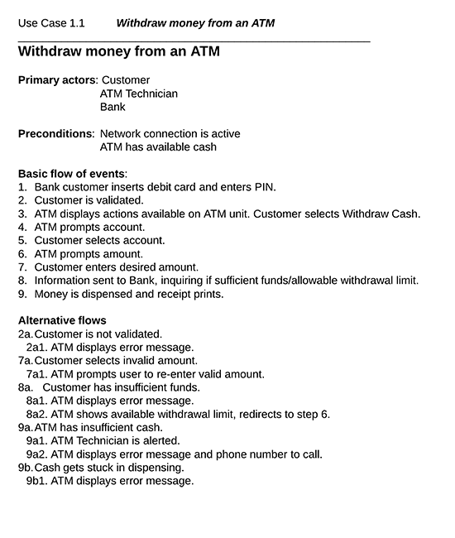
Example 1

Slide 53
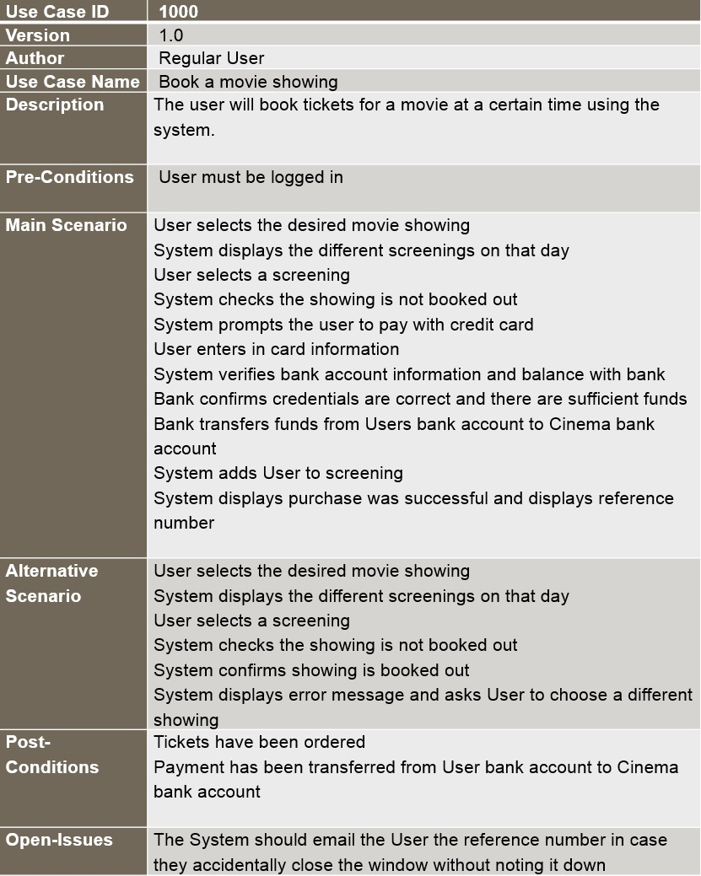
Example 2

Slide 54
Benefits of Use Case-Based Software Development
They can help to define the scope of the system
They are often used to plan the development process
They are used to both develop and validate the requirements
Simple, easy to create
All stakeholders understand them
Often reflect user's essential requirements
Separates normal behavior from exceptional behavior
They can form the basis for the definition of test cases
They can be used to structure user manuals

Slide 55
Quality Function Deployment
It is a technique that translate the needs of the customer into technical requirement for software.
Concentrates on maximizing customer satisfaction.
QFD emphasizes – what is valuable to the customer and then deploys these values throughout the engineering process.
Three types of requirement:
Normal Requirements – reflect objectives and goals stated for product. If requirement are present in final products, customer is satisfied.
Expected Requirements – customer does not explicitly state them. Customer assumes it is implicitly available with the system.
Exciting Requirements- Features that go beyond the customer’s expectation.
During meeting with customer –
Function deployment determines the “value” of each function required of the system.
Information deployment identifies data objects and events and also tied with functions.
Task deployment examines the behavior of the system.
Value analysis determines the priority of requirements during these 3 deployments.

Slide 56
Requirement Analysis
Requirement Analysis is to analyze, refine and scrutinize the gathered requirements in order to make consistent and unambiguous requirements.
Review the all requirements and provide a graphical view of the entire system.

Slide 57
Requirements Analysis
Draw Context Diagram
Develop Prototype (optional)
Model Requirements
Finalize Requirements

Slide 58
Requirement analysis
Context Diagram
Defines the boundaries and interfaces of the proposed system with external world.
Administrator
Marks entry operator
Subject infn
Entry
Student
Infn
entry
Student Result System
Marks entry
Student performance
generated
Students information
generated
Marks sheet
generated

Slide 59
Development of a prototype(optional): Prototype preferably act as a part of a system what the customer wants.
The prototype should be built quickly and relatively low cost.
Model the Requirements: process consists of various graphical representations of functions, data entities, external entities an relational between them. DFD, ER, Data dictionaries, state chart diagrams, etc.
Finalize the Requirements: The inconsistencies and ambiguities have been identified and corrected. Finalize the requirements and next step is document these requirements in prescribed format.

Slide 60
Analysis Model - A Bridge

Slide 61
Elements of Analysis model
There are two approaches
Structured Analysis:-
Data objects are modeled in a way that defines their attributes and relationships.
Processes that manipulate data objects in a manner that shows how they transform data as data objects flow through the systems.
Object Oriented Analysis :-
Focuses on the definition of classes and the manner in which they collaborate with one another.
UML is predominantly object oriented.

Slide 62
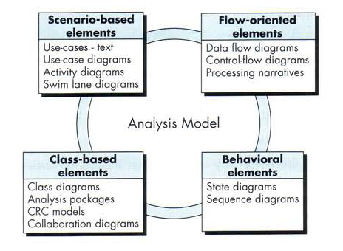
Elements of Analysis model

Slide 63
Modeling the Requirements: Structural Model
Data Flow Diagrams:
Data flow diagrams (DFDs) are one of the diagramming techniques used in structured systems analysis and design
Data flow diagrams show:
Data flowing through a system to or from users (external entities)
The processes that transform the data
The data stores that hold the data

Slide 64
Diff B/W DFD and Flow chart
Processes on DFDs can operate in parallel (at-the-same-time)
Processes on flowcharts execute one at a time
DFDs show the flow of data through a system
Flowcharts show the flow of control (sequence and transfer of control)
Processes on a DFD can have dramatically different timing (daily, weekly, on demand)
Processes on flowcharts are part of a single program with consistent timing

Slide 65
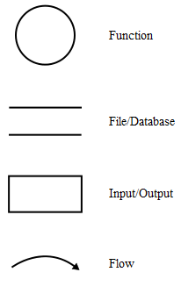
DFD Elements
Process → verb phrase
a system name
a subsystem name
Data Store → Noun
External Entity → Noun
Data Flow → Names of data

Slide 66
Creating Data Flow Diagrams
Steps:
Create a list of activities
Construct Context Level DFD (identifies external entities and processes)
Construct Level 0 DFD (identifies manageable sub process )
Construct Level 1- n DFD (identifies actual data flows and data stores )
Check against rules of DFD

Slide 67
Context Diagram
Campaign Manager
Staff Assignment
Payment
Accountant
Campaign
Staff
Client
Agate
Campaign
Management
System
Staff Grade
Staff
Contact
Advert Completion
Budget
Client Contact
Campaign Staff
Advert
Concept Note
Staff
Concept Note

Slide 68
Top Level Diagram (Level 0)
Campaign Manager
Client
1.
Record
Clients
Clients
4.
Maintain
Staff
Staff
Accountant
Client
Staff
Staff Grade
Staff Members
Payment
Campaign
Staff
Staff
Advert Completion
Budget
2.
Plan and
Manage
Campaigns
Campaigns
5.
Manage
Adverts
Staff
Contact
Campaign
Staff Assignment
Cost
Contact
+ Completion Date
Client Contact
Campaign Staff
Advert
3.
Prepare
Adverts
Adverts
Advert
6.
Browse
Concept
Notes
Concept
Note
Staff
Concept Note
Concept Note
Concept
Note
Notes
Concept
Note

Slide 69
Level 1 Diagram
Staff Members
Client Contact
Staff
5.1
Set Client
Contact
Contact
Adverts
Advert Completion
5.2
Set Advert Completed
Completion Date

Slide 70
Data Dictionaries
DFDs are supported by data dictionary entries
Each element is defined in a data dictionary
Data elements - name and data type
Data structures - name and composition
Data flows - name and content
Data stores - name and data structures contained
Processes - name and specification of the process, for example in Structured English

Slide 71
Data Dictionary
Client Contact = Staff ID + Advert Name
Staff = Staff ID + First Name + Last Name + Start Date + Grade + Date Of Birth
Staff Members = {Staff}
Contact = Staff ID

Slide 72
What DFDs can be used for
Modelling existing systems that are to be re-engineered using an object-oriented approach
Modelling data flows in systems that do no more than transform data
Modelling business processes in existing manual systems
Determining the automation boundary for a system (what is to be computerized)

Slide 73
Why DFDs aren’t used in O-O
In DFDs a clear separation is made between processes and stored data
It is assumed that all data is ‘visible’ to any process that needs to access it
In an O-O system the processes that operate on data are the methods of the classes that contain the data as attributes
Data is encapsulated within objects, and may be hidden too

Slide 74
Entity Relationship Diagram
Is a diagram used to conduct data modeling activity.
It describes the relationship between data objects.
DBA and System Analyst used ERD to perform data modeling, and explain the diagram to stakeholders.

Slide 75
ERD Components
The primary components of ERD are:
Data object
Attribute
Relationship

Slide 76
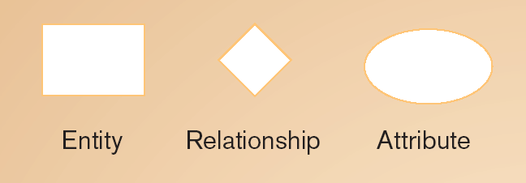
ERD Components
Association between the instances of one or more entity types
Data Object
Relationship
Attributes
Person, place, object, event or concept about which data is to be maintained
named property or characteristic of an entity

Slide 77
Cardinality
express the minimum and maximum number of occurrences of one entity for a single occurrence of the other
One-to-One (1:1)
One-to-many (1:N)
Many-to-Many (M:N)

Slide 78
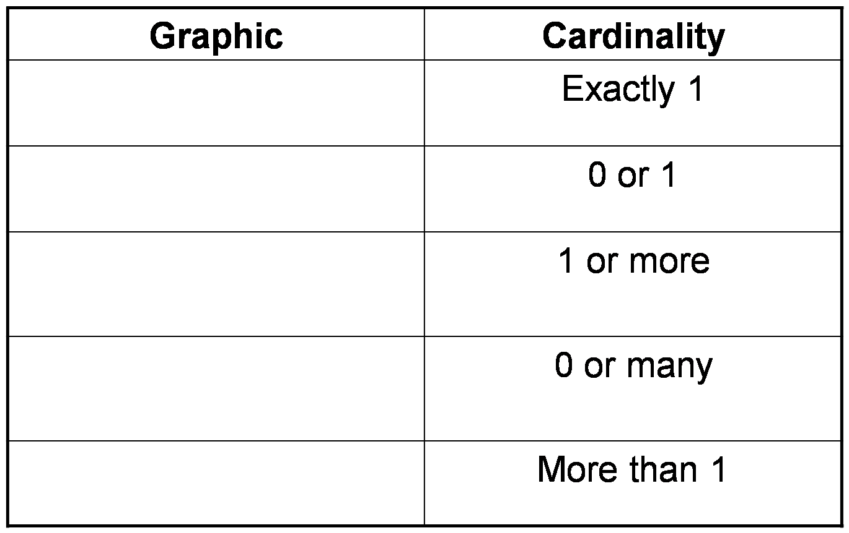
Relationship Cardinality

Slide 79
Degree of Relationship
Refer to the number of Entity type that participate in the relationship.
There are three case:
Unary: between two instances of one entity type
Binary: between the instances of two entity types
Ternary: among the instances of three entity types

Slide 80
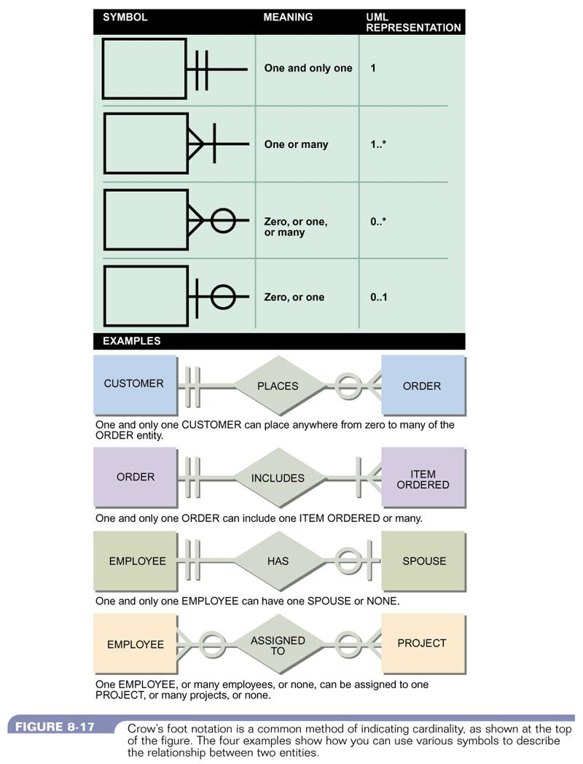
Example of ERD

Slide 81
Software Prototype
Prototype constructed for customer and developer assessment.
In some circumstances construction of prototype is require in beginning of analysis. (To derive requirement effectively)
Selecting Prototype Approach
Close ended (Throwaway Approach)
Open ended (Evolutionary Approach)
Close Ended – It serves as a rough demonstration of requirement. It is then discarded, and the software engineered using a different paradigm.
Open Ended - uses the prototype as the first part of an analysis activity that will be continued into design and construction. The prototype of the software is the first evolution of the finished system.

Slide 82
Approaches to prototyping

Slide 83
Evolutionary prototyping

Slide 84
Evolutionary prototyping advantages
Accelerated delivery of the system
Rapid delivery and deployment are sometimes more important than functionality or long-term software maintainability
User engagement with the system
Not only is the system more likely to meet user requirements, they are more likely to commit to the use of the system

Slide 85
Evolutionary prototyping problems
Management problems
Existing management processes assume a waterfall model of development
Specialist skills are required which may not be available in all development teams
Maintenance problems
Continual change tends to corrupt system structure so long-term maintenance is expensive
Contractual problems
Due to cost or time line agreed

Slide 86
Throw-away prototyping

Slide 87
Throw-away prototyping
Used to reduce requirements risk
The prototype is developed from an initial specification, delivered for experiment then discarded
The throw-away prototype should NOT be considered as a final system
Some system characteristics may have been left out
There is no specification for long-term maintenance
The system will be poorly structured and difficult to maintain

Slide 88
Requirements Documentation
The way to represent requirements in a consistent format.
The requirement documentation is called Software Requirement Specification.
First, the SRS could be created by customer of a system.
Second, the SRS could be created by developer of the system.

Slide 89
Nature of SRS
Functionality
External Interfaces
Performance
Attributes
Design constraints imposed on an implementation.

Slide 90
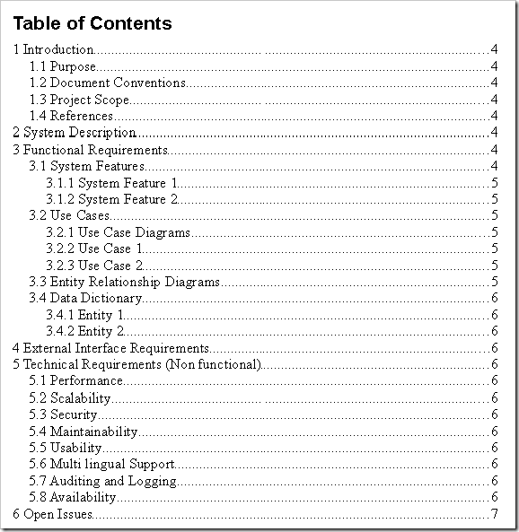
SRS format

Slide 91
Table of Contents
REVISION HISTORY II
DOCUMENT APPROVAL II
1. INTRODUCTION 1
1.1 Purpose 1
1.2 Scope 1
1.3 Definitions, Acronyms, and Abbreviations 1
1.4 References 1
1.5 Overview 1
2. GENERAL DESCRIPTION 2
2.1 Product Perspective 2
2.2 Product Functions 2
2.3 User Characteristics 2
2.4 General Constraints 2
2.5 Assumptions and Dependencies 2
3. SPECIFIC REQUIREMENTS 2
3.1 External Interface Requirements 3
3.1.1 User Interfaces 3
3.1.2 Hardware Interfaces
3.1.3 Software Interfaces 3
3.1.4 Communications Interfaces 3
3.2 Functional Requirements 3
3.2.1 <Functional Requirement or Feature #1> 3
3.2.2 <Functional Requirement or Feature #2> 3
5

Slide 92
3.3 Use Cases 3
3.3.1 Use Case #1 3
3.3.2 Use Case #2 3
3.4 Classes / Objects 3
3.4.1 <Class / Object #1> 3
3.4.2 <Class / Object #2> 3
3.5 Non-Functional Requirements 4
3.5.1 Performance 4
3.5.2 Reliability 4
3.5.3 Availability 4
3.5.4 Security 4
3.5.5 Maintainability 4
3.5.6 Portability 4
3.6 Inverse Requirements 4
3.7 Design Constraints 4
3.8 Logical Database Requirements 4
3.9 Other Requirements 4
4. ANALYSIS MODELS 4
4.1 Sequence Diagrams 5
4.3 Data Flow Diagrams (DFD) 5
4.2 State-Transition Diagrams (STD) 5
5. CHANGE MANAGEMENT PROCESS 5
A. APPENDICES 5
A.1 Appendix 1 5
A.2 Appendix 2

Slide 93
Requirements checking
Validity. Does the system provide the functions which best support the customer’s needs?
Consistency. Are there any requirements conflicts?
Completeness. Are all functions required by the customer included?
Realism. Can the requirements be implemented given available budget and technology
Verifiability. Can the requirements be checked?

Slide 94
Requirements validation techniques
Requirements reviews
Systematic manual analysis of the requirements.
Prototyping
Using an executable model of the system to check requirements.
Test-case generation
Developing tests for requirements to check testability.

Slide 95
Requirements management
Requirements management is the process of managing changing requirements during the requirements engineering process and system development.
New requirements emerge as a system is being developed and after it has gone into use.
You need to keep track of individual requirements and maintain links between dependent requirements so that you can assess the impact of requirements changes. You need to establish a formal process for making change proposals and linking these to system requirements.

Slide 96
Changing requirements
The business and technical environment of the system always changes after installation.
The people who pay for a system and the users of that system are rarely the same people.
Large systems usually have a diverse user community, with many users having different requirements and priorities that may be conflicting or contradictory.

Slide 97
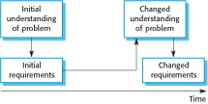
Requirements evolution

Slide 98

Requirements change management

Slide 99
Requirements change management
Deciding if a requirements change should be accepted
Problem analysis and change specification
During this stage, the problem or the change proposal is analyzed to check that it is valid. This analysis is fed back to the change requestor who may respond with a more specific requirements change proposal, or decide to withdraw the request.
Change analysis and costing
The effect of the proposed change is assessed using traceability information and general knowledge of the system requirements. Once this analysis is completed, a decision is made whether or not to proceed with the requirements change.
Change implementation
The requirements document and, where necessary, the system design and implementation, are modified. Ideally, the document should be organized so that changes can be easily implemented.

