Slide 1
Client-Server security threats
Bhoomika Gajpal
Divya Tiwari
Jagriti Bajpai
Namrata Singh
6th sem, IT

Slide 2
Threats
Threats are potentials for vulnerabilities to turn into attacks on computer systems, networks, and more. They can put individuals’ computer systems and business computers at risk, so vulnerabilities have to be fixed so that attackers cannot infiltrate the system and cause damage.

Slide 3
Threats (Cont.)
Threats can include everything from viruses, trojan, back doors to outright attacks from hackers. For example, a hacker might use a phishing attack to gain information about a network and break into a network.

Slide 4
Client-Server security threats
Client-server security threats can be divided into 2 major categories:-
Threats to client
Threats to server

Slide 5
a) Threats to client
Client threats mostly arise from malicious data or code, malicious code refers to viruses, worms, Trojan horses & deviant.

Slide 6
virus
A computer virus is a program – a piece of executable code – that has the unique ability to replicate and that is loaded onto your computer without your knowledge & runs against your wishes.
Viruses can attach themselves to just about any type of executable file and are spread as files that are copied and sent from individual to individual.

Slide 7
virus
Client/Server Security Agents can detect viruses during Antivirus scanning. The Trend Micro recommended action for viruses is clean.

Slide 8
Trojan horse
A Trojan is a malicious program that masquerades as a harmless application. Unlike viruses, Trojans do not replicate but can be just as destructive. An application that claims to rid your computer of viruses when it actually introduces viruses onto your computer is an example of a Trojan.
A program that performs a desired task but also performs unexpected function.

Slide 9
Trojan Horse
Client/Server Security Agents can detect Trojans during Antivirus scanning. Trojans do not infect files, thus cleaning is not necessary. The Trend Micro recommended action for Trojans is delete. To remove a Trojan, run Cleanup.

Slide 10
Worms
It is a self-replicating program that is self continued & does not need any host program to execute.
A computer worm is a self-contained program (or set of programs) that is able to spread functional copies of itself or its segments to other computer systems. The propagation usually takes place via network connections or email attachments. Unlike viruses, worms do not need to attach themselves to host programs.

Slide 11
Worms
Clients must scan for malicious data & executable program fragment that are transferred form the server to the client.
Client/Server Security Agents can detect worms during Antivirus scanning. Worms cannot be cleaned because they are self-contained programs. The Trend Micro recommended action for worms is delete.

Slide 12
Malware
Malware is a program that performs unexpected or unauthorized actions. It is a general term used to refer to viruses, Trojans, and worms. Malware, depending on its type, may or may not include replicating and non replicating malicious code.
Client/Server Security Agents can detect malware during Real-time scanning or Manual and Scheduled scans.

Slide 13
b) Threats to server
Unauthorized eavesdropping
Denial of services(Dos)
Modification of incoming data packets
Brute Force Attack
Open Relay
Cross-site Scripting
SQL Injection
Malware
Unpatched Software
Careless Users

Slide 14
Unauthorized Eavesdropping
Watching data or information as it travels through the internet.
During eavesdropping, an intruder intercepts the packages of data transferred over HTTP (through monitoring software), modifies the data and misuses them in order to harm the network.
Hackers can use to trap username & unencrypted password sent over that network.
Apply network segmentation which will prevent eavesdropping as well as other network attacks.

Slide 15
SQL Injection
SQL injection requires a vulnerability or susceptibility to be present in the database associated with a web application.
The malicious code is inserted into strings that are later passed to the SQL server, parsed, and executed. As with other susceptibility-dependent attacks, you can prevent it by scanning for problem code and fixing it.

Slide 16
Denial of services(Dos)
A denial of service attack is an effort to make one or more computer system unavailable.
It monopolizes the system with so many requests that the system collapses & denies service to every request.
It is typically targeted at web servers but it can also be used on mail server, name servers & any other type of computer system.
The 2 most common types of these attacks are:-
service overloading
message overloading

Slide 17
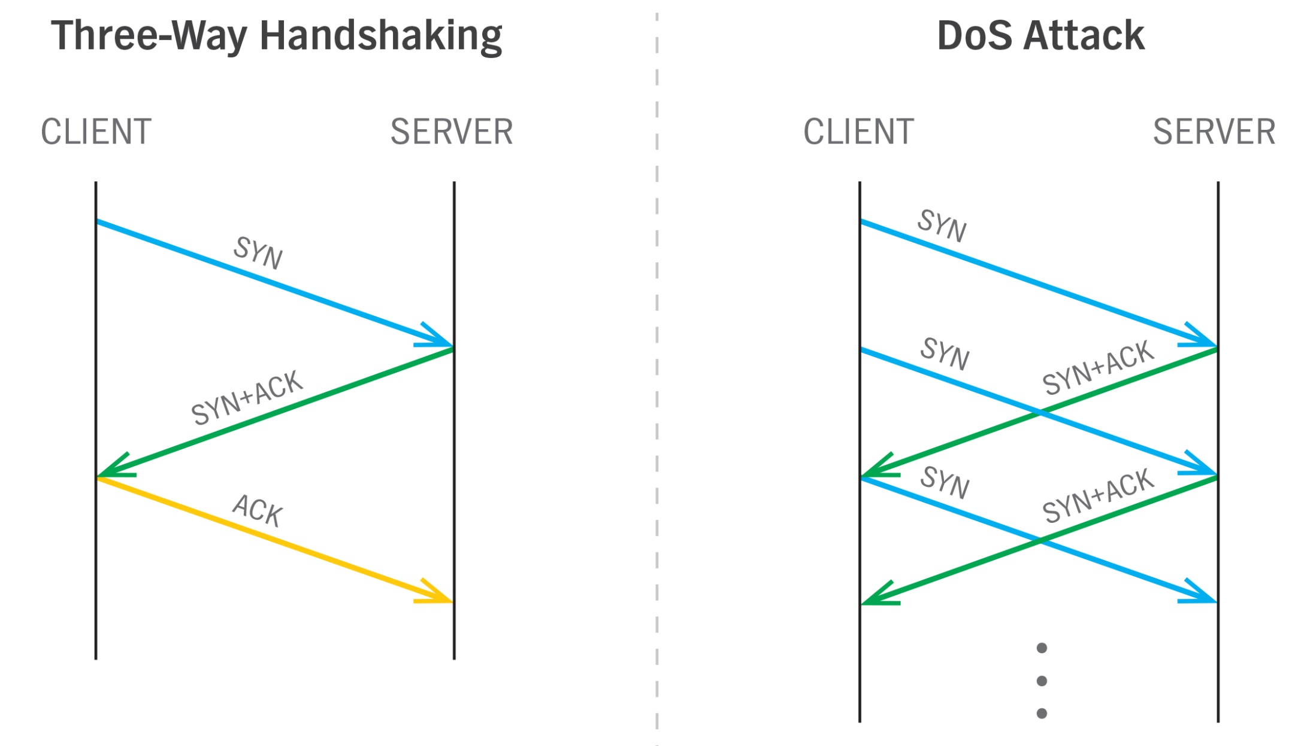
Service overloading:-
Servers are vulnerable to service overloading.

Slide 18
Message overloading:-
Message overloading will occur when someone sends a very large file to the message box of server at every few seconds.
The message box rapidly grows in size & begins to occupy all space on the disk & increase the number of receiving process on the recipient’s machine & causing a disk crash.

Slide 19
Brute force attack
In a brute force attack, the invader attempts to gain access to a server by guessing a user password (usually the root administrator) through the Mail server, or other service running on your system. The attacker will normally use software that will check every possible combination to find the one that works. Brute force detection software will alert you when multiple failed attempts to gain access are in progress and disable access from the offending IP address.

Slide 20
Unpatched Software
Most threats to a server can be prevented simply by having up-to-date, properly-patched software. All server operating system vendors and distributions publish security updates. By installing them on your system in a timely manner, you prevent attackers from using your server’s own exposure against it.

Slide 21
Packet modification
It is an integrity threat that involve modifying a message packet or destroyed the message packet.
An attacker can modify the data in the packet without the knowledge of the sender or receiver. Even if you do not require confidentiality for all communications, you do not want any of your messages to be modified in transit.
For example, if you are exchanging purchase requisitions, you do not want the items, amounts, or billing information to be modified.

Slide 22
Careless Users
Most prevalent threat to a server’s security is user carelessness. If you or your users have passwords that are easy to guess, poorly written code, unpatched software, or a lack of security measures like anti-virus software, you are just asking for trouble. By enforcing strong security practices and secure authentication, you can lessen or even eliminate most threats.

Slide 23
Thank you

