Slide 1
APT Hunter:
“Enabling the hunt for abnormalities”
HAO WANG
JOSHUA THEIMER

Slide 2
Introduction
Hao Wang:
Senior in the EY’s cybersecurity advisory practice.
5 years of experience in Attack & Penetration (A&P) and Incident Response (IR)
Joshua Theimer:
Manager in the EY’s cybersecurity advisory practice; primarily focused on Attack & Penetration (A&P) and Incident Response (IR)
DISCLAIMER: None of the ideas, content, or opinions expressed in this presentation are
shared, supported, or endorsed in any manner by our employer.

Slide 3
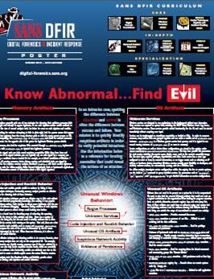
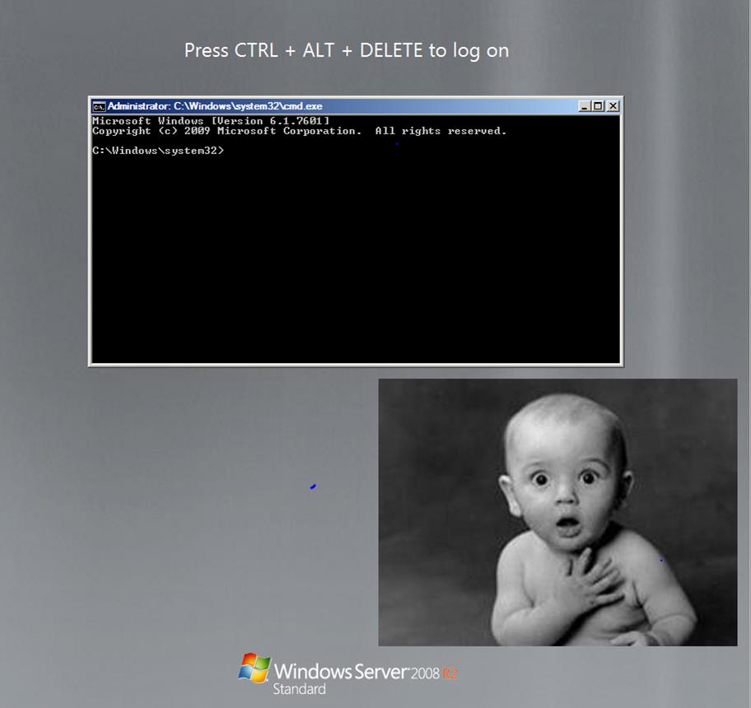
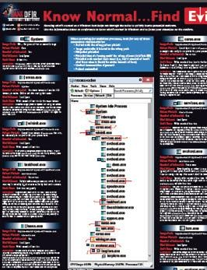
Motivation
“Know Abnormal…Find Evil”
- SANS poster 2014
Quickly find “abnormal” during our standard A&P testing?

Slide 4
Project Objectives
Goals:
Independent - Obtain critical information from system and memory to uncover “abnormal activities” within a Windows environment without reliance on commercial tools or agents; no agent or installation needed
Scalable - able to quickly tackle large enterprise-scale hunts
Lightweight - Pose minimal impact to analyzed systems
Analysis Requirements:
Basic IR knowledge required to understand and analyze some of the output via searching &
stacking
Effectiveness increases when parsing fed into an analysis platform

Slide 5
So, how does it work?
1. Establish privileged Windows Management
Instrumentation (WMI) connections to remote
Technical Requirements:
Privileged Active Directory account (administrator permissions needed on hosts where it will run)
VBScript – Windows Management Instrumentation (WMI)
.NET Framework 4.6
Windows systems. Use VBScript and WMI queries to extract host level information:
File system
Memory
Network connections
Look for “abnormalities” from an attack/breach:
Enumeration and lateral movement
Privilege escalation
Persistence mechanisms

Slide 6
Current tool capabilities
Enumeration and
lateral movement
Network connections
System root directory listing
Local host DNS
Local administrator group membership
System information
Privilege
escalation
ShimCache
AmCache
WDigest downgrade
RecentFileCache
Prefetch
Persistence
mechanisms
Sticky key backdoors
Rogue services & processes
Autoruns info
Scheduled tasks
“psexesvc.exe”
Uncommon RDP ports
`

Slide 7
Subset of capabilities discussed today
Enumeration and
lateral movement
◦ Network connections
◦ System root directory listing
◦ Local host DNS
◦ Local administrator group membership
◦ System information
Privilege
escalation
ShimCache
AmCache
WDigest downgrade
Persistence
mechanisms
Sticky key backdoors
Rogue services & processes
Autoruns info
Scheduled tasks
WMI Persistence
◦ “psexesvc.exe”
◦ Uncommon RDP ports
RecentFileCache
Prefetch
`

Slide 8
Abnormal File Execution
ShimCache, AmCache, RecentFileCache
Identification of suspicious file names (i.e. *dump*, *hash*,
*password*, single character)
Identify the use of utilities preferred by attackers (i.e. at.exe, rar.exe, psexec.exe, psexesvc.exe, wmic.exe, powershell.exe, cscript.exe, wscript.exe, mofcomp.exe, scrcons.exe, csc.exe w/ installutil.exe)
Identify binaries run from suspicious paths (i.e. c:\temp, c:\wmpub,
c:\Windows\addins, C:\users, C:\PerfLogs)
Identify known malware based on filename and file size
Very powerful for large-scale search & stacking analysis

Slide 9
ShimCache
What is ShimCache? | Windows registry keys storing file metadata of executed files Used by Microsoft for lookups to identify application compatibility issues; used to determine if modules require shimming for compatibility
What information can we get from ShimCache? | file path, size, last modified time, and last execution time (depending on OS) files executed or created on the file system
Location of ShimCache? | HKLM\SYSTEM\CurrentControlSet\Control\Session Manager\AppCompatibility [or] AppCompatCache
References:
https://dl.mandiant.com/EE/library/Whitepaper_ShimCacheParser.pdf
https://github.com/mandiant/ShimCacheParser
http://binaryforay.blogspot.com/2015/05/introducing-appcompatcacheparser.html
www.woanware.co.uk/forensics/shimcacheparser.html
Hunting in the Dark HTCIA 2015 by Ryan Kazanciyan

Slide 10
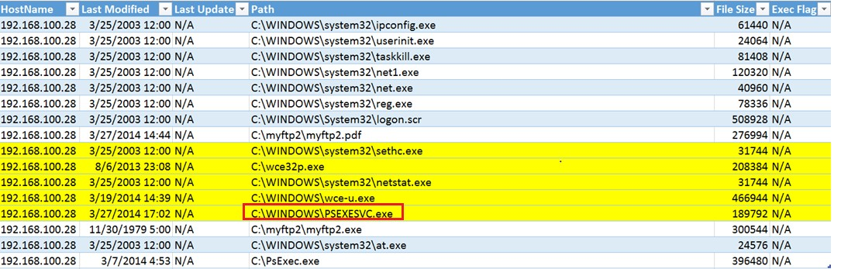
ShimCache (cont.)
ShimCache Example #1: After script run, look for evidence of
PsExec (“PSEXESVC.EXE”) execution in tool output:

Slide 11
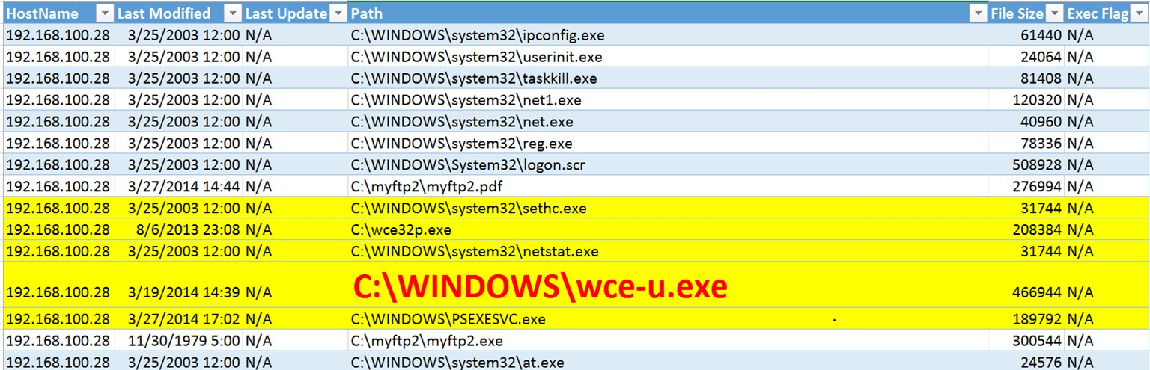
ShimCache (cont.)
ShimCache Example #1: After script run, look for evidence of
PsExec (“PSEXESVC.EXE”) execution in tool output:
Look at adjacent ShimCache entries for other suspicious files. Does anything look suspicious?

Slide 12
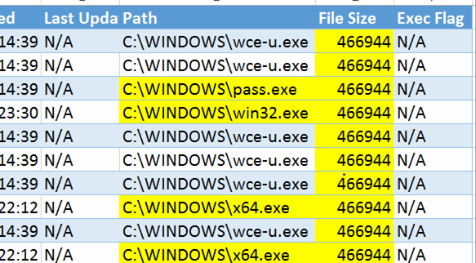
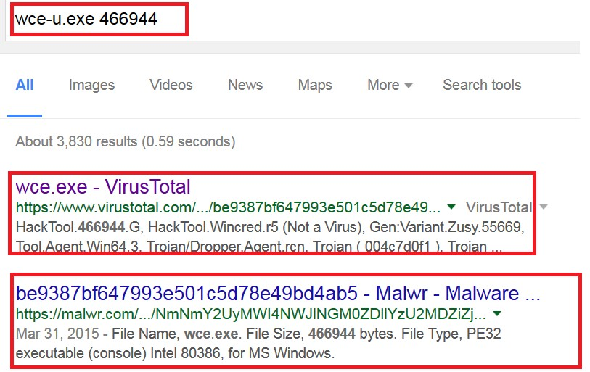
ShimCache (cont.)
ShimCache Example #2: Look for evidence of suspicious
entries by filename and file size in tool output:
Multiple filenames sharing the same file size. Suspicious?

Slide 13
AmCache
What is AmCache? | On Windows 7+ and Server 2008+ Shim database Store data for recent run programs / applications
What information can we get from AmCache? | Useful in identifying recent run files Detailed executable information (i.e. file name, full file path, sha1, file timestamps, PE information)
Location of AmCache? | C:\Windows\AppCompat\Programs\Amcache.hve
References:
http://www.swiftforensics.com/2013/12/amcachehve-in-windows-8-goldmine-for.html
https://github.com/williballenthin/python-registry/blob/master/samples/amcache.py
http://binaryforay.blogspot.com/2015/07/amcacheparser-reducing-noise-finding.html

Slide 14
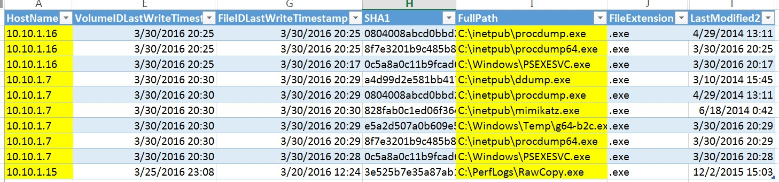
AmCache
AmCache Example #1: Look for evidence of suspicious process
creation in tool output:

Slide 15
RecentFileCache
What is RecentFileCache? | Windows 7 Shim database Used by ProgramDataUpdater to store data for recent process creation
What information can we get from RecentFileCache? | Useful in identifying recent process creation Limited executable information (i.e. file name and file path)
Location of RecentFileCache? | C:\Windows\AppCompat\Programs\RecentFileCache.bcf Replaced by AmCache in Windows 8+
References:
http://journeyintoir.blogspot.in/2013/12/revealing-recentfilecachebcf-file.html
https://github.com/sysforensics/RecentFileCacheParser

Slide 16
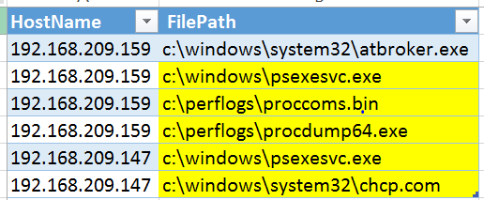
RecentFileCache
RecentFileCache Example #1: Look for evidence of suspicious
process creation in tool output:

Slide 17
Sticky Key (backdoors)
What are Sticky Key backdoors? | Sticky Keys are designed for people who have difficulty holding down two or more keys simultaneously. Attackers can replace the accessibility programs (through file replacement or registry modification with programs that provide SYSTEM-level shell access.(Network Level Authentication will not stop Sticky key backdoors.)
What is the meaning of a Sticky Key backdoor? | Useful to look for identifying (legacy) compromised hosts Often used as a backup tactic to persist on a select number of hosts
Location of Sticky Key backdoors? | Various locations (Please see following slides.)
References:
http://carnal0wnage.attackresearch.com/2012/04/privilege-escalation-via-sticky-keys.html
http://zachgrace.com/2015/03/23/hunting-sticky-keys-backdoors.html
http://www.crowdstrike.com/blog/registry-analysis-with-crowdresponse/

Slide 18
Sticky Key backdoor locations
1. File replacement
File sethc.exe or utilman.exe replaced with another file, typically cmd.exe or explorer.exe
2. Registry Modification
Make a registry modification to launch a debugger anytime one of the following $FILES is executed
Copy C:\Windows\system32\cmd.exe C:\Windows\system32\sethc.exe /y
Copy C:\Windows\system32\cmd.exe C:\Windows\system32\utilman.exe /y
Copy C:\Windows\explorer.exe C:\Windows\system32\utilman.exe /y
Copy C:\Windows\explorer.exe C:\Windows\system32\sethc.exe /y
REG ADD "HKLM\SOFTWARE\Microsoft\Windows NT\CurrentVersion\Image File Execution Options\ $FILES " /v Debugger /t REG_SZ /d "C:\windows\system32\cmd.exe“
REG ADD "HKLM\SOFTWARE\Microsoft\Windows NT\CurrentVersion\Image File Execution Options\ $FILES " /v Debugger /t REG_SZ /d "C:\windows\system32\explorer.exe"
$FILES = (sethc.exe ,utilman.exe, osk.exe, narrator.exe, magnify.exe, displayswitch.exe )

Slide 19
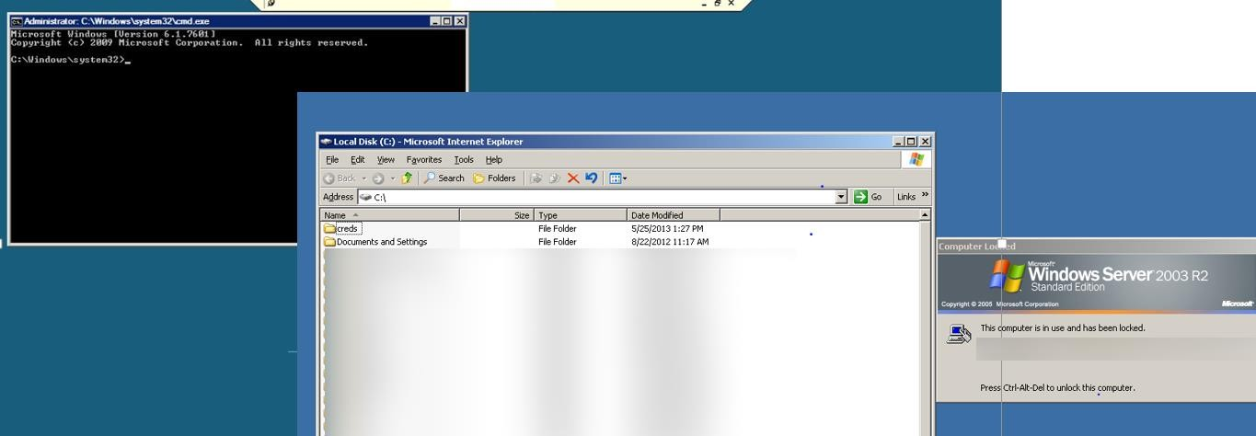
Sticky key backdoors

Slide 20
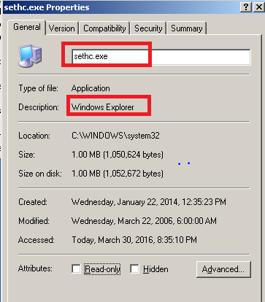
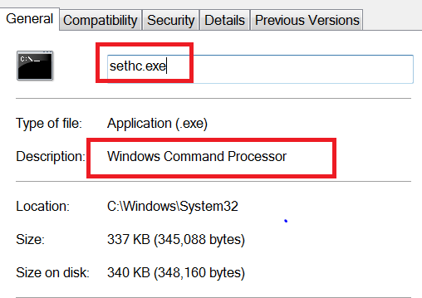
Detection of Sticky key backdoor via
1. File Replacement
Look for evidence of file description mispatch. Do sethc.exe
or utilman.exe have the legitimate file descriptions?
File Description Mismatch

Slide 21
Detection of Sticky key backdoor via
2. Registry Modification
Check if the debugger has been set up with certain binaries
for the following registries:
HKLM\SOFTWARE\Microsoft\Windows Options\setch.exe HKLM\SOFTWARE\Microsoft\Windows Options\utilman.exe HKLM\SOFTWARE\Microsoft\Windows Options\osk.exe HKLM\SOFTWARE\Microsoft\Windows Options\narrator.exe HKLM\SOFTWARE\Microsoft\Windows Options\magnify.exe HKLM\SOFTWARE\Microsoft\Windows Options\displayswitch.exe
NT\CurrentVersion\Image
File
Execution
NT\CurrentVersion\Image
File
Execution
NT\CurrentVersion\Image
File
Execution
NT\CurrentVersion\Image
File
Execution
NT\CurrentVersion\Image
File
Execution
NT\CurrentVersion\Image
File
Execution

Slide 22
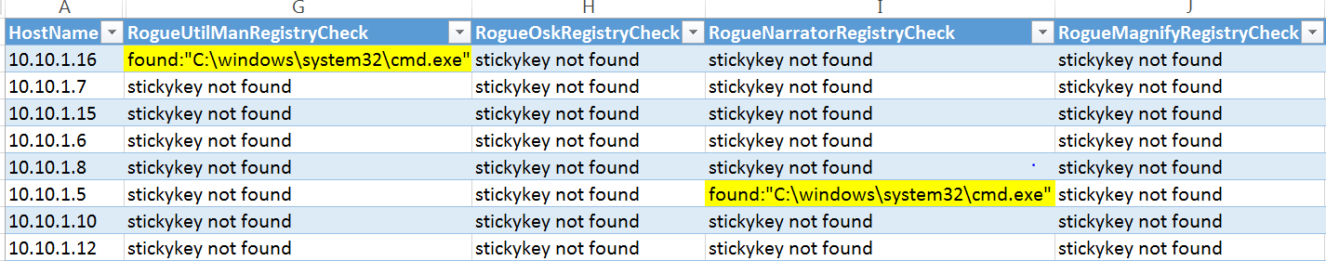
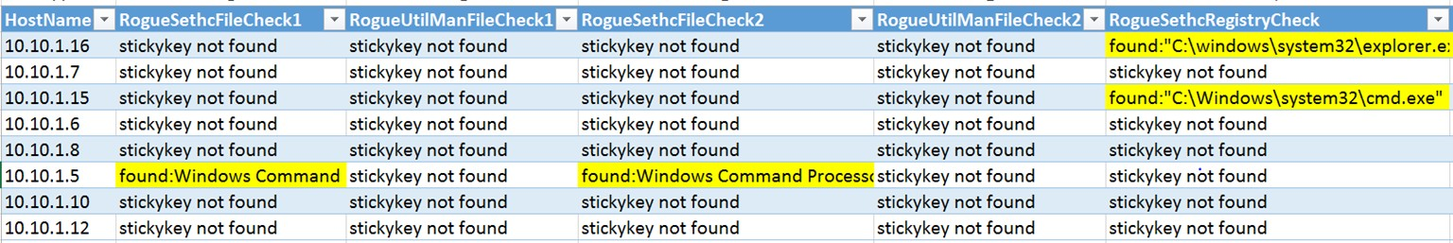
Sticky Key backdoors
Sticky Key Example #1: Look for evidence of found Sticky Key
replacements in tool output:

Slide 23
WMI Persistence
What is the WMI Persistence? | Using Windows Management Instrumentation (WMI) to create persistence for malicious payloads through the creation of a permanent WMI event subscription. Payloads can be run with SYSTEM privileges in sneaky ways.
Significance of WMI backdoors? | Useful for finding compromised hosts missed in prior investigation and eradication WMI persistence is relatively hard to detect, there are minimal artifacts on which to trigger alerts
Ways to find WMI persistence? | Registry key created from “Win32_LocalTime” using WMI EventFilter Enumerate / Stacking instances WMI classes: EventFilter (Payload triggering condition), EventConsumer (Actual payload), FilterToConsumerBinding (Link between condition and payload)
References:
http://la.trendmicro.com/media/misc/understanding-wmi-malware-research-paper-en.pdf
https://www.blackhat.com/docs/us-15/materials/us-15-Graeber-Abusing-Windows-Management-Instrumentation-WMI-To- Build-A-Persistent%20Asynchronous-And-Fileless-Backdoor-wp.pdf
https://dl.mandiant.com/EE/library/MIRcon2014/MIRcon_2014_IR_Track_There%27s_Something_About_WMI.pdf
https://github.com/PowerShellEmpire/Empire https://github.com/PowerShellMafia/PowerSploit
https://www.secureworks.com/blog/wmi-persistence
23

Slide 24
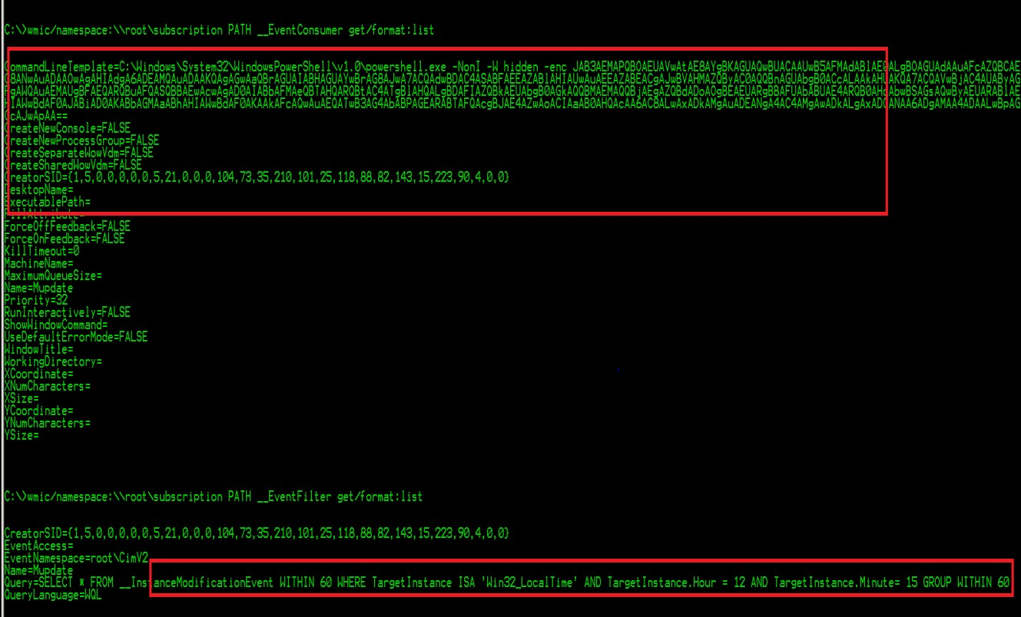
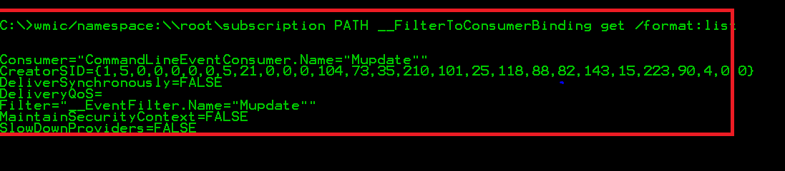
WMI Persistence
WMI Persistence Example #1: Look for suspicious instances from EventFilter,
EventConsumer, and FilterToConsumerBinding:
FilterToConsumerBinding
– Link for payload and condition
EventConsumer – “malicious payload”
EventFilter – Payload triggering condition via “Win32_LocalTime”

Slide 25
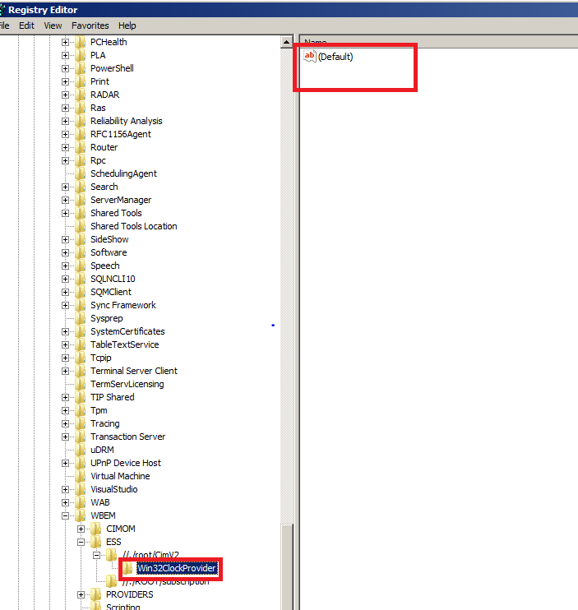
WMI Persistence
WMI Persistence Example #2: Look for registry key created by using
“Win32_LocalTime” from WMI EventFilter:
HKEY_LOCAL_MACHINE\SOFTWARE\Micr
osoft\WBEM\ESS\//./root/CIMV2\Wi
n32ClockProvider

Slide 26
WDigest (downgrade)
What is the WDigest downgrade? | Windows 8.1 and Windows 2012 R2 introduced a registry setting that disables storage of clear-text for credentials the WDigest provider. KB2871997 “back-ports” the registry setting to Windows 7, 8, Server 2008R2 and 2012.
Meaning of downgraded WDigest? | Good indicator to detect potential execution of clear-text credentials extraction like Mimikatz
Location of WDigest indicators? | HKEY_LOCAL_MACHINE\SYSTEM\CurrentControlSet\Control \SecurityProviders\WDigest\UseLogonCredential If the UseLogonCredential value is set to “1” [opposed to “0”], WDigest will store credentials in cleartext in memory.
References:
https://www.trustedsec.com/april-2015/dumping-wdigest-creds-with-meterpreter-mimikatzkiwi-in-windows-8- 1
https://adsecurity.org/?p=559

Slide 27
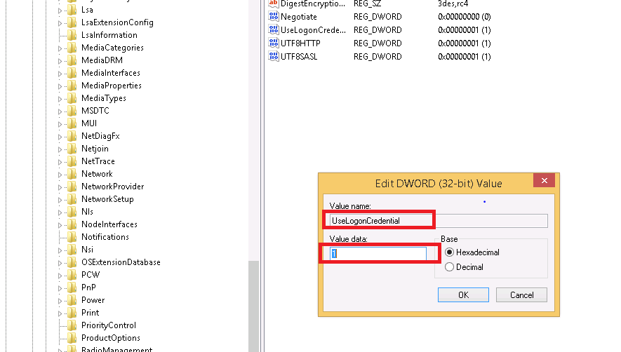
WDigest downgrade
If UseLogonCredential value is set to 1 in your environment,
something may be wrong!
reg add HKLM\SYSTEM\CurrentControlSet\Co ntrol\SecurityProviders\WDigest
/v UseLogonCredential /t REG_DWORD /d 1

Slide 28
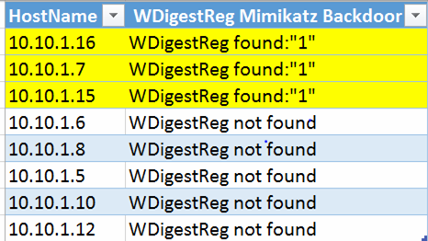
WDigest downgrade
WDigest Example #1: Look for evidence of found modified
WDigest values of “1” in tool output:

Slide 29
Scheduled Tasks
What are SchTasks? | A windows feature used to schedule the launch of programs / scripts at pre-defined times Tasks can be scheduled via Task Scheduler UI, schtasks.exe, at.exe
Information found in SchTasks? | Jobs can often contain activities indicating lateral movement and persistence mechanisms
Location of SchTasks indicators? | Primarily look for “at” *.job creation activities and *.job files created using the “AT” command in C:\Windows\Tasks\ locations: C:\Windows\Tasks\At*.job C:\Windows\Tasks\Schedlgu.txt
References:
https://www.blackhat.com/docs/webcast/09172015-leveraging-proactive-defense-rsa.pdf
https://github.com/sans-dfir/sift-files/blob/master/scripts/jobparse.pl

Slide 30
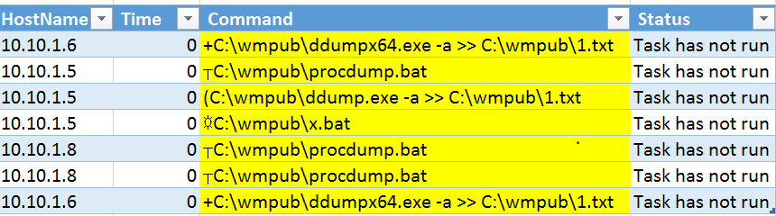
Scheduled Tasks
Scheduled Tasks Example #1: Look for evidence of malicious
“AT” job files and their associated content in tool output:
Suspicious “at” job
activities

Slide 31
Rogue Services
What are Rogue Services? | Windows services designed to run programs in the background Services can be started as executables or loaded as DLLs without user interaction
Information found in Rogue Services? | Uncommon services can often be created by attacker to establish persistence mechanisms
How to find Rogue Services? | Start Type 2 (auto-start) - Service automatically started by the SCM during system startup. Services are started even if a user does not log on. Error Control Set to 0- User is not notified if a service fails during startup. Random service name - Service name does not look like dictionary word Abnormal “ServicePathName” - DLLs loaded by svchost.exe or binaries being run from unusual locations
References:
https://digital-forensics.sans.org/media/poster_2014_find_evil.pdf
Intrusion Hunting for the Masses by David Sharpe

Slide 32
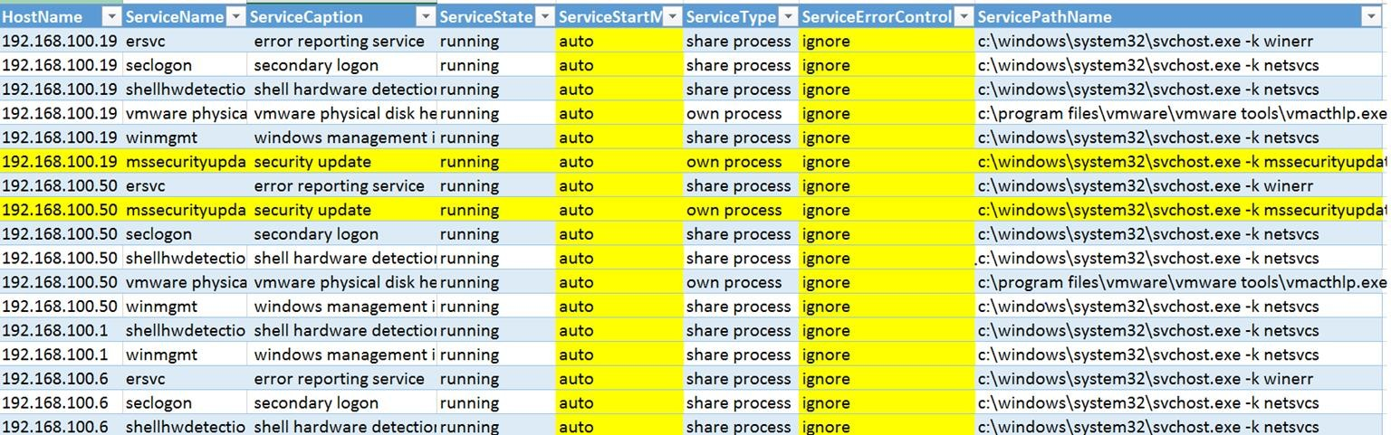
Rogue Services
Rogue Services Example #1: Look for evidence of uncommon
services in tool output:
Uncommon ServiceCaption
Auto-start & Error Control set to 0
Uncommon service name loaded by svchost

Slide 33
Maximizing tool output
If possible, use a golden image to whitelist data.
Use a tiered approach to normalize activity: Scan and analyze the tiers of hosts most likely to be the same. For example, separate the server tier from end user workstations.
Start with a small population to understand how everything works. If you have access, we recommend checking out Domain Controllers.

Slide 34
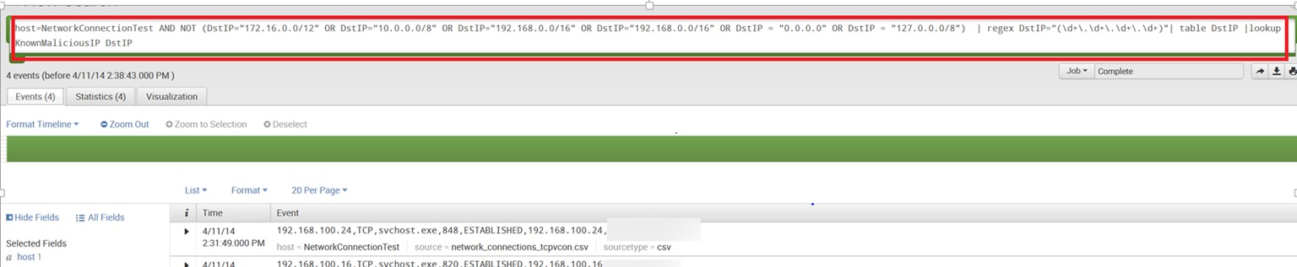
Maximizing tool output
Efficiencies can be gained with SIEM ingestion
Automate a portion of the analysis, use pre-existing rules, etc.
Create tailored rules designed for your corporate environment
Example rule: exclude all the internal destination IP addresses and search for external destination IP addresses against known malicious IP addresses.

Slide 35
DEMO

Slide 36
Project Details
Download a copy, contribute, or add suggestions:
https://github.com/apthunting/APT-Hunter
Hao Wang: @MrRed_Panda
Joshua Theimer: @6zq

