Slide 1
Security of BIOS/UEFI System Firmware from Attacker and Defender Perspectives Miscellaneous Training Materials
Yuriy Bulygin *
Alex Bazhaniuk *
Andrew Furtak *
John Loucaides **
* Advanced Threat Research, McAfee
** Intel

Slide 2
License
Training materials are shared under Creative Commons “Attribution” license CC BY 4.0
Provide the following attribution:
Derived from “Security of BIOS/UEFI System Firmware from Attacker and Defender Perspective” training by Yuriy Bulygin, Alex Bazhaniuk, Andrew Furtak and John Loucaides available at https://github.com/advanced-threat-research/firmware-security-training

Slide 3
MinnowMax Platform and EDKII

Slide 4
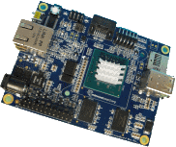
MinnowMax
Open hardware platform
Baytrail single or dual core
From http://firmware.intel.com/projects
This project focus in on the firmware source code (and binary modules) required to create the boot firmware image for the MinnowBoard MAX. The UEFI Open Source (EDKII project) packages for MinnowBoard MAX are available at http://tianocore.sourceforge.net/wiki/EDK2. To learn more about getting involved in the UEFI EDKII project visit the How to Contribute page.
The source code builds using Microsoft Visual Studios and GNU C Compiler (for both 32 and 64 bit images) - production and debug execution environments. The source code builds the same UEFI firmware image shipping on MinnowBoard MAX.
- See more at: http://firmware.intel.com/projects#sthash.1oOc8srY.dpuf

Slide 5
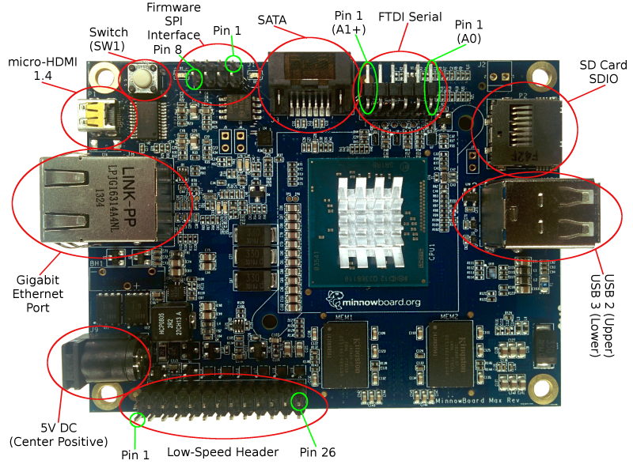
MinnowBoard Interfaces
Source: https://01.org/android-ia/guides/android-5.x-lollipop-bring-guide

Slide 6
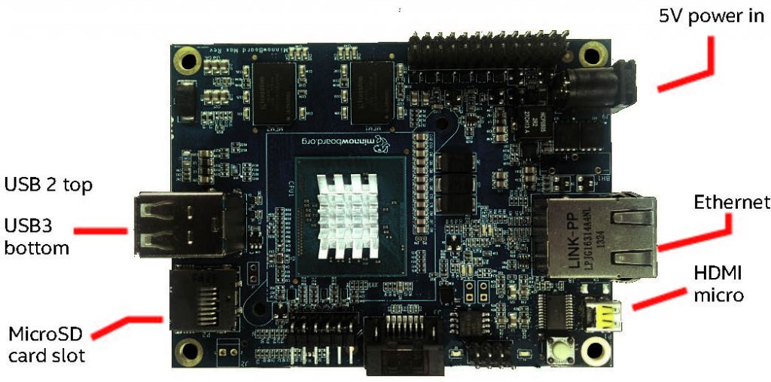
USB Ports in MinnowBoard
2 USB ports: USB3 on bottom and USB2 on top

Slide 7
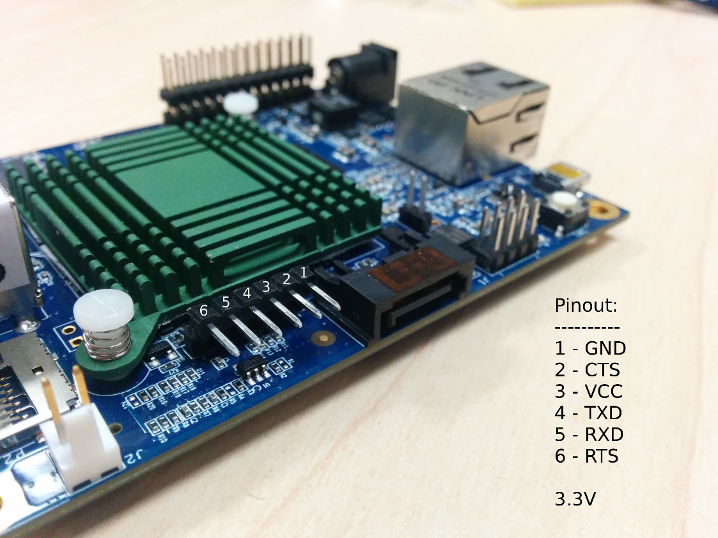
UART Pinout Configuration

Slide 8
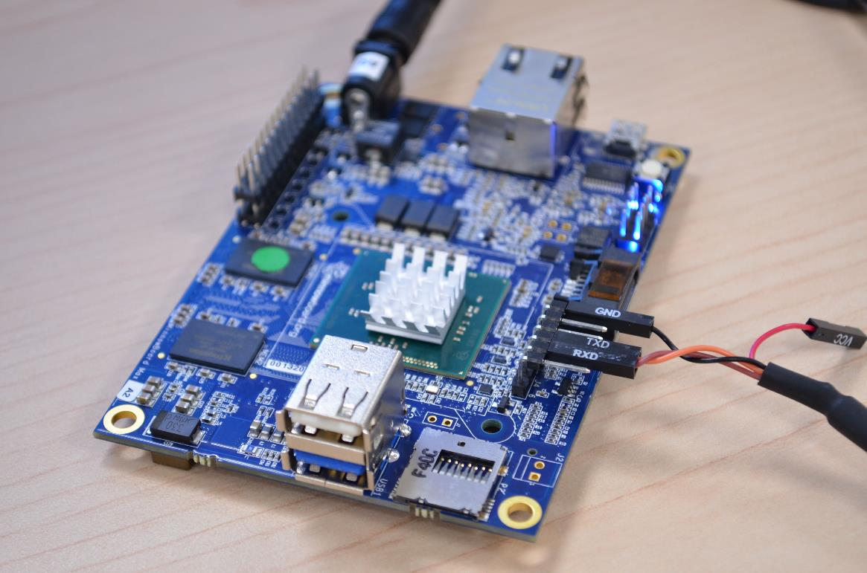
Connect to UART port

Slide 9
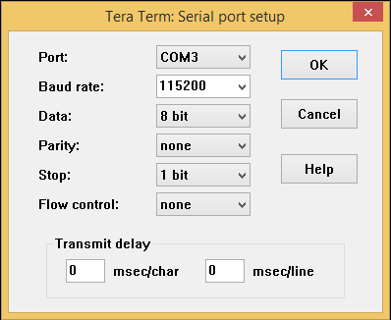
UART configuration
Baud rate – 115200
Flow control – 0
To read UART output
On Windows use: PUTTY or Tera Term
On Linux run minicom:
$minicom -D /dev/ttyUSB0

Slide 10
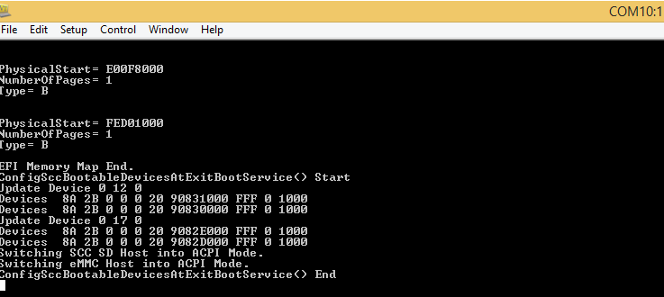
Successfully launch Linux

Slide 11
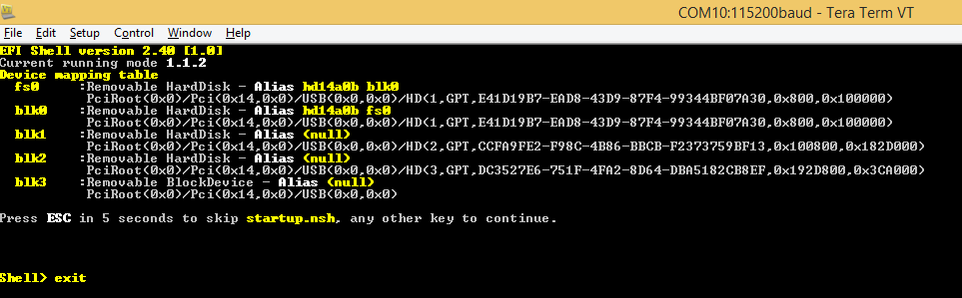
UEFI shell
For come to Setup Screen type exit & enter in the UEFI shell:

Slide 12
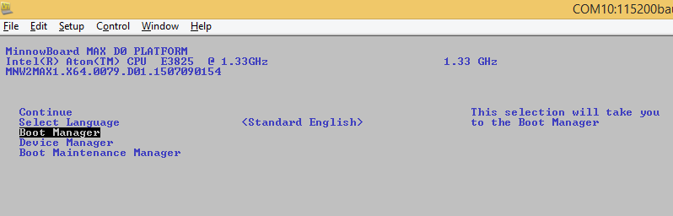
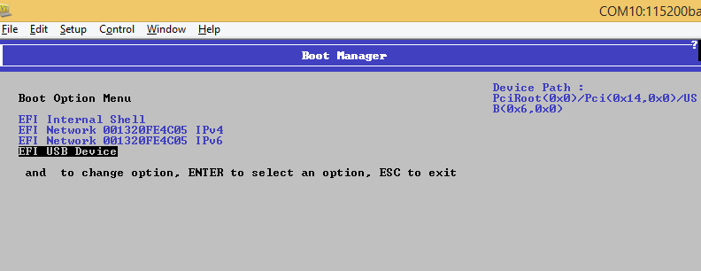
Boot from USB Device

Slide 13
MinnowBoard Configuration
Students need to configure Ethernet card in laptops with 192.168.1.1/24 IP address
Access to MinnowBoard board through SSH (22 port).
Recommended clients: PUTTY, MobaXterm
MinnowBoard Network configuration:
IP address: 192.168.1.2
Gateway: 192.168.1.1

Slide 14
MinnowBoard File System
~/Desktop/bios – MinnowBoard EDK2 FW sources
~/Desktop/chipsec – CHIPSEC framework
~/Desktop/image – binary BIOS images
~/Desktop/udk-debugger – udk-debugger installer & config
~/Desktop/patches – BIOS patches
~/Desktop/tools – misc useful BIOS/UEFI utilities
~/Desktop/exercises – materials for exercises

Slide 15
Useful UEFI Setup Options

Slide 16
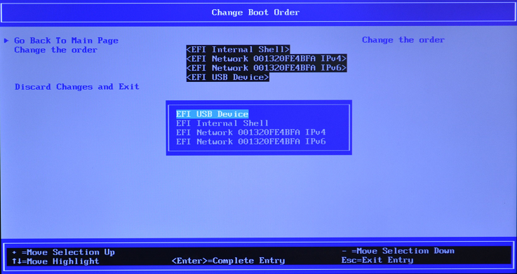
Changing Boot Order On MinnowMax

Slide 17
Training materials are available on Github
https://github.com/advanced-threat-research/firmware-security-training
Yuriy Bulygin @c7zero
Alex Bazhaniuk @ABazhaniuk
Andrew Furtak @a_furtak
John Loucaides @JohnLoucaides

