Slide 1
Security of BIOS/UEFI System Firmware from Attacker and Defender Perspectives Section 1. BIOS and UEFI Firmware Fundamentals
Yuriy Bulygin *
Alex Bazhaniuk *
Andrew Furtak *
John Loucaides **
* Advanced Threat Research, McAfee
** Intel

Slide 2
License
Training materials are shared under Creative Commons “Attribution” license CC BY 4.0
Provide the following attribution:
Derived from “Security of BIOS/UEFI System Firmware from Attacker and Defender Perspective” training by Yuriy Bulygin, Alex Bazhaniuk, Andrew Furtak and John Loucaides available at https://github.com/advanced-threat-research/firmware-security-training

Slide 3
Section 1. BIOS and UEFI Firmware Fundamentals

Slide 4
1.1 Introduction to Platform Hardware

Slide 5
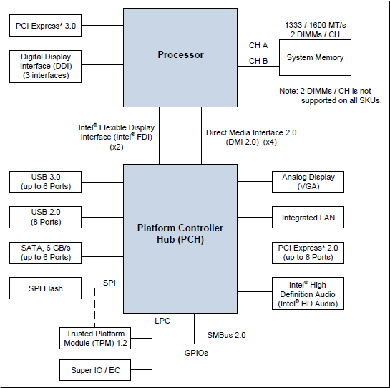
Main PC Platform Components
Source: 4th Generation Intel Core Processor Family Datasheet

Slide 6
PCI Express Overview
PCI Express Fabric consists of PCIe components connected over PCIe interconnect in a certain topology (e.g. hierarchy)
Root Complex is a root component in a hierarchical PCIe topology with one or more PCIe root ports
Components: Endpoints (I/O Devices), Switches, PCIe-to-PCI/PCI-X Bridges
All components are interconnect via PCI Express Links
Physical components can have up to 8 physical or virtual functions
Some endpoints are integrated into Root Complex

Slide 7
PCI Express Overview
CPU
PCI Express Endpoint
PCI Express
Root Complex
DRAM
PCI Express to PCI/PCI-X Bridge
PCI Express
PCI Express
PCI/PCI-X
Switch
PCI Express
PCI Express
Legacy Endpoint
Legacy Endpoint
PCI Express Endpoint
PCI Express Endpoint
Reference: https://www.mindshare.com/files/ebooks/PCI%20Express%20System%20Architecture.pdf

Slide 8
PCIe Configuration Space Layout
Each function has its own configuration (256 bytes of PCI config space and 4kB of PCIe extended config space)
FFFh
Extended configuration space for PCI Express parameters and capabilities (Not available on legacy OS)
PCI Express Capability Structure
Capability needed by BIOS or by driver software on non PCI Express aware OS
PCI 3.0 Compatible Configuration Space Header
PCI Express Extended Configuration Space (Not available for legacy operating system)
PCI Configuration Space (Available on legacy OS through legacy PCI mechanisms)
FFh
3Fh
0
Reference: PCI Express Base Specification Revision 3.0

Slide 9
PCIe Configuration Space Access
SW uses one these mechanisms to access config space:
Legacy configuration access via control CF8h & data CFCh processor I/O ports
PCI config register address
bus << 16 | device << 11 | function << 8 | offset & ~3
CF8h ← 1<<31 | bdf_address
Read data from or write data to port (CFCh + off[1:0])
Enhanced configuration access mechanism (ECAM) to PCIe extended configuration registers
8 * 100h per device
32* 8 * 100h per bus
100h bytes of CFG header

Slide 10
Low Pin Count (LPC) Interface
LPC specification
Substitutes Industry Standard Architecture (ISA) X-bus
7 required signals (LAD3-0,LFRAME,LRESET,LCLK), 6 optional
33 MHz PCI compatible host controller driven clock
LPC controller is integrated into PCH or ICH
Host decodes IO or MMIO cycles on PCI to LPC cycles:
Memory Rd/Wr
I/O Rd/Wr
DMA Rd/Wr (via Intel 8237 DMA controller)
Bus Master Memory Rd/Wr
Bus Master I/O Rd/Wr
Firmware Memory Rd/Wr

Slide 11
Low Pin Count (LPC) Interface
Firmware Hub: legacy Boot ROM (BIOS)
Discrete Trusted Platform Module (TPM)
MMIO 0xFED4xxxx
Super I/O (Floppy Disk Controller, PS/2 KBC, serial and parallel ports)
KB IO 60h/64h
FDD IO 3F0h-3F7h …
SP IO 3F8h-3FFh …
PP IO 378h-37Fh …
Embedded Controller
IO 62h/66h
Audio, AC’97, MIDI…
ISA (optional)
PCI/Host Bus
Host
Flash
BIOS
Super I/O
KBC, PP, SP, FDC
Embedded Controller
Reference: LPC specification

Slide 12
Serial Peripheral Interface (SPI)
4-pin synchronous serial interface
SCLK, MOSI, MISO, CSn/SSn (1 per slave device); optional IOx signals for fast read modes
Master - Slave protocol: 1 master, N slaves
Lower cost for system flash (BIOS) than FWH on LPC
SPI Controller is in PCH or ICH
Supports JEDEC Serial Flash Discoverable Parameter (SFDP) to query capabilities of SPI flash device
Boot BIOS straps (BBS) define if firmware is in LPC or SPI
SPI peripherals: sensors, serial NOR flash memory, MMC/SD...
Devices connected to SPI bus in chipset:
Flash Memory Devices
TPM over SPI (CS2#) on newer systems

Slide 13
Chipset SPI Controller
PCH supports 3 SPI flash devices up to 16MB each
Descriptor and non-descriptor Modes
CS0# must be flash memory device with a valid Flash Descriptor (FD)
Descriptor mode is required on PCH based platforms
Flash descriptor describes contents of the flash memory
Hardware and Software Sequencing operational modes
Hardware sequencing preprograms SPI bus cycles and CS0#
Software sequencing allows software to choose SPI cycles and CS

Slide 14
System Flash Memory
Direct Access (e.g. FFFFFFFFh PA mapped to SPI direct read cycle), Program Register Access (SW programs Flash Linear Address to SPI MMIO registers)
For multiple masters SPI flash should support HW seq
FLA FFFFFFh maps to the top of Flash device
Erase cycles set all Fs: 0 → 1
In descriptor mode, SPI flash memory devices contain multiple ranges
Region | Content
0 | Flash Descriptor
1 | BIOS
2 | Intel Management Engine
3 | Gigabit Ethernet
4 | Platform Data
Reference:
Intel 7 Series Chipset PCH datasheet

Slide 15
SPI Flash Descriptor
4KB
OEM Section
Region 0 at FLA 0 – FFFh (4 KB)
Signature: 0FF0A55Ah at 10h LBA
Contains the following sections:
Component: flash device configuration
Region: describes other regions
Master: defines Rd/Wr Access Control table
CPU and PCH soft straps
ME VSCC Table: JEDEC ID & VSCC info
OEM: reserved for OEM use
Access Control table defines which masters (CPU, ME, GbE) can access regions (FD has to be write-protected)
Descriptor Upper MAP
Management Engine VSCC Table
Reserved
PCH Soft Straps
Master
Region
Component
Descriptor MAP
10h
Reference: Intel 7 Series Chipset PCH datasheet
Signature

Slide 16
System Flash Security
Chipset (SPI controller) based protections
SMM based BIOS Write Protection: write-protects entire BIOS region from software other than SMI handler firmware executing in SMM
SPI Protected Range registers (PR0-PR4): read/write protection of SPI flash regions based on FLA for program register access
Flash Descriptor based access control: defines read/write access to each flash region by each master
Firmware may use SPI flash chips write protection (WP#)

Slide 17
System Management Bus (SMBus)
SMBus 2.0 specification
2-pin interface (SMBDATA, SMBCLK), opt. SMBALERT#
SMBus host controller to communicate over SMBus:
DIMM Serial Presence Detect (SPD) EEPROM
DIMM Thermal Sensors
EC or BMC (host-to-uC, uC-to-sensors, BMC-to-NIC)
Commands: Read/Write Byte/Word, Send/Receive Byte, Process Call..
Can operate in I²C mode
Intel ME has SMBus controller(s)
PCIe connectors include SMBus pins for side band management
DMTF Alert Standard Format (ASF) sensors
PMBus for power supplies

Slide 18
Where is system firmware?
VM
VM
App
App
App
App
OS
OS
System firmware (BIOS/SMM, EFI) & OS/VMM share access, but not trust
VMM / Hypervisor
SMM / BIOS
Privilege
Hypervisor can grant VM direct hardware access
CPU
Memory
Peripherals
Firmware
Hardware
A specific Peripheral may have its own processor, and its own firmware, which is undetectable by host CPU/OS.
Platform
DMA
Source: Symbolic execution for BIOS security

Slide 19
Hardware Boot Sequence
External power supplied (e.g. 12V) to the system and settles
Power is driven in a sequence to multiple processor and chipset voltage rails
Platform clocks are derived from external clock and oscillators
Processor reset signal is de-asserted
Power management logic in the CPU executes reset sequence (samples fuses, handshake with the PCH, reads Power-On configuration etc.)
Power management logic brings cores out of reset
Processor cores execute reset microcode (initializes x86 state, parses FW interface table, etc.)
Finally, reset microcode fetches the first instruction at physical address FFFFFFF0h known as reset vector

Slide 20
x86 Reset Vector
CPU starts in Real-Address Mode (or Real Mode)
CS = F000h, CS limit = FFFFh, EIP = FFF0h
So reset vector should be at F000:FFF0 = (F000h << 4) + FFF0h = 000FFFF0h
In 8086 BIOS ROM was mapped under 1MB. Now CPU/chipset map larger BIOS ROM under 4GB (FFFFFFFFh)
CPU asserts upper 12 address bits high by programming reset value of CS descriptor cache CS base to FFFF0000h
So reset vector is CS base + EIP = FFFF0000h + FFF0h = FFFFFFF0h
Until firmware executes FAR JMP to reload CS with F000h to stay in real mode under 1MB or enter protected mode early

Slide 21
Reset Vector Decode
CPU decodes addresses FFFxxxxxh down to system bus (DMI) to chipset
Chipset decoded memory reads to SPI flash controller (or Firmware Hub) per configurable decoding rules
Memory reads are claimed by SPI flash controller which sends them as direct SPI read cycle to FFFFF0h flash address (FLA)
This ensures that memory reads (i.e. reset vector code fetch) to mapped BIOS ROM range are directed to firmware ROM (e.g. SPI flash memory device)

Slide 22
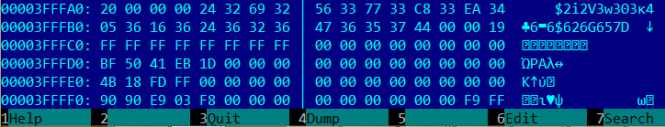
x86 Reset Vector Example
Reset vector: near jump to the rest of the BIOS Boot Block
NOP
NOP
JMP SHORT Rel16 ; EarlyBSPInit or SEC entry-point

Slide 23
Firmware Start
CPU start executing system firmware code at reset vector which is mapped to firmware ROM
Reset vector contains a jump to the initial firmware known as [Initial] Boot Block
Boot block consists of most of the early platform initialization functionality (SEC and PEI phases for UEFI based firmware)
Boot block executes early pre-memory initialization code, and memory initialization code (Memory Reference Code)

Slide 24
Firmware Boot Sequence – Early Boot
Firmware in multiprocessor system chooses Bootstrap Processor (BSP). Other processors are in Wait-For-SIPI
Firmware on BSP initializes BSP CPU
Loads early CPU microcode update on BSP
Initializes Local APIC
Ensure all APs are in Wait-For-SIPI or broadcast INIT IPI
Initializes IDT/GDT and switches to flat 32-bit protected mode (CR0.PE)
Configure fixed and variable memory types (MTRR)
Enable cache on BSP (CR0.CD/CR0.NW)
Enable No-Evict Mode (NEM) to set up Cache-As-RAM (CAR) for stack and code
Initialize basic chipset interfaces (Root Complex, SMBus controller, MMCFG…)

Slide 25
Firmware Boot Sequence – DRAM Init
FW performs SoC specific DRAM initialization (MRC)
Read DIMM parameters from SPD EEPROM over SMBus
Trains DDR busses
Initializes memory controller
Initializes memory map, stolen ranges
Memory shadowing: FW Copies the rest of the firmware to DRAM
Decompression code decompresses FV from SPI flash and copies below 1MB
Exit CAR mode and transition to shadowed code in DRAM
Modify Programmable Attribute Map (PAM) registers to decode to DRAM

Slide 26
Firmware Boot Sequence – DRAM Init
Wake other processors (APs)
APs will execute wake-up init code
SMRAM Init
BSP copies SMM relocation handler at 0x30000p
Allocates TSEG and copies run-time SMI handler
Sends SMI to relocate SMI handler to TSEG
SMM relocation handler will configure SMRR
Continue with chipset initialization (DXE for UEFI)
USB, SATA …
Enumerate and initialize PCI devices
PCI devices enumeration
Allocate MMIO spaces for device MMIO BARs
Load and execute PCI Expansion/Option ROMs

Slide 27
Memory Map: System View
High MMIO
Low DRAM
Memory vs MMIO
Low MMIO
4GB boundary
High DRAM
High MMIO
Top of High DRAM
4GB
Low MMIO
BAR 1 – BAR n
ECAM
Top of Low DRAM
Reference: 4th Gen Intel Core Processor Family Datasheet

Slide 28
Memory Map (Below 4GB)
System View
Memory Controller View
Legacy Ranges (PAMx)
ISA Hole
SMRAM
Graphics Stolen Memory
Low DRAM (TOLUD)
Memory vs MMIO
PCIe MMCFG
MMIO BARs
Reserved Ranges (APIC, TPM, TXT)
High BIOS
4GB
Direct-mapped BIOS, APIC, TPM
OS invisible
Reclaim
Memory area
Low MMIO (PCI memory range)
TOLUD
BAR 1 – BAR n
Graphics Stolen
& GTT Memory
ECAM
BGSM
SMM Memory
TSEG
SMM Memory
Low DRAM
Low DRAM
1 MB
Legacy Memory
0
Reference: 4th Gen Intel Core Processor Family Datasheet

Slide 29
Memory Map (Above 4GB)
Memory Reclaim
High DRAM (TOUUD)
ME Stolen Range
Top Of Memory
System View
Memory Controller View
High MMIO
TOUUD
TOM
OS invisible
Reclaim
Memory area
ME Stolen Mmeory
REMAP BASE
MESEG
High DRAM
High DRAM
4GB
OS invisible
Reclaim
Memory area
Reference: 4th Gen Intel Core Processor Family Datasheet

Slide 30
1.2 Platform Firmware: BIOS

Slide 31
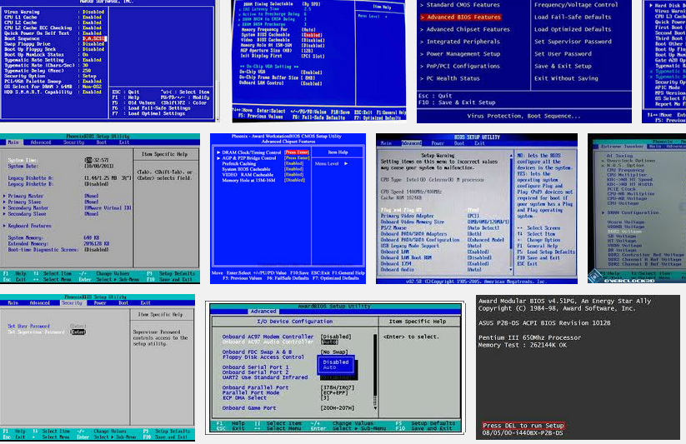

Slide 32
Legacy BIOS
The Basic Input / Output System (BIOS) is the software embedded on a ROM chip (SPI flash memory devices) located on the computer’s main board
The BIOS is fetched by the processor at reset vector address (FFFFFFF0h) and executes Power-On Self Test (POST) to test and initialize the system components, initializes add-on devices and then boots the OS.
The BIOS also handles the low-level input/output to the various peripheral devices connected to the computer
Plug and Play BIOS Specification

Slide 33
Legacy BIOS Stages
CPU Reset vector in BIOS ’ROM’ (Boot Block) →
Boot Block
Basic CPU, chipset initialization →
Initialize CAR, load and run from cache →
Initialize DRAM memory →
POST (Power-On Self Test)
Decompress and relocate system BIOS in DRAM →
Enumerate add-on devices (ISA, PCI).. →
Execute Option ROMs on expansion cards →
INT 19h
Locate, load and execute Initial Boot Loader code in MBR (at 0x7C00 PA) →
2nd Stage Boot Loader → OS Loader → OS kernel
Also Technical Note: UEFI BIOS vs. Legacy BIOS, Advantech

Slide 34
Legacy Option ROMs
Legacy option ROMs are BIOS extensions required to initialize add-on devices (ISA, PCI, PCIe) not supported by the system BIOS nor required to boot the system
Option ROMs are detected by the BIOS during after POST and their entry points are called
Scanned in physical memory between addresses C0000h and F0000h and detected by 0x55 0xAA signature
During initialization, an Option ROM may hook any IVT vectors and update any data structures required for it to access attached devices and perform the necessary identifications and initializations
BIOS Boot Specification

Slide 35
1.3 Platform Firmware: (U)EFI Firmware

Slide 36
Industry Transition
Pre-2000
All Platforms BIOS were proprietary
Intel invented the Extensible Firmware Interface (EFI) and provided sample implementation under free BSD terms
2000
tianocore.org, open source EFI community launched
2004
Unified EFI (UEFI)
Industry forum, with 11 members, was formed to standardize EFI
2005
240 members
Major MNCs shipping; UEFI platforms crossed most of IA worldwide units; Microsoft* UEFI x64 support in Server 2008, Vista* and Win7*; RedHat* and SuSEl* OS support. Mandatory for Windows 8 client. ARM 32 and 64 bit support. ACPI added.
2015
Source: http://www.slideshare.net/k33a/uefi

Slide 37
(Unified) Extensible Firmware Interface
Industry Standard Interface Between Firmware & OS
Processor Architecture and OS Independent
C Development Environment (EDK2/UDK)
Rich GUI Pre-Boot Application Environment
Includes Modular Driver Model
UEFI executables: PE/COFF or TE executable files
UEFI file system is FAT32
UEFI OS uses UEFI compliant bootloader:
/efi/boot/bootx64.efi /efi/redhat/grub.efi
Secure Boot of Microsoft Windows 8 or above requires UEFI
UEFI firmware supports booting legacy OS from legacy MBR via Compatibility Support Module (CSM)

Slide 38
UEFI Firmware Evolution
Class 0:
Legacy BIOS
Class 1:
UEFI CSM only
Class 2:
UEFI switch:
CSM & UEFI
Class 3:
UEFI only

Slide 39
Compatibility Support Module (CSM)
CSM is a UEFI component which allows legacy OS boot loader (MBR) and legacy Option ROM to execute on top of UEFI based firmware without modifications
CSM has to emulate some legacy BIOS runtime services required for legacy boot
CSM consists of the following components:
EfiCompatoibility (Legacy BIOS driver, drivers for legacy devices like PIC 8259)
Compatibility16BIOS (provides legacy BIOS runtime services as INT13, INT15, INT19 etc.)
Compatibility16SMM (provides legacy SMI handlers)
Thunk/ReserveThunk (switching between 32-bit and 16-bit modes)
Legacy Option ROM interface

Slide 40

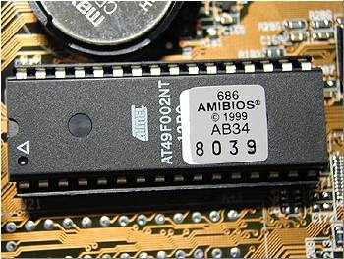
(U)EFI Firmware
OS Kernel / Drivers
UEFI OS Loaders
DXE
Driver
DXE
OROM
UEFI App
UEFI
Boot Loader
Bootx64.efi
Bootmgfw.efi
HDD
DXE
Driver
DXE
OROM
UEFI App
UEFI DXE Core / Dispatcher
System Firmware (SEC/PEI)
Hardware
I/O
Memory
Network
Graphics

Slide 41
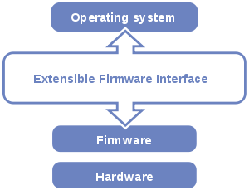
(U)EFI Firmware
OS Kernel / Drivers
UEFI OS Loaders
DXE
Driver
DXE
OROM
UEFI App
UEFI
Boot Loader
Bootx64.efi
Bootmgfw.efi
HDD
DXE
Driver
DXE
OROM
UEFI App
UEFI DXE Core / Dispatcher
System Firmware (SEC/PEI)
Hardware
I/O
Memory
Network
Graphics

Slide 42
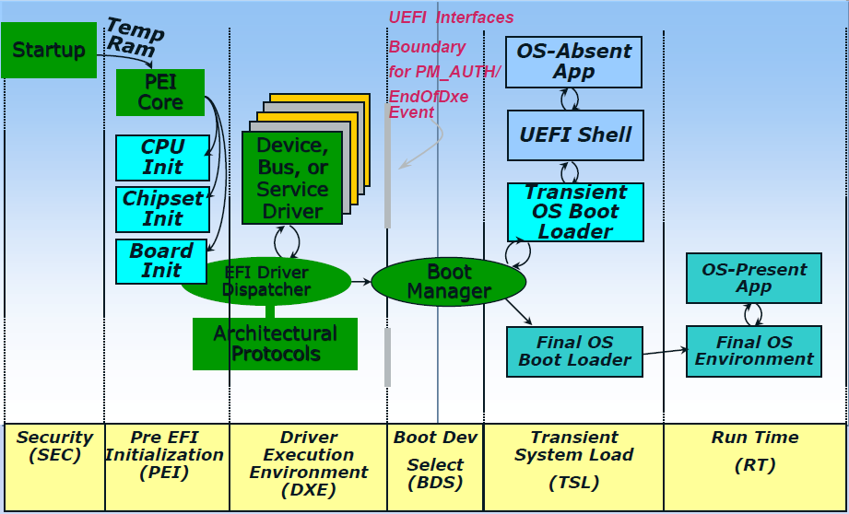
UEFI Boot
From Secure Boot, Network Boot, Verified Boot, oh my and almost every publication on UEFI

Slide 43
UEFI [Compliant] Firmware
CPU Reset
SEC
S-CRTM; Init caches/MTRRs; Cache-as-RAM (NEM); Recovery; TPM Init
Pre-EFI Init (PEI)
S-CRTM: Measure DXE/BDS
Early CPU/PCH Init
Memory (DIMMs, DRAM) Init, SMM Init
Driver Exec Env (DXE)
Continue initialization of platform & devices
Enum FV, dispatch drivers (network, I/O, service..)
Produce Boot and Runtime Services
Boot Dev Select (BDS)
Boot Manager (Select Boot Device)
EFI Shell/Apps; OS Boot Loader(s)
ACPI, UEFI SystemTable, SMBIOS table
Runtime / OS
ExitBootServices. Minimal UEFI services (Variable)

Slide 44
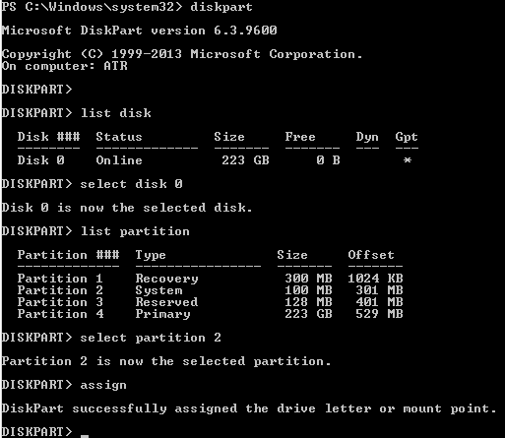
UEFI OS Booting
Exit UEFI Boot Services
Looking into UEFI boot variable: BootXXXX for discover UEFI storage devices
UEFI transfer control to OS bootloader from storage device
GPT
DISK
UEFI FS FAT32 partition with /EFI/BOOT/OS-loader.efi
OS partition
other partition…

Slide 45
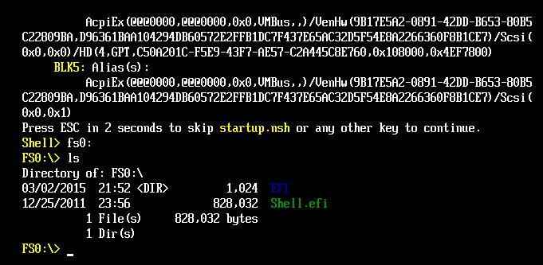
UEFI Shell
UEFI shell is a shell command line environment
Used to run shell commands and UEFI applications: dmpstore
UEFI OS boot loaders are also UEFI “applications”

Slide 46
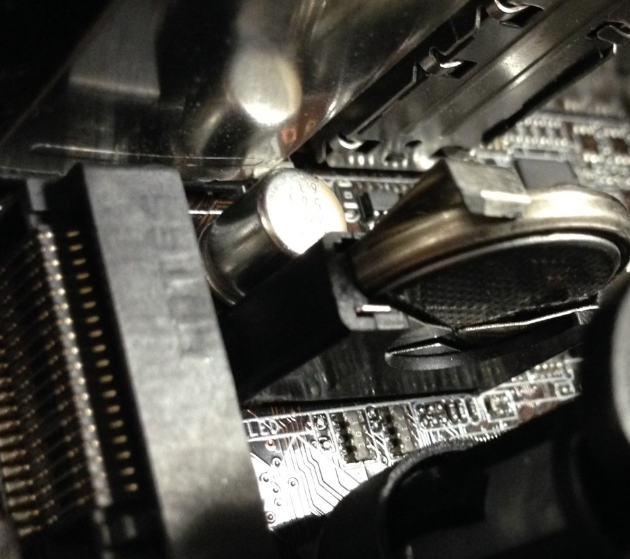
BIOS Configuration: CMOS Memory
256 bytes (low & high 128)
Backed by a small battery. Can be cleared by removing the “coin” battery (or a jumper)
Stores BIOS specific configuration settings
# chipsec_util.py cmos dump

Slide 47
UEFI Configuration: UEFI “Variables”
UEFI variables contain configuration setup, vendor information, language information, input/output console, error console, and boot order setting, secure boot configuration, long information after capsule update, pointer to S3 boot script and so on.
Attributes of UEFI variables:
NV (Non-Volatile)
BS (Boot Service)
RT (Run-Time)
Authentication attributes
NV variables are stored in NVRAM in SPI flash memory

Slide 48
Windows API to access UEFI variables
Windows 8+ provides user mode API to access run-time UEFI variables
GetFirmwareEnvironmentVariable http://msdn.microsoft.com/en-us/library/windows/desktop/ms724325(v=vs.85).aspx
SetFirmwareEnvironmentVariable http://msdn.microsoft.com/en-us/library/windows/desktop/ms724934(v=vs.85).aspx

Slide 49
UEFI, EDK I, EDK II, UDK, Tianocore
TianoCore is an open source implementation of UEFI, the Unified Extensible Firmware Interface
EDK II is a modern, feature-rich, cross-platform firmware development environment for the UEFI and PI specifications: http://www.tianocore.org/edk2/
UDK (UEFI Developers Kit) is a stable release of portions of the EDK II (UDK2015)
The UDK2015 is the EDKII support for all currently published UEFI specifications UDK2015 currently supports UEFI 2.5 and PI 1.4 level of specifications
EDK I is the older EFI 1.x development environment

Slide 50

UEFI Working Groups
USWG
UEFI Specification Working Group
PIWG
Platform Initialization Working Group
ASWG
ACPI Specification Working Group
BOS
Board Of Directors
USST
USWG Security Sub-team
Chaired by Vincent Zimmer (Intel)
Responsible for all security related material and the team that has added security infrastructure in the UEFI spec
USRT
UEFI Security Response Team
Chaired by Dick Wilkins (Phoenix)
Provide response to security issues.
UNST
UEFI Network Sub-team (VZ chairs, too)
Evolve network boot & network security infrastructure for UEFI Specification
www.uefi.org
ASWG, PIWG
BOD
USRT
USWG
UNST
USST
……
Note: Engaged in firmware/boot
Related WG’s of Trusted Computing Group (TCG), IETF, DMTF

Slide 51
The road from core to platform
tianocore.org
Open Source
Reference Tree
OEM BIOS
New product
Open Source
Existing product
End users updating?
Commercial product in the field
Consumer product in the field
IBV

ODM BIOS
All
Intel
OEM
IBV
ODM
ODMs updating?
New product
Existing ODM product
Time
Source: http://vzimmer.blogspot.com/2015_05_01_archive.html

Slide 52
1.4 Platform Firmware: SMI Handlers

Slide 53
x86 System Management Mode (SMM)
Real-Address Mode
SMI#
Reset or
PE=0
PE=1
Protected Mode
SMI#
RSM
System Management Mode
Reset
RSM
LME=1,CR0.PG=1
SMI#
IA-32e
Mode
VM=0
VM=1
RSM
Virtual-8086
Mode
SMI#
Source: Intel® 64 and IA-32 Architectures Software Developer’s Manual

Slide 54
System Management Mode (SMM)
SMRAM is a range of DRAM reserved by BIOS for runtime part - SMI handlers
CPU enters System Management Mode (SMM) upon receiving System Management Interrupt (SMI#) from the chipset or other logical CPU
SMI handler firmware is executing in SMM
CPU (OS) state is saved in SMRAM upon entry to SMM and restored upon exit from SMM
CPU exits SMM to the interrupted OS when SMI handler executes RSM instruction (“Resume from SMM”)

Slide 55
Initial SMM Execution Environment
Separate address space (SMRAM)
SMM starts as Read-Address Mode with flat 32-bit addressable space without paging (CR0 PE/PG = 0)
SMI handler firmware can enable paging later
Segments: base = 0, limit = FFFFFFFFh
Addressable physical memory: 0 to FFFFFFFFh (4G)
CS.base = SMBASE (30000h at reset), EIP=8000h
➔ SMM entry point = SMBASE + 8000h
All hardware interrupts are disabled upon entry

Slide 56
System Management RAM (SMRAM)
0xFFFFFFFF
SMRAM
SMRAM
SMBASE + FFFFh
SMM state save area
SMRR_PHYSBASE
SMBASE + FE00h
SMI handlers
SMBASE + 8000h
0x00000000
SMBASE

Slide 57
x64 SMM Save State
Offset (Added to SMBASE + 8000H) | Register | Writable?
7FF8H | CR0 | No
7FF0H | CR3 | No
7FE8H | RFLAGS | Yes
7FE0H | IA32_EFER | Yes
7FD8H | RIP | Yes
7FD0H | DR6 | No
7FC8H | DR7 | No
7FC4H | TR SEL1 | No
7FC0H | LDTR SEL1 | No
7FBCH | GS SEL1 | No
7FB8H | FS SEL1 | No
7FB4H | DS SEL1 | No
7FB0H | SS SEL1 | No
7FACH | CS SEL1 | No
7FA8H | ES SEL1 | No
7FA4H | IO_MISC | No
7F9CH | IO_MEM_ADDR | No
7F94H | RDI | Yes
Reference: Intel® 64 and IA-32 Architectures Software Developer’s Manual

Slide 58
x64 SMM Save State (cont’d)
Offset (Added to SMBASE + 8000H) | Register | Writable?
7F8CH | RSI | Yes
7F84H | RBP | Yes
7F7CH | RSP | Yes
7F74H | RBX | Yes
7F6CH | RDX | Yes
7F64H | RCX | Yes
7F5CH | RAX | Yes
7F54H | R8 | Yes
7F4CH | R9 | Yes
7F44H | R10 | Yes
7F3CH | R11 | Yes
7F34H | R12 | Yes
7F2CH | R13 | Yes
7F24H | R14 | Yes
7F1CH | R15 | Yes
7F1BH-7F04H | Reserved | No
7F02H | Auto HALT Restart Field (Word) | Yes
7F00H | I/O Instruction Restart Field (Word) | Yes
7EFCH | SMM Revision Identifier Field (Doubleword) | No
7EF8H | SMBASE Field (Doubleword) | Yes
Reference: Intel® 64 and IA-32 Architectures Software Developer’s Manual

Slide 59
Locating SMRAM using CHIPSEC
python chipsec_util.py msr 0x1f2
..
[*] loading common platform config from ‘..chipsec\tool\chipsec/cfg\common.xml'..
[*] loading 'hsw' platform config from ‘..chipsec\tool\chipsec/cfg\hsw.xml'..
[CHIPSEC] Executing command 'msr' with args ['0x1f2']
[CHIPSEC] CPU0: RDMSR( 0x1f2 ) = 00000000DA000006 (EAX=DA000006, EDX=00000000)
[CHIPSEC] CPU1: RDMSR( 0x1f2 ) = 00000000DA000006 (EAX=DA000006, EDX=00000000)
[CHIPSEC] CPU2: RDMSR( 0x1f2 ) = 00000000DA000006 (EAX=DA000006, EDX=00000000)
[CHIPSEC] CPU3: RDMSR( 0x1f2 ) = 00000000DA000006 (EAX=DA000006, EDX=00000000)
python chipsec_util.py msr 0x1f3
..
[*] loading common platform config from ‘..chipsec\tool\chipsec/cfg\common.xml'..
[*] loading 'hsw' platform config from ‘..chipsec\tool\chipsec/cfg\hsw.xml'..
[CHIPSEC] Executing command 'msr' with args ['0x1f3']
[CHIPSEC] CPU0: RDMSR( 0x1f3 ) = 00000000FF000800 (EAX=FF000800, EDX=00000000)
[CHIPSEC] CPU1: RDMSR( 0x1f3 ) = 00000000FF000800 (EAX=FF000800, EDX=00000000)
[CHIPSEC] CPU2: RDMSR( 0x1f3 ) = 00000000FF000800 (EAX=FF000800, EDX=00000000)
[CHIPSEC] CPU3: RDMSR( 0x1f3 ) = 00000000FF000800 (EAX=FF000800, EDX=00000000)

Slide 60
System Management Interrupt (SMI) Handler
SMM code flow
SMM Core dispatcher
SMST
SMI
RSM
I/O info
Memory info
CPU info
SMM callback
SMM Driver
SMM Driver
SMM callback
SMM callback
SMM Driver
...

Slide 61
1.4 Platform Firmware: Hardware Reference Code, etc.

Slide 62
Hardware Reference Code
Reference Code is a part of BIOS / system firmware which initializes specific piece of platform
CPU reference code (microcode update, CAR/NEM init)
Memory reference code trains DDR, initializes DIMMs, initializes memory controller, creates memory map
Chipset reference code initializes internal PCH interfaces
Provided by CPU/chipset vendors to original equipment manufacturers (OEMs) or BIOS vendors (IBV) for integration into the final BIOS for specific platform

Slide 63
Intel® Firmware Support Package (FSP)
The Intel FSP provides processor, memory & chipset initialization in a format that can easily be incorporated into existing boot loader (firmware) frameworks
EDKII Repo
FSP FV
Silicon initialization binaries (CPU, mem, PCH/SoC) packaged into FSP
Plugs into existing FW frameworks
Binary customization
PeiCore
Core PEIMs
CPU RC
Final BIOS
FSP
Reference
BIOS
Mem RC
Chipset RC
Si Init
Platform PEIMs
Other Glue
Reference: www.intel.com/fsp

Slide 64
References and Further Reading
For further details on platform and BIOS fundamentals take
Advanced x86: Introduction to BIOS & SMM
class by John Butterworth, Xeno Kovah and Corey Kallenberg at http://OpenSecurityTraining.info

Slide 65
References and Further Reading
Advanced x86: Introduction to BIOS & SMM by John Butterworth and Xeno Kovah at OpenSecurityTraining.info
4th Generation Intel® Core™ Processor Family Datasheet (vol 1, vol 2)
PCI Express System Architecture by Budruk, Anderson and Shanley (MindShare)
PCI System Architecture by Shanley and Anderson (MindShare)
An Introduction to PCI Express by Budruk (MindShare)
PCI/PCI Express Configuration Space Access (AMD)
PCI Express Base Specification Revision 3.0 (https://pcisig.com/specifications)
LPC specification
SPI Block Guide (Motorola, Inc.)
SMBus specification
Designing with SMBus 2.0 by Dale Stolitzka (Analog Devices, Inc.)
Minimal Intel Architecture Boot Loader by Jenny M Pelner & James A Pelner (Intel)
Pentium Processor Family Developer’s Manual (Initialization and Mode Switching)
Power Sequence and Reset Utilizing the Intel® EP80579 Processor by Julio Pineda (Intel)
Plug and Play BIOS Specification
BIOS Boot Specification
Booting an Intel Architecture System by Pete Dice (Intel)
Intel® 64 and IA-32 Architectures Software Developer’s Manual
UEFI Platform Initialization Specification 1.5
UEFI Specification 2.6
A Tour Beyond BIOS: Using Intel FSP with EDKII

Slide 66
Training materials are available on Github
https://github.com/advanced-threat-research/firmware-security-training
Yuriy Bulygin @c7zero
Alex Bazhaniuk @ABazhaniuk
Andrew Furtak @a_furtak
John Loucaides @JohnLoucaides

