Slide 1
Security of BIOS/UEFI System Firmware from Attacker and Defender Perspectives Section 2. Bootkits and Secure Boot
Yuriy Bulygin *
Alex Bazhaniuk *
Andrew Furtak *
John Loucaides **
* Advanced Threat Research, McAfee
** Intel

Slide 2
License
Training materials are shared under Creative Commons “Attribution” license CC BY 4.0
Provide the following attribution:
Derived from “Security of BIOS/UEFI System Firmware from Attacker and Defender Perspective” training by Yuriy Bulygin, Alex Bazhaniuk, Andrew Furtak and John Loucaides available at https://github.com/advanced-threat-research/firmware-security-training

Slide 3
Section 2. Bootkits and Secure Boot

Slide 4
2.1 In the beginning

Slide 5
Early days. Boot sector infection
Elk Cloner – one of the first known viruses. Created by CAS freshman Richard Skrenta (Sprengelmeyer) in 1981. Infected Apple II DOS 3.3 OS, occupied unused space inside “boot sector”. Resident in memory. Infects uninfected floppy disks.
http://virus.wikidot.com/elk-cloner

Slide 6
Early days. Boot sector infection
Brain – considered to be the first PC virus.
This virus originated in January, 1986, in Lahore Pakistan. The first noticeable infection problems did not surface until 1988.
The Brain is a boot sector infector, approximately 3 K in length, that infects 5 1/4" floppies.
The virus stores the original boot sector, and six extension sectors, containing the main body of the virus, in available sectors which are then flagged as bad sectors.
Brain is the only virus yet discovered that contains the valid names, phone numbers and addresses of the creators.
http://virus.wikidot.com/brain
http://www.textfiles.com/virus/braininf.vir (David Stang, NCSA)

Slide 7
Early days. BIOS infection
BIOS Meningitis – the worlds first flash BIOS infecting virus. Infects floppy boot-sector and hard drive MBR as well. It was coded by Qark of VLAD and appeared in Issue 2 of VLAD magazine in November 1994.
BIOS Meningitis uses various INT 16h AH=E0h (BIOS Flash routines) calls to manipulate the Flash memory. Hooks INT 19h (BIOS Boot Strap Loader) handler. The virus INT 19h handler copies the virus to 0000:7C00h (standard boot sector load address), emulates an infected MBR execution and then does the job of a standard INT 19h handler – boots from floppy or HDD.
http://virus.wikidot.com/bios-meningitis
http://www.wiw.org/~meta/vlad/vlad2/art44.htm (source code)

Slide 8
BIOS damage - CIH
In 1998-99 CIH (“Chernobyl”) virus infected 60 million and damaged 0.5 million computers causing ~$1B in damages
CIH destructive payload, when activated, attempts to corrupt system BIOS in ROM and 2048 sectors on all hard drives including boot sectors
Sources: Wikipedia, F-Secure, Kaspersky Lab, GRC

Slide 9
2.2 Boot Sectors

Slide 10
Master Boot Record (MBR)
MBR helps BIOS to locate OS partition and boot the OS
MBR is located at LBA 0 (the first boot sectors) of the disk
MBR contains:
boot code (initial program loader) which is loaded and invoked by the BIOS
up to four partition records each defining starting and ending logical block addresses (LBA) for corresponding partitions on a disk
Legacy MBR
Partition
Partition
Partition
Partition
LBA 0
Source: https://technet.microsoft.com/en-us/library/cc976786.aspx

Slide 11
Legacy MBR structure
Mnemonic | Byte Offset | Byte Length | Description
BootCode | 0 | 424 | X86 code used on a no-UEFI system to select an MBR partition record and load the first logical block of the partition. This code shall not be executed on UEFI systems
UniqueMBRDiskSignature | 440 | 4 | Unique Disk Signature. This may be used by the OS to identify the disk from other disks in the system. This value is always written by the OS and is never written by EFI firmware
Unknown | 444 | 2 | Unknown. This field shall not be used in UEFI firmware
PartitionRecord | 446 | 16*4 | Array of four legacy MSR partition records
Signature | 510 | 2 | Set to 0xAA55 (i.e., byte 510 contains 0x55 and byte 511 contains 0xAA)
Reserved | 512 | Logical BlockSize - 512 | The rest of the logical block, if any, is reserved.
As defined in UEFI Spec 2.5, Chapter 5 GPT Disk Layout
Source: https://technet.microsoft.com/en-us/library/cc976786.aspx

Slide 12
Legacy MBR partition record
Mnemonic | Byte Offset | Byte Length | Description
BootIndicator | 0 | 1 | 0x80 indicates that this is the bootable legacy partition. Other values indicate that this is not a bootable legacy partition. This field shall not be used by UEFI firmware
StartingCHS | 1 | 3 | Start of partition in CHS address format. This field shall not be used by UEFI firmware
OSType | 4 | 1 | Type of partition.
EndingCHS | 5 | 3 | Array of four legacy MSR partition records
StartingLBA | 8 | 4 | End of partition in CHS address format. This field shall not be used by UEFI firmware.
SizeInLBA | 12 | 4 | Size of the partition of LBA units of logical blocks. This field is used by UEFI firmware to determine the size of the partition
The partition defined by each MBR Partition Record must physically reside on the disk (i.e., not exceeding the capacity of the disk).
Each partition must not overlap with other partitions.
Source: https://technet.microsoft.com/en-us/library/cc976786.aspx

Slide 13
Protective MBR
Instead of legacy MBR a protective MBR may be located at LBA0 of the disk if it is using the GPT disk layout
One of the Partition Records shall be defined in a way reserving the entire space on the disk after the Protective MBR itself for the GPT disk layout
Protective MBR
Primary GPT
UEFI system partition
Partition
Partition
Partition
Backup GPT
GPT Protective partition
LBA 0
Reference: http://blog.fpmurphy.com/2011/10/fedora-16-mbr-grub-legacy-to-gpt-grub2.html

Slide 14
Protective MBR structure
The Protective MBR precedes the GUID Partition Table Header to maintain compatibility with existing tools that do not understand GPT partition structures
Mnemonic | Byte Offset | Byte Length | Description
Boot Code | 0 | 424 | Unused by UEFI systems
Unique MBR Disk Signature | 440 | 4 | Unused. Set to zero
Unknown | 444 | 2 | Unused. Set to zero
Partition Record | 446 | 16*4 | Array of four MSR partition records. Contains: One partition record Three partition record each set to zero
Signature | 510 | 2 | Set to 0xAA55 (i.e., byte 510 contains 0x55 and byte 511 contains 0xAA)
Reserved | 512 | Logical BlockSize - 512 | The rest of the logical block, if any, is reserved. Set to zero
Reference: https://en.wikipedia.org/wiki/GUID_Partition_Table#Protective_MBR_.28LBA_0.29

Slide 15
Volume Boot Record (VBR)
A Volume Boot Record (VBR) is the first sector of a partition (opposite to MBR which is the first sector of a hard disk).
VBR (just like MBR) also contain some code and data, but it's far less standard.
The code is always OS specific, but in common all versions does the same: locate the kernel on the partition, load and execute it.
A really good example for VBR is the original DOS bootsector, which used FAT and loaded IO.SYS and MSDOS.SYS from the root directory.
Source: OS Dev Wiki http://wiki.osdev.org/Volume_Boot_Record

Slide 16
2.3 Bootkits (Boot Rootkits)

Slide 17

eEye BootRoot
eEye BootRoot was the first pubic proof-of-concept bootkit developed by Derek Soeder and Ryan Permeh
Hooked INT 13h (Disk access ISR) to patch OSLOADER
OSLOADER patch was able to modify OS further, e.g. patch boot drivers

Slide 18
Chronology
OS Kernel Rootkits (~ 1999+)
Research: NTRootkit, SucKIT, adore, knark
In-the-Wild: HackerDefender, Haxdoor
MBR,VBR Bootkits (~ 2005+)
Defense: Windows DSE, Patch Guard
Research: eEye BootRoot, BOOT-KIT, Vbootkit, Stoned Bootkit, Deep Boot, EvilCore
In-the-Wild: Mebroot, TDL4, FIN1, Rovnix, Olmasco, XPAJ, Gapz, Petya and Goldeneye
BIOS Rootkits (~ 2006+)
Research: Heasman’s ACPI and PCI OpROM Rootkits, Clear Hat SMM Rootkit, Phrack 65 SMM, Persistent BIOS Infection, Phrack 66 “A Real SMM Rootkit”, Rakshasa
In-the-Wild: IceLord BIOS Rootkit, Mebromi, ANT catalog
UEFI Bootkits (~ 2012+)
EFI/UEFI (support in Windows Vista, Windows 7, Server 2008)
Research: Andrea Allievi’s UEFI Bootkit, Dreamboot
(U)EFI Firmware Rootkits (~ 2012+)
Defense: Windows 8 and UEFI Secure Boot
Research: Angry Evil-Maid SRTM rootkit, A Tale of Secure Boot Bypass UEFI Bootkit, Project Maux, snare’s Mac EFI Rootkit, Thunderstrike 1 and 2, Light Eater, firmware rootkit vs VMM, Dmytro Oleksiuk’s SmmBackdoor
In-the-Wild: HackingTeam UEFI Rootkit, Mac EFI Der Starke/DarkMatter implant, Sonic Scredriver

Slide 19
Types of Bootkits
MBR
MBR Bootstrap code area modification (TDL4 here & here, Goblin, Petya & Goldeneye ransomware)
MBR Partition Table modification (Olmasco)
VBR
VBR boot code (IPL) modification (FIN1, Rovnix)
VBR BIOS Parameter Block (BPB) modification (Gapz here & here)
BIOS, UEFI
Injecting malicious Option ROMs (Mebromi)
Replacing EFI boot loaders
Installing custom firmware (EFI DXE) executables (HackingTeam UEFI Rootkit)
Additional references: Bootkits step by-step

Slide 20
MBR Bootkit: TDL4 (Olmarik, Alureon)
BIOS
EFI
Load ldr16
Hook INT 13h
MBR
VBR
bootmgr
bootmgfw.efi
BcdLibraryBoolean_DisableIntegrityCheck
BcdOSLoaderBoolean_WinPEMode
Process BCD
Winload.exe
Driver Signing Check
ntoskrnl.exe
Hall.dll
Kdcom.dll
CI.dll
Driver Signing Check
Code Integrity Check
Load ldr32
Load drv32 or drv64
Source: What's different with TDL4 and TDL3

Slide 21
VBR Bootkit: Fin1
The installer (BOOTRASH) reads the original boot sector into memory
Saves an backup copy of the VBR code at 0xE sectors from the start of the partition. Apple integrity check.
Installer decodes the new bootstrap code from one of its embedded resources and overwrites the existing bootstrap code
BOOTRASH hijacks boot process in order to load the Nemesis payload before the OS.
BOOTRASH creates its own custom virtual file system (VFS) to store the components of the Nemesis
BIOS
MBR
VBR
bootmgr
Nemesis payload
Virtual File System (VFS)
Source: fin1 targets boot record

Slide 22
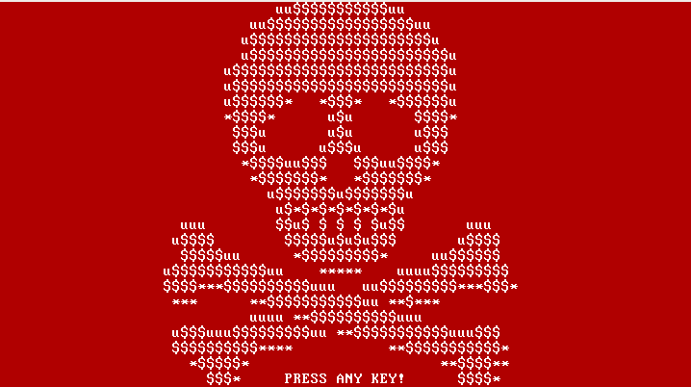
Ransomware Bootkit: Petya
Launched by Windows executable dropper
Overwrites the beginning of the disk (including MBR) and makes an XOR encrypted backup of the original data
The second stage is executed by the fake CHKDSK scan. After this, the file system is destroyed and cannot be read
This first ransomware targeting disk with MBR rather than individual files
Source: Petya – Taking Ransomware To The Low Level

Slide 23
Mebromi BIOS Infection
Mebromi malware includes BIOS infector & MBR bootkit components
Patches BIOS ROM binary injecting malicious ISA Option ROM with legitimate BIOS image mod utility
Triggers SW SMI 0x29/0x2F to erase SPI flash then write patched BIOS binary
# chipsec_util.py smi 0x2F
Infected BIOS injects boot strap code to MBR

Slide 24
Exercise 2.1
Extract and Parse Master Boot Record

Slide 25
2.3 GUID Partition Table

Slide 26
GUID Partition Table
GUID Partition Table (GPT) is a hard disk partition table layout using GUIDs defined as part of UEFI standard
The GPT Header defines the range of LBAs that are usable by GPT Partition Entries
Disk GUID is a GUID that uniquely identifies the entire GPT Header and all its associated storage

Slide 27
GUID Partition Table Disk Layout
First useable block
Start partition
LBA0
LBA1
End partition
LBAn
PMBR
Partition Table HDR
0
1
…
n
Partition 1
0
1
…
n
Partition Table HDR
Start partition
End partition
Last useable block
Primary Partition
Table
Backup Partition
Table
Source: http://kurtqiao.github.io/uefi/2014/12/31/GUID-Partition-Table-Disk.html

Slide 28
GUID Partition Table Header
Offset | Length | Contents
0x00 | 8 bytes | Signature ("EFI PART", 45h 46h 49h 20h 50h 41h 52h 54h or 0x5452415020494645ULL on littleendian machines)
0x08 | 4 bytes | Revision (for GPT version 1.0 (through at least UEFI version 2.3.1), the value is 00h 00h 01h 00h)
0x0C | 4 bytes | Header size in little endian (in bytes, usually 5Ch 00h 00h 00h or 92 bytes)
0x10 | 4 bytes | CRC32 of header (offset +0 up to header size), with this field zeroed during calculation
0x14 | 4 bytes | Reserved; must be zero
0x18 | 8 bytes | Current LBA (location of this header copy)
0x20 | 8 bytes | Backup LBA (location of the other header copy)
0x28 | 8 bytes | First usable LBA for partitions (primary partition table last LBA + 1)
0x30 | 8 bytes | Last usable LBA (secondary partition table first LBA 1)
0x38 | bytes | Disk GUID (also referred as UUID on UNIXes)
0x48 | 8 bytes | Starting LBA of array of partition entries (always 2 in primary copy)
0x50 | 4 bytes | Number of partition entries in array
0x54 | 4 bytes | Size of a single partition entry (usually 80h or 128)
0x58 | 4 bytes | CRC32 of partition array
0x5C | * | Reserved; must be zeroes for the rest of the block (420 bytes for a sector size of 512 bytes; but can be more with larger sector sizes)
GPT Entry
Source: http://ntfs.com/guid-part-table.htm

Slide 29
GUID Partition Table Entry
Offset | Length | Contents
0 (0x00) | 16 bytes | Partition type GUID
16 (0x10) | 16 bytes | Unique partition GUID
32 (0x20) | 8 bytes | First LBA (little endian)
40 (0x28) | 8 bytes | Last LBA (inclusive, usually odd)
48 (0x30) | 8 bytes | Attribute flags (e.g. bit 60 denotes readonly)
56 (0x38) | 72 bytes | Partition name (36 UTF16LE code units)
Source: http://www.datarecovery.institute/guid-partition-table-windows-10/

Slide 30
Exercise 2.2
Access ESP from Linux, UEFI shell and Windows; find OS boot loaders and GPT

Slide 31
2.4 UEFI Bootkits

Slide 32
UEFI Based Windows Boot
UEFI Firmware
Performs CPU and Chipset initialization, load drivers, etc.
UEFI Boot Manager
Loads UEFI device drivers (based on NVRAM DriverXxx variable), loads boot application
Windows Boot Manager (bootmgfw.efi)
Load Windows OS loader selected by user
Windows OS Loader (winload.efi)
Loads the Windows OS, calls ExitBootServices()
Kernel
(ntoskrnl.exe)
Source: Windows Boot Environment by Murali Ravirala

Slide 33
Types of UEFI Bootkits
Replacing Windows Boot Manager
EFI System Partition (ESP) on Fixed Drive
ESP\EFI\Microsoft\Boot\bootmgfw.efi
UEFI technology: say hello to the Windows 8 bootkit! by ITSEC
Replacing Fallback Boot Loader
ESP\EFI\Boot\bootx64.efi
Dreamboot by Sébastien Kaczmarek, QUARKSLAB
Adding New Boot Loader (bootkit.efi)
Modified BootOrder / Boot#### EFI variables
Adding/Replacing DXE Driver
Stored on Fixed Drive
Not embedded in Firmware Volume (FV) in ROM
Modified DriverOrder / Driver#### EFI variables

Slide 34
Types of UEFI Bootkits
Patching UEFI “Option ROM”
UEFI DXE Driver in Add-On Card (Network, Storage..)
Non-Embedded in FV in ROM
Mac EFI Rootkits by @snare, Black Hat USA 2012
Thunderstrike Mac EFI Rootkit by Trammell Hudson
Replacing OS Loaders (winload.efi, winresume.efi)
Patching GUID Partition Table (GPT)

Slide 35
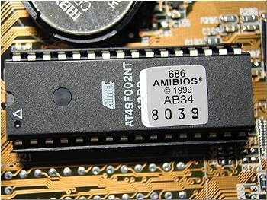
Replacing Boot Loaders
Malware
OS Kernel / Drivers
UEFI OS Loaders
UEFI
OROM
DXE
Driver
UEFI
Boot Loader
Bootx64.efi
Bootmgfw.efi
HDD
UEFI
OROM
DXE
Driver
UEFI DXE Core / Dispatcher
System Firmware (SEC/PEI)
Hardware
I/O
Memory
Network
Graphics

Slide 36
Adding/Replacing DXE Drivers
Malware
OS Kernel / Drivers
UEFI OS Loaders
UEFI
OROM
DXE
Driver
UEFI
Boot Loader
Bootx64.efi
Bootmgfw.efi
HDD
UEFI
OROM
DXE
Driver
UEFI DXE Core / Dispatcher
System Firmware (SEC/PEI)
Hardware
I/O
Memory
Network
Graphics

Slide 37
Replacing DXE Option ROM Drivers
Malware
OS Kernel / Drivers
UEFI OS Loaders
UEFI
OROM
DXE
Driver
UEFI
Boot Loader
Bootx64.efi
Bootmgfw.efi
HDD
UEFI
OROM
DXE
Driver
UEFI DXE Core / Dispatcher
System Firmware (SEC/PEI)
Hardware
I/O
Memory
Network
Graphics

Slide 38
UEFI Bootkits
Malware
OS Kernel / Drivers
UEFI OS Loaders
UEFI
OROM
DXE
Driver
UEFI
Boot Loader
Bootx64.efi
Bootmgfw.efi
HDD
UEFI
OROM
DXE
Driver
UEFI DXE Core / Dispatcher
System Firmware (SEC/PEI)
Hardware
I/O
Memory
Network
Graphics

Slide 39
UEFI Bootkit: Dreamboot
Replaces Windows 8 loader
Patches OS to disable kernel protections
Disables DEP (NX flag)
Disables Windows Patch Guard
Open source: https://github.com/quarkslab/dreamboot
Source: UEFI and Dreamboot by Sebastien Kaczmarek

Slide 40
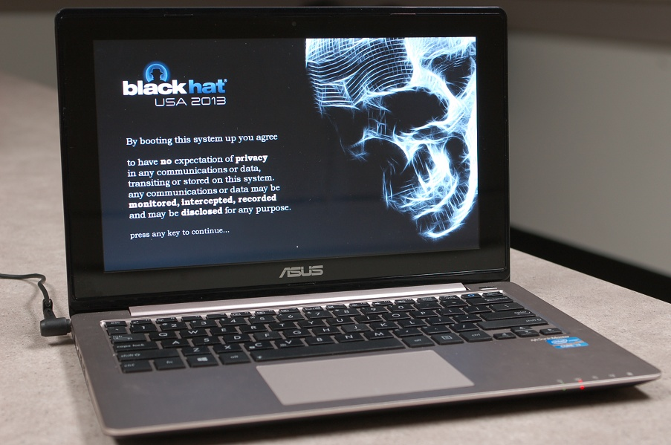
Windows 8 UEFI Bootkit
Source: A Tale of One Software Bypass of Windows 8 Secure Boot

Slide 41
2.5 UEFI Secure Boot

Slide 42
Secure Boot (UEFI + OS)
OS
Secure
Boot
OS Driver
OS Driver
Signed BIOS
Update
OS Kernel
UEFI OS Loaders
UEFI
Secure
Boot
DXE
Driver
DXE
OROM
UEFI App
UEFI
Boot Loader
Bootx64.efi
Bootmgfw.efi
DXE
Driver
DXE
OROM
UEFI App
UEFI DXE Core / Dispatcher
System Firmware (SEC/PEI)
Hardware
I/O
Memory
Network
Graphics

Slide 43
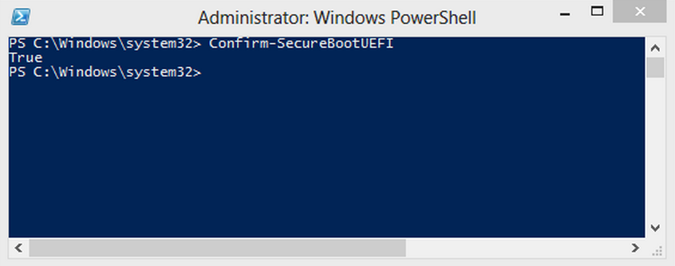
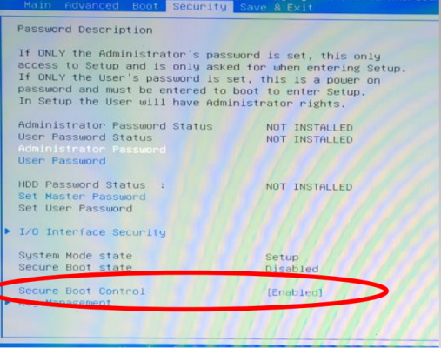
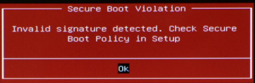

Slide 44
UEFI Secure Boot Configuration
SecureBoot
Enables/disables image signature checks
SetupMode
PK is installed (USER_MODE) or not (SETUP_MODE)
SETUP_MODE allows updating KEK/db(x), self-signed PK
CustomMode
Modifiable by physically present user
Allows updating KEK/db/dbx/PK even when PK is installed
SecureBootEnable
Global non-volatile Secure Boot Enable
Modifiable by physically present user

Slide 45
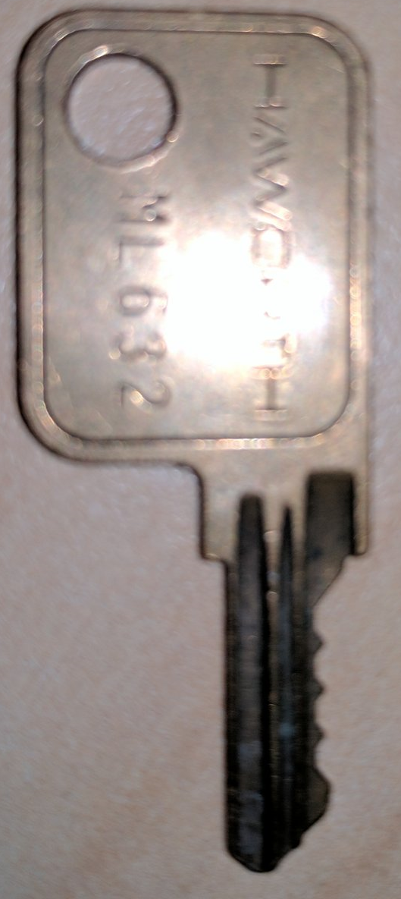
Secure Boot Key Hierarchy
PK
Update
Platform Key (PK)
Verifies KEKs
Platform Vendor’s Cert
Key Exchange Keys (KEKs)
Verify db and dbx
Earlier rev’s: verifies image signatures
Authorized Database (db)
Forbidden Database (dbx)
X509 certificates, SHA1/SHA256 hashes of allowed & revoked images
Earlier revisions: RSA-2048 public keys, PKCS#7 signatures
Update
KEK
Update
db
dbx
If signed by key in db, executable can be loaded
If signed by key in dbx, executable load is forbidden

Slide 46
PK (openssl x509 -in PK.pem –text)
Certificate:
Data:
Version: 3 (0x2)
Serial Number:
53:41:e0:15:c4:3a:f8:a8:48:36:b9:a5:ff:69:14:88
Signature Algorithm: sha256WithRSAEncryption
Issuer: CN=ASUSTeK MotherBoard PK Certificate
Validity
Not Before: Dec 26 23:34:50 2011 GMT
Not After : Dec 26 23:34:49 2031 GMT
Subject: CN=ASUSTeK MotherBoard PK Certificate
Subject Public Key Info:
Public Key Algorithm: rsaEncryption
Public-Key: (2048 bit)
Modulus:
00:d9:84:15:36:c5:d4:ce:8a:a1:56:16:a0:e8:74:
..
Exponent: 65537 (0x10001)
X509v3 extensions:
2.5.29.1:
?=.../0-1+0)..U..."ASUSTeK MotherBoard PK Certificate..SA...:..H6...i..
Signature Algorithm: sha256WithRSAEncryption
73:27:1a:32:88:0e:db:13:8d:f5:7e:fc:94:f2:1a:27:6b:c2:
..
-----BEGIN CERTIFICATE-----
MIIDRjCCAi6gAwIBAgIQU0HgFcQ6+KhINrml/2kUiDANBgkqhkiG9w0BAQsFADAt
..
-----END CERTIFICATE-----

Slide 47
Secure Boot Modes
Enroll PK
SETUP MODE
USER MODE
Delete PK
Platform specific Clear PK
Source: https://www.wzdftpd.net/blog/tag/debian.html

Slide 48
Secure Boot Modes
PK variable exists in NVRAM?
Yes: Set SetupMode variable to USER_MODE
No: Set SetupMode variable to SETUP_MODE
SecureBootEnable variable exists in NVRAM?
Yes
SecureBootEnable variable is SECURE_BOOT_ENABLE and SetupMode is USER_MODE? Set SecureBoot to ENABLE
Else? Set SecureBoot to DISABLE
No
SetupMode variable is USER_MODE? Set SecureBoot to ENABLE
SetupMode variable is SETUP_MODE? Set SecureBoot to DISABLE

Slide 49
Image Verification Policies
DxeImageVerificationLib defines policies applied to different types of images and on security violation
IMAGE_FROM_FV (ALWAYS_EXECUTE), IMAGE_FROM_FIXED_MEDIA,
IMAGE_FROM_REMOVABLE_MEDIA, IMAGE_FROM_OPTION_ROM
ALWAYS_EXECUTE, NEVER_EXECUTE,
ALLOW_EXECUTE_ON_SECURITY_VIOLATION
DEFER_EXECUTE_ON_SECURITY_VIOLATION
DENY_EXECUTE_ON_SECURITY_VIOLATION
QUERY_USER_ON_SECURITY_VIOLATION

Slide 50
Let’s have a look at the Secure Boot image verification process
SecurityPkg\Library\DxeImageVerificationLib
http://sourceforge.net/apps/mediawiki/tianocore/index.php?title=SecurityPkg

Slide 51
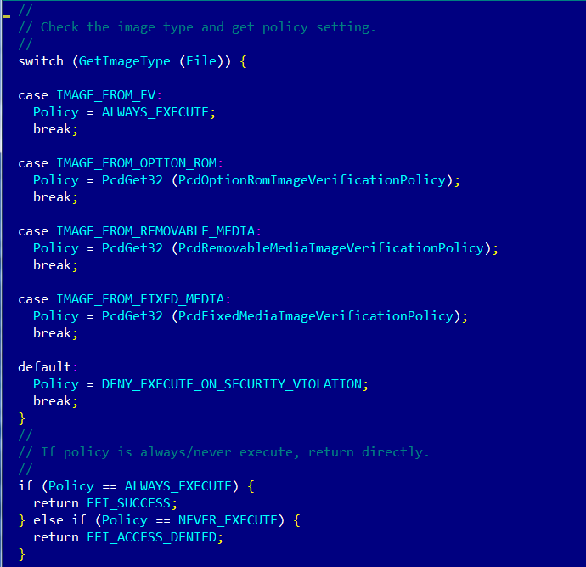
Verifying Policies
Image Verification Policy
(IMAGE_FROM_FV) ALWAYS_EXECUTE? EFI_SUCCESS
NEVER_EXECUTE? EFI_ACCESS_DENIED

Slide 52
Image Verification Handler
SecureBoot EFI variable doesn’t exist or equals to SECURE_BOOT_MODE_DISABLE? EFI_SUCCESS
File is not valid PE/COFF image? EFI_ACCESS_DENIED
SecureBootEnable NV EFI variable doesn’t exist or equals to SECURE_BOOT_DISABLE? EFI_SUCCESS
SetupMode NV EFI variable doesn’t exist or equals to SETUP_MODE? EFI_SUCCESS

Slide 53
Authenticating EFI Images (EDK2)
Image is not signed
Image signature or SHA256 hash in DBX? EFI_ACCESS_DENIED
Image signature or SHA256 hash in DB? EFI_SUCCESS
Image is signed
For each signature in PE file:
Signature verified by root/intermediate cert in DBX? EFI_ACCESS_DENIED
Image signature or SHA256 hash in DBX? EFI_ACCESS_DENIED
For each signature in PE file:
Signature verified by root/intermediate cert in KEK or DB? EFI_SUCCESS
Image signature or SHA256 hash in DB? EFI_SUCCESS
Else EFI_ACCESS_DENIED

Slide 54
Open source packages for Secure Boot Flow
MdeModulePkg
LoadImage Boot Service
gBS->LoadImage
CoreLoadImage()
EFI_SECURITY_ARCH_PROTOCOL
SecurityStubDxe
SecurityStubAuthenticateState()
DxeSecurityManagementLib
RegisterSecurityHandler()
ExecuteSecurityHandlers()
MdePkg
BasePeCoffLib
PeCoffLoaderGetImageInfo()
CryptoPkg
BaseCryptLib
Sha256Init()
Sha256Update()
Sha256Final()
Sha256GetContextSize()
AuthenticodeVerify()
Pkcs7Verify()
WrapPkcs7Data()
OpenSslLib
Openssl-0.9.8w
IntrinsicLib
SecurityPkg
DxeImageVerificationLib
DxeImageVerificationHandler()
HashPeImage()
HashPeImageByType()
VerifyWinCertificateForPkcsSignedData()
DxeImageVerificationLibImageRead()
IsSignatureFoundInDatabase()
IsPkcsSignedDataVerifiedBySignatureList()
VerifyCertPkcsSignedData()
Authenticated Variables
gRT->GetVariable
Source: A Tour Beyond BIOS into UEFI Secure Boot by Rosenbaum, Zimmer

Slide 55
2.6 Linux Secure Boot

Slide 56
Linux Secure Boot with Shim
UEFI
shim
db
UEFI CA
verify
Signature
Microsoft UEFI CA cert
verify
SUSE
Signature
SUSE UEFI cert
Either the UEFI public key or SUSE public key will let the shim boot with UEFI secure boot
Source: UEFI Open Platforms by Vincent Zimmer

Slide 57
Multiple OS Boot with MOK
DB
SUSE
SUSE
shim
grub2
kernel
load
load
SUSE UEFI key
SUSE boot path
Load
custom boot path
Load
BS Var
User
User
MOKList
grub2
Load
Kernel
User
Source: UEFI Open Platforms by Vincent Zimmer

Slide 58
Exercise 2.3
Secure Boot on Linux

Slide 59
Training materials are available on Github
https://github.com/advanced-threat-research/firmware-security-training
Yuriy Bulygin @c7zero
Alex Bazhaniuk @ABazhaniuk
Andrew Furtak @a_furtak
John Loucaides @JohnLoucaides

