Slide 1
Security of BIOS/UEFI System Firmware from Attacker and Defender Perspectives Section 5. Hands-On Learning of EFI Environment
Yuriy Bulygin *
Alex Bazhaniuk *
Andrew Furtak *
John Loucaides **
* Advanced Threat Research, McAfee
** Intel

Slide 2
License
Training materials are shared under Creative Commons “Attribution” license CC BY 4.0
Provide the following attribution:
Derived from “Security of BIOS/UEFI System Firmware from Attacker and Defender Perspective” training by Yuriy Bulygin, Alex Bazhaniuk, Andrew Furtak and John Loucaides available at https://github.com/advanced-threat-research/firmware-security-training

Slide 3
Section 5. Hands-On Learning of EFI Environment

Slide 4
5.1 UEFI Shell

Slide 5
Exercise 5.1
Getting Familiar with UEFI Shell

Slide 6
Booting in UEFI Shell and Using Built-in Shell Commands
Replace bootloader with uefi shell:
$cp /boot/efi/EFI/boot/bootx64.efi /boot/efi/EFI/boot/bootx64.efi.bak
$cp /boot/efi/EFI/boot/shell_bootx64.efi /boot/efi/EFI/boot/bootx64.efi
Reboot system: $shutdown –r now
Test built-in shell commands from UEFI shell (list in next slide)
Recover original bootloader in UEFI shell:
shell> fs0:
shell> rm EFI\boot\bootx64.efi
shell> cp EFI\boot\bootx64.efi.bak EFI\boot\bootx64.efi

Slide 7
Full UEFI Shell Commands/Apps
Tool | Description
help –b | Displays all UEFI shell internal commands
mode | Displays or changes the console output device mode.
memmap | Displays the memory map maintained by the EFI environment.
dmem | Displays the contents of system or device memory.
mm | Displays or modifies MEM/MMIO/IO/PCI/PCIE address space.
pci | Displays PCI device list or PCI function configuration space.
drivers | Displays the EFI driver list.
dmpstore | Displays all EFI NVRAM variables.
dh | Displays EFI handle information.
openinfo | Displays the protocols and agents associated with a handle.
dblk | Displays the contents of one or more blocks from a block device.
eficompress | Compress a file
efidecompress | Decompress a file
smbiosview | Displays SMBIOS information
loadpcirom | Loads a PCI Option ROM from the specified file.
edit/hexedit | Editor, hex editor
map | Defines a mapping between a user-defined name and a device handle.
vol | Displays the volume information for the file system that is specified by fs.

Slide 8
5.2 Building UEFI Firmware with EDK II

Slide 9
Exercise 5.2
Building EDK2 and flashing SPI image

Slide 10
Exercise Outline
Pre-requirement: Boot your system from USB stick. Connect your system to minnowboard through Ethernet cable and change IP address of your system to 192.168.1.1/24
Build open source EDK2 BIOS image for MinnowBoard on your system
Copy newly build Flash image to MinnowBoard (use scp command for it)
Flash it onto SPI using CHIPSEC
Read SPI image using CHIPSEC
Read SPI image using Dediprog HW SPI Flash programmer (optional)

Slide 11
MinnowBoard MAX Build Resources
Documents, Release Nodes, Pre-built Firmware Binary images, Buildable Development Tree, Flash Update Utilities:
http://firmware.intel.com/projects/minnowboard-max
Using EDK II with Native GCC:
http://tianocore.sourceforge.net/wiki/Using_EDK_II_with_Native_GCC

Slide 12
Create a Full Source Tree
Create a new folder (directory) on the root of your local hard drive (development machine) for use as your work space (In USB stick work space: "/home/user/Desktop/bios").
Checkout packages from: https://svn.code.sf.net/p/edk2/code/branches/UDK2014.SP1/
Download: MinnowBoard_MAX-{version}-Binary.Objects.zip
Download and patch openssl
Download edksetup.sh
Patch Vlv2TbltDevicePkg/bld_vlv.sh depends on GCC version
Or use script: bios_download_and_build.sh

Slide 13
Apply debug patch
Apply debug patch to Vlv2TbltDevicePkg directory:
$cd Vlv2TbltDevicePkg
$patch –p 0 < ~/Desktop/patches/debug.patch
$cd ..

Slide 14
Build MinnowBoard UEFI Firmware
Install iASL compiler
Install python, gcc, build-essential, subversion, uuid-dev
Run: $source edksetup.sh
Run:
$cd Vlv2TbltDevicePkg
$chmod +x bld_vlv.sh Build_IFWI.sh GenBiosId
Build EDKII Firmware:
$./Build_IFWI.sh MNW2 Debug # also use this to rebuild BIOS
Firmware binary MNW2MAX_X64_D_0079_01_GCC.bin should now be in directory Stitch/
$ ls -lah Stitch/
-rw-r--r-- 1 user user 8.0M Jun 4 18:06 MNW2MAX_X64_D_0079_01_GCC.bin
Copy SPI image to MinnowBoard system (use scp command for coping).

Slide 15
Read SPI Image Using CHIPSEC
Check SPI flash before/after erase and write operations.
CHIPSEC SPI commands:
$ chipsec_util spi dump rom.bin

Slide 16
Flash Image Onto SPI Using CHIPSEC
Disable BIOS Write Protection in UEFI Setup (DONE)
Enable writes to BIOS region of SPI flash memory
$python chipsec_util.py spi disable-wp
Erase full SPI flash memory chip
for(( i=0; i<2048; i++ ))
do
R=$(echo "obase=16; $i*4096" | bc)
python chipsec_util.py spi erase $R;
done
Write newly built firmware image to SPI flash memory
$python chipsec_util.py spi write 0x0 <NEW_BUILT_BIOS_FILE>

Slide 17
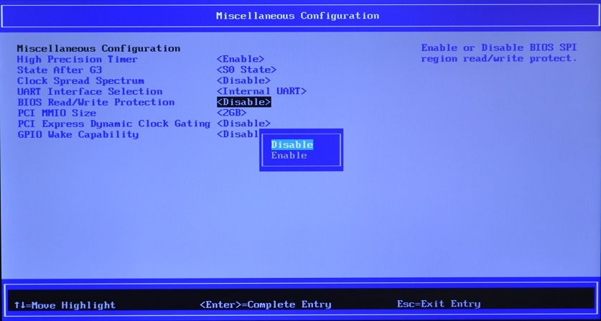
Changing BIOS WP in UEFI Setup

Slide 18
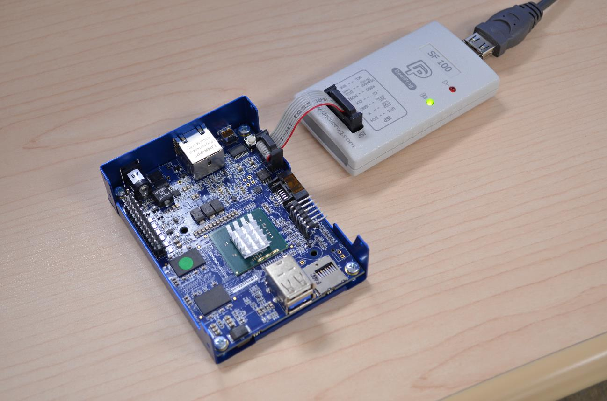
Manipulating SPI Image Using Dediprog Hardware SPI Flash Programmer

Slide 19
DediProg Software

Slide 20
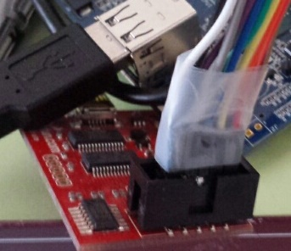
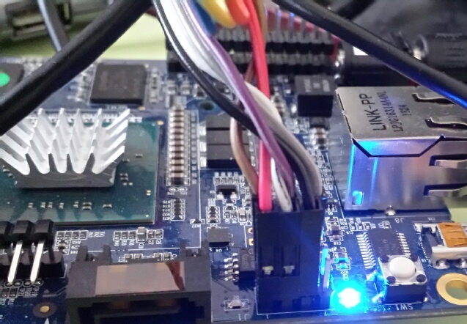
Manipulating SPI image using Bus Pirate as HW SPI Flash programmer

Slide 21
Manipulating SPI Image Using Bus Pirate as HW SPI Flash Programmer
Minnowboard Max
power
USB
brown
purple
Ethernet
gray
Power
SATA
uHDMI
SD
card
red
white
black
Bus Pirate
brown
red
orange
yellow
USB
green
blue
purple
gray
white
black

Slide 22
5.3 EDK II Debug

Slide 23
Exercise 5.3
EFI Debug

Slide 24
Exercise Outline
Serial connection setup
Configure host system for debugging
Debug example with GDB

Slide 25
Debug & Release Differences
DEBUG has a slower boot than RELEASE because of time it takes to display debug info
DEBUG has a larger image than RELEASE because the embedded debug info
DEBUG uses the serial port for debug string output
DEBUG contains the debug strings
DEBUG contains detailed debug strings that show the boot process and various ASSERT/TRACE errors

Slide 26
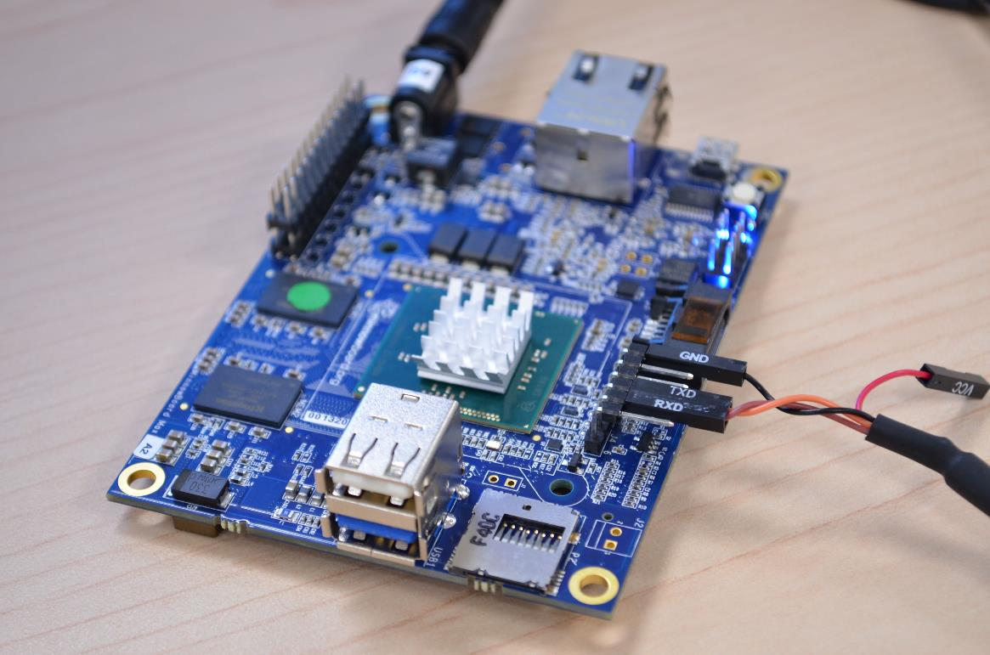
Connect to UART port
To read UART output run minicom:
$minicom -D /dev/ttyUSB0

Slide 27
Configuring the Debug Host (Done)
UDK debugger configuration:
Download 2013-WW52-UDK.Debugger.Tool-1.4-Linux.zip from:
http://firmware.intel.com/develop/intel-uefi-tools-and-utilities/intel-uefi-development-kit-debugger-tool
Install UDK debugger tool:
$./UDK_Debugger_Tool_v1_4_x86_64.bin
Check/change configuration file: /etc/udkdebugger.conf
$ cat /etc/udkdebugger.conf
[Debug Port]
Channel = Serial
Port = /dev/ttyUSB0
FlowControl = 0
BaudRate = 115200

Slide 28
GDB on Debug Host System (Done)
Rebuild GDB on HOST:
Download gdb source code:
$ apt-get install gdb-source
$ cp /usr/src/gdb.tar.bz2 ~/Desktop/udk-debugger/
$ cd ~/Desktop/udk-debugger/
$ bzip2 -dc gdb.tar.bz2| tar -xf –
$ cd gdb
Download (from http://expat.sourceforge.net ) and install expat
Configure and build gdb with expat:
$./configure --with-expat --with-python
$ make && make install

Slide 29
UEFI Firmware Debugging
Run UDK-GDB-SERVER
$/opt/intel/udkdebugger/bin/udk-gdb-server
Reboot Debug Target
Run GDB on Debug Host
$/home/user/Desktop/udk-debugger/gdb/gdb
(gdb) target remote :1234
Remote debugging using :1234

Slide 30
Source Level Debug
(gdb) source /opt/intel/udkdebugger/script/udk-gdb-script
##############################################################
# This gdb configuration file contains settings and scripts
# for debugging UDK firmware.
# WARNING: Setting pending breakpoints is NOT supported!
# Additional commands for source level debugging will be added!
##############################################################
Loading symbol for address: 0x78e1472c
add symbol table from file "/home/user/Desktop/bios/Build/Vlv2TbltDevicePkg/DEBUG_GCC48/X64/MdeModulePkg/Core/Dxe/DxeMain/DEBUG/DxeCore.debug" at
.text_addr = 0x78dde260
.data_addr = 0x78e180e0
(udb) where

Slide 31
Example: Setting Breakpoints
Set breakpoint on CoreLoadPeImage/CoreLoadImage functions
(udb) b CoreLoadPeImage
Breakpoint 1 at 0x78de2b22: file /home/user/Desktop/bios/MdeModulePkg/Core/Dxe/Image/Image.c, line 462.
(udb) b CoreLoadImage
Breakpoint 2 at 0x78de477c: file /home/user/Desktop/bios/MdeModulePkg/Core/Dxe/Image/Image.c, line 1409.
(udb) c
Continuing.
Loading symbol for address: 0x78de477c
Breakpoint 2, CoreLoadImage (BootPolicy=0 '\000', ParentImageHandle=0x78d78f18, FilePath=0x78d5f018, SourceBuffer=0x0, SourceSize=0, ImageHandle=0x78d5ee98)
at /home/user/Desktop/bios/MdeModulePkg/Core/Dxe/Image/Image.c:1409
1409 Tick = 0;

Slide 32
Example: Setting Breakpoints
Set breakpoint to CoreExitBootServices:
(udb) break CoreExitBootServices
Breakpoint 1 at 0x78ddfdac: file /home/user/Desktop/bios/MdeModulePkg/Core/Dxe/DxeMain/DxeMain.c, line 731.
(udb) c
Continuing.
Loading symbol for address: 0x78ddfdac
Breakpoint 1, CoreExitBootServices (ImageHandle=0x768d8798, MapKey=3615) at /home/user/Desktop/bios/MdeModulePkg/Core/Dxe/DxeMain/DxeMain.c:731
731 gTimer->SetTimerPeriod (gTimer, 0);

Slide 33
Example: Setting Breakpoints
Set breakpoint to DxeImageVerificationHandler which contains PE/TE header confusion vulnerability in Secure Boot implementation
(udb) break DxeImageVerificationHandler
(udb) c
Continuing.
Debug function DxeImageVerificationHandler using step:
(udb) step

Slide 34
Useful GDB commands
Disassembly:
(gdb) display/i $pc
(gdb) set disassemble-next-line on
(gdb) show disassemble-next-line
(gdb) layout asm(udb)
Other:
(gdb) info breakpoints
(gdb) info args # Print args to the function of the current stack frame
(gdb) list # Shows the current or given source context.
(gdb) info registers # Show registers
(gdb) info frame # Show the stack frame info

Slide 35
5.4 EDK II Overview

Slide 36
EDK II
Most of the source code written in C
Provides Flash Mapping Tool generating Firmware Volumes and the resulting SPI flash image
Build Existing EDK Modules
EDKII projects are made up of packages (DEC files)
Compiles to .EFI files: UEFI/DXE Driver, PEIM, UEFI Application, DXE Library

Slide 37
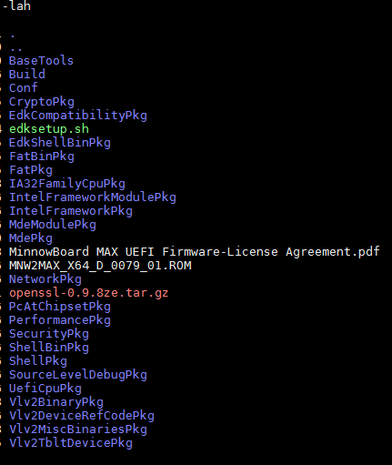
MinnowBoard Max EDKII Source Tree
Package concept for each EDK II sub-directory
Platform specific packages (Vlv2..Pkg) are also there
EDK II build process reflects the package
# edksetup
# build -p Nt32Pkg\Nt32Pkg.dsc -a IA32

Slide 38
EDK II Packages
MdePkg - Include files and libraries for Industry Standard Specifications
MdeModulePkg - Modules only definitions from the Industry Standard Specification are defined in the MdePkg
SecurityPkg – Implements security related functionality (Secure Boot, Authenticated Variables, etc.)
CryptoPkg – Provides crypto functionality
ShellPkg & NetworkPkg - Functionality of shell & network stack
IA32FamilyCpuPkg – Package supporting IA32 family processors
IntelFrameworkPkg - Include files and libraries for those parts of the Intel Platform Innovation Framework for EFI specifications not adopted “as is” by the UEFI or PI specifications
Nt32Pkg – Windows UEFI emulator

Slide 39
EDKII File Extensions
.DSC - Platform Description file (recipe for creating a package, contains definitions to build the package)
.DEC - Package Declaration file
.INF - Module Definition (defines a component)
.FDF - Flash Description File (describes information about flash parts)
.FV - Firmware volume (FV) binary file

Slide 40
Platform Configuration Database (PCD)
PCD options define parameters which allow modules to define firmware configuration without recompile/rebuild or source code change
There’s an API to access to PCD options
PCD options can store platform or feature configuration settings

Slide 41
PCD Example
PCD options are defined in the DEC files in any package
./SecurityPkg/SecurityPkg.dec:
gEfiSecurityPkgTokenSpaceGuid.PcdOptionRomImageVerificationPolicy
|0x04|UINT32|0x00000001
Values of PCD options are set in DSC files
[PcdsFixedAtBuild.IA32]
...
gEfiIchTokenSpaceGuid.PcdIchAcpiIoPortBaseAddress|0x400

Slide 42
5.5 Building UEFI Applications/Drivers

Slide 43
Building UEFI Application
UDKII User Manual describes a module building process in Chapter 3.4. You need to create a new package containing the module or add the module to existing package
http://tianocore.sourceforge.net/wiki/EDK_II_User_Documentation
UEFI Driver Wizard is of great help for module creation
http://tianocore.sourceforge.net/wiki/UEFI_Driver_Wizard

Slide 44
Building UEFI Application
For this exercise, there’s a myapp package and a module generated with UEFI Driver Wizard and located in myapp folder in the UEFI source tree
myapp/
myapp.h
myapp.c
myapp.dec – package declaration file
myapp.dsc – platform build description file
myapp.inf – module information file
myapp.uni – unicode string file

Slide 45
UEFI Driver Wizard

Slide 46
Building a UEFI application
Linux:
#!/usr/bin/env bash
source edksetup.sh
build -a X64 -p myapp/myapp.dsc -m myapp/myapp.inf
Windows:
call edksetup.bat
build -a X64 -p myapp\myapp.dsc -m myapp\myapp.inf

Slide 47
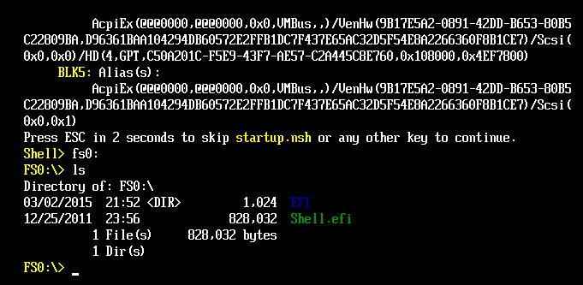
UEFI Shell

Slide 48
Reading Command-Line Arguments
Some information can be found here:
Creating a Shell Application
http://tianocore.sourceforge.net/wiki/Creating_a_Shell_Application
From ShellLib we’ll use following structure
SHELL_PARAM_ITEM,
and functions
ShellCommandLineParseEx
ShellCommandLineGetFlag
ShellCommandLineGetValue

Slide 49
Reading Command-Line Arguments
EFI_STATUS EFIAPI ShellCommandLineParseEx ( IN CONST SHELL_PARAM_ITEM * CheckList,
OUT LIST_ENTRY ** CheckPackage,
OUT CHAR16 **ProblemParam OPTIONAL,
IN BOOLEAN AutoPageBreak,
IN BOOLEAN AlwaysAllowNumbers )
Checks the command line arguments passed against the list of valid ones. Optionally removes NULL values first. If no initialization is required, then return RETURN_SUCCESS.
Parameters:
[in] CheckListThe pointer to list of parameters to check.
[out] CheckPackageThe package of checked values.
[out] ProblemParamOptional pointer to pointer to unicode string for the paramater that caused failure.
[in] AutoPageBreakWill automatically set PageBreakEnabled.
[in] AlwaysAllowNumbersWill never fail for number based flags.
Return values:
EFI_SUCCESS The operation completed sucessfully.
EFI_OUT_OF_RESOURCES A memory allocation failed.
EFI_INVALID_PARAMETER A parameter was invalid.
EFI_VOLUME_CORRUPTED The command line was corrupt.
EFI_DEVICE_ERROR The commands contained 2 opposing arguments. One of the command line arguments was returned in ProblemParam if provided.
EFI_NOT_FOUND A argument required a value that was missing. The invalid command line argument was returned in ProblemParam if provided.

Slide 50
Reading Command-Line Arguments
BOOLEAN EFIAPI ShellCommandLineGetFlag ( IN CONST LIST_ENTRY *CONST CheckPackage,
IN CONST CHAR16 *CONST KeyString )
Checks for presence of a flag parameter.
Flag arguments are in the form of "-<Key>" or "/<Key>", but do not have a value following the key.
If CheckPackage is NULL then return FALSE. If KeyString is NULL then ASSERT().
Parameters:
[in] CheckPackage The package of parsed command line arguments.
[in] KeyStringThe Key of the command line argument to check for.
Return values:
TRUE The flag is on the command line.
FALSE The flag is not on the command line.

Slide 51
Reading Command-Line Arguments
CONST CHAR16* EFIAPI ShellCommandLineGetValue ( IN CONST LIST_ENTRY *CONST CheckPackage,
IN CONST CHAR16 *CONST KeyString )
Checks for presence of a flag parameter.
Value parameters are in the form of "-<Key> value" or "/<Key> value".
If CheckPackage is NULL then return NULL.
Parameters:
[in] CheckPackage The package of parsed command line arguments.
[in] KeyStringThe Key of the command line argument to check for.
Return values:
NULL The flag is not on the command line.
!=NULL The pointer to unicode string of the value.

Slide 52
Reading Command-Line Arguments
#define NAME_OPTION (L”-n”)
#define GUID_OPTION (L”-g”)
#define HELP_OPTION (L”-?”)
SHELL_PARAM_ITEM ParamList[] = {
{ NAME_OPTION, TypeValue },
{ GUID_OPTION, TypeValue },
{ HELP_OPTION, TypeFlag },
{ NULL, TypeMax },
};
LIST_ENTRY *ParamPackage;
ShellCommandLineParseEx(ParamList, &ParamPackage, NULL, TRUE, FALSE);

Slide 53
Reading Command-Line Arguments
CONST CHAR16 *name_str = 0;
CONST CHAR16 *guid_str = 0;
if (ShellCommandLineGetFlag(ParamPackage,NAME_OPTION)){
name_str = ShellCommandLineGetValue (ParamPackage, NAME_OPTION);
}
if (ShellCommandLineGetFlag(ParamPackage, GUID_OPTION )) {
guid_str = ShellCommandLineGetValue (ParamPackage, GUID_OPTION );
}

Slide 54
Using UEFI Runtime Services
Good reference: http://wiki.phoenix.com/wiki/index.php/EFI_RUNTIME_SERVICES
Global variable gRT, points to runtime service table, declared in
Library/UefiRuntimeServicesTableLib.h
Calling the service function:
gRT->GetVariable((CHAR16*)name_str, &guid,
&attributes, &size, buffer);

Slide 55
Dependencies
Add include files to myapp.h:
#include <Library/ShellLib.h>
#include <Protocol/EfiShell.h>
#include <Protocol/EfiShellInterface.h>
#include <Protocol/EfiShellParameters.h>

Slide 56
Dependencies
ShellPkg is used. Add ShellPkg and its dependencies to package files.
Add to myapp.inf [Packages] section
ShellPkg/ShellPkg.dec
Add [LibraryClasses] section
ShellLib to myapp.inf
Specify the location of ShellLib module INF file and dependecies in myapp.dsc [LibraryClasses]:
ShellLib|ShellPkg/Library/UefiShellLib/UefiShellLib.inf
FileHandleLib|ShellPkg/Library/UefiFileHandleLib/UefiFileHandleLib.inf
HiiLib|MdeModulePkg/Library/UefiHiiLib/UefiHiiLib.inf
SortLib|ShellPkg/Library/UefiSortLib/UefiSortLib.inf UefiHiiServicesLib|MdeModulePkg/Library/UefiHiiServicesLib/UefiHiiServicesLib.inf

Slide 57
Exercise 5.4
Building UEFI Application

Slide 58
References
TianoCore.org site documentation
http://sourceforge.net/projects/edk2/files/
EDK II INF File Specification, Version 1.2, Intel, 2009.
EDK II DSC File Specification, Version 1.2, Intel, 2009.
EDK II DEC File Specification, Version 1.2, Intel, 2009.
EDK II FDF (Flash Description File) File Specification, Version 1,2, Intel, 2009.
EDK II Build Specification, Version 1.2, Intel, 2009.

Slide 59
Training materials are available on Github
https://github.com/advanced-threat-research/firmware-security-training
Yuriy Bulygin @c7zero
Alex Bazhaniuk @ABazhaniuk
Andrew Furtak @a_furtak
John Loucaides @JohnLoucaides

