Slide 1
Security of BIOS/UEFI System Firmware from Attacker and Defender Perspectives 7. Hands-On System Firmware Forensics
Yuriy Bulygin *
Alex Bazhaniuk *
Andrew Furtak *
John Loucaides **
* Advanced Threat Research, McAfee
** Intel

Slide 2
License
Training materials are shared under Creative Commons “Attribution” license CC BY 4.0
Provide the following attribution:
Derived from “Security of BIOS/UEFI System Firmware from Attacker and Defender Perspective” training by Yuriy Bulygin, Alex Bazhaniuk, Andrew Furtak and John Loucaides available at https://github.com/advanced-threat-research/firmware-security-training

Slide 3
Section 7. Hands-on System Firmware Forensics

Slide 4
7.1 Live Forensic / Incident Response
Important: software based forensics is not reliable to detect firmware compromise. Firmware rootkits can interfere with software based forensics.

Slide 5
Live System Forensics
To perform system firmware forensics, the following components can be extracted & analyzed:
Layout and entire contents of SPI Flash memory
BIOS/UEFI firmware including EFI binaries and NVRAM
Runtime or Boot UEFI Variables (non-volatile and volatile)
UEFI Secure Boot certificates (PK, KEK, db/dbx ..)
UEFI system and configuration tables (Runtime, Boot and DXE services)
UEFI S3 resume boot script table
PCIe option (expansion) ROMs

Slide 6
Live System Forensics
Settings stored in RTC-backed CMOS memory
ACPI tables
SMBIOS table
HW protection settings (e.g. SPI W/P)
System firmware protection settings (Secure Boot, etc.)
MBR/VBR or UEFI GUID Partition Table (GPT)
Files on EFI system partition (boot loaders)
Contents of TPM Platform Configuration Registers (PCR)
Firmware images from other components such as HDD/SSD, NIC, Embedded Controller, etc.

Slide 7
Live System Forensics
SPI Flash Memory Contents
chipsec_util spi info
chipsec_util spi dump SPI.bin
chipsec_util spi read <start> <size> BIOS.bin

Slide 8
Understanding Layout of SPI Flash Memory
# chipsec_util.py spi info
. . .
============================================================
SPI Flash Map
------------------------------------------------------------
BIOS Flash Primary Region
------------------------------------------------------------
BFPREG = 0BFF0500:
Base : 00500000
Limit : 00BFF000
Shadowed BIOS Select: 0
------------------------------------------------------------
Flash Region | FREGx Reg | Base | Limit
------------------------------------------------------------
0 Flash Descriptor | 00000000 | 00000000 | 00000FFF
1 BIOS | 0BFF0500 | 00500000 | 00BFFFFF
2 Intel ME | 04FF0003 | 00003000 | 004FFFFF
3 GBe | 00020001 | 00001000 | 00002FFF
4 Platform Data | 00001FFF | 01FFF000 | 00000FFF
List of Flash Regions
BIOS region

Slide 9
Extracting Contents of SPI Flash Memory...
Read/Write/Erase SPI flash memory
# chipsec_util.py spi
chipsec_util spi info|dump|read|write|erase [flash_address] [length] [file]
Examples:
chipsec_util spi info
chipsec_util spi dump rom.bin
chipsec_util spi read 0x700000 0x100000 bios.bin
chipsec_util spi write 0x0 flash_descriptor.bin
# chipsec_util.py spi dump spi.dump.bin
# dir spi.dump.bin
Directory of C:\Users\user\Desktop\chipsec\tool
03/05/2015 11:31 PM 8,388,608 spi.dump.bin
1 File(s) 8,388,608 bytes
0 Dir(s) 209,732,562,944 bytes free
CHIPSEC SPI command line interface
Full dump of SPI flash
SPI flash image
size: 8M

Slide 10
Live System Forensics
BIOS and UEFI System Firmware
chipsec_util uefi var-list
chipsec_util uefi var-find fTA
chipsec_util uefi var-read db D719B2CB.. db.bin
chipsec_util uefi tables
chipsec_util uefi s3bootscript
chipsec_util acpi list
chipsec_util acpi table FADT

Slide 11
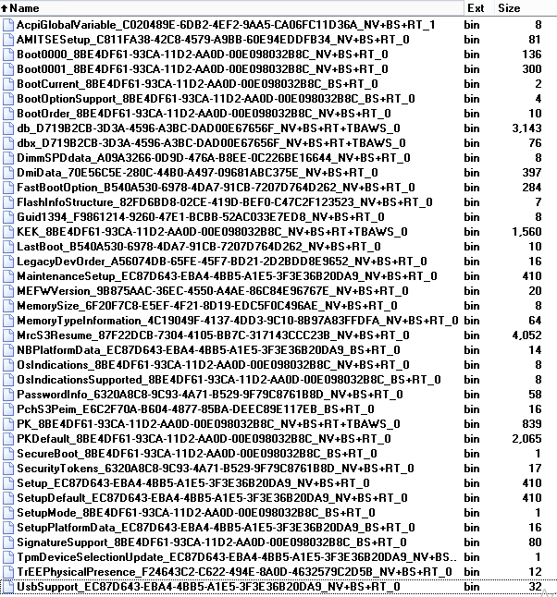
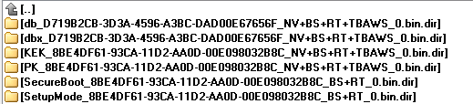
Extracting Persistent EFI Configuration…
# chipsec_util.py uefi var-list
AcpiGlobalVariable
BootOrder vars
Secure Boot certificates (PK, KEK, db, dbx)
Setup Variable

Slide 12
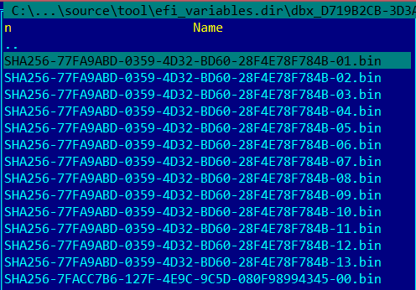
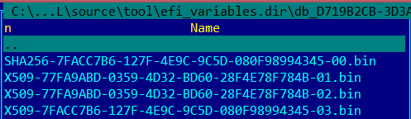
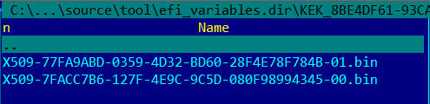
Extracting UEFI Secure Boot keys…
# chipsec_util.py uefi keys db.bin / dbx.bin / kek.bin

Slide 13
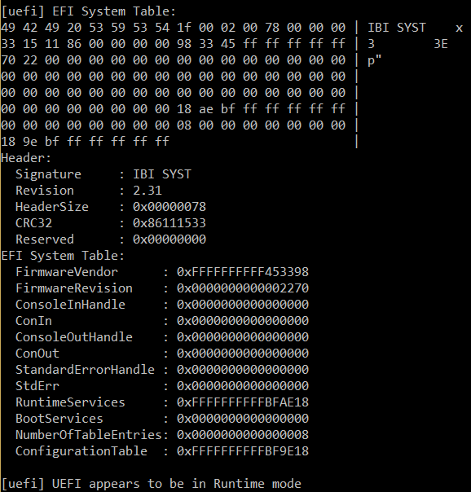
Locating UEFI System Tables…
# chipsec_util.py uefi tables

Slide 14
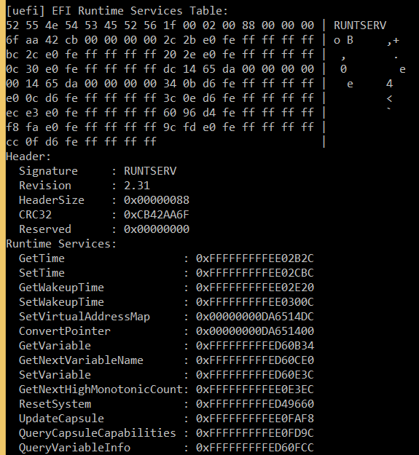
Locating Runtime UEFI Services…
# chipsec_util.py uefi tables

Slide 15
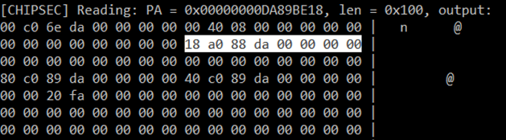
Locating S3 Resume Boot Script Table…
AcpiGlobalVariable UEFI variable points to a structure in memory (ACPI_VARIABLE_SET_COMPATIBILITY)
[CHIPSEC] Reading EFI variable Name=‘AcpiGlobalVariable’..
[uefi] EFI variable AF9FFD67-EC10-488A-9DFC-6CBF5EE22C2E:AcpiGlobalVariable:
18 be 89 da
# chipsec_util.py uefi s3bootscript

Slide 16
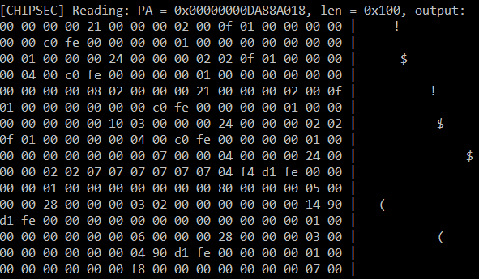
Extracting S3 Boot Script Table…
# chipsec_util.py uefi s3bootscript

Slide 17
Decoding S3 Boot Script Opcodes…
[000] Entry at offset 0x0000 (length = 0x21):
Data:
02 00 0f 01 00 00 00 00 00 00 c0 fe 00 00 00 00
01 00 00 00 00 00 00 00 00
Decoded:
Opcode : S3_BOOTSCRIPT_MEM_WRITE (0x02)
Width : 0x00 (1 bytes)
Address: 0xFEC00000
Count : 0x1
Values : 0x00
..
[359] Entry at offset 0x2F2C (length = 0x20):
Data:
01 02 30 04 00 00 00 00 21 00 00 00 00 00 00 00
de ff ff ff 00 00 00 00
Decoded:
Opcode : S3_BOOTSCRIPT_IO_READ_WRITE (0x01)
Width : 0x02 (4 bytes)
Address: 0x00000430
Value : 0x00000021
Mask : 0xFFFFFFDE
# chipsec_util.py uefi s3bootscript

Slide 18
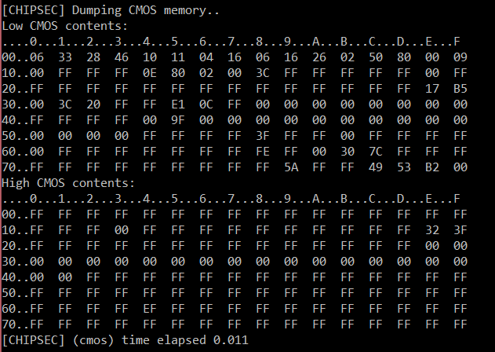
Extracting CMOS Settings…
# chipsec_util.py cmos dump

Slide 19
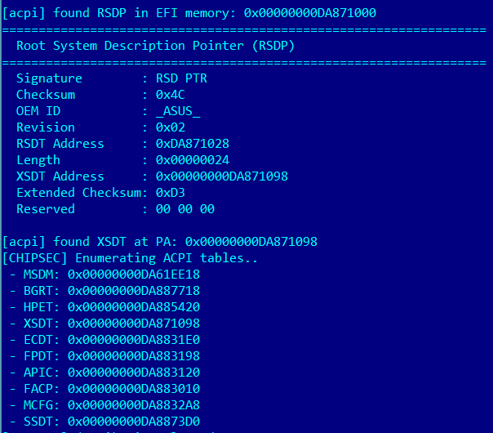
Locating ACPI Tables…
# chipsec_util.py acpi list

Slide 20
Live System Forensics
Platform Hardware Configuration
chipsec_util pci enumerate
chipsec_util mmio list
chipsec_util mmio dump GTTMMADR
chipsec_util io list
chipsec_util cpu info
chipsec_util cpu cupid
chipsec_util ucode id

Slide 21
Live System Forensics
Operating System
chipsec_util idt
chipsec_util gdt
chipsec_util cpu pt
chipsec_util mem read 0x41E 0x20 kbrd_buffer.bin
chipsec_util mem pagedump 0xFED00000 0x100000

Slide 22
Live System Forensics
Platform Components
chipsec_util cmos dump
chipsec_util ec dump
chipsec_util ec read 0x2F
chipsec_util tpm state
chipsec_util tpm command pccrread 0
chipsec_util spd detect
chipsec_util spd dump
chipsec_util smbus read 0xA0 0x0 0x100

Slide 23
Live System Forensics
Virtual Machine Monitor (VMM) Configuration
chipsec_util iommu list
chipsec_util iommu config
chipsec_util iommu pt
chipsec_util vm status
chipsec_util vm pt

Slide 24
Live System Forensics
Checking Platform Configuration
chipsec_main
chipsec_main –m common.bios_wp
chipsec_main –m common.smrr
chipsec_main –m common.spi_lock
chipsec_main –m common.spi_desc
chipsec_main –m common.secureboot.variables
chipsec_main –m common.uefi.s3bootscript
chipsec_main –m remap
chipsec_main –m smm_dma

Slide 25
Exercise 7.1
Online Forensics (UEFI Firmware and SPI Flash Contents)

Slide 26
7.2 Offline Forensic of Firmware Images
Important: ensure that firmware images were obtained using trusted hardware tools (that haven’t been tampered with)

Slide 27
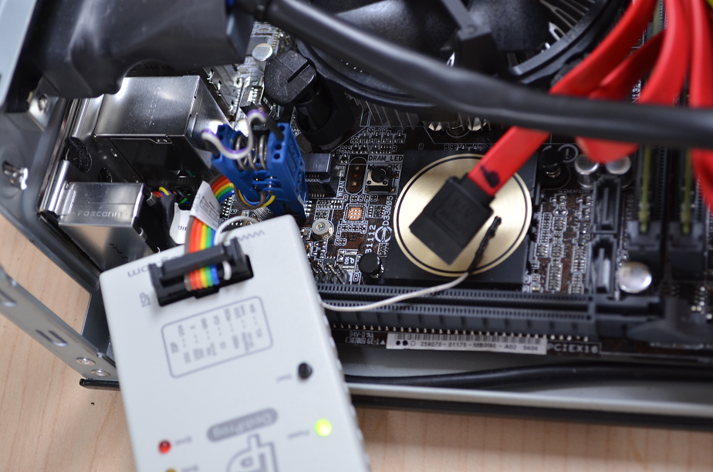

Slide 28
Where to Start From?
Option 1: Find original firmware image
Check BIOS update (capsule) image or the BIOS image on the platform manufacturer’s web-site
Check BIOS security advisories to understand how the firmware could be compromised and infected
Compare multiple images including suspect and clean
Option 2: Extract a known good SPI memory image from a clean system (or from multiple systems)
Option 3: Make SPI memory dumps before and after the infection if you have an infector/dropper

Slide 29
Analyzing firmware images
Decode two images:
# chipsec_util.py decode original_bios.bin
# chipsec_util.py decode current_bios.bin
Extracted binaries and other artefacts extracted from the images are stored in directories: original_bios.bin.dir, current_bios.bin.dir
Compare the contents of the two directories with any tool of choice:
# diff –qr original_bios.bin.dir current_bios.bin.dir
Analyze/compare extracted EFI executables and analyze/compare extracted NV variables
Contents of NVRAM (NV EFI variables) are dynamic and will differ between platform reboots (and even within the same boot)
BIOS update images downloaded from the manufacturer’s web-site typically don’t contain NVRAM
Update images may not contain non-BIOS regions of SPI flash memory (e.g. flash descriptor)

Slide 30
BIOS/Firmware Forensics: Offline
Offline system firmware analysis
chipsec_util uefi keys PK.bin
chipsec_util uefi nvram vss bios.bin
chipsec_util uefi decode rom.bin
chipsec_util decode rom.bin
chipsec_util spidesc spi.bin

Slide 31
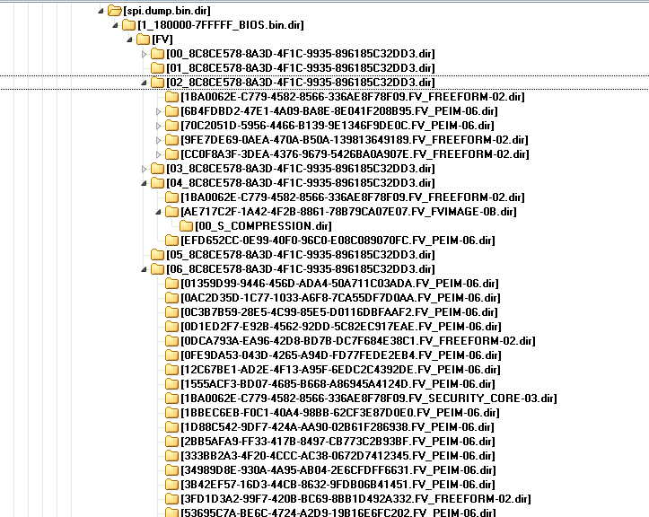
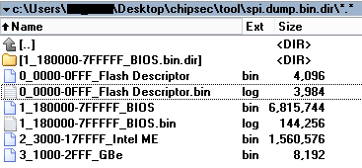
Extracting EFI Executables
# chipsec_util.py decode spi.dump.bin
spi.dump.bin.dir
1_180000-7FFFFF_BIOS.bin.dir - SPI Flash Region
FV
06_8C8CE578-8A3D-4F1C-9935-896185C32DD3.dir - FV (FW volume)
F7D22BCA-1BCA-5591-CC8B-1CA98F2890FE.FV_PEIM-06.dir - EFI Executable
01_S_PE32.pe32.efi - Section

Slide 32
UEFI FW Volume (FV) Structure
Volume offset : 0x00600000
File system GUID : 8C8CE578-8A3D-4F1C-9935-896185C32DD3
Volume length : 0x00080000 (524288)
Attributes : 0x0003FEFF
Header length : 0x00000048
Checksum : 0xE6AE (0xE6AE)
Extended Header Offset : 0x00000000
File offset : 0x00600048
Name : 92685943-D810-47FF-A112-CC8490776A1F
Type : 0x04
Attributes : 0x00000040
State : 0xF8
Checksum : 0xEAA3 (0xEAA3)
Size : 0x00E6DC (59100)
Section offset : 0x00600060
Name : S_PE32
Type : 0x10
File offset : 0x0060E728
Name : DF8556F0-3A61-11DE-8A39-0800200C9A66
Type : 0x06
Attributes : 0x00000040
State : 0xF8
Checksum : 0xA86D (0xA86D)
Size : 0x001E04 (7684)
Section offset : 0x0060E740
Name : S_PEI_DEPEX
Type : 0x1B
Section offset : 0x0060E748
Name : S_PE32
Type : 0x10
Firmware Volume
EFI Binary
Section

Slide 33
Flash Descriptor
# chipsec_util.py spidesc fd.bin
[spi_fd] Valid SPI flash descriptor found at offset 0x00000000
+ 0x0000 Reserved : FFFFFFFFFFFFFFFFFFFFFFFFFFFFFF
+ 0x0010 Signature: 0x0FF0A55A
...
Flash Regions
--------------------------------------------------------
Region | FLREGx | Base | Limit
--------------------------------------------------------
0 Flash Descriptor | 00000000 | 00000000 | 00000FFF
1 BIOS | 07FF0180 | 00180000 | 007FFFFF
2 Intel ME | 017F0003 | 00003000 | 0017FFFF
3 GBe | 00020001 | 00001000 | 00002FFF
4 Platform Data | 00007FFF | 07FFF000 | 00000FFF (not used)
+ 0x0060 Master Section:
========================================================
+ 0x0060 FLMSTR0 : 0x0A0B0000
+ 0x0064 FLMSTR1 : 0x0C0D0000
+ 0x0068 FLMSTR2 : 0x08080118
Master Read/Write Access to Flash Regions
--------------------------------------------------------
Region | CPU/BIOS | ME | GBe
--------------------------------------------------------
0 Flash Descriptor | R | R |
1 BIOS | RW | |
2 Intel ME | | RW |
3 GBe | RW | RW | RW
4 Platform Data | | |
Access permissions to SPI flash regions

Slide 34
Reading EFI Configuration
# chipsec_util.py uefi nvram nvar rom.dump.bin
Path to extracted/parsed NVRAM contents:
NVRAM dump: rom.dump.bin.dir\nvram_nvar.nvram.bin
Decoded variables: rom.dump.bin.dir\nvram_nvar.nvram.lst
Format of NVRAM and variables are platform/BIOS specific.
CHIPSEC supports multiple types of NVRAM (evsa, nvar, vss, vss_new)

Slide 35
Decoding NVRAM from SPI dump
# type nvram_nvar.nvram.lst
...
--------------------------------
EFI Variable (offset = 0x4ec4):
--------------------------------
Name : Setup
Guid : EC87D643-EBA4-4BB5-A1E5-3F3E36B20DA9
Attributes: 0x7 ( NV+BS+RT )
Data:
01 5b 00 53 00 5b 00 01 01 72 00 68 00 72 00 01 | [ S [ r h r
01 50 00 46 00 50 00 01 01 50 00 46 00 50 00 01 | P F P P F P
01 f8 11 18 15 b8 0b 10 0e b8 0b 10 0e 90 01 d0 |
07 00 00 00 00 e8 03 d0 07 02 fa 00 00 28 64 00 | (d
03 00 00 00 00 00 00 00 00 00 00 00 00 00 00 00 |
00 00 00 00 00 00 00 00 00 01 00 00 00 00 00 00 |
00 00 00 01 00 00 01 01 01 01 01 01 00 00 00 00 |
00 00 00 00 01 02 00 01 00 00 00 00 00 00 00 00 |
00 00 00 00 00 01 02 01 08 00 00 00 00 00 00 00 |
00 00 01 00 00 00 00 00 00 00 00 00 00 00 00 00 |
00 00 00 00 00 00 00 00 00 00 00 00 00 00 00 00 |
00 00 00 00 00 00 00 00 01 00 00 01 01 00 00 00 |
00 00 00 00 00 00 00 00 00 01 00 00 00 00 00 00 |
00 01 01 20 00 00 00 00 00 00 00 00 00 00 00 00 |
00 00 00 00 00 00 01 01 00 00 00 01 01 00 01 00 |
01 00 00 00 00 00 00 00 00 00 00 00 01 00 0a 00 |
00 01 00 00 02 01 00 01 00 00 00 01 00 00 00 00 |
...

Slide 36
Exercise 7.2
Offline Firmware Image Forensics

Slide 37
Case Study: ]HackingTeam[ UEFI Rootkit

Slide 38
Case Study: HackingTeam’s UEFI Rootkit
Leaked emails reveal Uefi_windows_persistent.zip with UEFI based firmware image
The image contains unexpected sections:
rkloader DXE driver executable
NTFS DXE driver executable
Unnamed PE executable
Initial analysis by ATR from July 2015

Slide 39
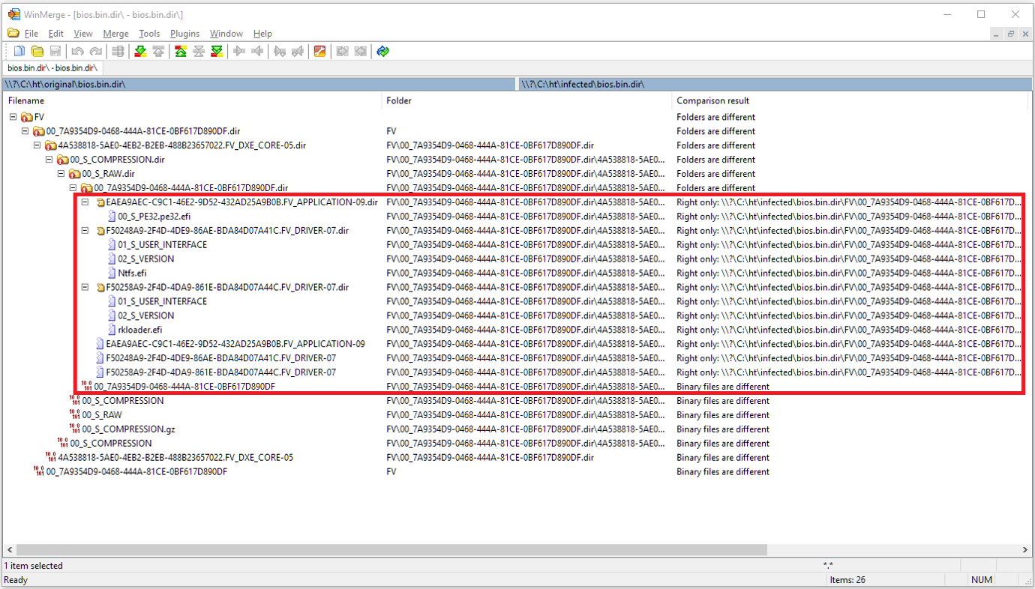
Case Study: HackingTeam’s UEFI Rootkit

Slide 40
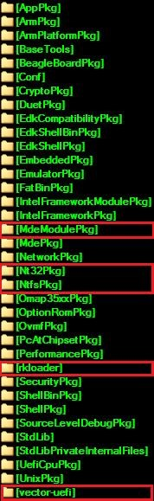
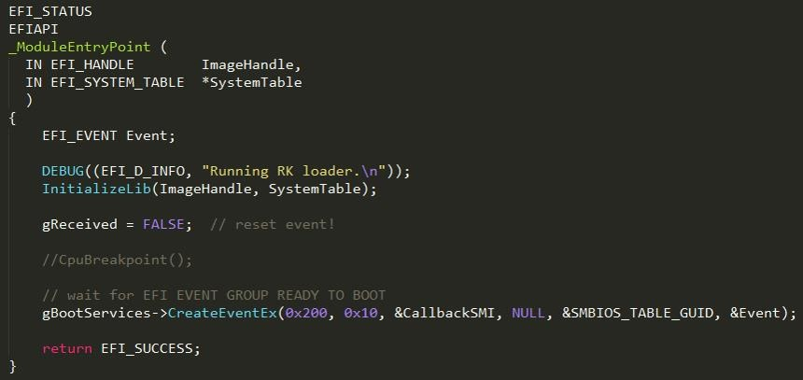
Case Study: HackingTeam’s UEFI Rootkit
From leaked source code, we can see that the “rkloader” is a DXE driver that is automatically executed during boot
The module simply registers a callback (on the “READY_TO_BOOT” event) to execute the malicious payload

Slide 41
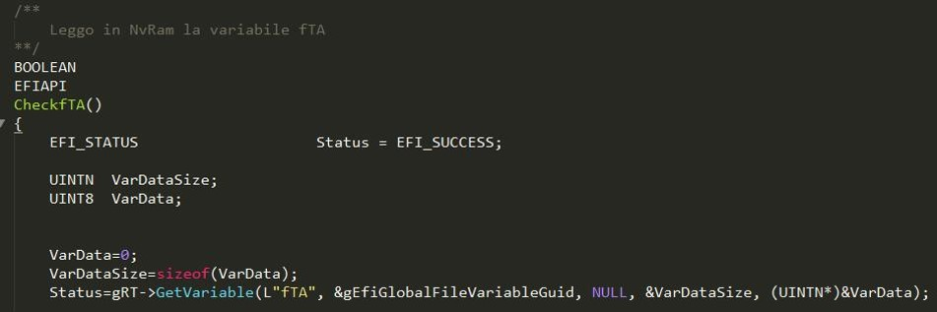
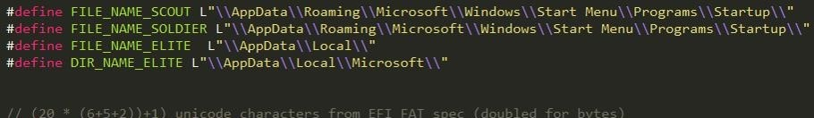
Case Study: HackingTeam’s UEFI Rootkit
The callback then loads a UEFI application, which does the following:
Check for infection by looking for UEFI variable “fTA”
Use NTFS module to drop a backdoor (scoute.exe) and RCS agent (soldier.exe) onto the filesystem

Slide 42
Case Study: HackingTeam’s UEFI Rootkit
Installation options
Physical Access and a SPI programmer
Booting a USB image to erase and reprogram firmware. Requires unlocked (vulnerable) firmware
Impact
Automatic reinfection after removal of remote access components
Detection
Look for fTA UEFI variable with GUID
8BE4DF61-93CA-11d2-aa0d-00e098302288
Examine SPI image for additional DXE modules

Slide 43
Exercise 7.3
Solve UEFI Crack Me

Slide 44
Training materials are available on Github
https://github.com/advanced-threat-research/firmware-security-training
Yuriy Bulygin @c7zero
Alex Bazhaniuk @ABazhaniuk
Andrew Furtak @a_furtak
John Loucaides @JohnLoucaides

