Slide 1

Advanced x86: BIOS and System Management Mode Internals Introduction
Xeno Kovah && Corey Kallenberg
LegbaCore, LLC

Slide 2
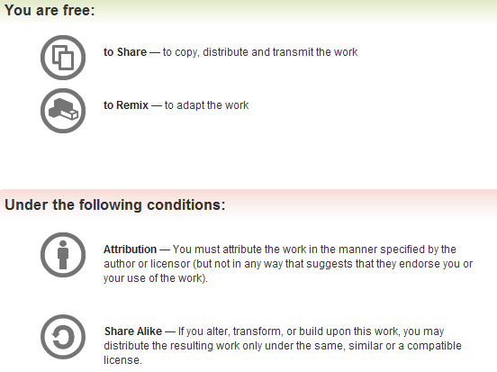
All materials are licensed under a Creative Commons “Share Alike” license.
http://creativecommons.org/licenses/by-sa/3.0/
Attribution condition: You must indicate that derivative work
"Is derived from Xeno Kovah & John Butterworth's ’Advanced Intel x86: BIOS and System Management Mode Internals"
Notes:
Attribution condition: You must indicate that derivative work
"Is derived from Xeno Kovah's ’Introductory Intel x86: Assembly, Architecture, and Applications’ class"

Slide 3
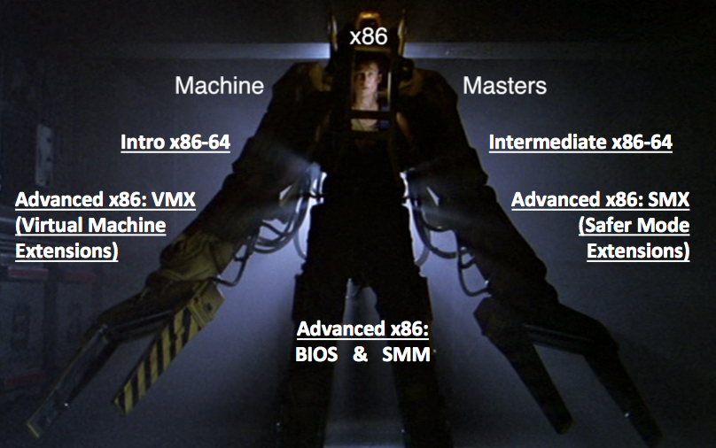
Welcome x86 Machine Masters!!!
You are here!

Slide 4

US VS THEM!
“With great power loader suit, comes great responsibility”
Notes:
http://www.character-shop.com/tcslargescale/alien%20queen/aliens-ripley-alien-queen.jpg

Slide 5
Required
r0x0r Skill Tree
"PC deep system security & trusted computing"
Recommended
Approved
Intended Future
Intro Trusted Computing
2 day, Ariel Segall
Intel SGX
2 day, Xeno Kovah
Advanced x86:
BIOS & SMM (System Management Mode)
2 day, John Butterworth
YOU ARE HERE
Advanced x86:
Trusted Execution Technology (TXT)
2 day, Xeno Kovah
Advanced x86:
Virtualization
2 day, David Weinstein
Intermediate x86
2 day, Xeno Kovah
Stealth Malware
2 day, Xeno Kovah
YOU TOOK THIS RIGHT?
Intro x86-64
2 day, Xeno Kovah
Life of Binaries
2 day, Xeno Kovah

Slide 6

About Us
We do digital voodoo :)
Full time security researchers at MITRE since 2007
Leading and working on our own research ideas since 2009
Basically a bunch of people propose ideas, some get selected, and they get funded from overhead money (i.e. not paid for or directed by government funds)
Started out working on trustworthy Windows kernel rootkit detection via memory integrity checking & timing-based attestation (“Checkmate”)
Eventually got interested in BIOS/SMM level threats, and started working on them in earnest around 2011
By 2012, had our first custom extra-security BIOS based on our previous work
By 2013, had our first BIOS exploit and a BIOS vulnerability/integrity checker (Copernicus)
By 2014, had *lots* of BIOS exploits and a slightly more trustworthy Copernicus 2
Formed the LegbaCore security consultancy in Jan. 2015
Continue to specialize in low level security, from the Windows kernel and lower
Notes:
Papa Legba Hear My Call!
http://upload.wikimedia.org/wikipedia/commons/6/69/PapaLegbaCharlesSanderson.jpg

Slide 7
About Us
Conferences, we’ve spoke at a few:
BlackHat USA 2013-2015, BlackHat EUR 2014, IEEE S&P 2012, ACM CCS 2013, Defcon 2012 & 2014-2015, CanSecWest 2014-2015, PacSec 2013, Hack in the Box KUL 2013-2014, Hack in the Box AMS 2014-2015, Microsoft BlueHat 2014, Syscan 2013, EkoParty 2013, BreakPoint & RuxCon 2013-2014, Shmoocon 2012, 2014-2015, Hack.lu 2013-2014, NoSuchCon 2013, SummerCon 2014, ToorCon 2013, DeepSec 2014, VirusBulletin 2014, MIRCon 2014, AusCERT 2014, Trusted Infrastructure Workshop 2013, NIST NICE Workshop 2013, DOD Information Assurance Symposium 2013, and MTEM 2013
Notes:
Papa Legba Hear My Call!
http://upload.wikimedia.org/wikipedia/commons/6/69/PapaLegbaCharlesSanderson.jpg

Slide 8

About You
What is your name?
(What do you want/hope
to get out of the class?)
Did you watch any of the prerequisite classes? :P
Do you know C?
What is your typical day-to-day job?
Notes:
http://www.adventureclassicgaming.com/index.php/gallery/image/328/
http://www.adventureclassicgaming.com/images/galleries/54/54_6.jpg

Slide 9
Course Goals
Provide you a basic background in BIOS technologies
Very few people know anything about it. Knowledge is power :)
Convince you that having unlocked BIOS is a really bad thing that can adversely affect the entire system during runtime
Show you how to measure and interpret the results to understand if and how a system BIOS may be vulnerable
Provide you a lot of hands-on examples when possible so you can “see” the effects
Its such an abstract topic that provides very little visibility, I have sought to lift this veil
Convince you that this problem IS solvable! Especially the information which we cover over these 2 days
Introduce you to some forensics tools that can not only help you analyze and interpret whether a system BIOS is vulnerable, but also introduce you to some methods to analyze changes if you think a BIOS has been compromised
There is still a lot of work to be done on the latter

Slide 10
Course Outline Day 1
BIOS Introduction
Chipset basics
How to identify a chipset
Boot process Overview
Reset vector & BIOS Operating Environment
PCI
PCI Option ROM attacks
System Management Mode (SMM)
SMM attacks

Slide 11
Course Outline Day 2
BIOS flash (Serial Peripheral Interface (SPI) mostly)
Flash chip access control vulnerabilities
Introduction to UEFI
Secure Boot & Measured Boot
Forensic analysis of UEFI BIOS
Reverse engineering BIOS files
Trusted Computing technologies to try and detect BIOS attackers

