Slide 1
Unified Extensible Firmware Interface

Slide 2
What is Extensible Firmware Interface (EFI)
The Extensible Firmware Interface (EFI) is a specification that defines a software interface between an operating system and platform firmware.
EFI is a replacement for older BIOS firmware interface present in all IBM PC – compatible personal computers.

Slide 3
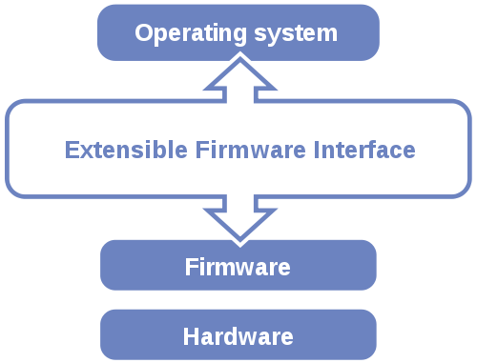
Position of EFI

Slide 4
What is firmware…?
Installed with a computer in a non-volatile location (PROM/EEPROM)
Initializes low level hardware
Initializes memory controller timings, powers on critical boot devices.
Hands off control to operating system loader
Operating system loader uses firmware interfaces to initialize the operating system.
Referred to as pre-boot firmware
Examples: BIOS and EFI.

Slide 5
BIOS firmware (de-facto standard)
Mechanism used to boot PCs for the last 25+ years
All x86/x64 architecture machines in the market support BIOS firmware.
BIOS has 16-bit architecture
1 Mb addressable space.
In early systems (16-bit era) BIOS was used for hardware access
Operating systems would call the BIOS rather than directly accessing the hardware (ex. MS-DOS).

Slide 6
BIOS firmware (cont.)
In 32-bit era OSs instead generally directly accessed the hardware using their own device drivers
Role of BIOS has changed over time
Primarily used for booting a system.
Also for certain additional features like Power Management(ACPI), Video Initialization(X.org), hot swapping.

Slide 7
BIOS limitations
BIOS is a real mode environment
16-bit real mode interfaces.
BIOS systems with MBR disks use 32-bit values to describe the starting offset and length of a partition
MBR allows a maximum disk size of approx. 2.2 TB and a maximum of four primary partitions.

Slide 8
BIOS limitations (cont.)
BIOS showing its age
Over 25 years old.
Documentation is scattered.
Interfaces have evolved in an ad-hoc manner as technical advances exposed limitations.
Non – graphical interface
Programmed in hex/assembly code
Regarded as legacy firmware

Slide 9
EFI Firmware (Motivation & History)
EFI creation motivated by Itanium bring up
Desire to avoid BIOS limitations in a brand new high end architecture.
Also designed as a BIOS replacement.
Initially known as Intel Boot Initiative
Modern design incorporates twenty five years of progress in computer science
Well specified, largely in one self-contained document

Slide 10
Transition from EFI to UEFI
The emergence of x64 architecture provides an inflection point to begin industry wide transition to EFI
To encourage transition, the UEFI Forum was created in 2005, which is now responsible for EFI development
Broad industry forum with common goal.
UEFI version 2.3 published in May 2009.
Forum members :
AMD, American Megatrends, Apple, Dell, HP, IBM, Insyde Software, Intel, Lenovo, Microsoft, Phoenix Technologies.

Slide 11
Overcoming BIOS limitations
EFI adds support for a new partition scheme : GUID Partition Table(GPT)
Unlimited partitions can be created (W-128).
Maximum disk and partition size of 9.4 ZB.
UEFI processor mode can be either 32-bit or 64-bit (long mode)
Architecture is modular and extensible
More accessible than BIOS
Graphical user interface
Can be programmed in C/C++
EFI interfaces are object oriented

Slide 12
Firmware roadmap goals
Enable mainstream 64-bit computing
Achieve firmware independence
Transition away from BIOS to EFI
Removal of BIOS architectural barriers will enable new scenarios over time.
Avoid jarring changes during this transition
Support boot of older operating system on UEFI platform

Slide 13
Simplifying UEFI transition
Firmware footprint for both 32-bit and 64-bit UEFI implementations on same machines is cost prohibitive
Nearly all processors are 64-bit capable
64-bit computing is the wave of the future
Little motivation to support 32-bit UEFI boot
32-bit systems most boot Windows via BIOS
Differences between UEFI and BIOS environments are abstracted from the end user wherever possible

Slide 14
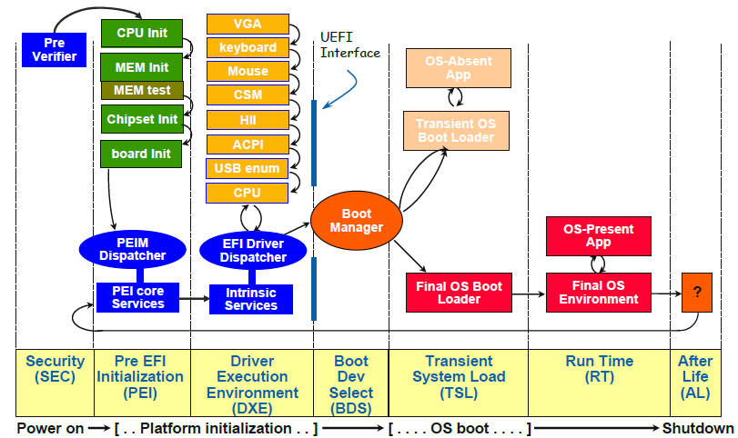
Overall view of boot time line

Slide 15
Understanding GPT
GUID Partition Table (GPT) partitioning is required for UEFI boot
Partition table information stored in GPT header.
Stores MBR entry in first sector of disk.
Uses Logical Block Addressing.
Provides redundancy, writing header and partition table both at beginning and end.

Slide 16
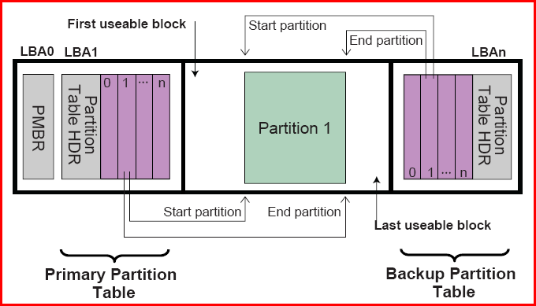
GPT disk partitioning

Slide 17
A new partition
EFI System Partition (ESP)
Formatted using FAT variant.
Contains the boot loader program, device driver files.
System utility programs that are intended to run before OS is booted.

Slide 18
Disk Partitioning in MBR
Partition length & partition start address stored as 32-bit quantities
Sector size 2^9 = 512 bytes
Neither max. partition size, nor max. start address can exceed
2^9 * 2^32 = 2^41 bytes.
2 * 2^40 = 2 TiB.

Slide 19
…in GPT
512 byte sector
2^64 * 2^9 = 2^73
2^73 = 9.4 ZiB
…warning from Apple Inc.
“Do not assume that the block size is always going to be 512 bytes”.
Hardware manufacturers are completing the transition to 4096-byte sectors
2^64 * 2^12 = 2^76

Slide 20
Logical Block Addressing
Common scheme for specifying the location of blocks of data
Particularly simple linear addressing scheme
Introduced as an abstraction
In 2002, ATA-6 introduced 48-bit LBA

Slide 21
Conversion between CHS & LBA
LBA = ((C * HPC) + H) * SPT + S – 1
C,H & S are cylinder no., head no., sector no.
LBA is the logical block address.
HPC is the no. of heads per cylinder.
SPT is the no. of sectors per track.
S = (LBA mod SPT) + 1
H = (LBA / SPT) mod HPC
C = LBA / (SPT * HPC)

Slide 22
UEFI only installs on UEFI
To install via EFI requires that the installation be booted via EFI (vice-versa)
The OS installer must configure the ESP, including OS metadata(boot options)
Once the OS is installed via EFI it can only boot via EFI
Booting via BIOS cannot access the metadata on the ESP.

Slide 23
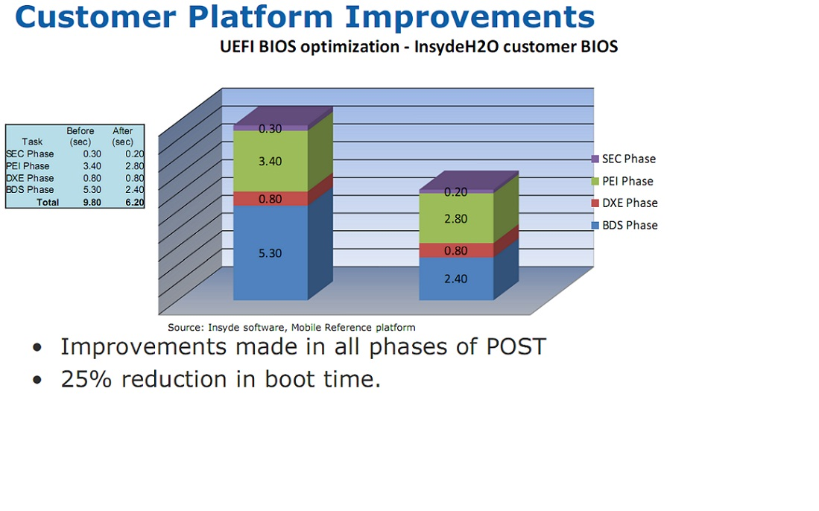
Optimized Performance…

Slide 24
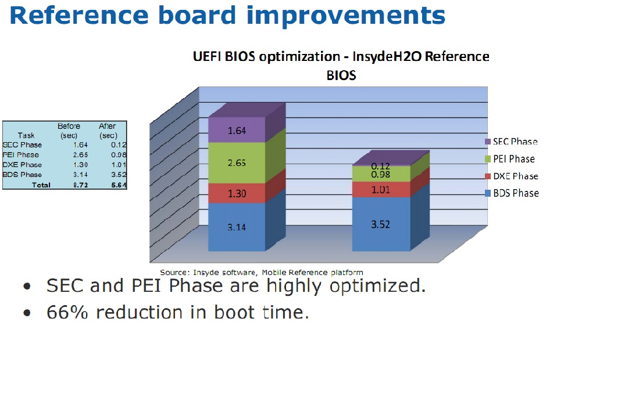
Performance (cont.)

Slide 25
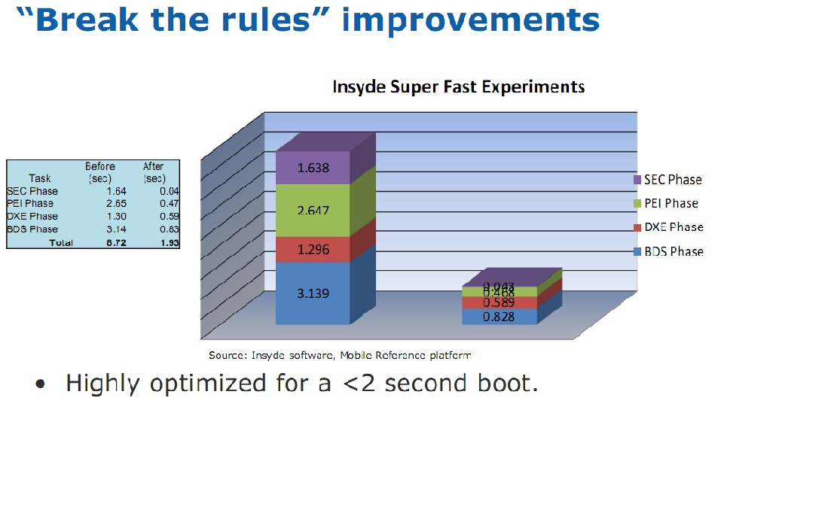
Performance (cont.)

Slide 26
Advantages of UEFI
Reduce 16-bit code from boot environment
Embrace 64-bit native code for x64 arch.
Specified standard for booting an OS
Engineering agility in pre-operating system space
Clean, architected interfaces.
Active industry standard working group.
Move beyond legacy BIOS
Improved boot graphics.
Faster network boot performance.

Slide 27
UEFI Implementation
Microsoft Windows
Windows XP 64-bit.
Windows server 2008 for x64 and Intel Itanium based platform.
Windows 7.
64-bit windows versions only.
Apple Macintosh
Intel based Macs.
Since Mac OS X v10.4 (Tiger).
Linux platforms
Used since early 2000, using elilo.
EFI versions of GRUB are available.

Slide 28
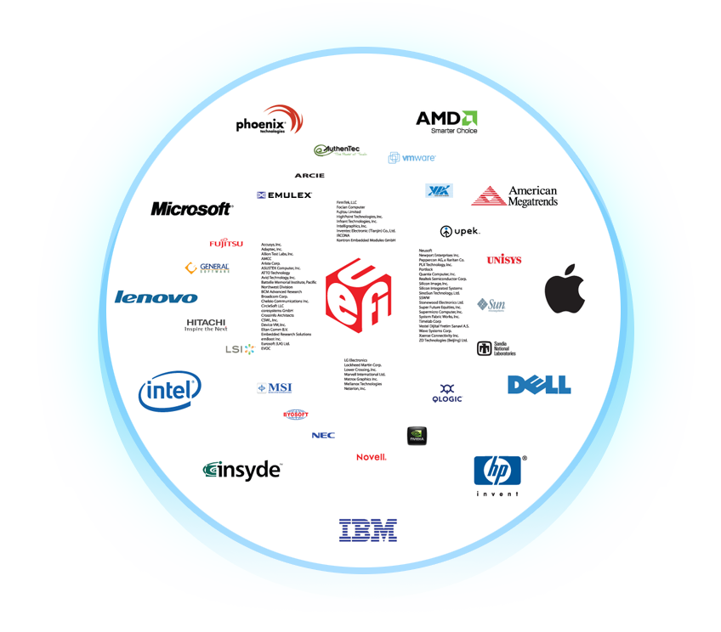
UEFI and the Industry
11 Promoters
20+ Contributors
70+ Adopters
100
80
60
40
20
0
2006
2007
2008
2009
2010
UEFI Framework Based %
Legacy Based %

Slide 29

Q & A

Slide 30

Thank you

