Slide 1
Deep Learning Software

Slide 2
Frameworks
Caffe
Keras
Tensorflow
Torch7
Pytorch
Caffe2

Slide 3
Caffe

Slide 4
caffe

Slide 5
caffe

Slide 6
caffe

Slide 7
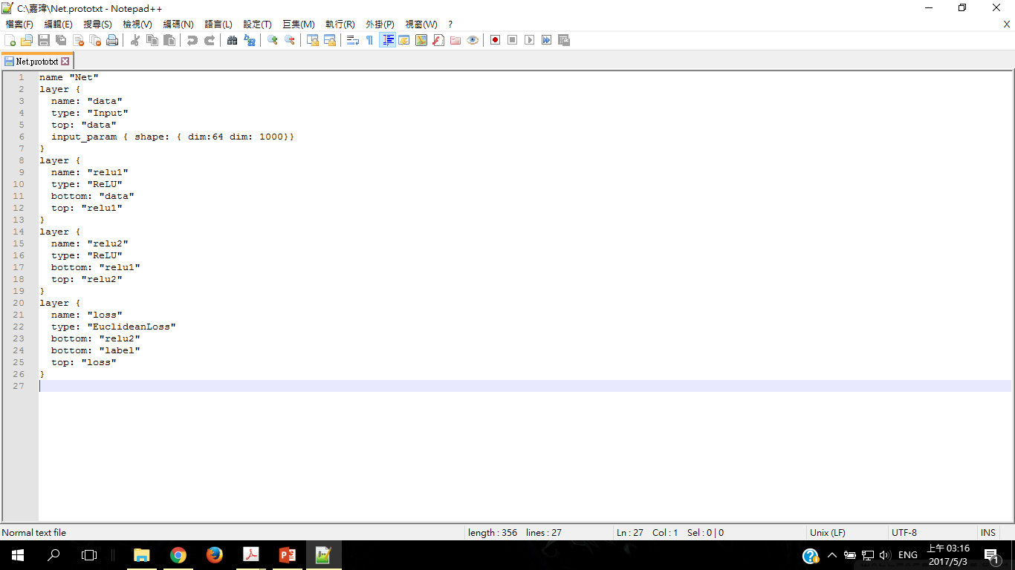
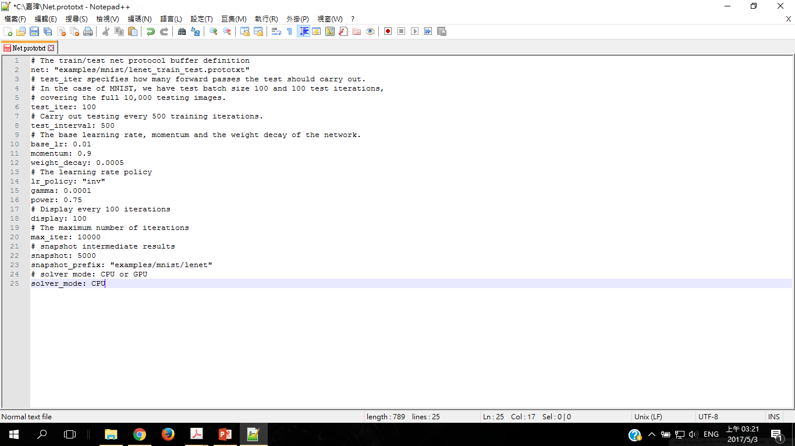
Caffe (net and solver)

Slide 8
caffe

Slide 9
Tensorflow

Slide 10
Tensorflow

Slide 11
Keras

Slide 12
Keras
The core data structure of Keras is a model
model = Sequential()
Use .add() Stacking layers
model.add(Dense(units=64, input_dim=100))
Comfigure learning process with .compile()
model.compile(loss='categorical_crossentropy', optimizer='sgd', metrics=['accuracy'])
Iterate on your training data in batches
model.fit(x_train, y_train, epochs=5, batch_size=32)

Slide 13
Keras pros/cons
(+) build a neural network just nead few lines of code
(+)Python API
(+)tensorflow backend
(-) slower than tensorflow

