Slide 1
TPU

Slide 2
開發緣由
Google 一開始曾經考慮要用 FPGA
BUT：
1.程式化晶片製造費用太高
2.我們分析認為，FPGA 晶片並不比 GPU 快
SO：
USE ASIC（專屬積體電路，一旦設計製造完成後電路就固定了，無法再改變）

Slide 3
特長
On our production AI workloads that utilize neural network inference, the TPU is 15x to 30x faster than contemporary GPUs and CPUs
有特殊的前提

Slide 4
The TPU also achieves much better energy efficiency than conventional chips, achieving 30x to 80x improvement in TOPS/Watt measure (tera-operations [trillion or 10¹² operations] of computation per Watt of energy consumed).
The neural networks powering these applications require a surprisingly small amount of code: just 100 to 1500 lines. The code is based on TensorFlow, our popular open-source machine learning framework.
More than 70 authors contributed to this report. It really does take a village to design, verify, implement and deploy the hardware and software of a system like this

Slide 5
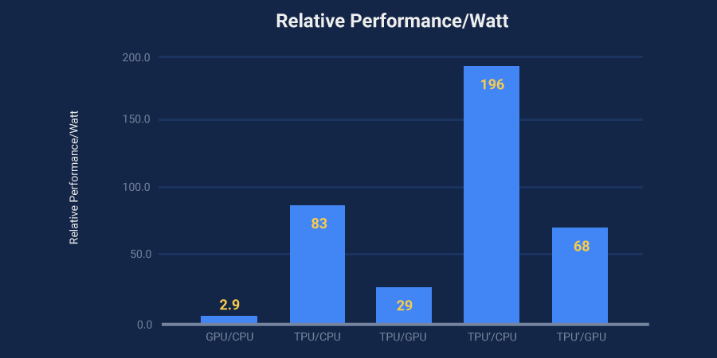

Slide 6
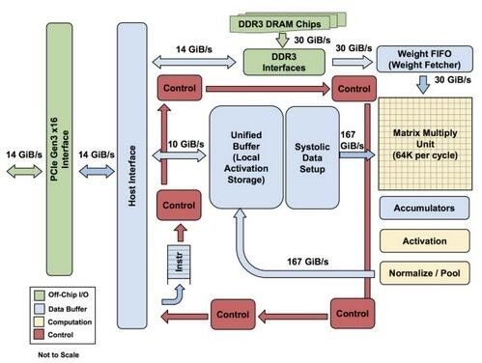

Slide 7
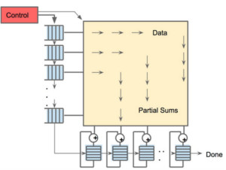
256×256 陣列縮放數據流引擎，經過矩陣乘法積累後實現非線性輸出

