Slide 1
Differnet between TPU GPUs
GPUs is training in floating point (16-bit)
TPU transforms floating-point numbers into narrow integers (8-bits)
Eight-bit integer multiplies can be 6X less energy and 6X less area than IEEE 754 16-bit floating-point multiplies, and the
advantage for integer addition is 13X in energy and 38X in area
TPU use ASIC

Slide 2
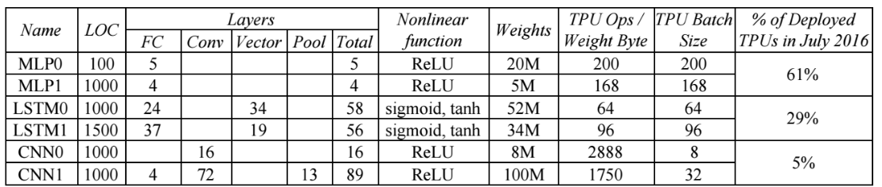
TPU NN inference workload

Slide 3
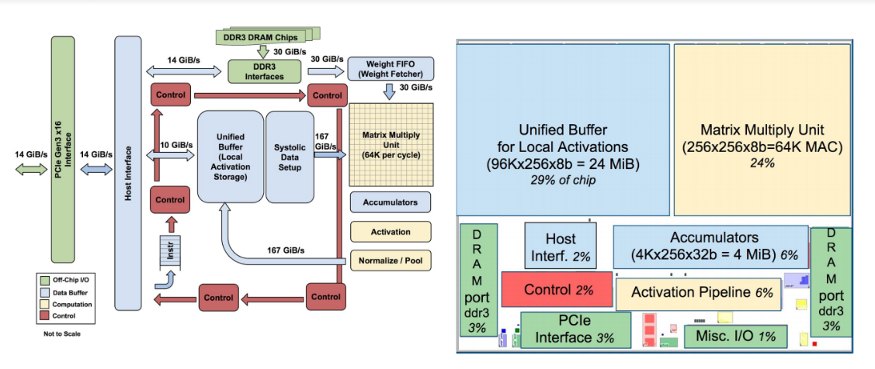
TPU block diagram and floor plan

Slide 4
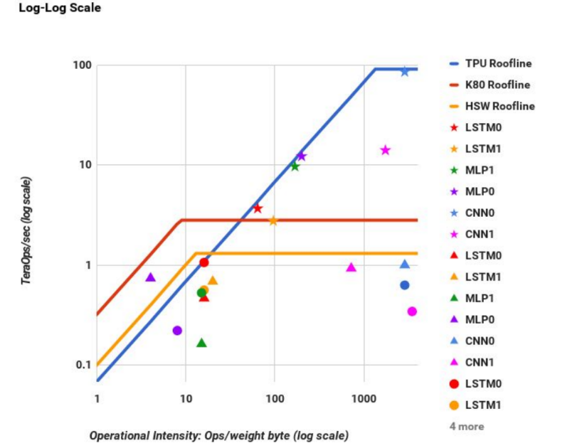
TPU and other GPUs roofline

Slide 5
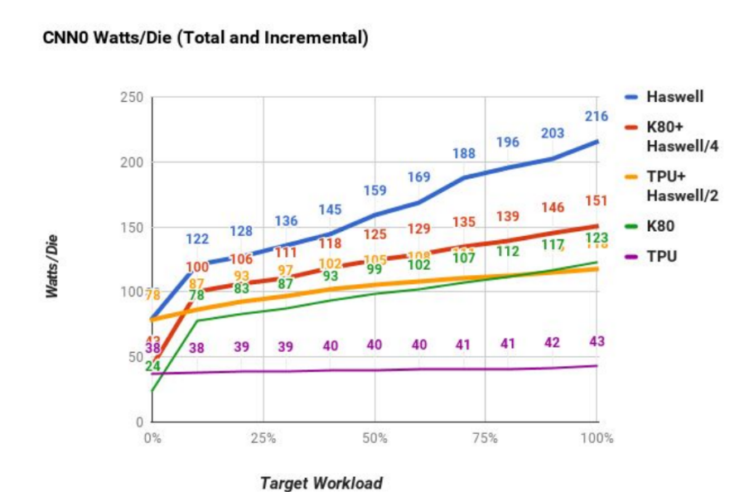
TPU and other GPUs Power Cost

