Slide 1
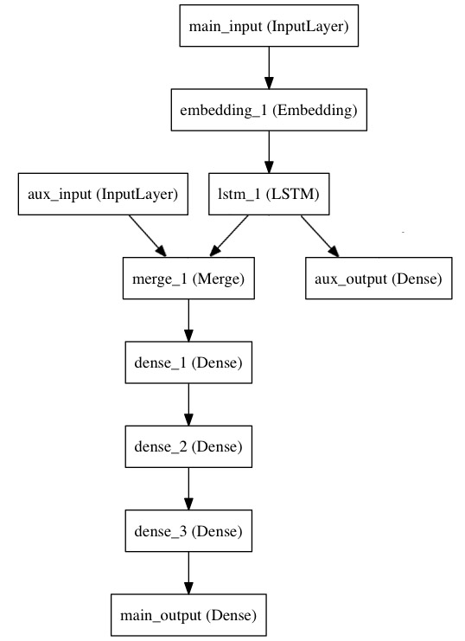
Keras 補充說明
Model function: 所有keras建出的neural network都是用model來形成，所以functional model 支持多輸入多輸出，也可以實作跨層的連接，然而sequential 的方式只是functional model的特殊情形，是keras提供一個快速的方式建一個簡單的squential model

Slide 2
Keras 補充說明
Flatten layer:把多維的input轉成一維
Ex. (64,32,32) -> (65536)

Slide 3
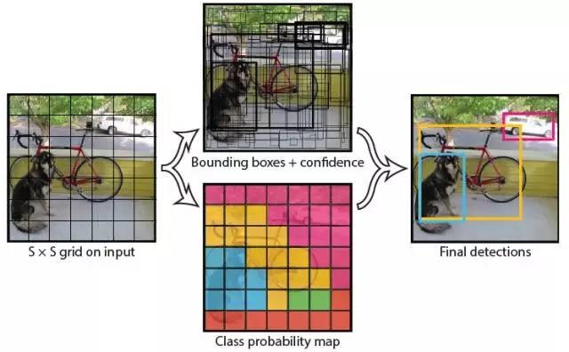
YOLO – you only look once
每個圖片分割成S*S的grid
每個grid產生B個bounding boxes(每個bounding boxes包含座標、cofidence、C類的機率)
總共會有S*S*B個bounding boxes
每個bounding box 算出 class-specific confidence score
剔除score低的bounding box
剩餘的bounding box做RMS

Slide 4
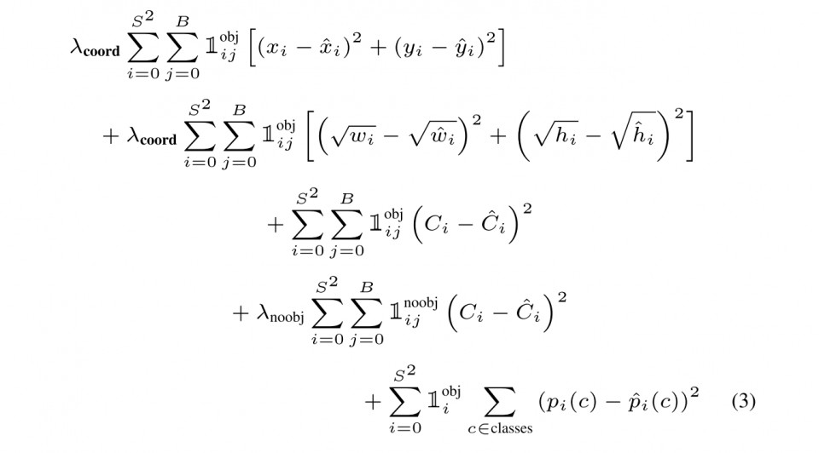
YOLO- loss function

Slide 5
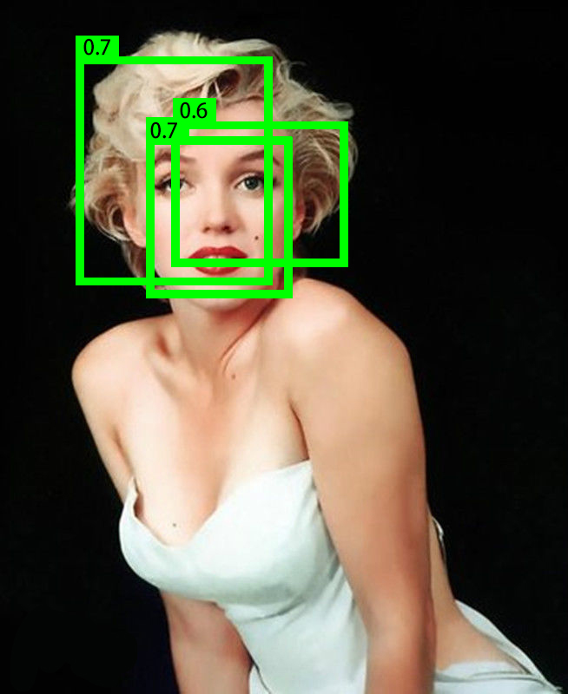
NMS – Non Maximum Suppression
從所有bounding box中依score排列
把confidence最大當作目標bounding box
計算剩餘bounding box 跟目標bounding box 的IoU，如果大於閾值就刪掉那個bounding box
剩下的從第二高的confidence再繼續做NMS

Slide 6
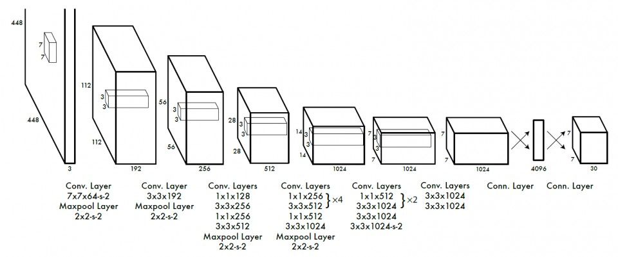
YOLO – network structure

Slide 7
YOLO v2
Better:
Batch normalization: add batch normalization on all of convolution layer
High Resolution Classifier: 224x224 -> 448x448 resolution
Convolutional With Anchor Boxes: bounding box -> anchor box
Dimension Clusters: use k-means to determine anchor box
Direct location prediction: directly predict location coordinates relative to grid cell
Fine-Grained Features: 26x26x512 feature map -> 13x13x1024 feature map
Multi-Scale Training: every few iterations change image dimension size

Slide 8
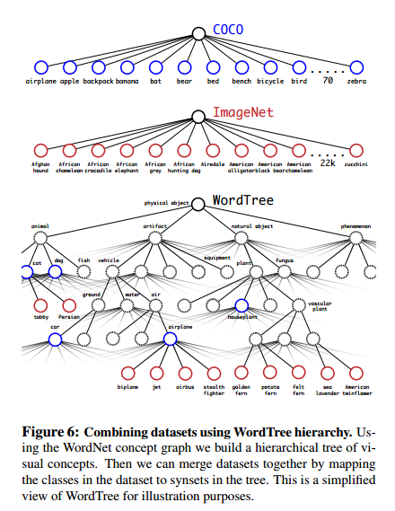
YOLO v2
Faster:
Use darknet-19 as pretrained model
Stronger:
Combine COCO and ImageNet dataset label

Slide 9
YOLO -demo

