Slide 1
RNN(recurrent neural network)
Why RNN:
傳統神經網路無法準確處理NLP(natural language processing)等問題，nlp每一個輸出可能都跟之前的輸出有關。
VS. CNN :
CNN:
a type of feed-forward artificial neural network
a neural network that's been extended across space
images
RNN:
can use their internal memory to process arbitrary sequences of inputs
a neural network that's been extended across time
text and language
RCNN: recurrent convolutional neural network(object recognition)

Slide 2
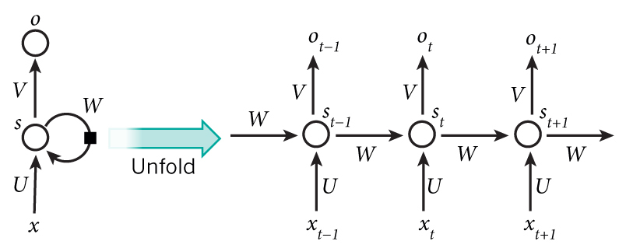
RNN – vanilla rnn
X(t) -> S(t) -> O(t)可以看做是傳統的neural network
X 是 input ， S 是hidden layer 可能會有很多層 ， o是output
S(t) = fw( s(t-1) , xt )
S(t) = tanh(W*S(t-1) + U*X(t-1))
O(t) = V * S(t)
V, U, W 都需要train來獲得

Slide 3
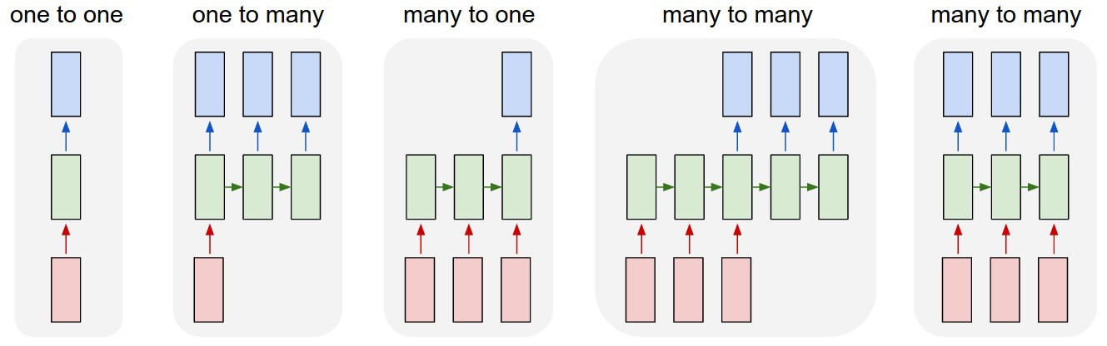
RNN – different type
NN
Image captioning
A photo -> a sentence
Sentiment analysis
A sentence -> sentiment
Machine translation
e.g. google translation
Video keyframe tagging

Slide 4
RNN training and optimization
RNN 的 training類似neural network，但是要加上time的變數
T可能會非常大，會導致 exploding/vanishing gradient problem
因為W, U, V皆是經由SGD train獲得的，因為t很大時，會導致S最後會變很大，或是變成0
Optimization:
Nesterov momentum：在遇到懸崖之前減速
Gradient clipping：規定gradient上限，超過上限就降成上限的值
RMS prop：用一個變數去控制要記前幾次的gradient，可以避免一些不必要的gradient影響現在的gradient

Slide 5
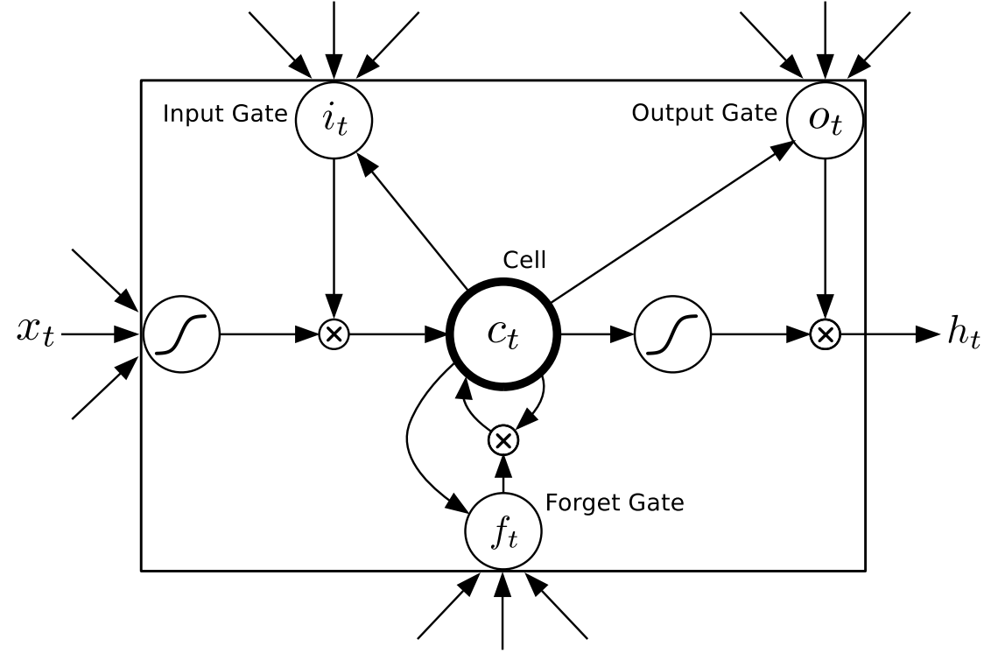
LSTM(Long Short-Term Memory)
Create a shortcut, make error signal flow backward more smoothly，that is gradient is less easy to decay
~ -> activation function (e.g. tanh)

