Slide 1
Unsupervised Learning
Supervised learing
Data : (X,Y) (X is data Y is label)
Goal : X->Y (input data -> output label)
Examples: nn,cnn,rnn
Unsupervised learning
Data: X only data
Goal: learn some structure of data
Examples: clustering, autoencoder

Slide 2
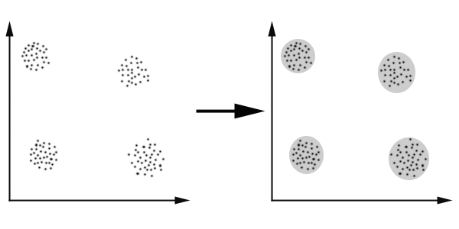
Clustering
Goal :
把相似的data分成一群
Algorithm :
K-means clustering
Hierarchical clustering

Slide 3
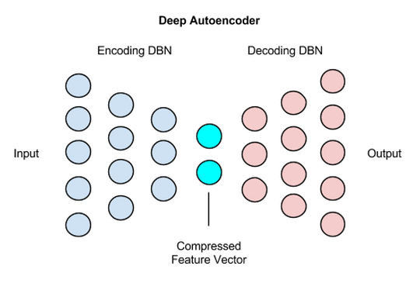
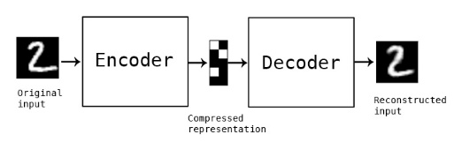
Tradictional Autoencoder
Goal: feature learning

Slide 4
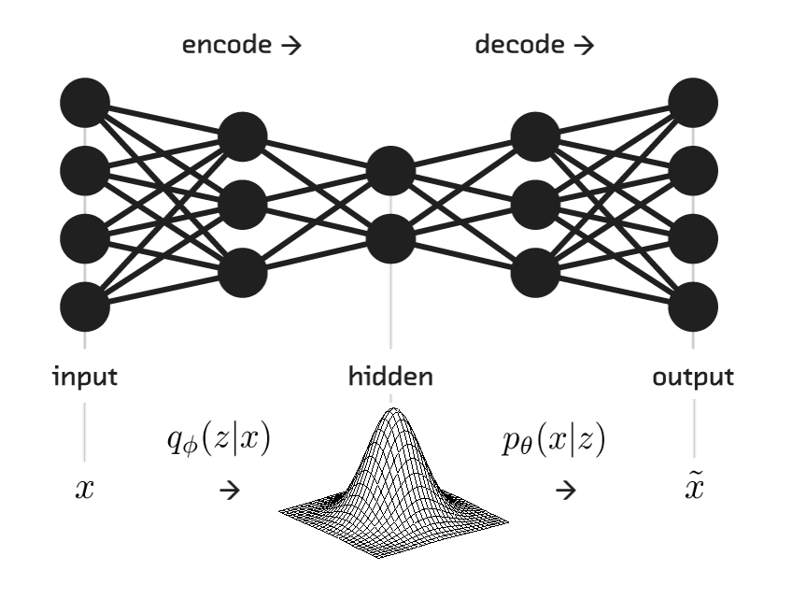
Variational Autoencoder
Vs. Traditional AutoEncoder:
Traditional AutoEncoder只能從input data中學習input的特徵，不能從中產生出新的data
Variational Autoencoder則是可以從input data中summarize，並且output出跟input不同的圖

Slide 5
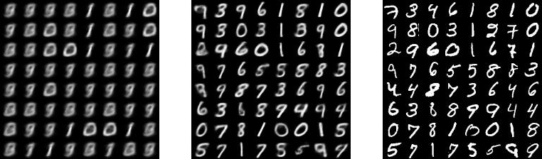
Variational Autoencoder
1 st Image
9 th Image
Original Image

