Slide 1
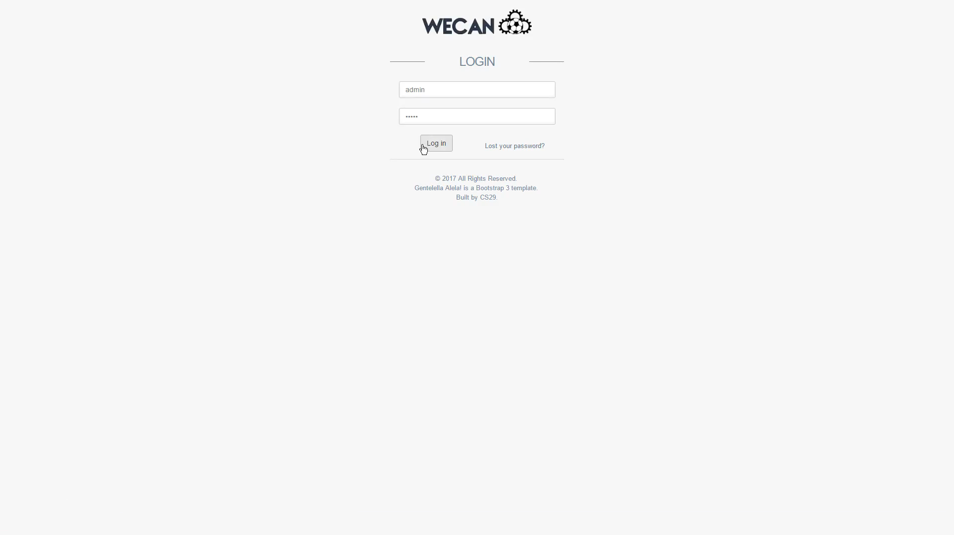
WECAN
Subtitle

Slide 2
Team Roles
Jack – Lead System Development, CRUD/PHP/JS/CSS
Rob – Database Engineer, SQL & Documentation
Harry – Testing and Quality Assurance
David – UX Design, Graphics and Design
Mark – Quality Assurance, Presentation

Slide 3
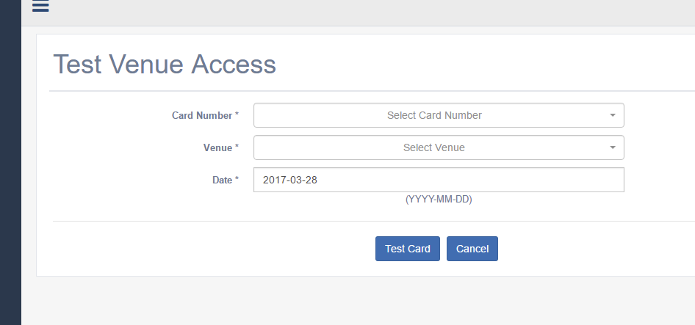
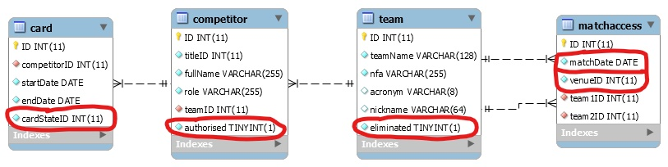
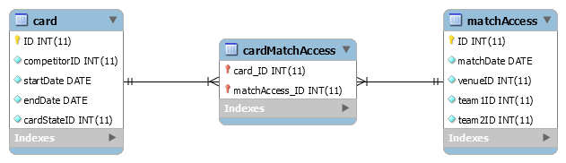
What we did well
Authorisation Table
Front End JavaScript Template
Login Screen with Password Reset
Table to CSV Exporting
Virtual Card Reader for Access Testing

Slide 4
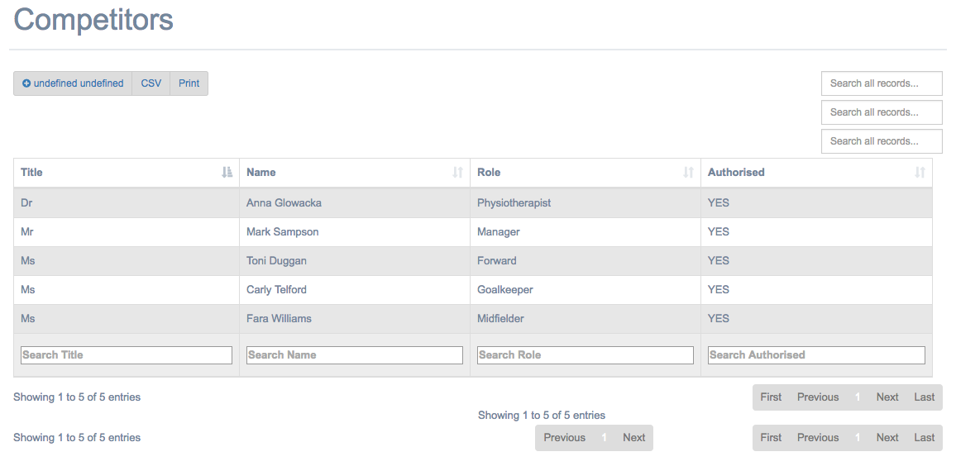
Problems Encountered
Drawing multiple tables on one page
Search function with multiple tables on one page

Slide 5
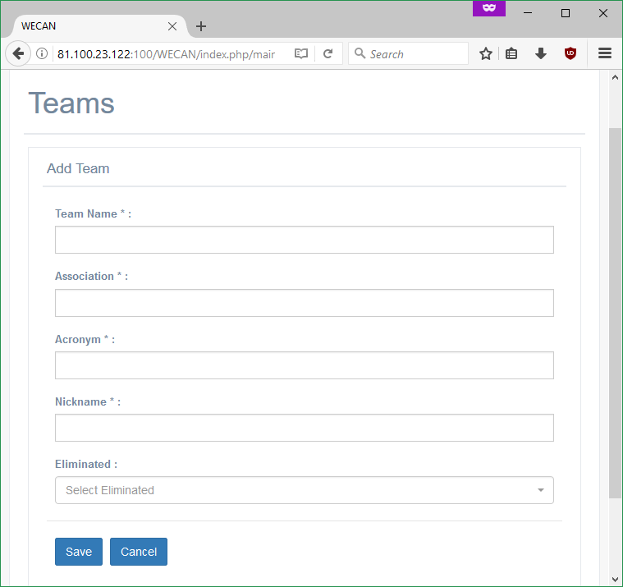
Things That We Haven’t Implemented
Creating a team with competitors

Slide 6
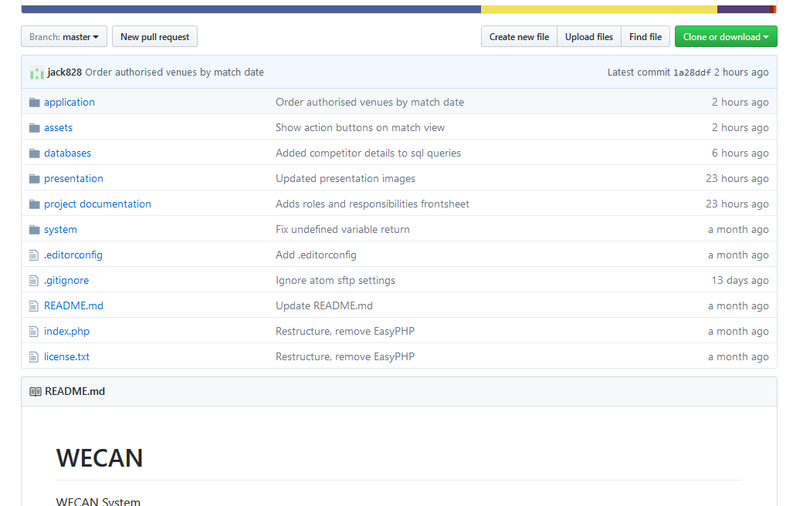
What did we do well?
Version Control – GitHub
Regular Meetings – 2-3/Week
Clear Communication – WhatsApp Group Chat, GitHub Issues
Hosted Live

Slide 7
What we didn’t do so well?
Task Prioritising

