Slide 1

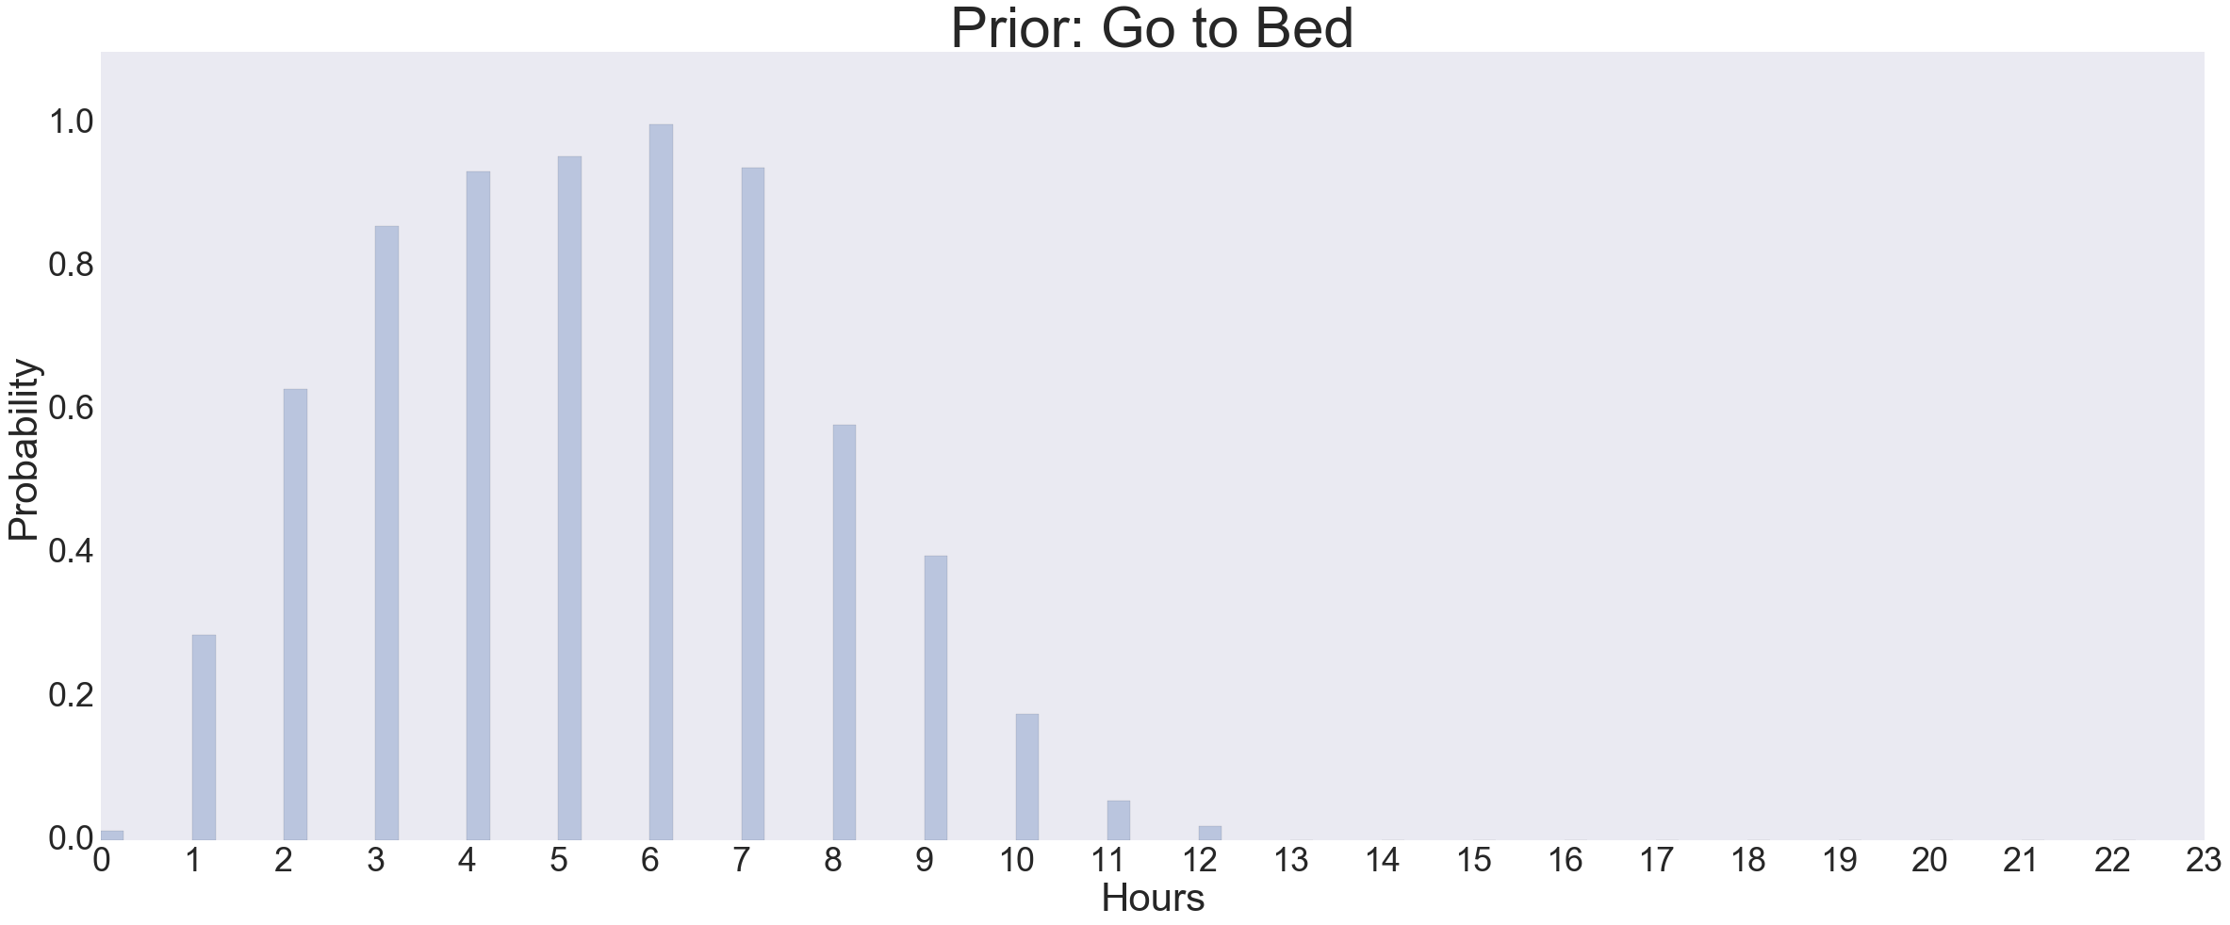
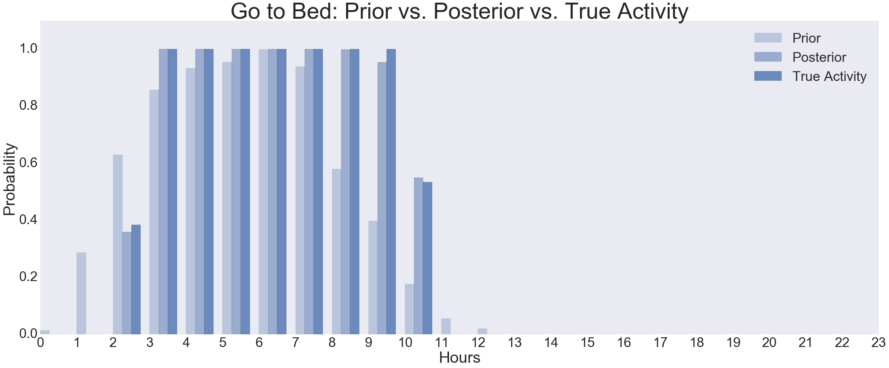
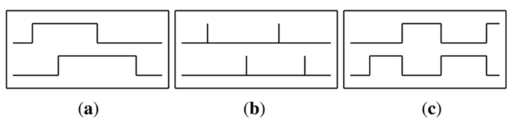
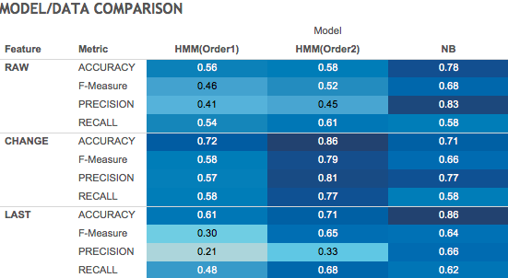
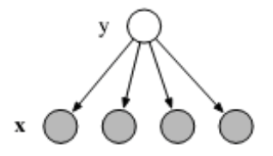


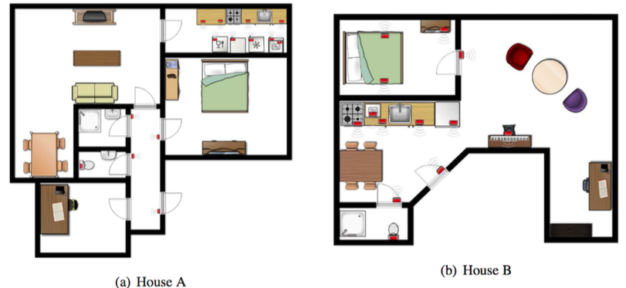
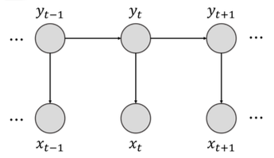
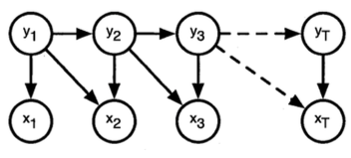
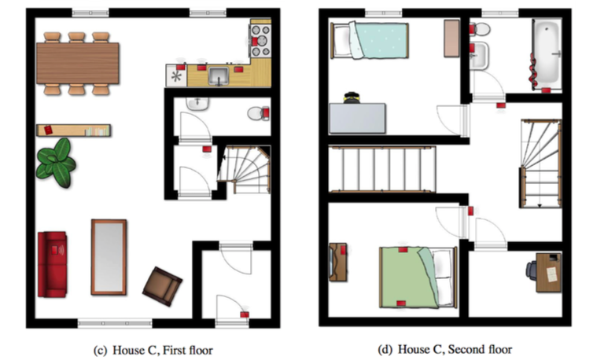

NOW I SEE YOU :
Sensor Based Single User Activity Recognition
Xiaowen Chang, Baijie Lu, Fangzheng Qian, and Yuhang Tang
AM207 Stochastic Methods for Data Analysis, Inference and Optimization
Spring 2016
Introduction
Approach
Results
Activity recognition, which identifies the activity (eg. cooking, sleeping, reading) that a user performs from a series of observations, is an active research area. It has many real-life applications ranging from healthcare to intelligent environments. In our project, to simplify the problem, we used sensor based single user data instead of complex activities data where multiple users are involved.
Recognizing activities from sensor data poses the following challenges. First, there is an ambiguity of interpretation. For example, ’cooking’ and ’cleaning fridge’ both involve opening the fridge. Second, same activity may be performed in different ways. Third, it is hard to see when one activity ends and another one starts.
We used three ways of feature representation of the sensor data and implemented Naive Bayes Model, First Order HMM and Second Order HMM models. We tested model performance on three houses with metrics Precision, Recall, F-score and Accuracy.
Feature Representation:
Figure 2. (a) Raw (b) Change Point (c) Last Sensor
Figure 4. Prior Distribution for Activity Sleeping (top). Naïve Bayes Result Improved after Adding Prior (bottom).
(a) is raw data where 1 means sensor is firing and 0 otherwise.
(b) represents change points such that 1 means a sensor changes value.
(c) indicates which sensor fired last. The sensor that changed state last continues to give 1 and changes to 0 when another sensor changes.
Data
We use three online datasets with single user activity recorded in different houses (see Figure 1 for floor plans). Sensors (the red boxes) were installed in different places inside the houses.
Then we discretize data into time slices of length ∆t = 60 seconds which is discriminative and gives a relatively small discretization error. When two or more activities occur within the same time slice, we use the activity that occupies most of the time slice.
Naïve Bayes:
Figure 5. Model Comparison in Accuracy, F-Measure, Precision and Recall with Different Data Representations
Conclusions
Naïve Bayes assumes conditional independence and iid for all data points. Thus we do not consider correlations between data points.
There is no significant performance improvement between Naïve Bayes and HMM. This might be because HMM model needs more training data to accurately learn the parameters. In addition, the choice of feature representation strongly affects the recognition performance. Complex models like Hidden semi-Markov model, Conditional Random Fields, Neutral Network could be tried in the future to improve the performance.
Hidden Markov Models:
Figure 3. First Order HMM (left). Second Order HMM (right).
The 1st Order HMM assumes the a hidden state at time t depends only on the hidden state at time t-1, and the output observation at time t depends only on the hidden state at time t.
The 2nd order HMM depends upon the two previous states. This allows a more realistic context dependence.
Reference
T.L.M. van Kasteren, A. K. Noulas, G. Englebienne and B.J.A. Kröse “Accurate Activity Recognition in a Home Setting.” ACM Tenth International Conference on Ubiquitous Computing (Ubicomp'08). Seoul, South Korea, 2008.
Figure 1. Floor Plans of 3 Houses
School of Engineering and Applied Sciences • Institute for Applied Computational Science

