Slide 1

Flights and Australia
Group Project, INFO20002
Rahul, Jack, Julian

Slide 2
About our datasets
The main dataset we used for this project is about International airline flights that enter or exit Australia during the period of September 2003 and February 2015.
We also used some smaller datasets such as the changes of airfares and the number of departures and arrivals in Australia to assist us in creating better insights for our main dataset and hypothesis in general.
All of our datasets have been collected from BITRE (Bureau of Infrastructure, Transport and Regional Economics). It initially was an .xls file which we converted to a csv format.

Slide 3
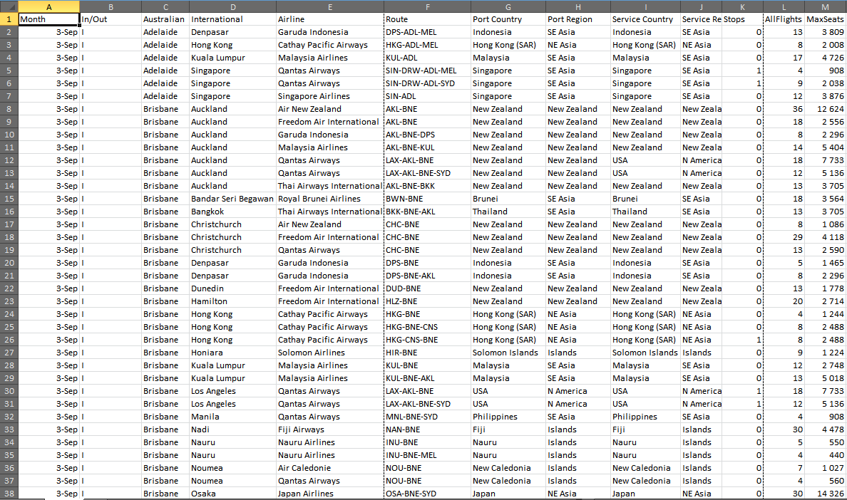
Main Dataset

Slide 4
Web Application
Pivot Table
Interactive Map
Data Analysis

Slide 5
Technologies
HTML
CSS
Javascript (+jQuery)
Python as CGI, delivering JSON to JS

Slide 6
Data Preprocessing
Converted Excel files to CSV format
CSV as input to Python script and Google Spreadsheet

Slide 7
Pivot Table
Select rows/columns/values to be displayed
Aggregate options
Filter type and options
Python for reading CSV, aggregating and binning
Javascript used for interactivity
HighCharts for presentation

Slide 8
How it works
Webpage
(HTML, CSS, Javascript)
Filter Type
CGI
(Python)
Data
(CSV File)
Available Options
Options
CGI
(Python)
Pivot Table Data

Slide 9
Interactive Map
Visualisation of flights
Immediate response to month/date and inbound/outbound selection
Google Maps for presentation
Python as CGI

Slide 10
How it works
Webpage
(HTML, CSS, Javascript)
CGI
(Python)
Data
(CSV File)
Map Options
Route Coordinates

Slide 11
Data Analysis
HighCharts for visualisation
Linked directly to Google Spreadsheets

Slide 12
How it works
Worksheet 1
Webpage
(HTML, CSS, Javascript)
Worksheet 2
Worksheet 3
Worksheet 4

Slide 13
Our Hypothesis
How has airline travel in Australia changed over the years?

Slide 14
Our Problems
Year Ranges
The Given Data Format (3-Sep)
Map: What About the Other Countries With Airports?
Many limitations

