Slide 1
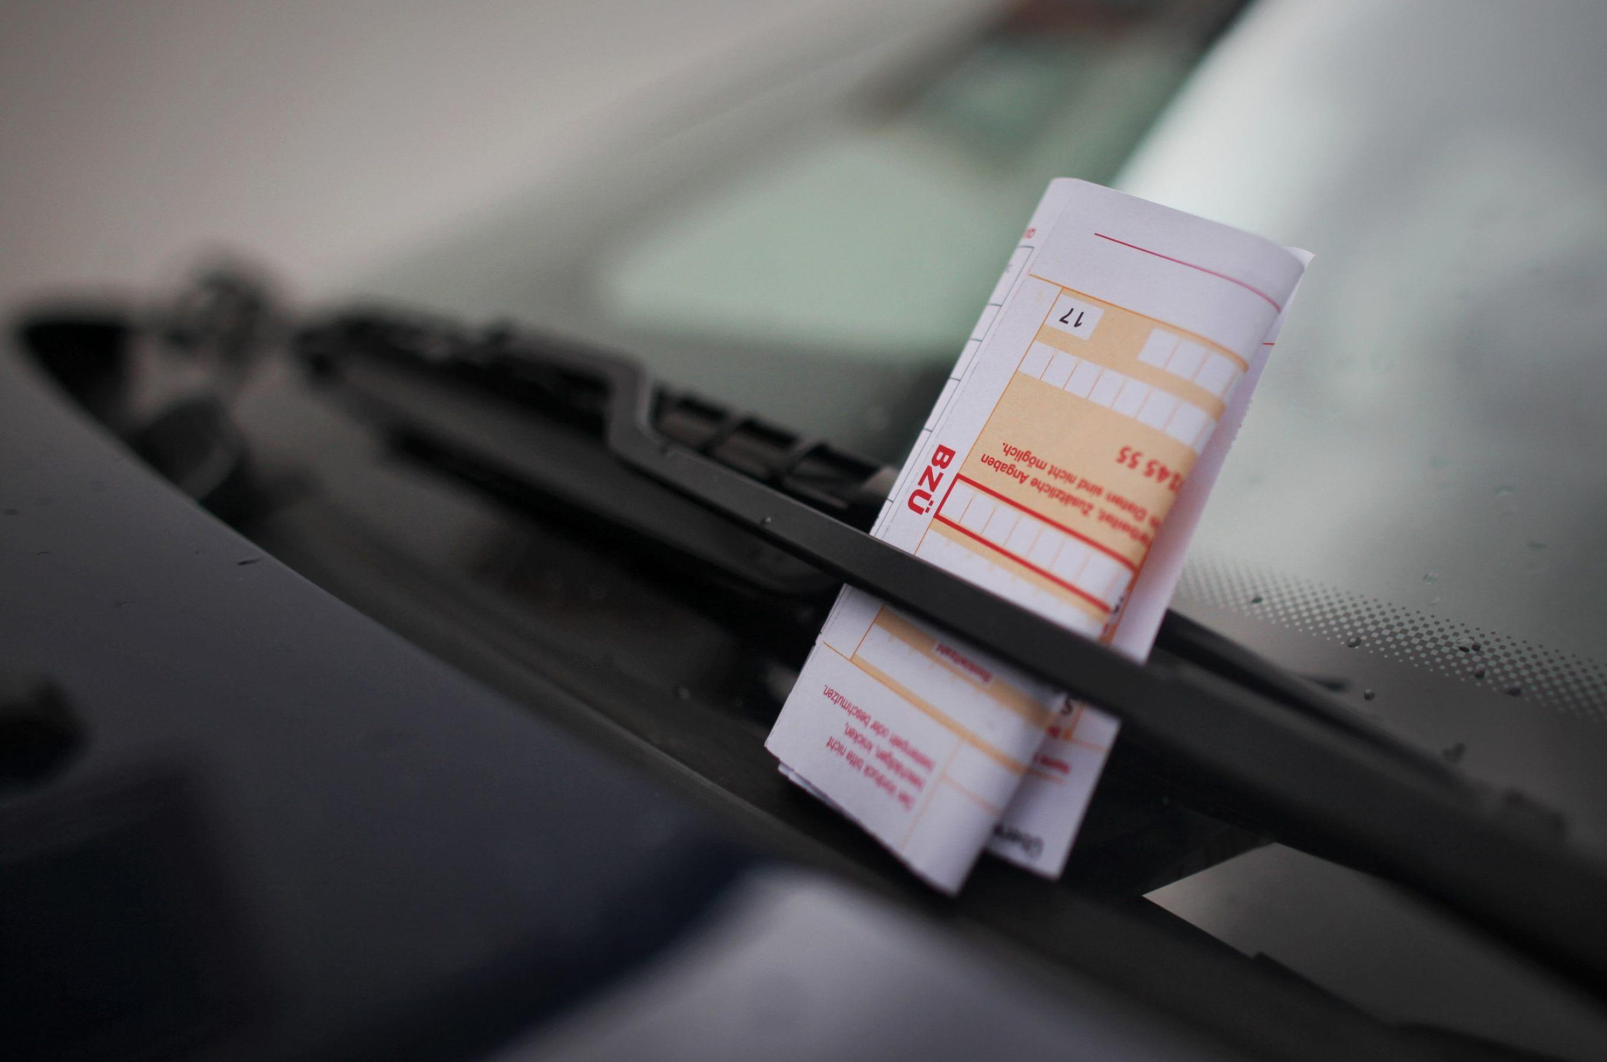
How to improve controls for parking violations
Correlation of the number of parking violations with the time of day and the weather
AMSE/SAKI
Jannik Kiesel

Slide 2
Structure
Overview
Data
Research question 1: Influence of time of day on parking violations
Research question 2: Influence of temperature on parking violations
Discussion

Slide 3
Overview
Two data sources
Weather data of Bonn
Record of parking violations in Bonn
Aim: Empower the City of Bonn to devise a new and more effective approach to prevent parking violations
Two Approaches
Influence of time of the day
Influence of temperature

Slide 4
Data
Parking violations
Tattag (Date)
Tatzeit (Time)
Tatort (Location)
Tatbestandbe_tbnr (Code)
Geldbusse (Fine)
Bezeichnung (Description
Hour (Hour of the day, 0-23)
Weather
Date
Hour (Hour of the day, 0-23)
Temperature
Humidity
Snow_depth
Sunshine
…

Slide 5
Research question 1: Influence of time of day on parking violations

Slide 6
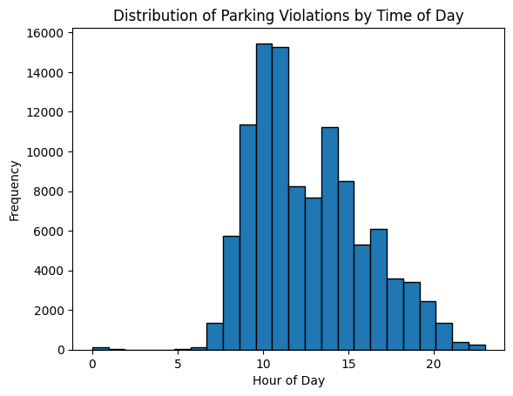

Slide 7
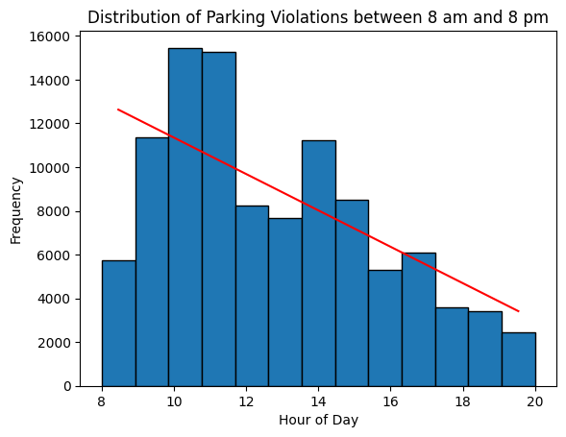

Slide 8
Research question 2: Influence of temperature on parking violations

Slide 9
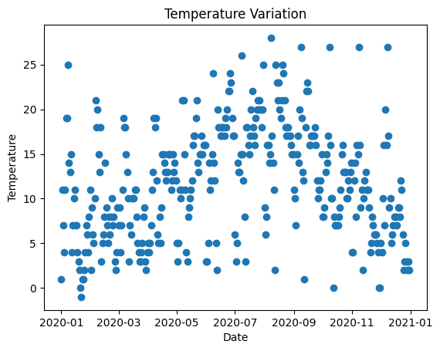

Slide 10
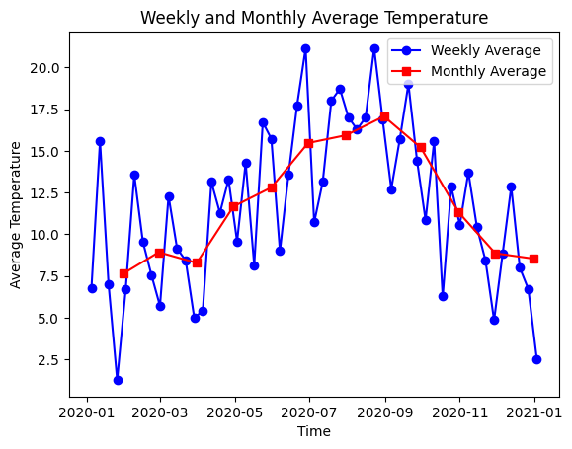

Slide 11
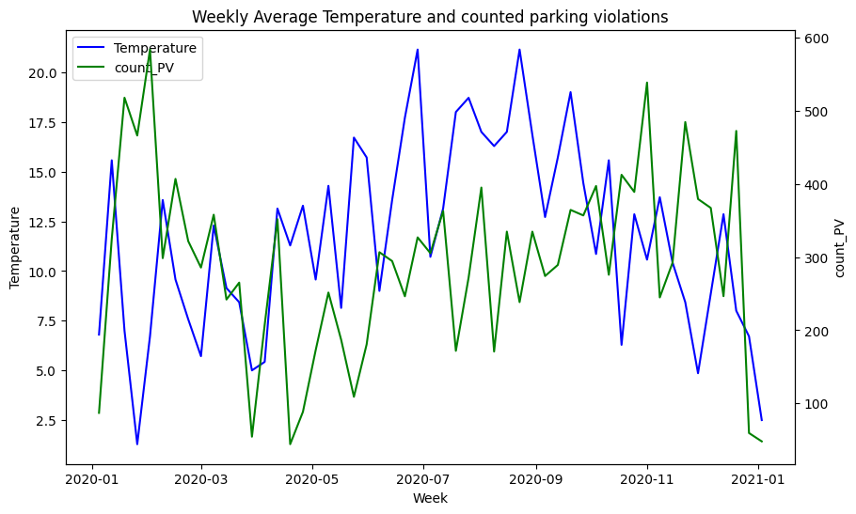

Slide 12
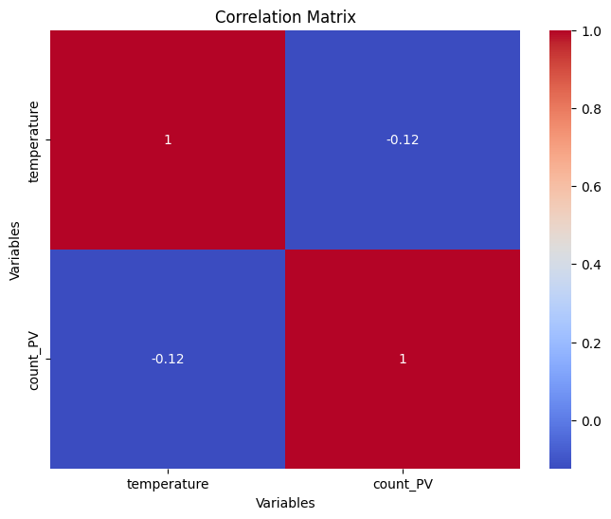

Slide 13
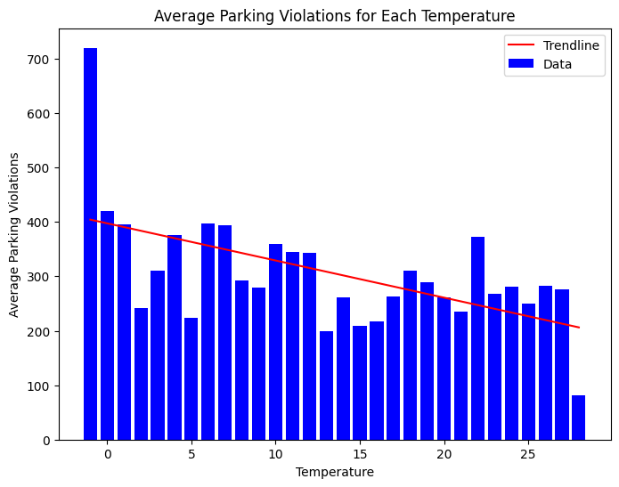

Slide 14
Discussion
Result
Fewer parking violations occur later in the day
Only slight correlation between temperature and number of parking violations
Recommendation for the city of Bonn
Increase monitoring between 10 and 12 am
Increase monitoring at low temperatures (?)
Limitations
Caution in interpreting the results
Controls are not equally strong at all times
There are different no parking zones at different times

Slide 15


Thank you
Jannik Kiesel
Jannik.Kiesel@gmx.de
Jannik Kiesel

