Slide 1
Finding Patient Zero: Learning Contagion Source with Graph Neural Networks
Chintan Shah, Nima Dehmamy, Nicola Perra, Matteo Chinazzi, Albert-László Barabási, Alessandro Vespignani, Rose Yu1

Slide 2
Not Infected
Infected
p
Disease spreading (Covid-19) is modeled as a contagion process on a network.
Problems?
Often a delay
P is not costant (asymptomatic?)
And others

Slide 3

How to describe the disease dynamics
SIR
SEIR
SIR model
Exposed -not yet infectious
SEIR model

Slide 4
How to process the p0 problem?
WE AIM TO LEARN THE REVERSE DYNAMICS OF CONTAGION PROCESSES USING GNN

Slide 5
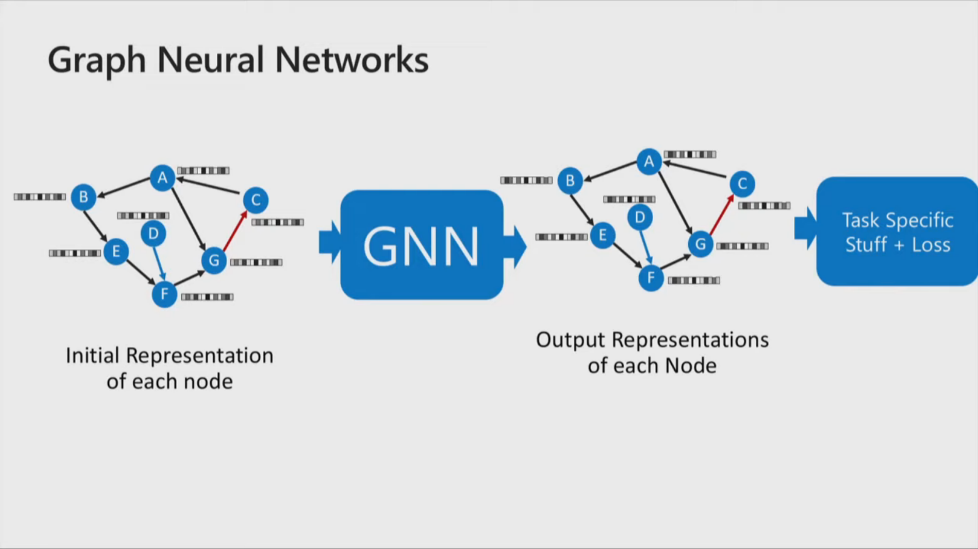
= GRAPH THEORY + ML

Slide 6
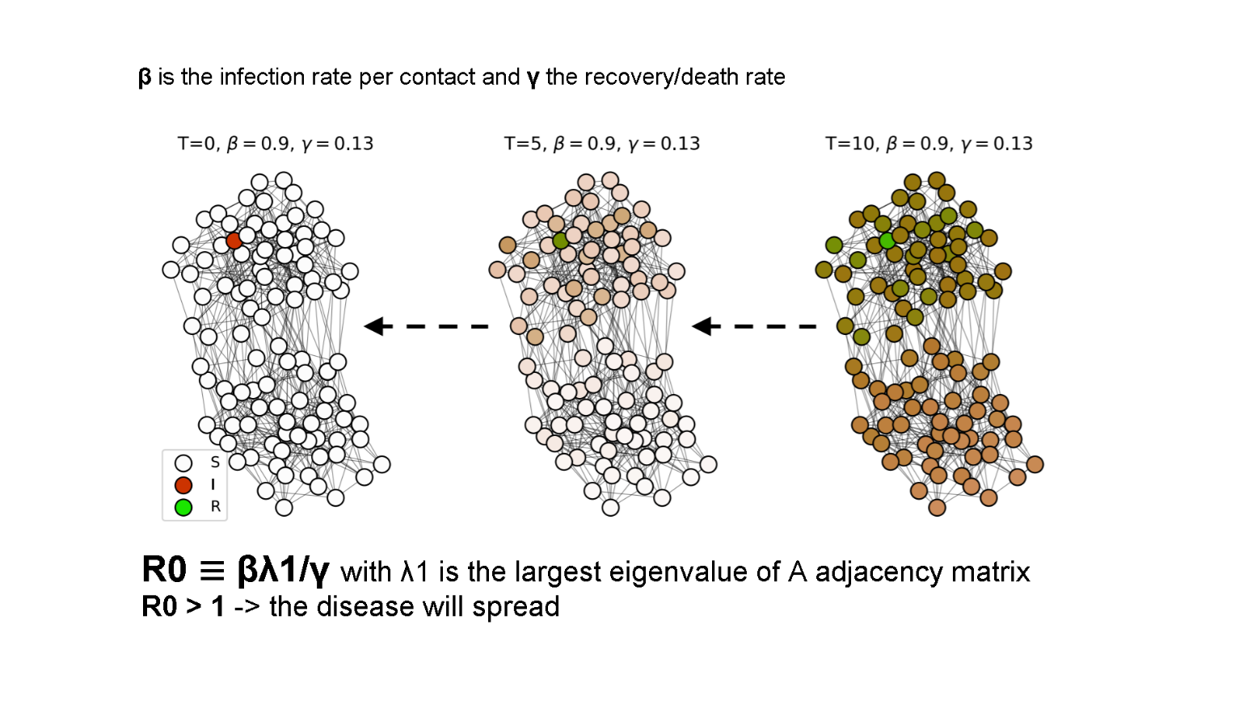
P0 problem

Slide 7
Technical difficulties:
Presence of cycles that decrease the accuracy (high order transmission), in general in connected ER random graphs.
The removed state (additional uncertainty)
Uncertainty of the exact time step of the observed states

Slide 8
Goal: understand the trade-off between different probabilistic inference methods
Dymanic Message Passing (DMP) algorithm: O(T N^2 <k>)
where <k> is the avg degree, N=nodes and T diffusion steps
GNN: O(N^2 <k>)
does not require inputting the model epidemic parameters
The task is to predict the probability for each node being P0 given a single graph snapshot.

Slide 9
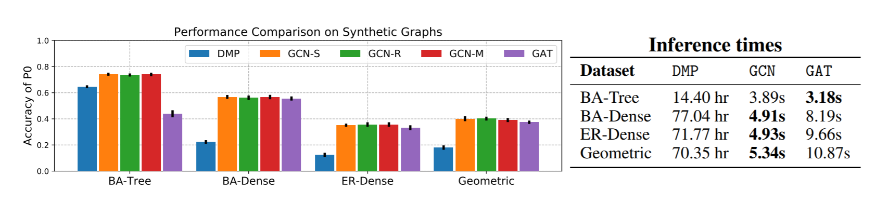
Result
GNN-based models perform with more accuracy and efficiency respect to DMP.

Slide 10
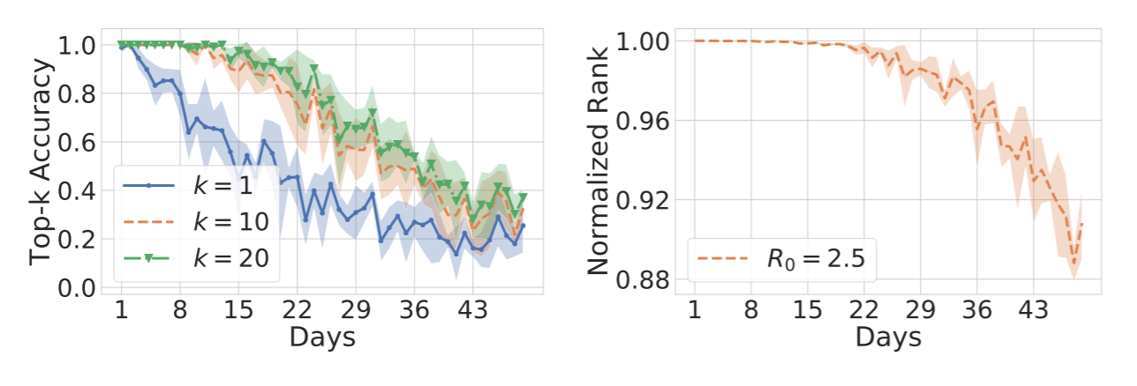
Real-world scenario: covid-19
N = 2, 689 and |E| = 30, 376: maintaining degree distr. and connectivity patterns of the original graph.
Each simulation contains 1 patient zero (random). R0 = 2.5. The simulation is run for 50 days:
These results highlight an important trade-off between accurately determining patient zero and retrieving the general infected region.

Slide 11
TAKE AWAY POINTS:
Yet, each node can be only get infected by its neighbors, this is not a «real world scenario».
GNNs can have different f (propagation rule) but they cannot learn using sequences of graph snapshots.
Fundamental limit of finding P0: there are some cases where no alg. can detect P0 after t_steps.

Slide 12
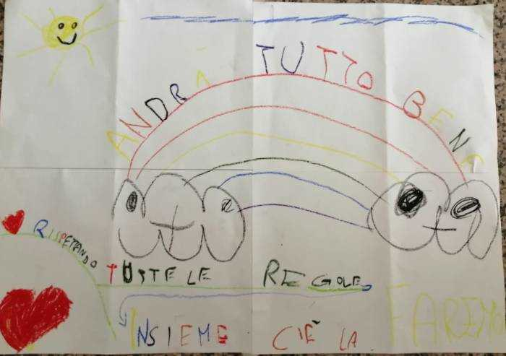
END

