Slide 1






VC-176 Carer Manager
By Stanley, Jack, William, Dunith and Zhihao

Slide 2
Group 176 Members
Stanley Chum – Front-End Developer
Zhihao Zhong - Front-End Developer
Nadvi Karawita - Front-End Developer
Jack Sydenham - Front-End Developer
William Hu – Scrum Master

Slide 3
Project Description
Carer Manager Plus Pty Ltd has reached out to RMIT students for assistance in developing an administrative portal through which new care agencies can be easily added to and managed through their current cloud-based home care agency system by Carer Manager administrators.
The sponsor has taken RMIT students on board in previous years to work on this system and now expects a working prototype of this system to be developed tested by the end of the project's duration.

Slide 4

Functional Requirements

Slide 5
Admins must be able to login to the system using a created login form
2
Admins must be able to change their passwords
3
Admin Application must be able to access existing data on companies and employees within the Carer system.
4
Admins must be able to add new care agencies to their list of companies, along with specific data pertaining to said agency (such as charge rate or address)
5
Companies need to be able to create an employee in their company with default roles
1

Slide 6

Project Plan

Slide 7
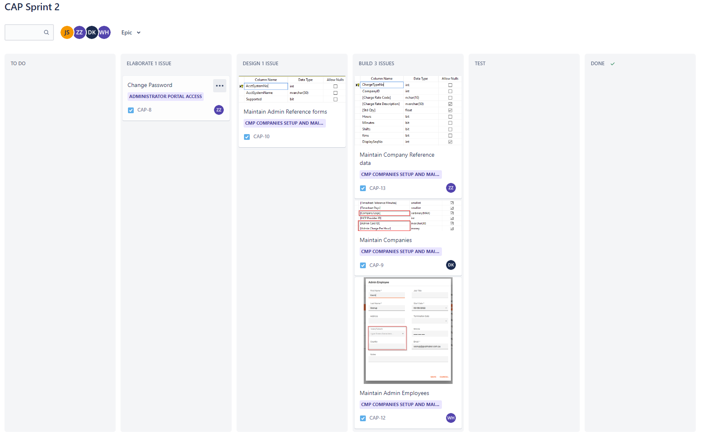
- Using agile methodology to complete fortnightly sprints over the course of 8 weeks.
- Jira is used to plan upcoming sprints and to track progress made on tasks.
- MS Teams to communicate within the project team, and Slack to communicate with the client directly.
- Zoom and MS Teams to carry out meetings with our client and mentor.
- Upcoming Sprints are still being planned based on further requirements.

Slide 8
User Stories
As an Administrator, I want to add a new agency company to the table, so that I can view and manage that company later
As an Administrator, I want to edit/delete the information of existing companies, so that I can update something if need
As an Administrator, I want to view all the information about the agency companies in a table, so that I can access all those info clearly
As an Administrator, I want to view and edit the information of clients in a table, so that I can manage the appropriate agency to the clients conveniently

Slide 9
User Stories Continued
As an Administrator, I want to generate a report of the hours charged by the company, so that I can look at the number of hours charged by the company to analyse patterns
As an Administrator, I want to import clients from excel, to make setting up the clients’ information faster
As an Administrator, I want to import carers from excel, to make setting up carers’ information faster
As an Administrator, I want to import employees from excel, to make setting up the company’s employees faster

Slide 10

THANK YOU :)

