Slide 1
Data Security Health Mapping
Sponsor : Castle Ventures
Team : Joel Ulahanna (PM)
Viral Patel
Varun Shah
Aditya Gumastedesai

Slide 2
Scope

Slide 3
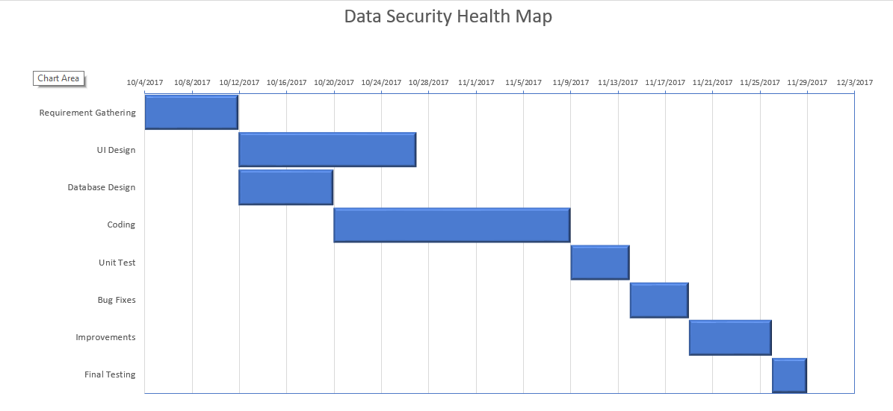
Gantt Chart

Slide 4
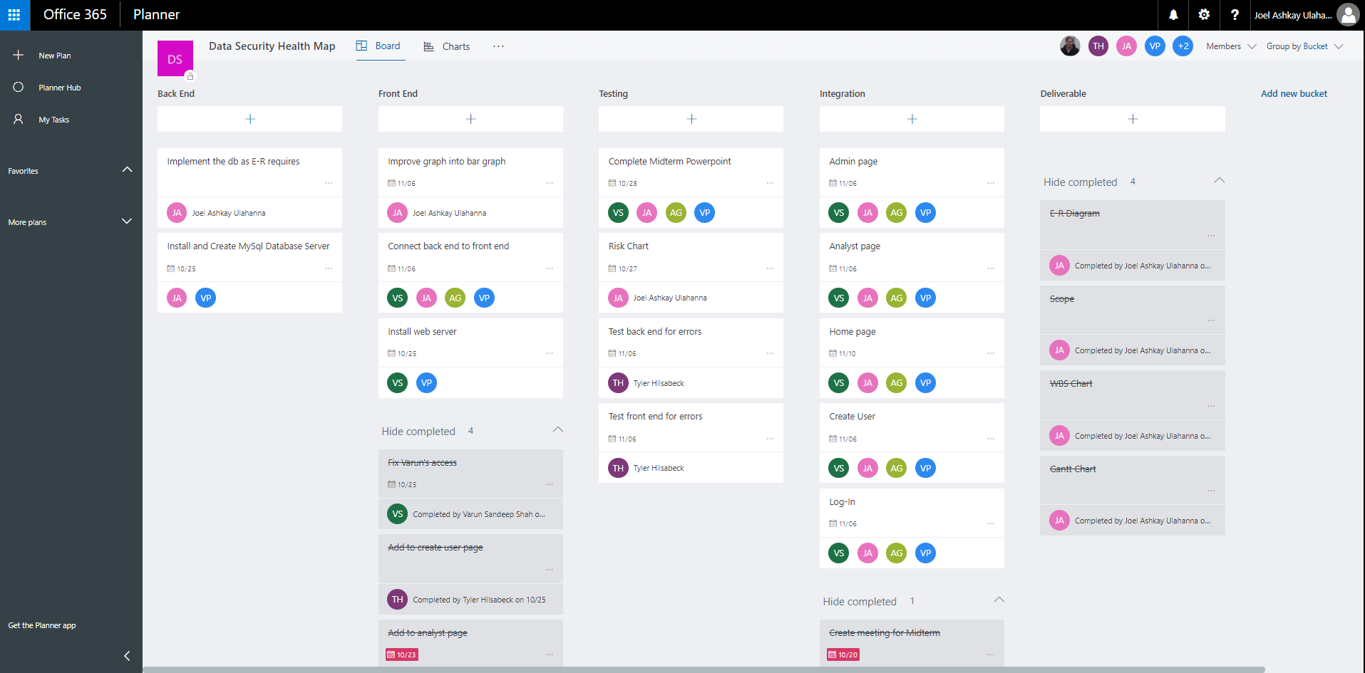
Planner

Slide 5
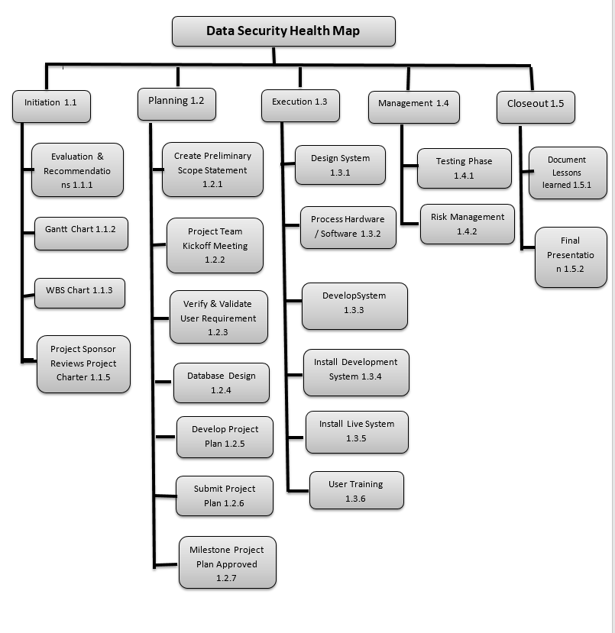
WBS

Slide 6
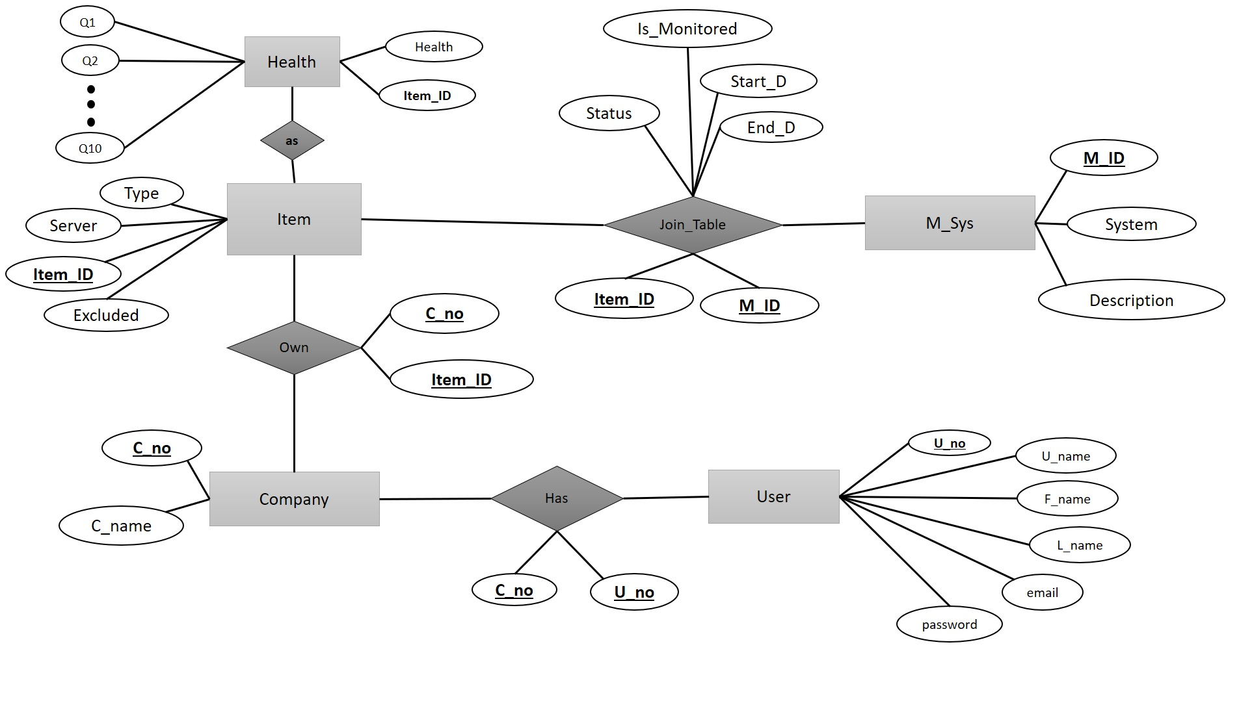
E-R Diagram

Slide 7
Risk

